Slide 1
Computer Cases
Unit II

Slide 2
Introduction
A computer case is also known as a computer chassis, tower, system unit, CPU (when referring to the case as a whole rather than the processor), or cabinet.
It is the enclosure that contains most of the components of a computer (usually excluding the display, keyboard, and mouse).
Cases are usually constructed from steel (often SECC—steel, electrogalvanized, cold-rolled, coil) or aluminum. Plastic is also used sometimes.

Slide 3
Types of Cases (Form Factor)
The most common system case type is the tower.
Depending on the specific number of internal drive bays and the height of the tower, these cases can be further classified into mini-size, mid-size and full-size tower cases.
One of the biggest considerations when choosing between case sizes is the number of slots and the number of devices we would like to add to those cases.

Slide 4
Full Tower
Full-tower cases are generally big with a height that is about or more than 30 inches (more than 76 cm). The number of internal drive bays inside these cases can be between 6 and 10.
Mid Tower
Another case that might be a step down, would be classified as a mid tower case. Mid-tower cases are the most widely used computer cases. Mid Tower cases are about 18 to 24 (45 to 60 cm) inches high and they usually contain 2 to 4 internal drive bays and a similar number of external bays (for CD/DVD readers and similar).

Slide 5
Mini Tower
Mini-tower usually have up to 2 or sometimes 3 internal drive bays. Mini-cases normally stand at a height of 12 to 18 inches (30 to 45 cm). Expandability is a problem with these cases.
Slim Line Case
Slim line cases are simply tower cases turned on their sideways. They can hold a monitor on top of the case.
Small Form Factor (SFF) Case
Small form factor or SFF cases are custom cases that are designed to minimize the spatial volume of a desktop computer. SFFs are available in a variety of sizes and shapes, including shoe boxes, cubes, and book-sized PCs.

Slide 6
Drive bay
A drive bay is a standard-sized area for adding hardware to a computer.
Most drive bays are fixed to the inside of a case, but some can be removed.
Four form factors are in common use today, the 5.25″, 3.5″, 2.5″ or 1.8″ drive bays.
These names do not refer to the width of the bay itself, but rather to the width of the disks used by the drives mounted in these bays.
Drive bays are most commonly used to store disk drives, although they can also be used for front-end USB ports, I/O bays, card readers, fans, fan controllers, RAID controllers, tool storage, and other uses.

Slide 7
LEDS and Switches
Computer cases normally contains two LEDs and two switches.
The two LEDs are:
Power LED
This led is generally blue or green in color. This LED lights up when the computer is turned on.
HDD LED
This LED is generally red in color. This LED lights up when the computer reads the hard disk.

Slide 8
The two switches are:
Power switch
This switch is used for cold booting i.e. to turn on the computer from off state. In ATX casings, pressing the power switch while the computer is on shuts down the computer.
Reset switch
This switch is used for warm booting i.e. to restart the computer while it is turned on. Pressing the reset switch while the computer is off does not turn on the computer. The reset switch is normally smaller in size than the Power switch.

Slide 9
Connecting the LEDs and Switches
The cables for the switches and LEDs come in pairs, representing the positive and negative terminal.
The cables comes in different colors and the lighter color is always negative.
The pin configuration to connect the LEDs and switches can be shown using following diagram:

Slide 10
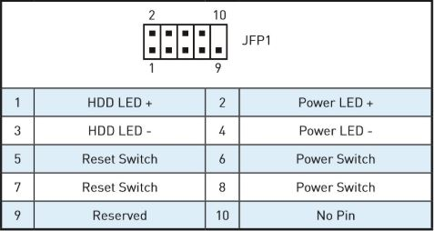
Fig: Pin configuration of the LEDs and Switches

Slide 11
The panel to connect the cables for the switches and LEDs is called front panel and is usually labelled JFP1, FP1, F_Panel, J_Panel, Front, etc.
There are three similar panels with the same number of pins.
The panels are differentiated using the missing pin.
If the number 10 pin is missing, then it is used for front panel(switches and LEDs).
If the number 9 pin is missing, then it is used for USB port connection of the case.
If the number 8 pin is missing, then it is used for Audio port connection of the case.

Slide 12
The End
Subash Bhuju
Department of IT
Nepal Banepa Polytechnic Institute

