Slide 1


现在，翻译：投资组合
保罗·戴
2023年7月
Notes:
Before we start, I want to thank you (all) for being here.
It’s my pleasure to introduce myself to you.

Slide 2
现在，翻译：目录
现在，翻译：项目2- Cyclistic自行车数据分析
现在，翻译：项目3-数字营销关键绩效指标跟踪仪表板
自我介绍
现在，翻译：1
项目1-LLM申请-自动查询助手
2
现在，翻译：项目2-时间序列模型-每日销售预测
3
项目3-AB测试-购买卡
4
现在，翻译：项目4-谷歌数据分析- Cyclistic自行车
5
许可证和奖项
6
Notes:
I’ll present for 20 mins:
First part, it’s about my background
The second part we have some project demos.
Because the limitation of our time, I think you could choose 1 or 2 case, and I’ll present that to you.
So, let me quickly go through all of them.
The 1st one is an AI model, going to predict the daily sales
The 2nd is data analysis case study, trying to find marketing strategies to enhance their members
3rd is an dashboard project, how I used AWS architecture to build dashboard.
4th is an expense reimbursements application system, that is a case I used VBA, SQL to help a start-up to build their expense application system.
Last one is an digital transformation strategies alignment, we helped a company to figure out their digital transformation blueprint.
So which one are you interested in?

Slide 3
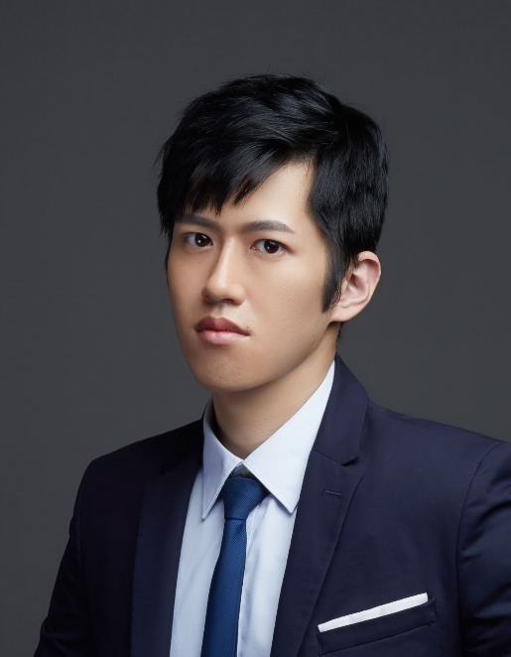

现在，翻译：Paul Dai， 高级数据分析师
工作经验（6年+）
技能
现在，翻译：CTW Inc. (东京) 高级数据分析师
2023-现在
报告自动化 (VBA)
数据库和SQL
现在，翻译：通过Transformer模型建立了礼品推荐系统，并每天赚取了350k JPY。
KPMG 数字化转型咨询 助理经理
现在，翻译：ML
2020-2023
数据分析 Analysis
数据可视化 Visualization
领导负责为财富500强公司开展数字化转型项目的开发和执行。
应用人物聚类、数据分析等方法在各个项目中，以提供高管报告。
现在，翻译：语言
姓名:
Neogence化妆品和护肤品 总经理特别助理
保罗·戴
现在，翻译：中文（母语）
英语（TOEIC 890）
日语（JLPT N2）
2017-2020
协助总经理和领导团队通过数据分析和建模制定行动计划。
带领一支初级助理团队优化和自动化各部门的流程。
申请职位：
数据科学家
教育
KMC链条工业有限公司 (深圳) 管理助理
2014-2017
國立臺灣師範大學MBA
2010-2014 人力資源管理系，國立臺灣師範大學 Taiwan Normal University
联系方式：
手机：+81-80-6080-5242
2017年
建立了跨职能部门的报告，以监控进度表现。
电子邮件：paul60209@gmail.com
Notes:
I believe that I am the best candidate for this position because an excellent Data Analyst needs not only hard skills,
but also have to know how to communicate cross-dep., how to lead or encourage your team members.
During my 6 years work experiences, I started from being a MA at KMC Chain, I rotated in different dep. and work with them.
That helped me to know each dep.’s culture and what’s they desire. And, that’s my first time working in China, at 深圳.
Bcz of the health issue of my family, I went back to 台灣 after a half year. That was the second stage of my career path.
I was the special assistant to GM in the company called “Neogence”. It’s a company which dedicates to skincare and makeup market. Neogence has a self-own brand and a factory.
It’s a 7 years start-up, yearly Rev. is about 1 billion NT dollars.
My first job was to restructure the ERP system and to repair the database.
I re-defined the principle of product ID and mapped the old product ID to the new one in the database.
Next, I developed automatic program to help our colleague to key-in purchase/selling order into ERP system more efficiently.
After a year, I was promoted to “Section Chief of GMO”. I started to build my own team.
There were 3 members in my team. We built an expense application system, imported the BI tool (Qlik Sense) to establish the visualized dashboards.
I started to train my soft skills, like… divide the project scope, track timeline, ensure everyone is clear about the project purpose, and how to review each member’s performance. My team achieved many huge projects perfectly during the period.
In 2020, I was seeking for a boarder stage and wanted to work aboard but because of COVID-19, it’s risky.
Thanks for the hunter who is my friend now, he referred me to KPMG as the assistant manager of the digital transformation consulting dep.
In KPMG, I engaged in more then 10 projects as project manager (PM).
I focus on digital transformation project, which include data analysis(TA persona tagging),
dashboard building (marketing campaign dashboard),
data modeling(used car residual value prediction),
process optimization (material requirement planning)
and strategies alignment(planning the blue print of digital transformation).
About the skills:
I’m good at VBA, which is for report automation and I’m also familiar with DB and SQL. Fourth more, I have experience of data analysis and machine learning (which I will demo later.)
I’m a Chinese native speaker. Although my English is not really fluent but I’m working on improving my English and I think I could handle daily conversation with no problem.
I just passed JLPT N2 this year. If there is any occasion that needs Japanese, the company could make good use of my skill.

Slide 4

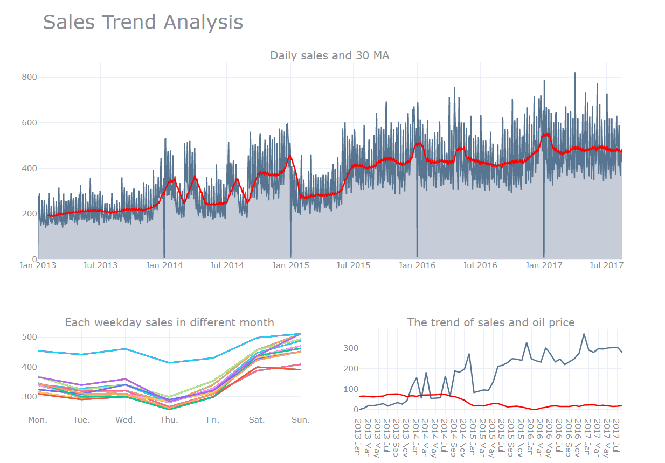

销售趋势分析
趋势分析
发现：
销售趋势持续增长。
每年1月1日的销售额为0。^{这是每年的第一天。}周末的销售额明显高于工作日。
我们将在后面将其作为外生变量使用。12月的销售额始终高于其他月份。We will use it as our exogeneous variable later.
Sales in Dec. always higher than other months.
Notes:
I also made some dashboard to figure out weather is the trend or seasonal effect in our data.
There are some interesting findings.
Start from the top middle figure: It shows our sales is increasing, which means there is a trend in our data.
And, the sales on the 1st day of each year is 0.
Next, if you see the figure here, you will find sales on weekend is always higher than weekdays.

