Slide 1
Franchise Optimization

Slide 2
Outline
Business problem
Research problem
Mathematical formulation
Solutions
Results

Slide 3
Business problem
Problem :
Michael Ball wants to build an American cuisine franchise in Cairo.
The demand in Cairo varies with the location.
A lot of options of places to serve the food and to prepare the meals.
His choice will affect the profit of his franchise.

Slide 4
Business problem
Objective :
Divide Cairo into a set of areas where each area has a demand.
Cairo has a set of units that could be utilized as a kitchen or as a restaurant.
For each unit we decide whether Michael should rent or not and whether the chosen unit will be a restaurant or kitchen.
Kitchens will serve meals to restaurants and restaurants will serve the customers.

Slide 5
Business problem
Inputs :
Budget
Cost per distance
The optimisation ratio
List of areas where each area has:
Position, Demand, Fixed radius
List of units where each unit has the following:
Position
Yearly rent
Initial cost of starting a restaurant or a kitchen.
Maximum number of customers served (restaurant and kitchen).

Slide 6
Business problem
Outputs :
Which units will be kitchens.
Which restaurants will be served by each kitchen.

Slide 7
Business problem
Features :
Customers served should not exceed the capacity of the restaurant.
Meals produced should not exceed the capacity of the kitchen.
The total number of customers served by all units inside any area should not exceed the demand for this area.
For each pair of units (u1,u2), if u1 is transporting meals to u2 , then u1 is a kitchen and u2 is a restaurant
For all units that are being provided with meals from some kitchen k, the sum of their customers is equal to the meals produced by that kitchen.
Each restaurant is only associated with one kitchen.

Slide 8
Business problem
Key Metrics :
maximizing the number of customers served and minimizing the total cost.

Slide 9
Research problem
Problem Analysis and Definition :
Location-allocation problem / Facility Location Problem.
Known customer locations and several facilities need to be located.
The optimizer must decide which facility will serve which customer.
The target is to minimize the distance between the customers and their corresponding facilities while satisfying all customers.

Slide 10
Research problem
Modelling Approaches and solutions :
1. Location-allocation Problem [1] :
Try to find facilities locations to satisfy the demand of the customers given their positions.
They have to decide which customer should be served by which facility while taking into consideration the demand of each customer.
Models:
General location allocation model.
LA Model Each Customer Covered by Only One Facility.

Slide 11
Research problem
Modelling Approaches and solutions :
1. Location-allocation Problem [1] :
Solutions:
Exact Solution:
Differentiate the total distance cost with respect to x and y coordinates.
This can only be done if the cost is only a function of the new facility but there is another variable in this problem.
we could try a facility-customer combination and find the optimal solution, but this is impossible due to the large number of variables.

Slide 12
Research problem
Modelling Approaches and solutions :
1. Location-allocation Problem [1] :
Solutions:
The Heuristic Approach:
Given initial facility location, the local optimal allocation solution will be found.
Given the found facility allocation, the local optimal location solution will be found.
The algorithm will stop once the last optimal solution is the same as the new one.

Slide 13
Research problem
Modelling Approaches and solutions :
Optimization of competitive facility location for chain stores [2] :
Trying to choose the best positions to open a chain of stores.
It aims to find the price of each market in the chain depending on its location.
competitive location problems take the location and price of the competitors at each location into account in the model, while the non competitor doesn’t.

Slide 14
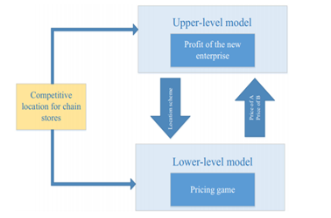
Research problem
Modelling Approaches and solutions :
Optimization of competitive facility location for chain stores [2] :
Model:
The upper-level model is given the prices of the market in chain A (the candidate) and the prices of competitor chain B
Using this data as a static data, the model tries to choose the best locations of the stores in the chain.
The model gives these locations to the low-level model, where the model will choose the prices of each store in A and the predicted prices of store B.

Slide 15
Research problem
Modelling Approaches and solutions :
Optimization of competitive facility location for chain stores [2] :
Solution: The paper chose the Tabu Search Algorithm to solve the bi-level model problem.

Slide 16
Research problem
Modelling Approaches and solutions :
3. The uncapacitated facility location problem[3] :
Model:
Given n possible sites and demands at m locations.
Determine the optimal location of facilities to fulfil all demands such that the total cost of establishing the facilities and fulfilling the demands is minimized.

Slide 17
Research problem
Modelling Approaches and solutions :
3. The uncapacitated facility location problem[3] :
Solution: The paper chose the Tabu Search Algorithm to solve the model problem.
The proposed algorithm has two subproblems:
It finds the optimal locations of the facilities.
Using the giving locations from the first subproblem it finds the optimal allocation.

Slide 18
Research problem
Best Approach:
Model :
Mostly the inputs is the location and the demand of each customer.
The optimizers try to minimize the distance between them.
We will consider the facilities as our kitchens and the customers as our restaurants.
However, we have to decide the position of the restaurants such that enough restaurants are present in each area.
Like what is present in [1] we add a constraint that each restaurant could only be served by one kitchen.

Slide 19
Research problem
Best Approach:
Solution:
It was found that these problems are NP problems.
It is hard to find the global optimal solution
Most researchers go with metaheuristics techniques.
For example, genetic algorithms and tabu search methods.
These algorithms give satisfactory results and converge to a local minimum throughout the iterations.

Slide 20

Mathematical formulation

Slide 21

Mathematical formulation

Slide 22

Mathematical formulation

Slide 23

Mathematical formulation

Slide 24
Solutions
Greedy algorithm
MIP algorithm
DP algorithm
Metaheuristic algorithm

Slide 25
Solutions
Greedy algorithm
Sort units based on (total kitchens price/kitchen capacity)
For each unit, take it as kitchen
Then sort the remaining units based on
(Total restaurant price + transport to chosen kitchen) /restaurant capacity
Take as many restaurants as constraints allow

Slide 26
Solutions
MIP algorithm
Implemented the model using or-tools

Slide 27
Solutions
DP algorithm
Choice Problem.
Demand constraint problem
Flow problem.

Slide 28
Solutions
DP algorithm
Locations’ choice.
State = remaining budget, current location, kitchen capacity
Compute for unit (Kitchen/Restaurant/not taken).
Compare the results and consider solutions within the budget.
Choose the sub-solution that care more about customers, then cost

Slide 29

Solutions

Slide 30
Solutions
DP algorithm
Flow Problem
Graph with edges from all kitchens to all restaurants
Kitchens supply = kitchens supply
Restaurant supply = - restaurant demand (calculated from demand problem)

Slide 31
Solutions
Metaheuristic algorithm
Choice Problem.
Demand constraint problem (same as DP).
Flow problem (same as DP).

Slide 32
Solutions
Metaheuristic algorithm
Choice Problem (Genetics):
Initialize with valid solutions.
Probability for each location Not taken (1/8), kitchen (2/8), restaurant (5/8).
Each 2 members get 1 new child.
Probability inheritance for each location Higher Fitness (3/6), Lower Fitness(2/6), Random(1/6).
Sort descendingly according to:
fitnessFunction =customers*1e6 + cost + transmission cost
survive of the fittest (keep best n of the population).
Repeat till k no changes in fittest.

Slide 33
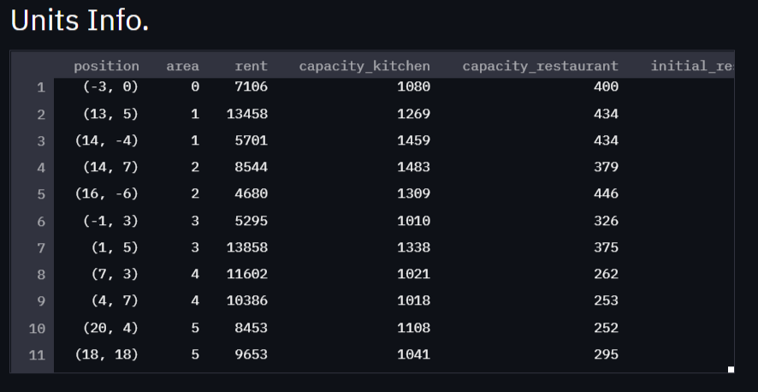
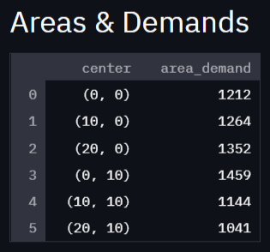
Results
Input information

Slide 34
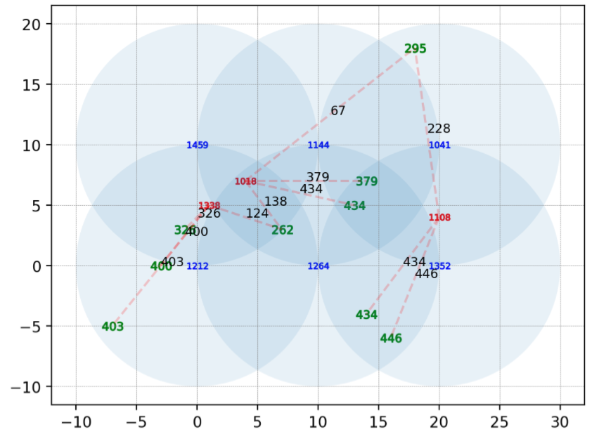
Results
Output Graph

Slide 35
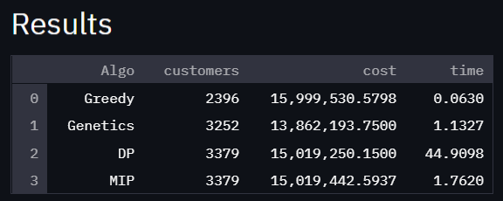
Results
Result details

Slide 36
References
[1] Azarmand, Z., & Neishabouri, E. (2009). Location Allocation Problem. Springer Link.
[2] Shan, W., Yan, Q., Chen, C., Zhang, M., Yao, B., & Fu, X. (2017). Optimization of competitive facility location for chain stores. Springer Science+Business Media, 187–205.
[3] Al-Sultan, K. S., & Al-Fawzan, M. A. (1999). A tabu search approach to the uncapacitated facility location problem. Annals of Operations Research, 91–103.

