Slide 1
Lecture 3: Intro to linear models: Simple linear regression
PDSS3

Slide 2
Today’s lecture
We will cover:
Simple linear regression using R

Slide 3
Simple linear regression
The last lecture focused on modeling distributions with means and medians. This lecture teaches you how to condition a mean on another variable.
You will create models that predict conditional means—means that shift around depending on what value some other piece of data assumes.
In modeling such conditional means, you move from the topic of univariate statistics (describing single variables) to bivariate statistics (describing the relationship between two variables).

Slide 4
Simple linear regression
Example: Word frequency (from Bodo Winder SFL).
Many studies have found that frequent words are comprehended faster than infrequent words (e.g., Postman & Conger, 1954; Solomon & Postman, 1952; Jescheniak & Levelt, 1994).

Slide 5
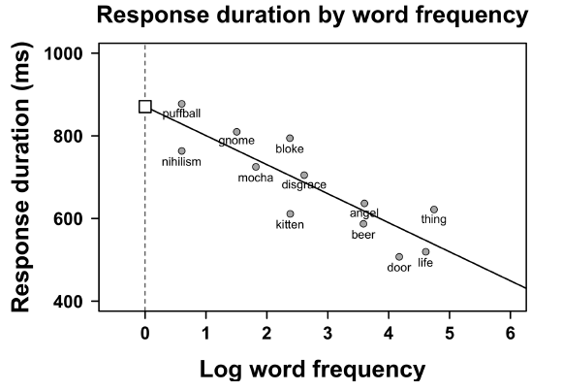
Simple linear regression
For example, it seems to be a correlation between response duration and word frequency (Balota et al., 2007).
The y-axis extends from 400ms to 1000ms. Longer response durations (up on the graph) mean that participants responded more slowly; shorter response durations (down on the graph) mean they responded faster. Word frequencies are represented on the x-axis on a logarithmic scale.

Slide 6
Simple linear regression
For example, it seems to be a correlation between response duration and word frequency (Balota et al., 2007).
The relationship between response duration and frequency is neatly summarized by
a line. This line is the regression line, which represents the average response duration for different frequency values.

Slide 7
Simple linear regression
For example, it seems to be a correlation between response duration and word frequency (Balota et al., 2007).
Simple linear regression is an approach that models a single continuous response variable as a function of a predictor variable.

Slide 8
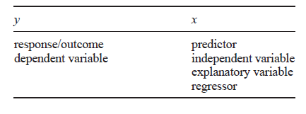
Simple linear regression
Different names for dependent variable (y) and independent variable (x)
It is important to remember that the regression model cannot tell you whether there actually is a causal relationship between x and y.

Slide 9
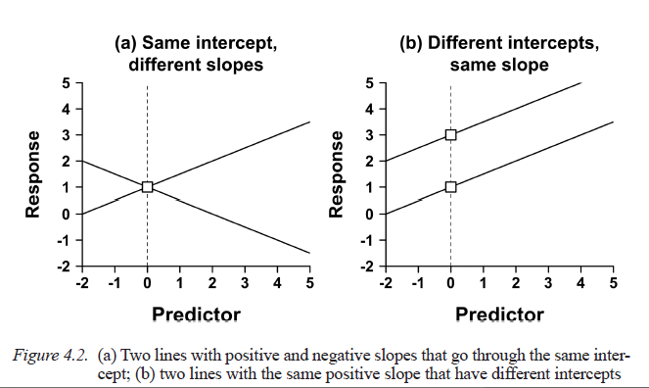
Simple linear regression
Intercepts and Slopes
Positive slope
Negative slope

Slide 10
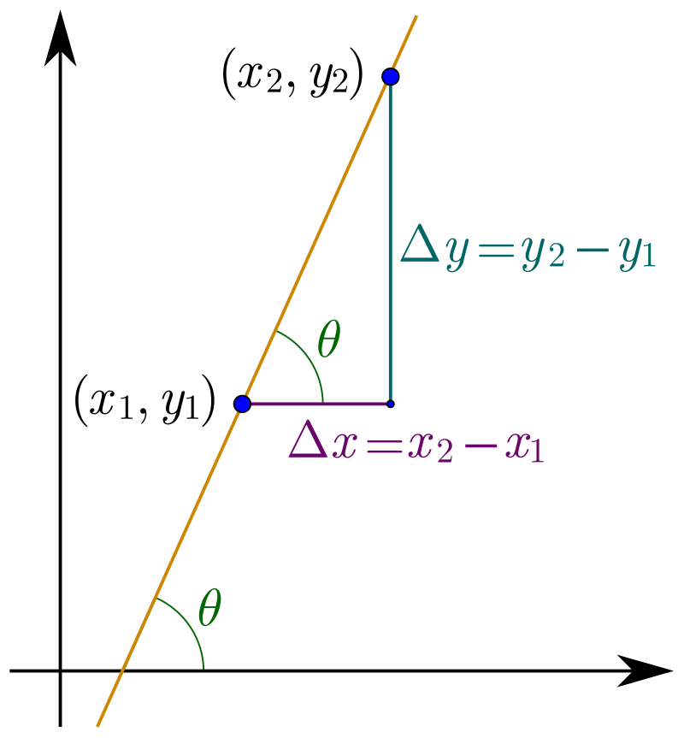

Simple linear regression
Intercepts and Slopes
The slope is defined as the change in y (Δy, ‘delta y’) over the change in x (Δx, ‘delta x’)

Slide 11
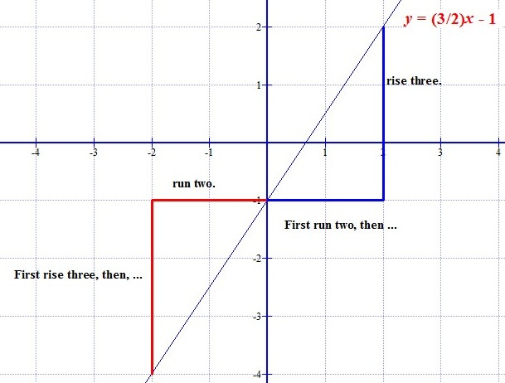
Simple linear regression
Intercepts and Slopes
The slope is defined as the change in y (Δy, ‘delta y’) over the change in x (Δx, ‘delta x’)
slope

Slide 12
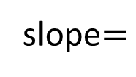
Simple linear regression
Intercepts and Slopes
The slope is defined as the change in y (Δy, ‘delta y’) over the change in x (Δx, ‘delta x’)
slope$=$

Slide 13
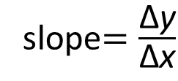
Simple linear regression
Intercepts and Slopes
The slope is defined as the change in y (Δy, ‘delta y’) over the change in x (Δx, ‘delta x’)
slope$=\frac{\text{Δ}\text{y}}{\text{Δ}\text{x}}$

Slide 14
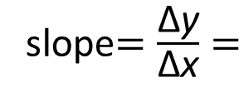
Simple linear regression
Intercepts and Slopes
The slope is defined as the change in y (Δy, ‘delta y’) over the change in x (Δx, ‘delta x’)
slope$=\frac{\text{Δ}\text{y}}{\text{Δ}\text{x}}=$

Slide 15
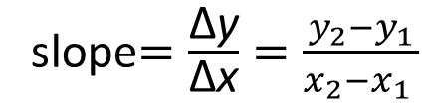
Simple linear regression
Intercepts and Slopes
The slope is defined as the change in y (Δy, ‘delta y’) over the change in x (Δx, ‘delta x’)
slope$=\frac{\text{Δ}\text{y}}{\text{Δ}\text{x}}=\frac{y_{2}−y_{1}}{x_{2}−x_{1} }$

Slide 16
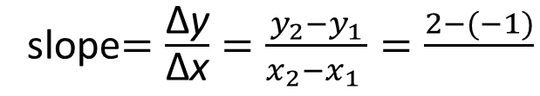
Simple linear regression
Intercepts and Slopes
The slope is defined as the change in y (Δy, ‘delta y’) over the change in x (Δx, ‘delta x’)
slope$=\frac{\text{Δ}\text{y}}{\text{Δ}\text{x}}=\frac{y_{2}−y_{1}}{x_{2}−x_{1} }=\frac{2−(−1)}{}$

Slide 17
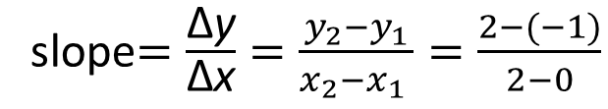
Simple linear regression
Intercepts and Slopes
The slope is defined as the change in y (Δy, ‘delta y’) over the change in x (Δx, ‘delta x’)
slope$=\frac{\text{Δ}\text{y}}{\text{Δ}\text{x}}=\frac{y_{2}−y_{1}}{x_{2}−x_{1} }=\frac{2−(−1)}{2−0}$

Slide 18
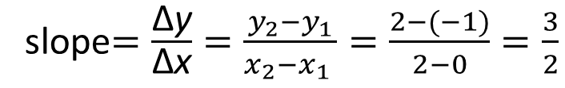
Simple linear regression
Intercepts and Slopes
The slope is defined as the change in y (Δy, ‘delta y’) over the change in x (Δx, ‘delta x’)
slope$=\frac{\text{Δ}\text{y}}{\text{Δ}\text{x}}=\frac{y_{2}−y_{1}}{x_{2}−x_{1} }=\frac{2−(−1)}{2−0}=\frac{3}{2}$

Slide 19
Simple linear regression
Intercepts and Slopes
The slope is defined as the change in y (Δy, ‘delta y’) over the change in x (Δx, ‘delta x’)
slope$=\frac{\text{Δ}\text{y}}{\text{Δ}\text{x}}=\frac{y_{2}−y_{1}}{x_{2}−x_{1} }=\frac{2−(−1)}{2−0}=\frac{3}{2}$
Thus, for each increase in x by 1 unit, the
predicted value of y increases by 3/2

Slide 21
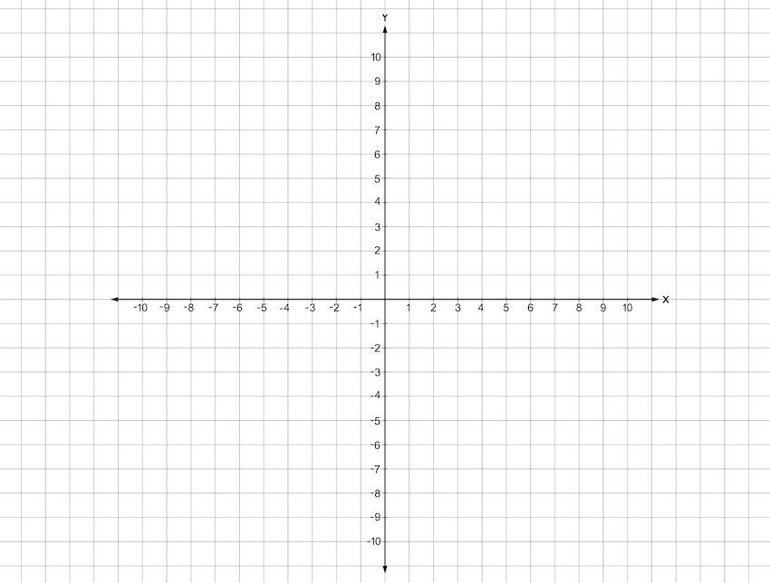
Simple linear regression
Intercepts and Slopes
However, a slope is not enough to specify a line. For any given slope, there is an infinity of possible lines.

Slide 22
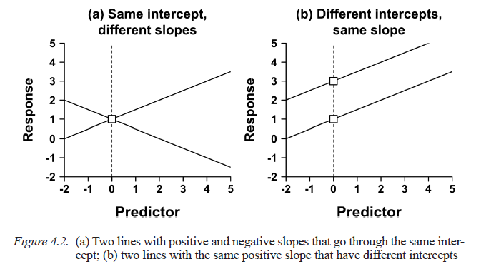
Simple linear regression
Intercepts and Slopes
Figure 4.2b shows two lines with the same slope but differing ‘intercepts’. You can think of the intercept informally as the point ‘where the line starts’ on the y-axis. As the y-axis is located at x = 0, this means that the intercept is the predicted y-value for x = 0.
B₀ = 2
B₀ = 1

Slide 23

Simple linear regression
Intercepts and Slopes
Once the intercept and slope are fixed, there can be only one line. In math-speak, the line is said to be ‘uniquely specified’ by these two numbers.
The intercept and slope are both ‘coefficients’ of the regression model.
The letters b0 and b1 are commonly used to represent the intercept and the slope. Thus, the regression line has the following form:
Intercept:
predicted y value for x=0
Slope:
Change in y over change in x

Slide 24
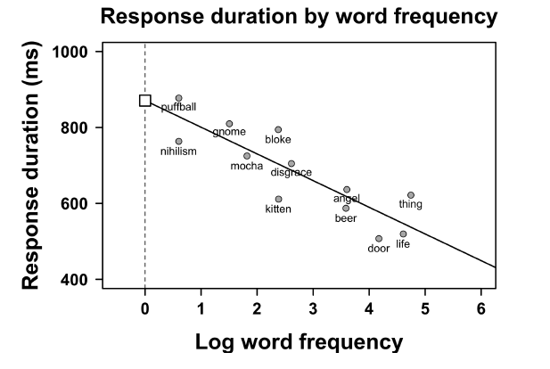
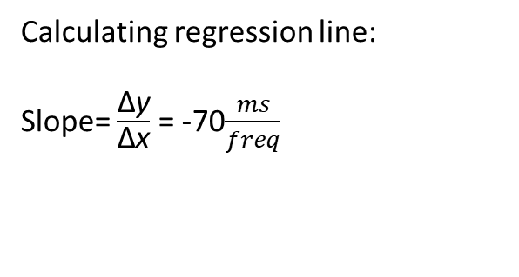
Simple linear regression
Intercepts and Slopes
Example
Calculating regression line:
Slope= $\frac{\text{Δ}\text{y}}{\text{Δ}\text{x}}$ = -70$\frac{ms}{freq}$

Slide 25
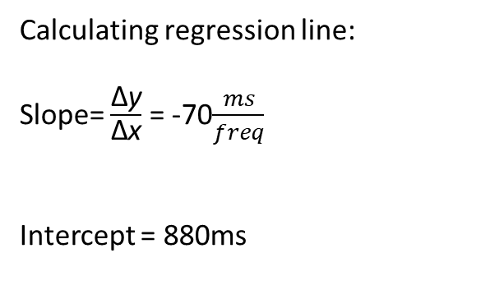
Simple linear regression
Intercepts and Slopes
Example
Calculating regression line:
Slope= $\frac{\text{Δ}\text{y}}{\text{Δ}\text{x}}$ = -70$\frac{ms}{freq}$
Intercept = 880ms

Slide 26

Simple linear regression
Intercepts and Slopes
Example
Calculating regression line:
Slope= $\frac{\text{Δ}\text{y}}{\text{Δ}\text{x}}$ = -70$\frac{ms}{freq}$
Intercept = 880ms

Slide 27

Simple linear regression
Fitted Values
Let’s see what response duration the regression model predicts for a random word, for example: script
Given that we know that script has a (log) frequency of 3.
General regression model:
Our example regression model:
Our example regression model:
The expected response duration for script is 670ms. Such a prediction is called a
‘fitted value’, as it results from ‘fitting’ a regression model to a dataset.

Slide 28
Simple linear regression
Fitted Values
The expected response duration for script is 670ms. Such a prediction is called a
‘fitted value’, as it results from ‘fitting’ a regression model to a dataset.
script

Slide 29
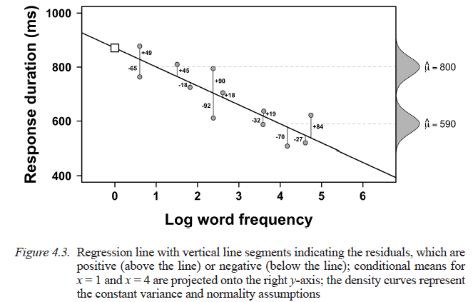
Simple linear regression
Residuals
The frequency model doesn’t fit any of the data points perfectly. The extent to which the model is wrong for any specific data point is quantified by the residuals, which are the vertical distances of the observed data from the regression line

Slide 30


Simple linear regression
Fitted values and Residuals
The relationship between fitted values, observed values, and residuals can be summarized as follows:
Or
Is summary, residuals are the difference between the observed value and the mean value that the model predicts for that observation. A residual is the error in a result.

Slide 31
Simple linear regression
Fitted values and Residuals
So, the regression equation has two parts.
One part is ‘deterministic’ and allows you to make predictions for conditional
means (a mean dependent on x).
Then, there is a ‘stochastic’ part of the model that gives you the error of the predictions, represented by e.

Slide 32
Simple linear regression
Assumptions: Normality and Constant Variance
We make a few assumptions when we use linear regression to model the relationship between a response and a predictor.
These assumptions are essentially conditions that should be met before we use a model to make a prediction.

Slide 33
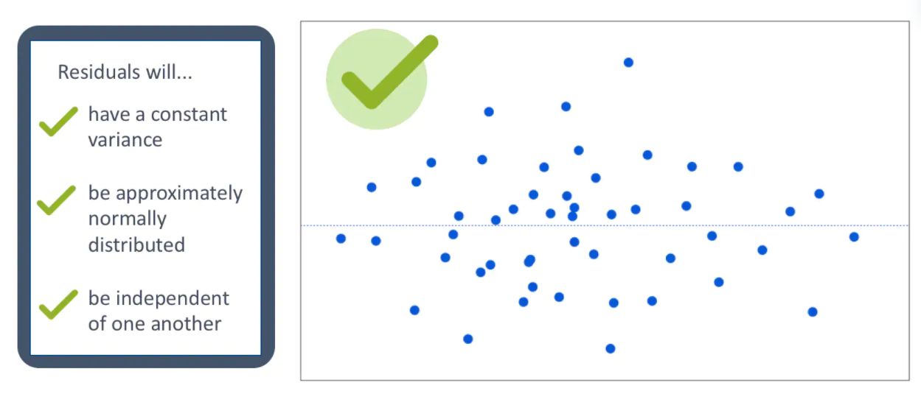
Simple linear regression
Assumptions: Normality and Constant Variance

Slide 34
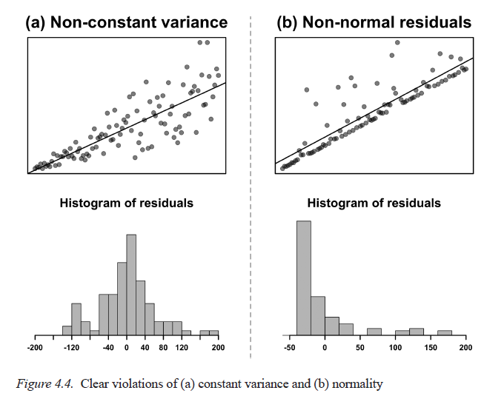
Simple linear regression
Assumptions: Normality and Constant Variance
Case (a): violation of constant variance; the residuals are larger for larger x-values.
Case (b): violation of normality; the residuals
reveal a ‘positive skew’, i.e., there are a few infrequent extreme values.

Slide 35
Simple linear regression
Measuring Model Fit with R²
The residuals are useful for creating a measure of the ‘goodness of fit’ of a model—how well a model ‘fits’ the observations overall.
A well-fitting model will have small residuals.

Slide 36
Simple linear regression
Measuring Model Fit with R²
To get an overall measure of ‘misfit’, the residuals can be squared and summed.
The corresponding measure is called ‘sum of squared errors’ (SSE).
Example:
Which is a better model?
Regression model with the slope of –70.24 has an SSE of 42,609.
Zero-slope model has an SSE of 152,767.
The regression model with the estimated slope (b1 = −70.28) results in the smallest residuals. Regression is sometimes called ‘least squares regression’ because it yields the coefficients that minimize the squared residuals.

Slide 37
Simple linear regression
Measuring Model Fit with R²
Smallest SSE
Highest SSE

Slide 38
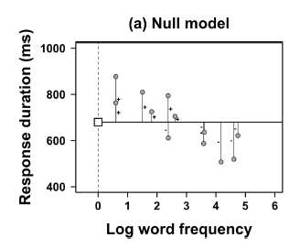

Simple linear regression
Measuring Model Fit with R²
The zero-slope model (also called the “intercept-only model”) can be a useful a reference model or ‘null model’ for
comparing SSE values
This ‘null model’ without a slope can be used to calculate the R2 (‘R squared’), which is value that measures the strength of the relationship between our two variables.
The formula for R2 is as follows:

Slide 39
Simple linear regression
Measuring Model Fit with R²
Example: Calculating R²
The SSE of the regression model is 42,609.
The SSE of the null model is 152,767
42,609 divided by 152,767 is 0.28.
Then R2 value then is 1 − 0.28 = 0.72.
This number can be conceptualized as how much variance is ‘described’ by a model. In this case, 72% of the variation in response durations can be accounted for by incorporating word frequency into the model.
Conversely, 32% of the variation in response durations is due to chance, or due to factors the model omits.

Slide 40
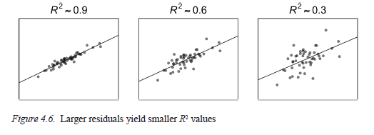
Simple linear regression
Measuring Model Fit with R²

Slide 41
Simple linear regression
A Simple Linear Model in R
Upload your tidyverse package

Slide 42
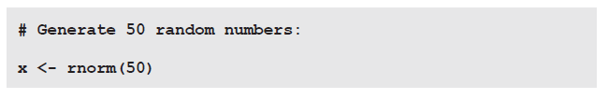
Simple linear regression
A Simple Linear Model in R
First, let’s generate some random data, for example, 50 random normally distributed numbers

Slide 43
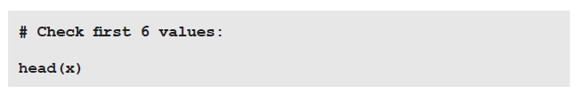
Simple linear regression
A Simple Linear Model in R
Check the vector. Each student will have different data

Slide 44
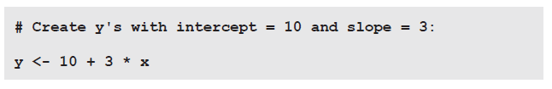
Simple linear regression
A Simple Linear Model in R
To be able to do anything bivariate, you need y-values to go with the x-values. Let’s say that the intercept is 10 and the slope is 3:

Slide 45

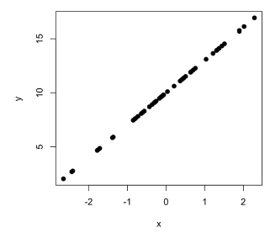
Simple linear regression
A Simple Linear Model in R
Let’s plot y against x in a scatterplot (using the optional argument pch = 19 to change the pcharacters to filled circles). This reveals a straight line. In other words, y is a perfect function of x —something that would
never happen in social sciences data.

Slide 46

Simple linear regression
A Simple Linear Model in R
So, let’s add noise. To add noise, the rnorm() function is used a second time to generate residuals.

Slide 47
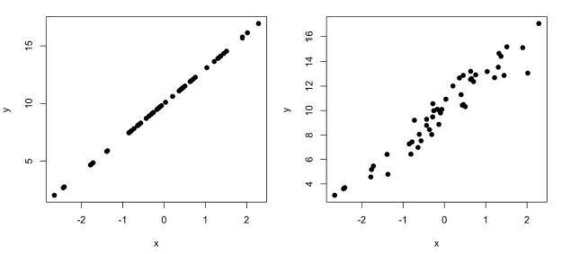
Simple linear regression
A Simple Linear Model in R
Let’s plot the varibles with the error

Slide 48
Simple linear regression
A Simple Linear Model in R
The data is in place. Specifically, you generated random data where y depends on x.
Since you generated the data yourself, you know that the intercept is 10 and the slope is 3.

Slide 49
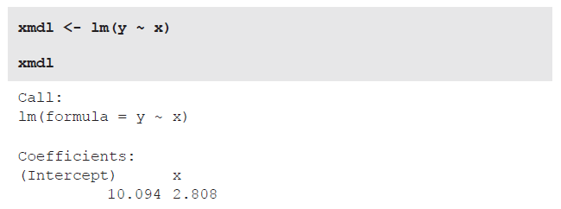
Simple linear regression
A Simple Linear Model in R
Let’s see whether regression is able to retrieve these coefficients from the data.
For this, use the lm() function, which stands for linear model. The syntax used in
‘y ~ x’ is called ‘formula notation’, and it can be paraphrased as ‘y as a function of x’. Usually, you want to save linear models in R objects so that you can access them for later use.
The deviations from the exact values 10
and 3 are due to the random noise that was added to the data.

Slide 50
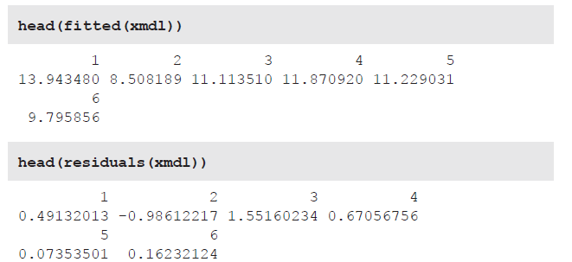
Simple linear regression
A Simple Linear Model in R
The fitted() and residuals() functions can be used to retrieve the model’s
fitted values and residuals. The following command uses the head() function merely to reduce the output to the first six values.
The first element of the output of fitted(xmdl) is the prediction for the first data
point, and so on. Similarly, the first element of the output of residuals(xmdl) is
the deviation of the model’s prediction for the first data point, and so on.

Slide 51
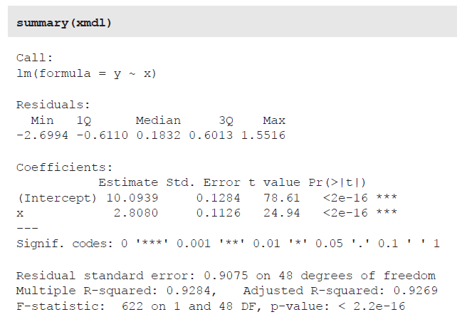
Simple linear regression
A Simple Linear Model in R
A very useful function to apply to linear model objects is summary().
Estimated intercept
A p-value less than 0.05 (typically ≤ 0.05) is statistically significant. Rejection of null hypothesis (i.e. rejection of zero effect)
Estimated slope
R²

Slide 52

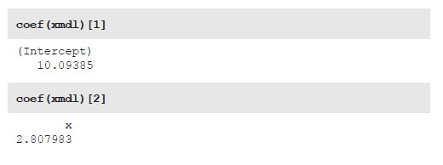
Simple linear regression
A Simple Linear Model in R
The coef() function retrieves the coefficients of a linear model. The output of this is a vector of coefficients.
This vector can be indexed as usual. The following commands retrieve the intercept and slope, respectively.

Slide 53
Simple linear regression
A Simple Linear Model in R
This vector can be indexed as usual. The following commands retrieve the intercept and slope, respectively.

Slide 54
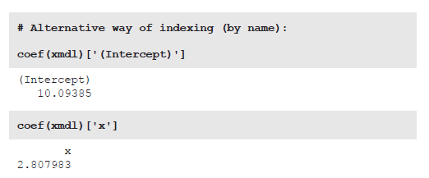
Simple linear regression
A Simple Linear Model in R

Slide 55

Simple linear regression
A Simple Linear Model in R
The following command computes the fitted value for an x-value of 10:

Slide 56

Simple linear regression
A Simple Linear Model in R
The predict() function is useful for generating predictions for fitted models,
thus saving you some arithmetic. The function takes two inputs: first, a model which forms the basis for generating predictions; second, a set of new values to generate predictions for.
Let’s generate predictions for a sequence of numbers from –3 to +3 using the seq() function. This particular sequence is specified to increase in 0.1 intervals (by = 0.1).

Slide 57

Simple linear regression
A Simple Linear Model in R
The predict() function needs a data frame or tibble as input. Importantly, the
column has to be named ‘x’, because this is the name of the predictor in xmdl.

Slide 58
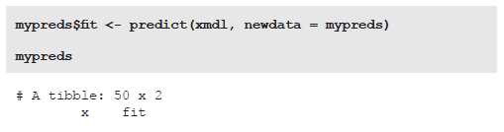
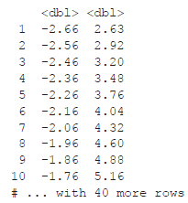
Simple linear regression
A Simple Linear Model in R
Now that you have a tibble to generate predictions for, you can use predict(). The following code stores the output of the mypreds tibble in a new column, called fit.
So, for an x-value of –2.66, the model predicts a y-value of 2.63, and so on.

Slide 59
Hands-on lab
Week 3
Lab 3
Problem_set_3

