Slide 1
Note keeping application
Paul Băltărete

Slide 2
motivation
Productivity
To-do lists
Stay focused on the things that matter to you

Slide 3
Technologies used
CSS (Cascading Style Sheets)
HTML (HyperText Markup Language)
JavaScript
JQuery

Slide 4
The menu
My notes (Home)
Archive

Slide 5
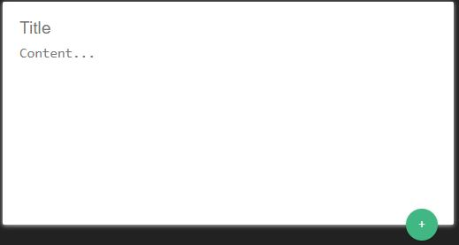
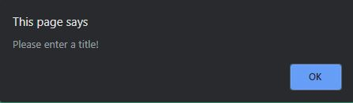
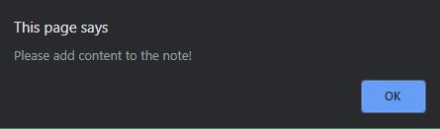
The input
Add title
Add content

Slide 6
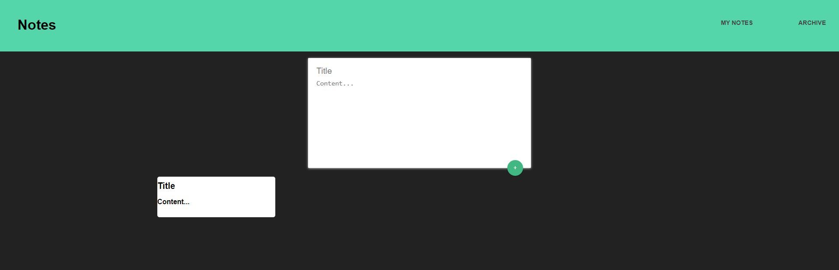
ADDIng a note
Click the “+” button

Slide 7
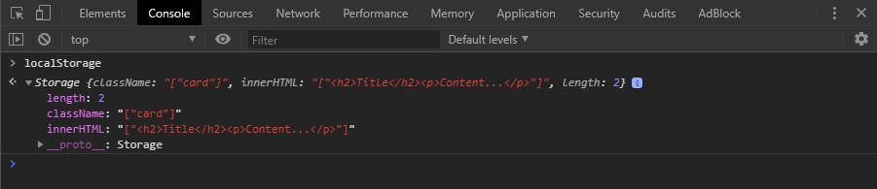
Local Storage
Refresh the page
Exit the browser

Slide 8
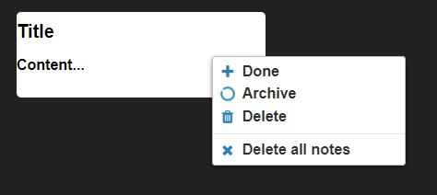
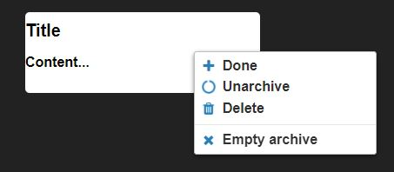
Context menu
Right-click on the note to open the context menu

Slide 9
Demo

Slide 10
Thank you!

