Slide 1

MANIPULATING STYLES
JavaScript Fundamentals

Slide 2
HTML and the DOM
The style object
Reading and setting CSS properties
CSS Classes and JavaScript
The calculated style of an object
Adding and removing classes
INTRODUCTION

Slide 3
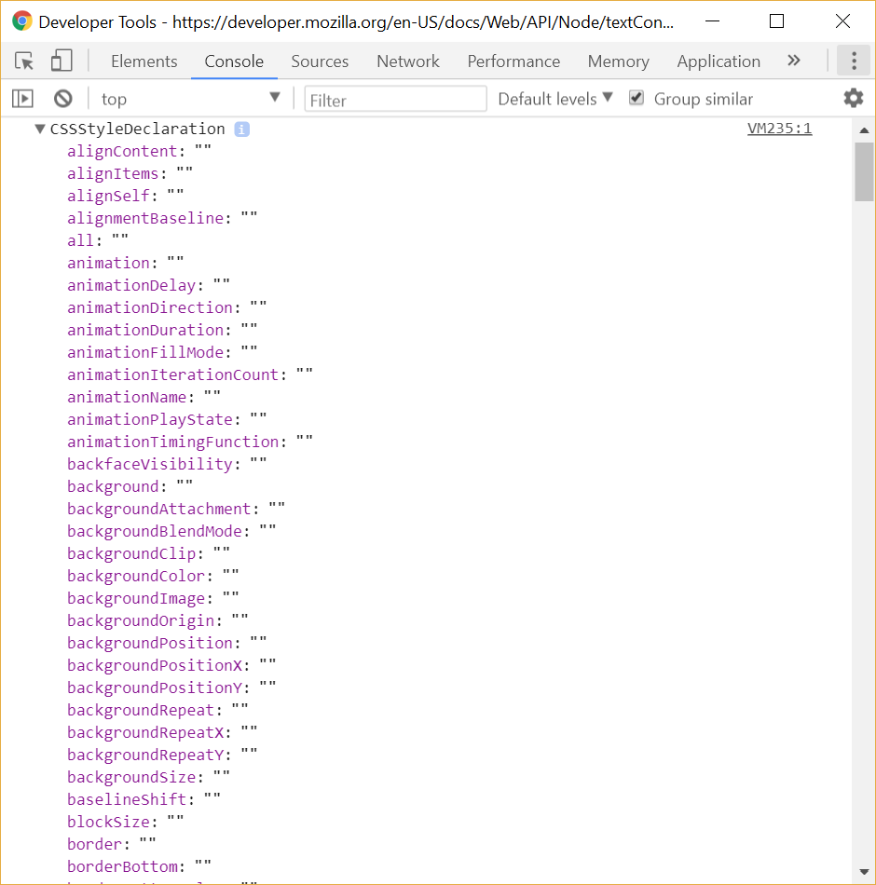
The style object
Every rendered HTML object contains a style sub object
Use a console.dir() against the <p> declaration we will see
Each CSS rule is passed in as a parameter list
Applied to the appropriate property if understood
If not understood, a silent fail occurs
Great for cross browser issues and new CSS features
<p style="background-color: #b6ff00; border: 1px solid red" ></p>
Notes:
The style property of a HTML element allows us to apply an inline CSS style. The style object is an associative array of key properties and applied styles. As we will see in the next few slides, we can use JavaScript to manipulate the CSS style. Most CSS JavaScript programming occurs using this object and ensures the JavaScript manipulation will always take precedence over any CSS classes or IDs applied to the DOM object.
At execution, the CSS style or JavaScript is examined as a set of parameters and applied to the appropriate style keys. Via HTML rendering, any issues will fail silently. In our own JavaScript code, this is not the case and we should check for the property if we believe it may not be present for any reason.

Slide 4
Reading CSS properties
You can access an existing CSS property and assign it to a variable
CSS function can request any CSS property
This gives you the element’s style property, if there is one
If the property has been set via style or JavaScript, it returns a value
If by CSS class or ID you do not
You receive the value that is part of the CSS Style Object, not necessarily what has actually been rendered
let bgColor = document.querySelector('p:nth-child(2)').style.backgroundColor

Slide 5
Setting multiple CSS Properties
The style property can alter the CSS properties of an object
For writing properties to an existing object
You must ensure the element has rendered before you try to do this
This could get repetitive. What about if we used Object.assign to help us out here?
document.querySelector('p:nth-child(1)').style.backgroundColor = '#dddddd';
document.querySelector('p:nth-child(1)').style.color = '#666666';
let div = document.querySelector('div');
let styles = {
backgroundColor: "pink",
borderRadius: '5px’,
boxShadow: "5px 5px 5px deeppink"
}
Object.assign(div.style,styles);
Notes:
The advantage of using the style object is its authority in the hierarchy of CSS application – even if a CSS class is applied, this will override those rules. Each style rule must be applied as a separate function call, which can end up being very weighty in code.

Slide 6
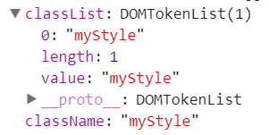
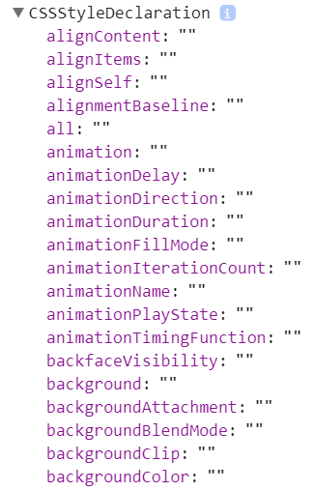
CSS classes and JavaScript
Classes are attached to a DOM object in a slightly different way
Classes render as part of a DOM element
Represented as an array
Multiple classes can be added to an element
Their styles do not become party of the style property
.myStyle {
background-color: #4cff00;
border: 1px solid red;
}
<p class="myStyle">test</p>
Notes:
In all probability, we will be using CSS classes and in that situation, as outlined above. CSS classes apply to the DOM object, but we will not see it in the style property of the object.
Trying to retrieve the a CSS style property via JavaScript will only work when that style property has previously been set via JavaScript or when that style property was defined inline by using the style attribute in HTML. Now this doesn't do you much good if you haven't first set said CSS property in JavaScript and you still want to retrieve it via JavaScript.

Slide 7
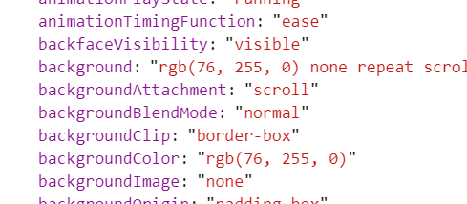
Obtaining the calculated style of an object
In most cases, we will read a CSS class from a style sheet
Use the window.getComputedStyle() method
Provides a read only final used values of the CSS
Returning a CSSStyleDeclaration object
let elem = document.querySelector('p:nth-child(1)');
let compStyle = getComputedStyle(elem).backgroundColor;
Notes:
getComputedStyle() gives the final used values of all the CSS properties of an element, where the returned style is a CSSStyleDeclaration object.
The returned object is of the same type as that of the object returned from the element's style property; however, the two objects have different purposes. The object returned from getComputedStyle is read-only and can be used to inspect the element's style (including those set by a <style> element or an external stylesheet). The style object should be used to set styles on a specific element.

Slide 8
Adding and removing classes
A class can be switched or added via JavaScript
Add or alter a class attribute
Up to and including IE9
Removal must be done via string manipulation – it is quite tedious
IE10 onwards
Can easily add and remove any class and modern browsers have the toggle method too!
const element = document.getElementById(elementID);
element.className = 'special';
const c = document.querySelector('#container');
c.className += ' div2';
const element = document.getElementById(elementID);
element.classList.add('special');
element.classList.remove('another-class');
Notes:
All elements can have attributes added or changed via JavaScript. The setAttribute method takes an attribute value and sets it to the new value. Any CSS class that is currently loaded into the page can be referenced in this way.
There is an alternative approach that can be used if you want to apply multiple classes. The DOM element holds all applied classes in the className property. It is simply a string value that we can append to.

Slide 9
QuickLab 11 – Manipulating Style with JavaScript
Experiment with adding and removing styles on HTML elements

Slide 10
REVIEW
HTML to DOM rendering
Accessing the style object
Reading style properties
Setting style properties
Understanding CSS classes
Obtaining the object computed style
Applying classes via JavaScript

