Slide 1
Structural HTML
Basic HTML

Slide 2
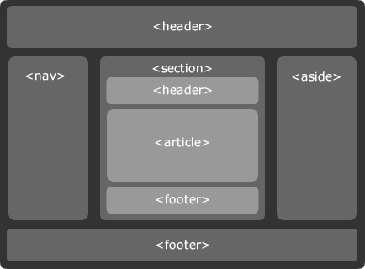
HTML5 Structural Elements
HTML5 has a series of structural elements
To create a more semantically structured page
The main building blocks of HTML5 are:
<header>
<nav>
<section>
<main>
<article>
<aside>
<footer>
Notes:
If you look at some of the more obscure HTML 4 tags like <kbd>, <samp> and <var> you can see the scientific roots of HTML 4. HTML5 is a child of its time for a mainstream, information-based web. If you consider your own pages they are probably littered with <div> tags with semantically useful id attributes such as header, foot, nav and content. To save us from the swarm of <div> tags more suitable structural elements have been added.
As previously discussed, HTML5 introduces a new sectioning set of tags. These allow us to provide semantic description to a page and place the document into a more human readable and better structured document. Over the next pages we will examine these elements and understand how to use them effectively and appropriately.

Slide 3
Headings and sectioning elements
HTML5 documents have an outlining algorithm
Generates a table of content based on the section and heading you’ve used
Important for assistive technology and search engine optimisation
Sectioning elements create a logical structure in the document outline
<body>
<h1>Main heading</h1>
<p>Some text</p>
<h2>Level 2 heading</h2>
<p>Some more text</p>
<h3>Level 3 heading</h3>
<p>A bit more text</p>
<h2>Another level 2 heading</h2>
<p>The last bit of text</p>
</body>
Notes:
The document outline is the structure of a document, generated by the document’s headings, form titles, table titles, and any other appropriate landmarks to map out the document. The user agent can apply this information to generate a table of contents, for example. This table of contents could then be used by assistive technology to help the user, or be parsed by a machine like a search engine to improve search results.
The sectioning elements <section>, <article>, <aside> and <nav> can all help to create a more logical structure in the document outline.

Slide 4
The <header> element
Normally the first element of the document
Should act as container logos, links back to home etc.
Will usually contain a <h1> to <h6> to denote level of header
There can be one <header> per sectioning block
<header>
<a href="/">
<img src="logo.png" alt="QA Home">
</a>
<h1>My Main Title</h1>
<h2>My Sub title></h2>
</header>
Notes:
Assuming we are using the <hn> tags as is appropriate in modern mark-up development, the main heading will normally have a <h1> element within.
The specification says it should be used to represent a group of introductory or navigational aids. It can contain an optional hgroup element. It can also be used to wrap a section's table of content, search form or similar.
Essentially when a <hn> element on its own is not suitable, there is other related information that makes up the block you should use a <header>.
Each block element, be that the <html> root or an <article> element for example can contain a <header> element. You may not have more than one <heading> per sectioning block.
The optional <hgroup> may only contain <hn> elements its purpose is to take a heading element, which would normally appear in the outline, out of it!

Slide 5
<nav> is used to mark up navigation
Should be limited to links within the page and site
Not sponsored links for instance
Links normally surrounded by <li> within a <ul>
Multiple <nav> allowed, each should contain a related category
The <nav> element
<nav>
<h2>Main site navigation</h2>
<ul>
<li>
<a href="/">Home</a>
</li>
<li>
<a href="/aboutsus.html">
About Us
</a>
</li>
</ul>
</nav>
Notes:
Not all groups of links on a page need to be in a nav element – the element is primarily intended for sections that consist of major navigation blocks.
It is common for footers to have a short list of links to various pages of a site, such as the terms of service, the home page, and a copyright page. The footer element alone is sufficient for such cases; while a nav element can be used in such cases, it is usually unnecessary.
<nav> elements can be nested inside other sectioning elements, <footer> and <header> most commonly.

Slide 6
Many <footer> elements may occur on a page
Appear at the end of a sectioning element
blockquote, body, div etc.
Contains information about the section or document, e.g. the author
The <footer> element requires no heading element
Unique in the sectioning element
It is optional and can be added
The above code is a ‘fat footer’
The <small> tag represents small print in HTML5
Add a <nav> element within if links required
The <footer> element
<footer>
<small>
This tag has been redefined
</small>
</footer>
Notes:
The footer element represents a footer for its nearest ancestor sectioning content or sectioning root element. A footer typically contains information about its section, such as who wrote it, links to related documents, copyright data, and the like.
When the footer element contains entire sections, they represent appendices, indexes, long colophons, verbose license agreements, and other such content.
A common use of the <footer> element is to create a so-called ‘fat footer’. “Fat Footer” are footers that contain a lot of material, including images, links to other articles, links to pages for sending feedback, special offers... in some ways, a whole "front page" in the footer.

Slide 7
Represents a self-contained composition on the page
A blog entry
Comic strip
Video
Articles represent indivisible units of work
The <article> element
<article>
<h2>Yesterday</h2>
<p>Some stuff goes here</p>
</article>
<article>
<h2>Today</h2>
<p>Some more stuff goes here</p>
</article>
Notes:
The <article> element represents a unit of work that makes up a significant section of data. This may include a <video> element, a blog entry or news story, or results from a dynamic server page.
As is common with all of our sectioning elements the first tag inside an <article> must be a heading.

Slide 8
<aside> provides tangential information to a block
It should assist but not be essential to the main document
For example nested within an <article>
Or used at a page level to denote 'sidebar' content
The <aside> element
<article>
<h1>My Blog Post</h1>
<p>...</p>
<aside>
<h1>Glossary</h1>
<dl>... </dl>
</aside>
</article>
<aside>
<h2>Blog roll</h2>
<ul>
<li><a href="#">Link 1</a></li>
<li><a href="#">Link 2 Friend</a></li>
</ul>
</aside>
Notes:
The <aside> element is an often misused tag in HTML5. Its purpose is to provide data that is tangential to the main block to assist with related but non-essential information. In the first example above it is used to enclose a glossary.
With the new definition of aside, it is important to remain aware of its context. When used within an article element, the contents should be specifically related to that article (e.g. a glossary).
While in the second example which would exist as a child of the <body>, the contents relate to the site (e.g. a blogroll, groups of additional navigation, and even advertising if that content is related to the page).

Slide 9
The <section> element
<section> is used to break up semantic elements
Different parts to a news story or a group of links
Should be used in conjunction with a heading
Otherwise the <section> is untitled in the HTML outline
Most generic and easiest to abuse semantic element
Do not use as a pure stylistic container
<body>
...
<section>
<h2>
heading level = section nesting level
</h2>
rest of the content
</section>
...
</body>
Notes:
The section is used to break semantic articles like the <article> or <nav> into smaller chunks. There are a few simple rules in their use:
Do not use it as a container for styling to scripting the <div> element should be used
Most generic and least meaningful of the other sectioning elements use them when more appropriate
The section must be followed by a <hn> element
<sections> unlike <div> provide a child level in the document outline, they are a structural sub level in the hierarchy. A common mistake is new developers to HTML5 think the <div> tag is obsolete. As we will discuss shortly when you are using a <Tag> as a container presentational rather than informational structure the <section> element should not be used.

Slide 10
The <section> vs. <article> element

Slide 11
<Div> Is Still Valid HTML5
You can still use the <div> tag no change to it in HTML5
I.e. A generic element for structuring a page
Has no semantic meaning except via attributes
Used if no semantic alternative or as a CSS wrapper
<body>
<div id="wrapper">
<header>…</header>
<nav>…</nav>
...
</div>
</body>
Notes:
The new semantic elements allow us to replace a lot of <div>’s old functionality. It is not a tag to discount in this new semantic world. The use of <div> is perfectly appropriate if no suitable semantic definition can be found. Its most common purpose is for stylistic functionality where we want the rendered mark-up to look different but not apply meaning.
The same is true of the <span> element. There are may more suitable semantic definitions such as <mark> but its use as a generic content wrapper is still very useful.

Slide 12
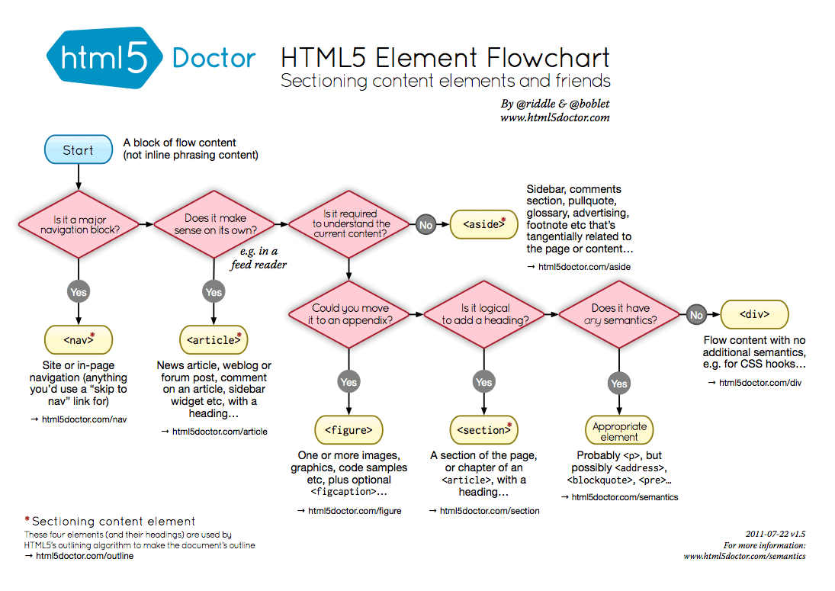
When to use what

Slide 13
When to use what
Element | Typical Content | Typical Parent Element | Typical Child Element
<header> | Title, logo, banner, Introductory information | Body, Section, Article | Nav, Section
<nav> | Primary navigation content | Body | Section, Nav
<section> | Generic page section | Body | Article, Header, Footer, Aside, Nav
<article> | Story, subsection, blog post | Body, Section | Section, Header, Footer
<aside> | Sidebar content, tip, quotation | Body | Section, Article
<footer> | Footer, summary, copyright, info, secondary navigation | Body, Section, Article | Nav, Section
<main> | Unique content, central to the topic of the document | Body | Section, Article, Aside (not repetitive content like nav, header or footer)

Slide 14
Restructuring A Blog With HTML5
Each blog entry would be an article
Providing clear semantic intent for the page
<article>
<header>
<h2>My HTML5 Blog</h2>
<p>March 15th 2010</p>
</header>
<p>Much less divitius occurs!</p>
<footer>
<address>
<a href="..">Posted in</a>
</address>
</footer>
</article>
Notes:
Here we have implied some intent meaning that the correct semantic tag is an <article> specifying a single unit of information. The introductory mater is encapsulated in a header and the footer contains closing navigation. While the main body of the article can go back to using <p> for what it was intended!
With the right use of CSS selectors we can easily style these specific articles (more on this later).
Still, there are issues with the article. The data is in a <p> for example which does not emphasis the intent of the data being displayed.

Slide 15
Quick Lab Ext 1 – Structural HTML
Convert an HTML document into a semantically tagged document and test the outcome

