Slide 1
Program an Arduino Robot using AI
DPRG October 24 2026
https://tinyurl.com/PicoAiBotSlides

Slide 2
Laptop Checks
Connect to the guest wifi
Arduino IDE and Pico support pre-loaded? Check it works:
  Connect the Pico to your laptop
  Launch the Arduino IDE and open the Blink example
  Set the board type (Pico) and port (e.g. /dev/ttyACM0, COM9)
  Build and program Blink. Observe the flashing LED
Get your Interposer board
https://tinyurl.com/PicoAiBotSlides
Notes:
Make sure everyone can connect to guest wifi.
Check everyone has pre-loaded Arduino IDE and Pico support: connect Pico to laptop; launch Arduino IDE and open blink example; set the board type (Pico) and port (e.g. /dev/ttyACM0, COM9); build and program blink example. Observe flashing LED.
Hand out Interposer boards.

Slide 3

Learn to program a robot using AI
Today we become Embedded Systems Engineers:
Understand the robot hardware
Use AI to generate firmware code
Debug on simulator with AI OURSELVES
Use that code to control the robot

Slide 4
Workshop timeline
Start | Block | Minutes
10:00 AM | Laptop checks and board setup. Hand out Interposers | 15
10:15 AM | Intro and workflow | 10
10:25 AM | Robot, Arduino and PWM theory | 15
10:40 AM | AI demo (web + cli) | 15
10:55 AM | Blink test | 10
11:05 AM | AI ramp sketch | 15
11:20 AM | Challenge design, coding and robot runs | 40
12:00 PM | Pizza lunch | 30
12:30 PM | Robot Challenge Judging | 60
1:30 PM | Wrap-up | 10
Notes:
Workshop runs 10:00 AM to 1:40 PM.

Slide 5
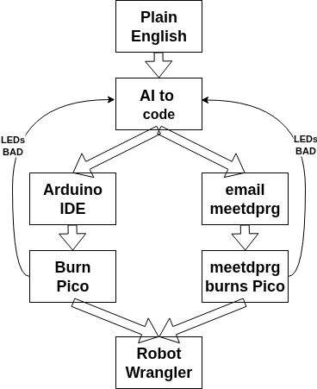
Workflow
1. Describe the behavior
  Plain-English requirements become the AI prompt
2. AI generates the code (sketch)
  Arduino C/C++ with setup() and loop()
3. Copy into the Arduino IDE
  Paste into a sketch
4. Flash the Pico
  Compile and upload over USB
  Check the LEDs show the desired motion
OR: Email sketch to meetdprg@gmail.com
Ask meetdprg to burn a pico, check LEDs
5. Ask Robot Wrangler to run it on the robot
  Mount the Interposer on the robot and power up
Notes:
Talking points:
Step 1: Inputting the Instructions. Explain the robot's intended behavior using simple, natural language. Feed these functional requirements directly into the AI assistant as a prompt.
Step 2: AI Code Generation. The AI instantly translates human logic into structured Arduino C/C++ code. It automatically handles standard structural blocks like setup() and loop().
Step 3: Moving to the Arduino IDE. Copy the raw code block generated by the AI with a single click. Paste the script directly into a fresh workspace inside the Arduino IDE software.
Step 4: Flashing the Hardware. Tether the physical Arduino microcontroller to the computer using a USB cable. Compile the script and hit the upload button inside the IDE to flash the board's memory. Observe that the LEDs indicate the desired motion before moving to the physical robot.
Step 5: Physical Integration & Operation. Securely mount the newly programmed Arduino board onto the robot chassis. Connect a portable power source so the board can read sensors and drive physical motors autonomously.

Slide 6
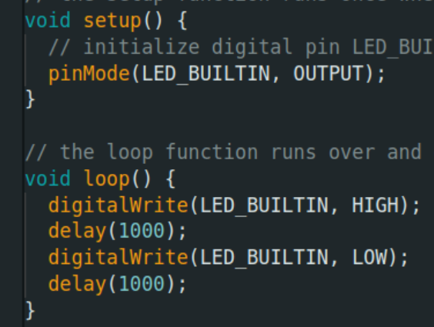
What is Arduino?
Arduino: a microcontroller running firmware in the Arduino environment
The Arduino environment:
  setup() runs once at power-up
  loop() runs over and over, forever
  Arduino language: C/C++ plus easy hardware functions
AI writes code like this. You copy/paste it from the browser into the Arduino IDE, build it, and load it into the Pico
Interposer LEDs light when the motors would run
Notes:
Define Arduino as meaning a microcontroller that runs firmware in the Arduino environment.
Explain the Arduino environment: setup() and loop() functions, plus Arduino language.
Explain that AI will write code like this, that you will copy/paste from browser window into Arduino IDE window, build it and load it into Pico. Interposer lights will illuminate when motors would run.

Slide 7
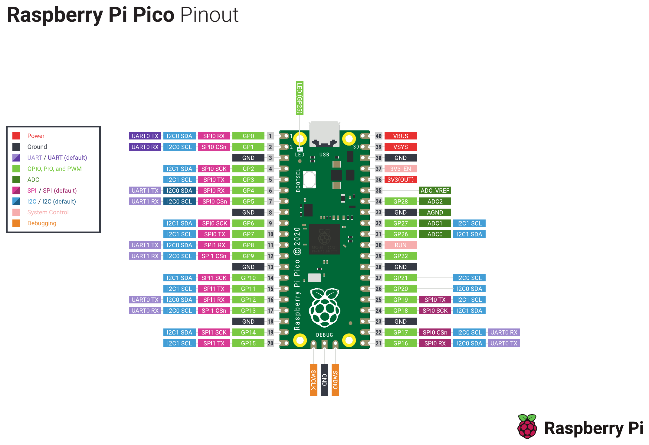
Pico Pinout
The Pico is very versatile. Each pin can be:
  Digital input or output
  Analog input
  I2C bus communication
  Timer / PWM
  OR… OR… OR…
We use only 2 pins: GP0 and GP1, as outputs that drive the LEDs and motors
Notes:
Explain that the Pico is very versatile, with pins that can be general purpose digital inputs or outputs, or analog inputs, or I2C bus communication pins, or timer pins OR...OR...OR
We're only using 2 pins: GP0 and GP1 as general purpose outputs that drive the LEDs and motors.

Slide 8
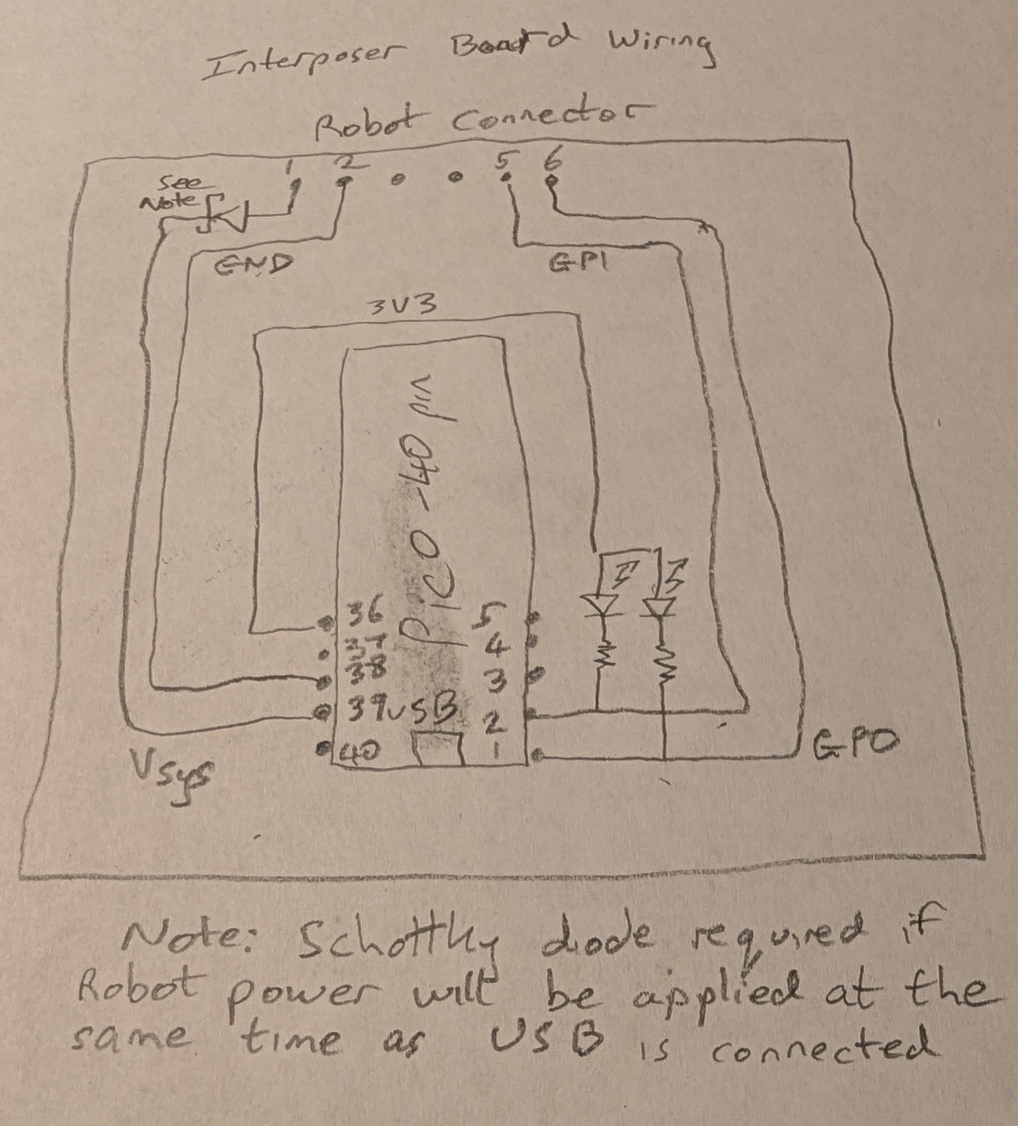
Interposer board
The Interposer goes between the Pico and the robot circuit board
GP0 and GP1 drive the LEDs and the motor-run signals out to the robot
It is your personal robot simulator: generate code with AI, load it into the Pico, and watch the LEDs. ON means that wheel's motor will run
Happy with the LEDs? Mount your Interposer on the SHARED robot
Notes:
The Interposer is interposed - goes between - the Pico circuit board and the robot circuit board.
Explain that we use 2 GPIOs: GP0 and GP1, and they drive LEDs and drive motor-run signals out to the robot.
The Interposer is your own personal robot simulator. You can ask the AI to generate code from your text, download it to the Pico, and watch the LEDs - ON means the corresponding wheel motor will run.
When you're happy with what the LEDs indicate, you can mount the Interposer board on the SHARED robot.

Slide 9
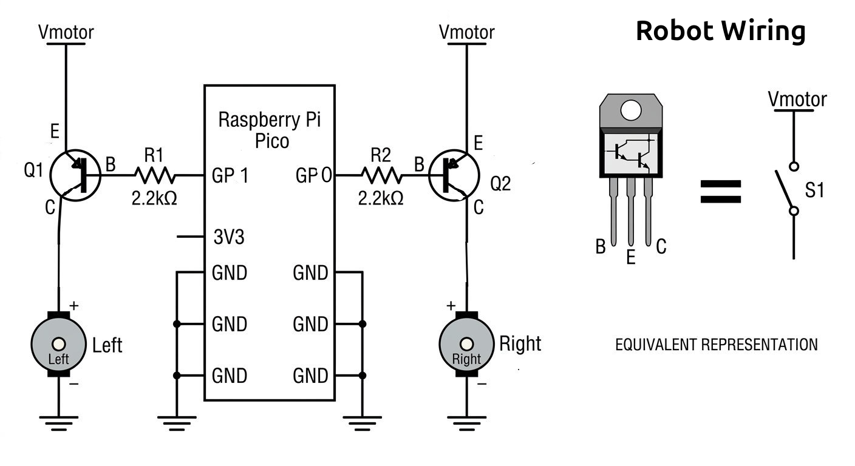
Arduino-Pico + Robot Overview
Each Pico pin drives a transistor switch for one motor: GP1 → Left, GP0 → Right. Pin LOW = switch closed = motor runs.
Notes:
Arduino with two pins driving switches which control 2 motors on the robot.

Slide 10

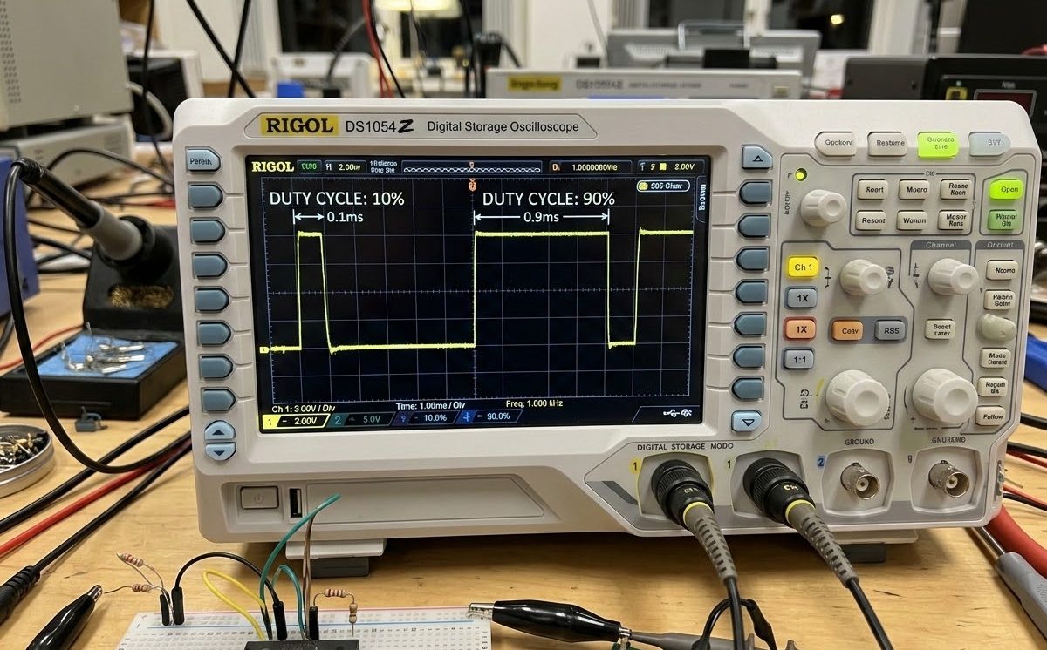
SYS.WORKFLOW // ARDUINO_ROBOTICS // PWM_CONTROL
PULSE WIDTH MODULATION
PWM Governs Motor Speed Through Precise Control of the Average Applied Power Duration.
255
MAX SIGNAL VALUE (ANALOGWRITE RANGE: 0–255)
Controlling the speed of a DC motor requires manipulating the power it receives. Since microcontrollers typically output digital signals (fully on or fully off), we use Pulse Width Modulation (PWM) to simulate a variable analog voltage.
The Speed Relationship: The physical motor speed is directly related to the average duration of the applied power. A longer 'on' time results in higher average voltage and a faster spinning motor.
Core Signal Range: On this hardware, analogWrite defaults to a 0–255 range. To achieve a 50% duty cycle (half speed), the programmed value becomes approximately 128.
Inverted Signal: This robot runs the motor at full speed when the PWM signal is low (0%) and stopped when PWM signal is high (100% = 255). Variable speed is any value inbetween.
FIG 1.0 // OSCILLOSCOPE TRACE OF 10% AND 90% DUTY CYCLES
10% DUTY
90% DUTY
PULSED VOLTAGE APPLICATION
PWM works by rapidly switching the output voltage on and off. The diagram above illustrates pulsed voltage applied to the motor, contrasting a low 10% PWM pulse (mostly on / high speed) with a high 90% PWM pulse (mostly off / low speed).

Slide 11
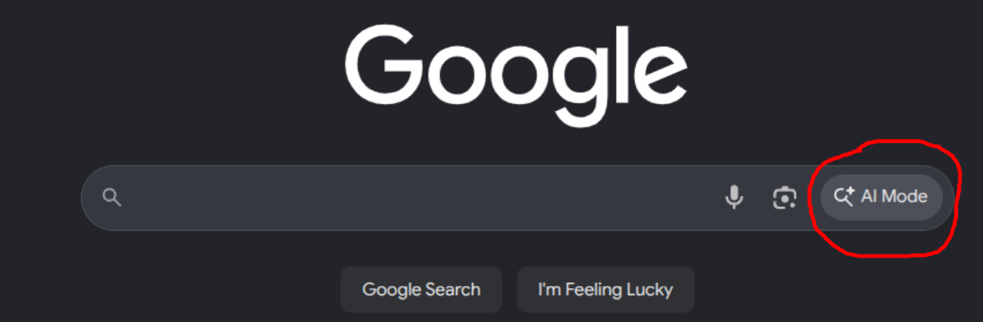
How to use AI (demo)
Launch Google in AI mode
Give it a detailed instruction, with context. Example:
I have an LED controlled by PWM on GP0 on a Raspberry Pi Pico. I am using the Arduino IDE with the earlephilhower arduino-pico core. Give me an arduino sketch to ramp it up to full brightness then back down to off every 5 seconds
Copy the resulting sketch into the Arduino IDE. Download & show.
This is not a great instruction: does the ramp take 5 seconds, or the whole loop? The AI will take a guess.
Notes:
Launch google in AI mode.
Give it a detailed instruction on what to do, with context (example prompt on slide).
Copy the resulting sketch into the Arduino IDE. Download & show.
Note this is not a great instruction - it's ambiguous regarding whether the ramp should take 5 seconds or the loop should take 5 seconds. The AI will take a guess.

Slide 12
Next level (not this workshop)
Run AI on your machine to edit files directly:
  Google Antigravity, Claude Code, OpenAI Codex, VS-code Copilot, Cursor
I have an LED controlled by PWM on GP0. Write a file called led_ramp.ino in the current directory which is an arduino-Pico sketch to ramp it up to full brightness then back down to off every 5 seconds
Demo: agy (Google Antigravity)
If you have VS Code with Copilot, Claude, or any other AI, you are welcome to use it for The Challenge
Notes:
Run AI in your machine to directly edit files (Google Antigravity, Claude Code, OpenAI Codex, GitHub Copilot, Cursor).
Demo agy.
If you have VS-Code with Copilot, or claude or any other AI you are welcome to use it for The Challenge.

Slide 13
Ask AI to write a sketch
Open Google in AI mode. Give it this instruction:
I have a differential drive robot with two motors controlled by PWM. The PWM signal is produced by a Raspberry Pi Pico. I am using the Arduino IDE with the earlephilhower arduino-pico core. The left motor is driven by GP1. The right motor is driven by GP0. The GPIO pins drive a PNP transistor that enables the motors. When the output is low (PWM = 0%) the motors run at full speed. When the output is high (PWM = 100%) the motors are stopped.
Give me an arduino sketch to control the motors as follows. The motors should be stopped for 5 seconds at startup. Then the left motor should ramp to full speed in 1 second then ramp down to stopped in 1 second. Then the right motor should ramp to full speed in 2 seconds, run at full speed for 1 second, then ramp down to stopped in 1 second. Then the sequence should repeat twice after which the motors should stay stopped.
Notes:
Open up google in AI mode. Give it the instruction on the slide.

Slide 14
Ask AI to write a sketch: build, test, run
Build
  Copy the code into the Arduino IDE
  Set the board type to Raspberry Pi Pico, then build and load the sketch
Test with the LEDs
  Check the light pattern is as specified
  Not as expected? Ask AI to add debug print statements, then watch them in the Arduino Serial Monitor
  Look at the code. Ask AI how the code works
Run on the robot
  Put your Interposer on a robot. Wheels off the ground: check they move as expected
  Robot on the table: check it spins one way, then the other
Notes:
Copy the code it produces into the Arduino IDE. Set the board type to Raspberry Pi Pico, and build and load the sketch into the Raspberry Pi.
Look at the LEDs and check that the light pattern is as specified. If results aren't as expected, ask AI to add debug print statements to the sketch. Load the modified sketch and watch the prints with the Arduino monitor. Look at the code. Ask AI how the code works.
Put your interposer on a robot. Get the wheels off the ground and check that the wheels move as expected. Put the robot on the table and check it spins one way then the other.

Slide 15
Hands-on: The Challenge
Robot Motion
Make a robot do the best break-dancing moves. Get AI to write code that makes the robot move in fun and interesting ways. Spins and herky-jerky are good. It should begin its moves at power-on, and stop when it's finished.
Prez Mark will judge the best performance.
There is no prize - maybe a certificate
Notes:
Explain The Challenges, and how your firmware will drive the motors (forwards-only) to accomplish the goal.
Point out that you can use variable PWM independently to create interesting light patterns.

Slide 16
How-To
Begin by writing a plan in plain English
Then paste your plan into the prompt with the surrounding context (pin numbers etc.)
e.g. forward 2 seconds at 50%, pause 0.5 sec, spin left 1 second at full speed, .....
Notes:
Begin by writing a plan in plain English first (e.g. forward 2 seconds at 50%, pause 0.5 sec, .....). Then paste your plan into the prompt with the surrounding context (pin numbers etc).

Slide 17
Wrap-up
Give the AI as much context as you can
Be unambiguous
Consider writing a text file with your requirements and context
If you like the DPRG, email paul.bouchier@gmail.com to connect with us
If you love the DPRG, consider becoming a member and supporting the group
Notes:
Content: TBD

