Slide 1
Program an Arduino Robot using AI
DPRG October 24 2026

Slide 2

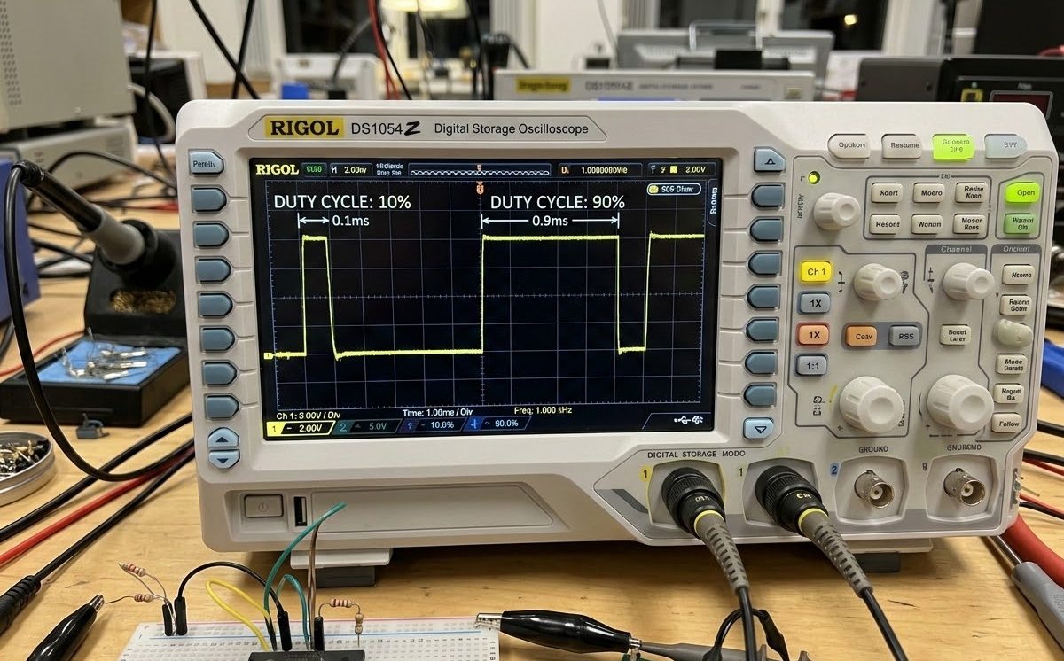
SYS.WORKFLOW // ARDUINO_ROBOTICS // PWM_CONTROL
PULSE WIDTH MODULATION
PWM Governs Motor Speed Through Precise Control of the Average Applied Power Duration.
255
MAX SIGNAL VALUE (ANALOGWRITE RANGE: 0–255)
Controlling the speed of a DC motor requires manipulating the power it receives. Since microcontrollers typically output digital signals (fully on or fully off), we use Pulse Width Modulation (PWM) to simulate a variable analog voltage.
The Speed Relationship: The physical motor speed is directly related to the average duration of the applied power. A longer 'on' time results in higher average voltage and a faster spinning motor.
Core Signal Range: On this hardware, analogWrite defaults to a 0–255 range. To achieve a 50% duty cycle (half speed), the programmed value becomes approximately 128.
Inverted Signal: This robot runs the motor at full speed when the PWM signal is low (0%) and stopped when PWM signal is high (100% = 255). Variable speed is any value inbetween.
FIG 1.0 // OSCILLOSCOPE TRACE OF 10% AND 90% DUTY CYCLES
10% DUTY
90% DUTY
PULSED VOLTAGE APPLICATION
PWM works by rapidly switching the output voltage on and off. The diagram above illustrates pulsed voltage applied to the motor, contrasting a low 10% PWM pulse (mostly on / high speed) with a high 90% PWM pulse (mostly off / low speed).

