Slide 1
Diag_demo
A demo was built to illustrate the power and use of the ROS diagnostic architecture. It simulates a GPS, camera & battery monitor, all emitting diagnostic status. Each HW simulator is a class with a method that's called at 100Hz and given a sinusoidally varying value with a period of about 10 seconds, which it uses to control its faulting behavior. It also demonstrates logging to file & console, and dynamic reconfiguration.
https://github.com/PaulBouchier/diag_demo

Slide 2
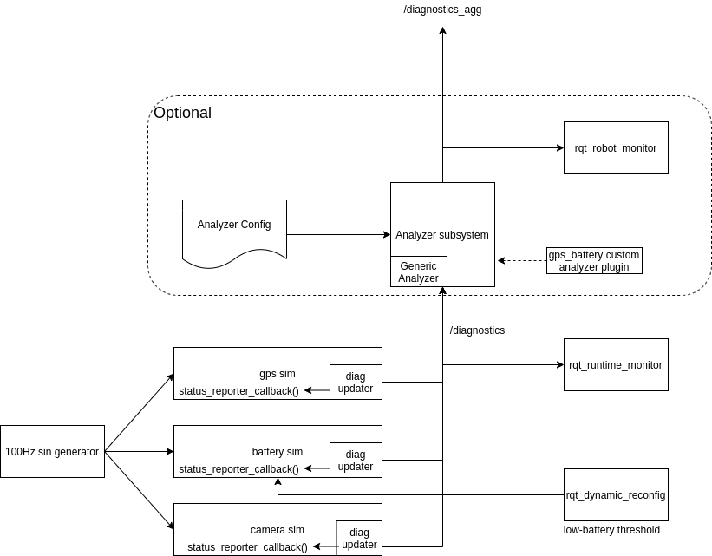

Slide 3
Diag_demo
Overall status, varying in real-time. rqt_robot_monitor
Pop-out details for each monitored item
Table of diagnostic data: rqt_runtime_monitor
Text & ROS_INFO logs collected by the ros master. Display with rqt_console
Dynamically altering log level - rqt_logger_level
Echo /diagnostic & /diagnostic_agg
Graph of ROS nodes: rqt_graph

