Slide 1
Automating Assessment QA
A Modern Approach to Quality Assurance for NAEP
Proof of Concept
Internal Review • 2026

Slide 2
The QA Challenge We Face
What it takes to validate assessment content today
🖱️
👁️
📖
📊
Manual Testing
Visual Inspection
Content Review
Tracking/Reporting
Click through every assessment item in every language, browser, and viewport combination
Manually inspect each screen for layout issues, missing content, and rendering artifacts
Read every line of text looking for spelling errors, homophone misuse, and grammar issues
Track what's been tested in spreadsheets with no centralized visibility or trend analysis
1000s
Multiple
3+
∞
Items to Test
Languages
Browsers
Screen Combinations

Slide 3
The Proposed Solution: Playwright
An industry-leading test automation framework by Microsoft
What Playwright Offers
Sounds Great, Right?
✓ Cross-browser testing (Chrome, Firefox, Safari)
✓ Auto-wait and intelligent selectors
✓ Screenshot & video capture
✓ Network interception and mocking
✓ Parallel test execution
✓ Built-in visual comparison
There's just one problem... Someone has to write the code.
?

Slide 4
What The Team Needs to Learn
Before writing a single test...
💻
📦
🔍
JavaScript
Node.js Ecosystem
CSS Selectors & DOM
Learn the language: variables, functions, async/await, promises, error handling
npm, package.json, module systems, dependency management
Navigate complex DOM trees, iframes, shadow DOM, custom elements
🎭
⌨️
🧪
Playwright API
Command Line
Test Architecture
Page objects, locators, assertions, test fixtures, browser contexts
Terminal operations, env variables, CI/CD pipelines, debugging tools
Page Object Model, helpers, reporters, data-driven testing patterns
⏱ Estimated ramp-up time: weeks to months per team member

Slide 5
A "Simple" Playwright Test
Even a basic test requires significant code knowledge
const { test, expect } = require('@playwright/test');
test('verify assessment item loads correctly', async ({ page }) => {
// Navigate to the assessment platform
await page.goto('https://assessment.example.com');
// Fill login credentials
await page.fill('#username', process.env.USER);
await page.fill('#password', process.env.PASS);
await page.click('button[type="submit"]');
// Wait for dashboard to load
await page.waitForSelector('.assessment-list', { timeout: 30000 });
// Select the assessment form
await page.click('text=Grade 4 Reading');
await page.waitForNavigation();
// Verify the item rendered
const frame = page.frameLocator('#content-frame');
await expect(frame.locator('.item-content')).toBeVisible();
// Take a screenshot for review
await page.screenshot({ path: 'results/item-check.png' });
});
async/await
Every line needs async programming knowledge
CSS Selectors
#username, .assessment-list, button[type='submit']
Iframes
frameLocator for nested content — common source of confusion
Assertions
expect() patterns from Playwright's assertion library

Slide 6
A Real Assessment Test Script
Real-world complexity: PIAAC portal with cascading filters, popups, and nested iframes
const { test } = require('@playwright/test');
const { login } = require('../src/helpers/auth');
const { selectFilters, getItemLinks, openItem,
navigateItemScreens } = require('../src/helpers/piaac');
test('Baseline screenshots — U501-Hiccups', async ({ page }) => {
test.setTimeout(300000); // 5 min timeout
const envConfig = JSON.parse(process.env.SCOUT_ENV_CONFIG);
await login(page, { env: envConfig });
await selectFilters(page, {
version: 'FT New', country: 'ZZZ',
language: 'eng', domain: 'LITNew'
});
const items = await getItemLinks(page);
const targets = items.filter(it =>
it.title?.toLowerCase().includes('u501-hiccups')
);
for (const item of targets) {
const itemPage = await openItem(page, item.itemId); // popup!
await navigateItemScreens(itemPage, envConfig,
async (pg, idx) => { // callback
await pg.waitForLoadState('networkidle');
await pg.screenshot({
path: \`results/\${item.itemId}-screen-\${idx}.png\`,
fullPage: true
});
});
await itemPage.close(); // close popup
}
});
🔧
Helper Libraries
Requires 1,600+ lines of custom helper code across 6 utility modules
🪟
Popup Handling
Items open in new browser windows — need cross-window coordination
🖼️
Iframe Traversal
Content lives inside deeply nested iframes that must be individually discovered
⚙️
Environment Config
JSON config for auth, URLs, CSS selectors — different per deployment

Slide 7
The Reality of Adding An Assessment
6
Weeks
Ongoing
High
Helper Modules
Ramp-up Time
Maintenance
Skill Barrier
1,600+ lines of custom utility code to maintain
Per team member before writing productive tests
Every UI change can break selectors and flows
Requires software engineering expertise from QA staff
If only there was a way to get all the power of Playwright without needing to become a software developer.
There is.

Slide 8
Forget everything on the last 5 slides.
Introducing SCOUT
System for Content-validation, Overlap-detection, and UI Testing
AI-Powered Test Automation for Assessment QA
Describe what to test in plain English. Let AI do the rest.

Slide 9
What SCOUT Does
An all-in-one platform that replaces manual QA with intelligent automation
🤖
⚡
🧠
AI Test Generation
Automated Execution
Intelligent Analysis
Describe tests in plain English. SCOUT's AI Builder writes production-ready Playwright scripts automatically.
One-click test runs across multiple browsers. Screenshots, videos, and traces captured automatically.
AI scans every screenshot and text for spelling, grammar, layout issues, and visual regressions.
No coding required • AI is advisory, humans approve • Environment-scoped access control

Slide 10
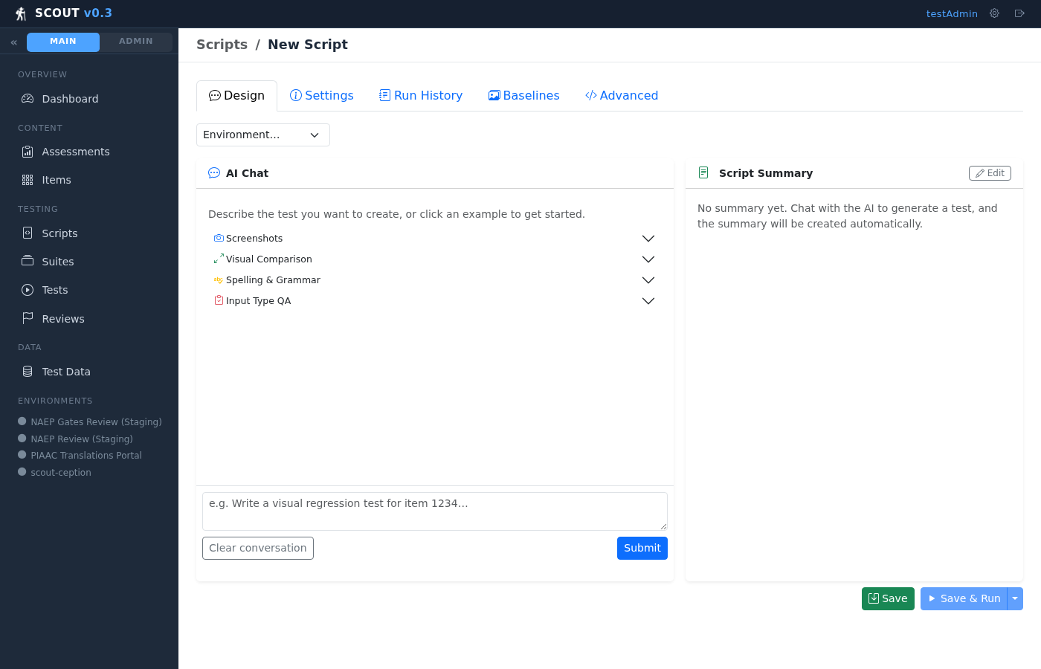
The AI Test Builder
Chat with AI to generate complete Playwright test scripts — no coding required
💬
Natural Language
Describe what you want to test in plain English
🔧
Agentic AI
AI researches existing code, helpers, and items before generating scripts
📝
Live Code Editor
See the generated code in real-time, validate with one click
💾
Save & Register
Save to disk and register in SCOUT with one click

Slide 11
How SCOUT Works
From plain-language description to verified results in minutes
1
2
3
4
5
6
Describe
Generate
Organize
Execute
Analyze
Review
Tell AI what to test
AI writes the Playwright script
Group scripts into suites
One-click run across browsers
AI inspects results
Humans triage AI findings
The Old Way
The SCOUT Way
✗ Learn JavaScript & Playwright API
✗ Write hundreds of lines of code
✗ Debug complex async test failures
✗ Manually review every screenshot
✓ "Write a visual regression test for item VH123456"
✓ Click Run — tests execute automatically
✓ AI analyzes screenshots & text for issues
✓ Review only what AI flags — approve or dismiss

Slide 12
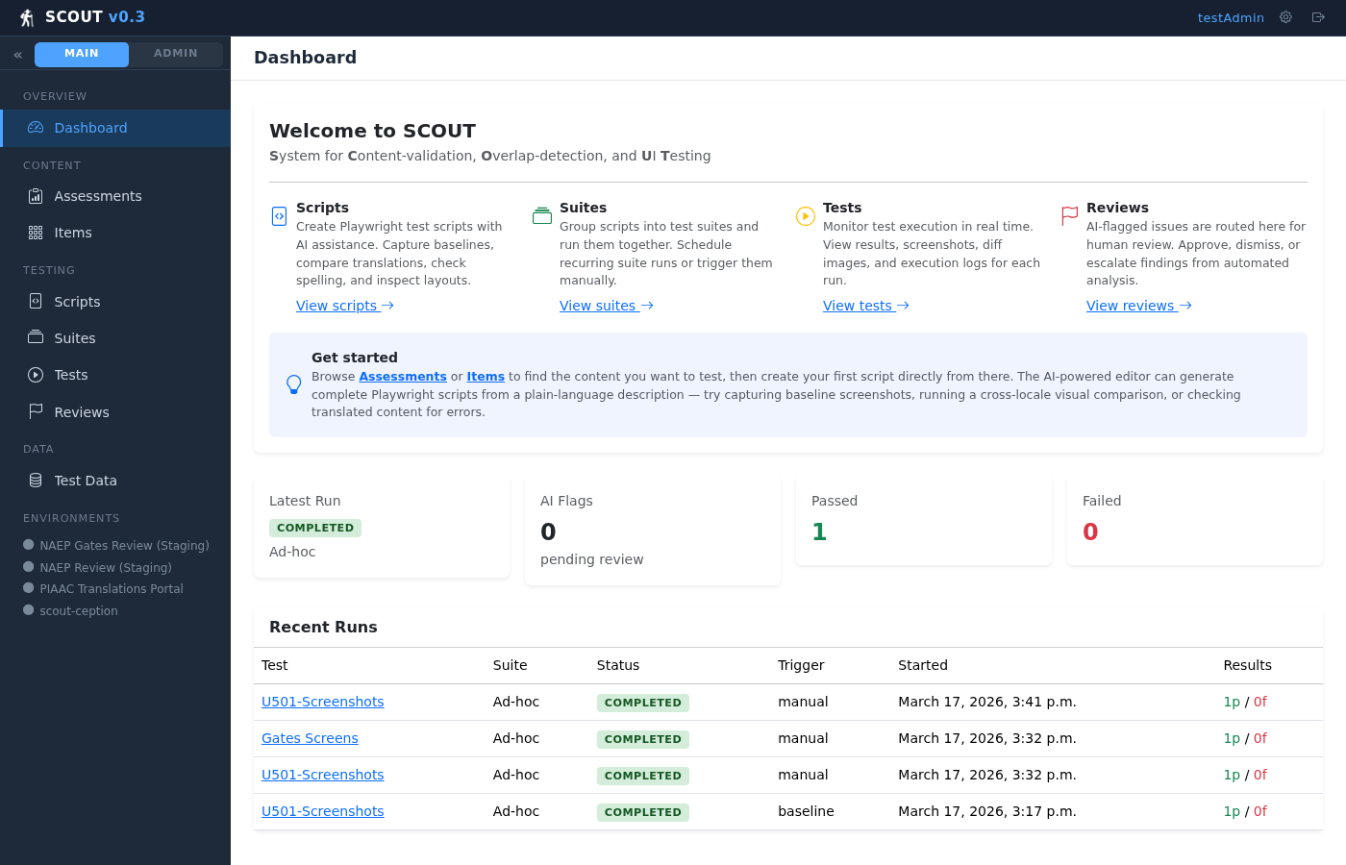
Centralized Dashboard
Everything your team needs at a glance
📊
Run Status
Latest run results at a glance
🚩
AI Flags
Pending items needing review
📈
Trends
Pass/fail tracking over time
🔗
Quick Links
Jump to scripts, suites, and runs

Slide 13
AI-Powered Analysis
Every test result is automatically analyzed by AI — catching what humans miss
📝 Text Analysis
👁️ Visual Analysis
● Spelling errors across all languages
● Homophone misuse (there/their/they're)
● Grammar and punctuation issues
● Missing or truncated content
● Character encoding problems
● Layout and rendering issues
● Missing or broken images
● Text readability & contrast
● Pixel-diff baseline comparison
● Cross-browser visual regressions
🛡️ AI is advisory, not autonomous — every flag requires human approval before action

Slide 14
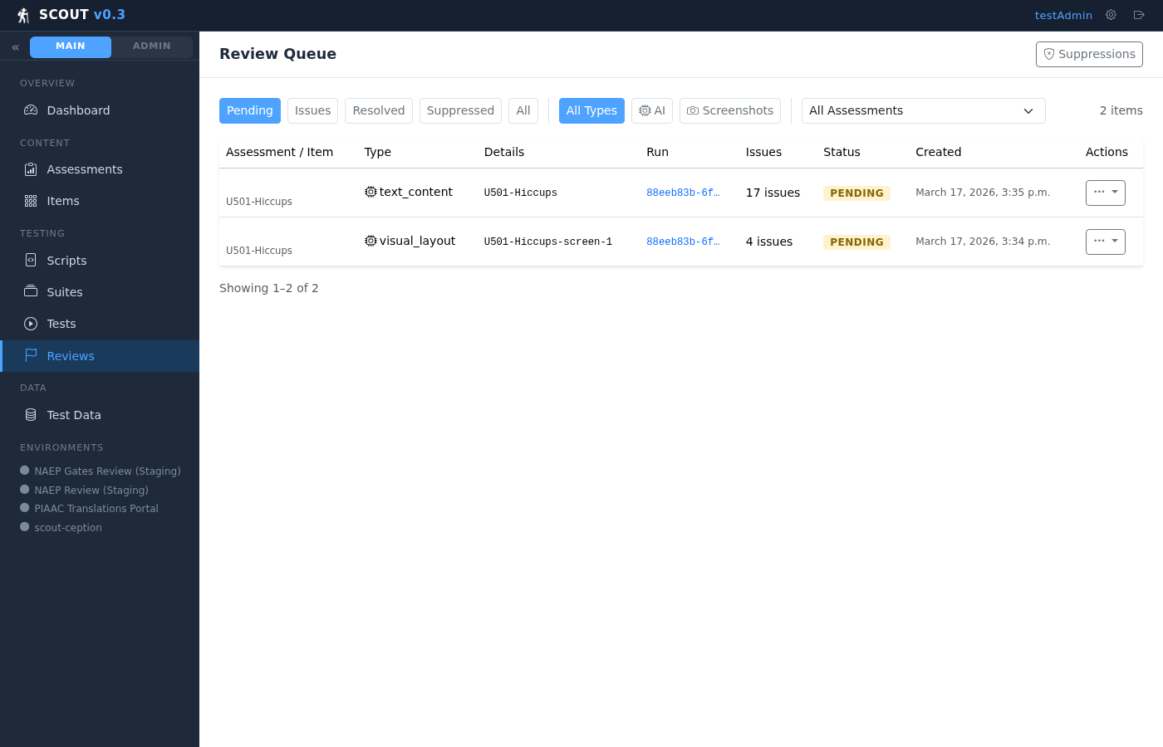
Human Review Queue
AI flags potential issues — humans make the final call
✅
Mark as Issue
Confirm the AI finding as a real problem
🔇
Suppress
Dismiss and auto-suppress future occurrences
✔️
Resolve
Mark a confirmed issue as fixed
↩️
Return
Send back to pending for re-review

Slide 15
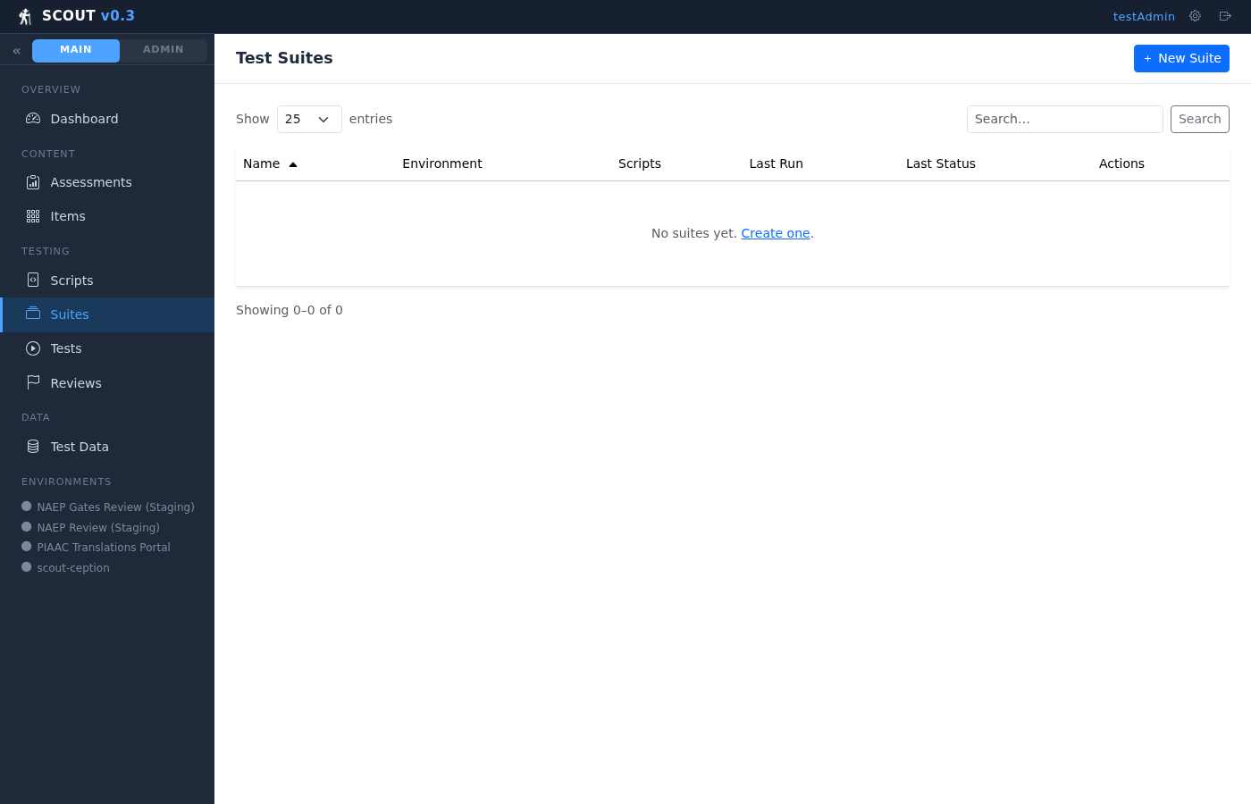

Test Organization & Execution
Group scripts into suites, run with one click, track all results
Test Suites
Test Runs & Results
📦 Group scripts into reusable suites
🎯 Target specific environments & browsers
▶️ One-click execution for entire suites
📸 Screenshots, videos & trace files
⏱️ Per-script timing and status
🔄 Real-time status updates

Slide 16
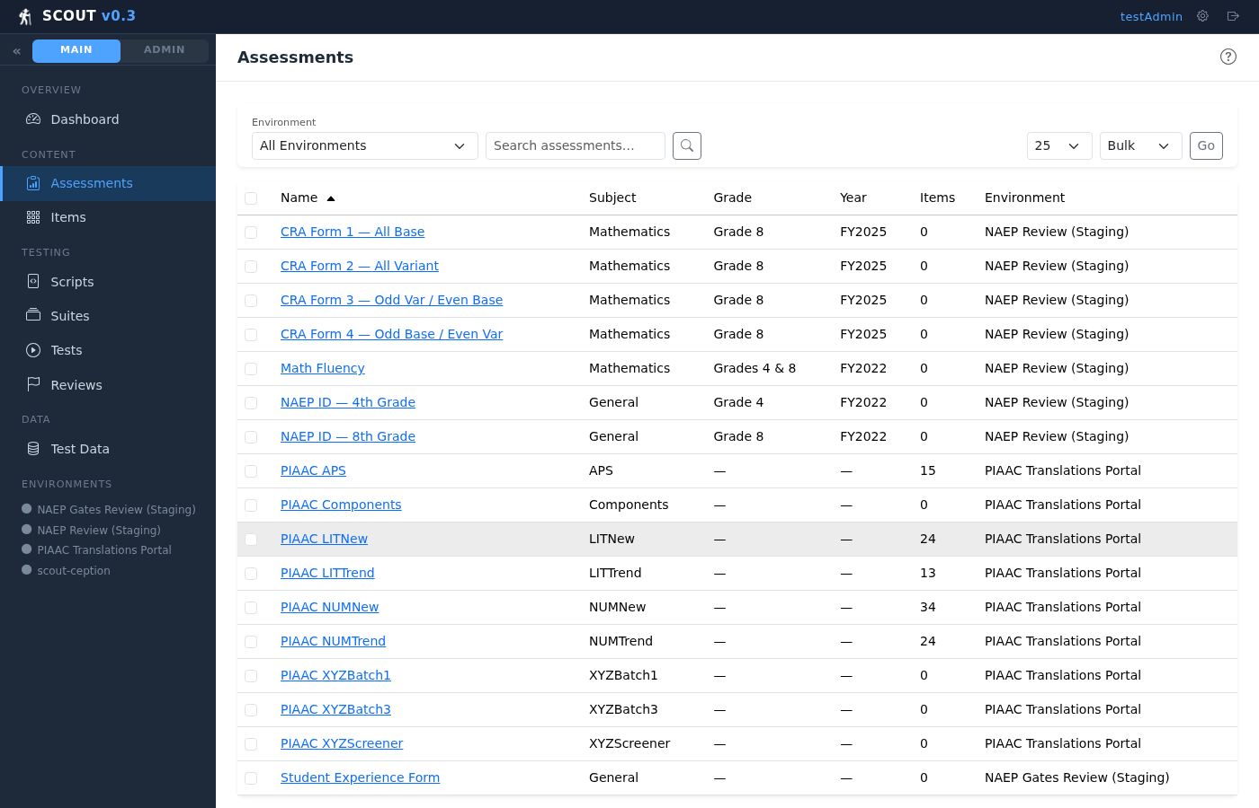

Assessment & Item Management
Full inventory of assessments and items with linked test scripts
Assessments
Items
📋 Full assessment metadata & item counts
🔗 Direct links to associated test scripts
➕ Create new scripts from any item
🌍 Multi-language support per item
🏷️ Categories, tiers, and metadata
📊 Linked scripts show test coverage

Slide 17
Under the Hood
Simple three-process architecture — no complex infrastructure required
🌐 Web Server
⚙️ Task Worker
🗄️ PostgreSQL
Django views, API Dashboard, Builder UI
Playwright execution AI analysis pipeline
App data + task queue No Redis needed
🎭 Playwright
🤖 AI Providers
📡 REST API
🐳 Docker
Cross-browser test execution engine
Azure OpenAI, Anthropic Ollama, OpenRouter
External integrations CI/CD pipelines
Containerized deployment
Flexible AI: Each feature (Builder, Text Analysis, Vision) can use a different AI provider Swap between Azure OpenAI, Anthropic Claude, local Ollama, or any OpenAI-compatible endpoint

Slide 18
Security & Access Control
Environment-scoped RBAC ensures teams only see their own data
🔐
Environment Scoping
👥
Role-Based Access
Users are assigned to specific environments. They can only see assessments, items, runs, and reviews within their scope.
Admin and standard user roles. Admins manage environments, AI config, and user accounts. Standard users run tests and review.
🔑
API Authentication
🛡️
Audit Trail
REST API uses client keys with per-client rate limits, environment scoping, and usage logging for external integrations.
All AI analysis results, review decisions, and suppression rules are tracked with timestamps and user attribution.

Slide 19
Why SCOUT?
🚀
🧠
⚡
No Coding Required
AI Catches What We Miss
Faster QA Cycles
QA staff describe tests in plain English. AI generates production-ready scripts.
Automated spelling, grammar, and visual analysis across every language and screen.
From hours of manual clicking to automated runs that complete in minutes.
📊
🔄
🔒
Centralized Visibility
Consistent & Repeatable
Enterprise Ready
All results, screenshots, and AI findings in one place — no more spreadsheets.
Same tests, same criteria, every time. No human variability or fatigue.
Environment-scoped access, API keys, Docker deployment, flexible AI providers.
SCOUT: Let AI handle the complexity so your team can focus on quality.

Slide 20
Ready to Get Started?
🔍 Live demo walkthrough with your team
🧪 Pilot program — pick one assessment to automate
📖 Training session — 30 minutes to get your first test running
🚀 Phased rollout — expand to additional assessments
SCOUT • Every pixel, every word, every time

