Slide 1
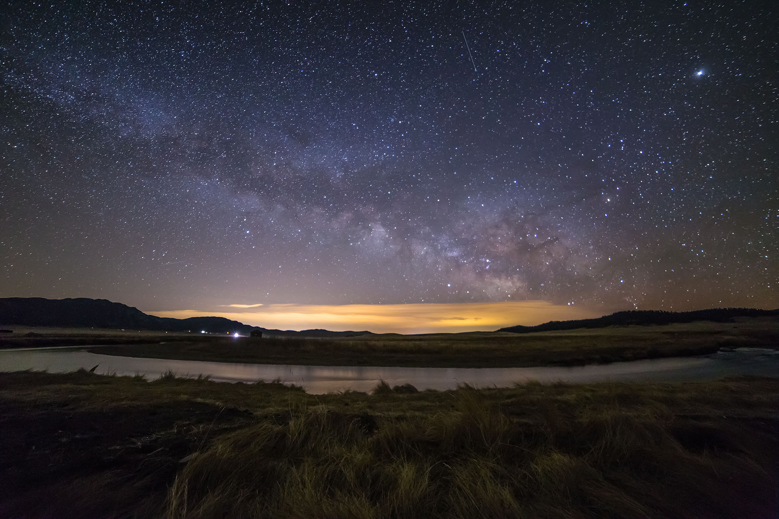
Paul Byrne Portfolio Presentation

Slide 2
Run through of Portfolio website and features-
Home Page
Projects Page
Bio Page
Contacts page
Paul Byrne Portfolio

Slide 3
Design Process and decisions
Chose background
Picked colour Scheme
Created Moodboard
Photoshoot
Coded Project

Slide 4
Review of Dev/build and challenges
Keeping the hover system to work due to it having to be connected to certain code to keep functional
Getting grid set up on projects page
Getting images to be the right size for background and hover images
Getting the margins and padding right for all pages
Favourite parts would be getting the hover on the home page working and bringing the project to life

