Slide 1
ALTEGRAD Project Presentation:
Cellular Component Ontology Prediction
CECCHINI Alessandro
CHAUVIN Paul
LOISEAU Thibaut
January 26th 2023

Slide 2
1. Introduction
Proteins are essential biomolecules that play important roles in living organisms, including acting as enzymes and providing structural support.
The structure of proteins is determined by the sequence of amino acids, which fold to form a 3D structure that determines their specific chemical functionality, but the exact details of this process are not yet fully understood.
We propose to study and apply machine learning/deep learning techniques to classify 6k+ proteins into 18 different classes, each representing a characteristic of a protein
Two different types of models where implemented: sequence based and structure based models will be used for the classification task

Slide 3
2.1. Methodology - Data Used
This project aims to classify a dataset of 6,111 proteins into 18 different classes, each representing a characteristic of the protein.
Some of the proteins are labeled (4888) while others are not (1223).
For sequence based models, we used the sequence of each protein and the labels associated.
For structure based models, we used edges, attributes of the edges, attributes of the nodes, graph indicators and labels for the proteins
The goal of the project is to predict the class label of proteins that have not been labeled.

Slide 4
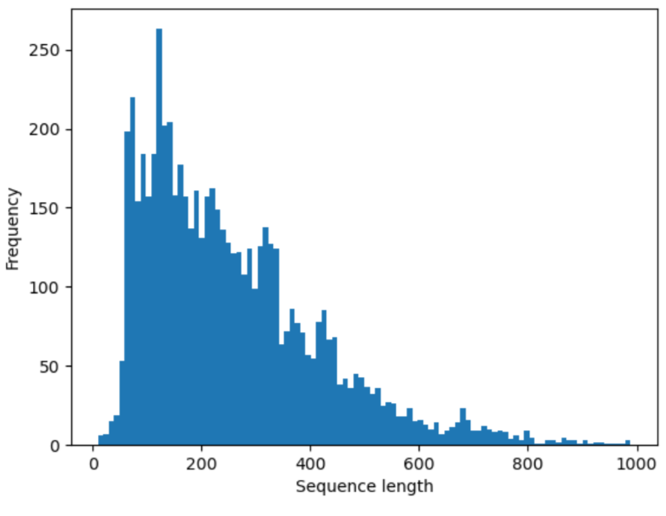
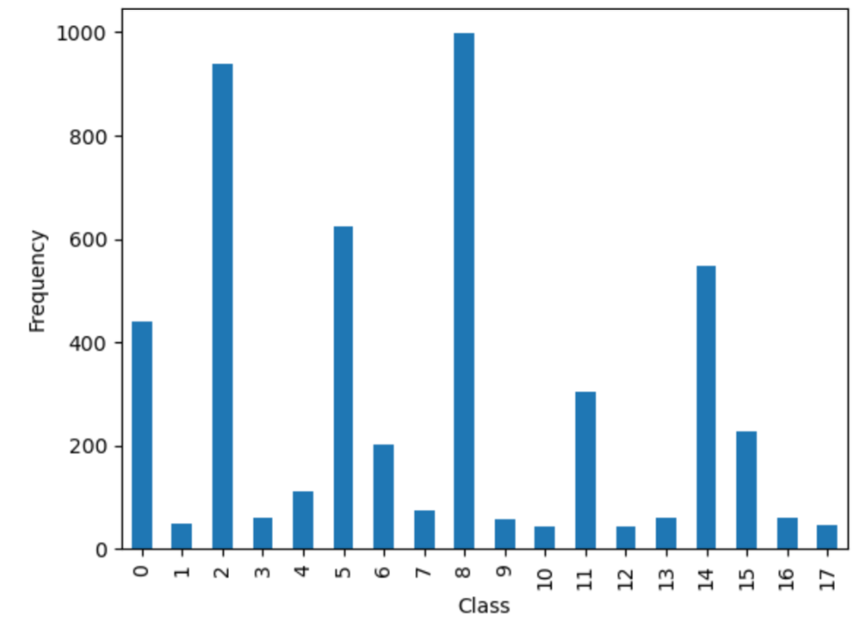
2.2. Methodology - Data Analysis
For sequence base models, we will use a sequence length of 512.
We will also change the sampling method during training by taking a weighted random sampler to get an evenly distributed dataset.
Distribution of the sequence length over training and testing set
Distribution of the number of examples per class over training set

Slide 5
2.3. Methodology - Sequence based models
1. Modifications made on the sequence baseline
Modify the number of n-grams:
Trying with 3 to 7 n-grams taken into account => decrease of the performances
Modify the classifier used in the sequence baseline
Initially: Logistic regression
Change using Support Vector Machine
Change using Decision Tree

Slide 6
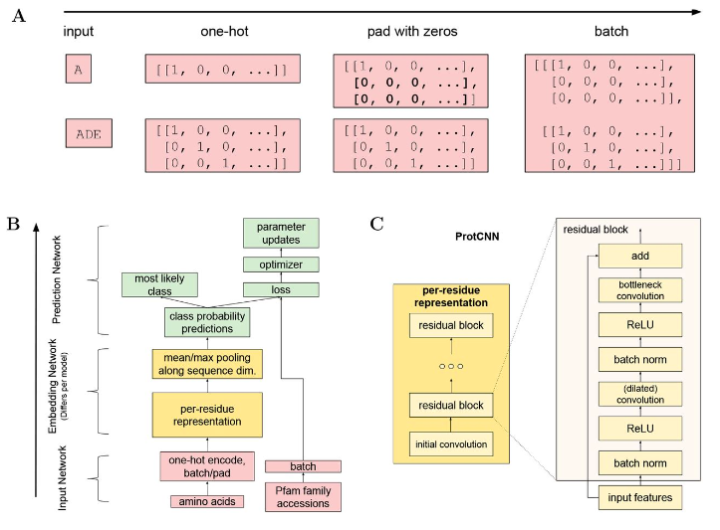
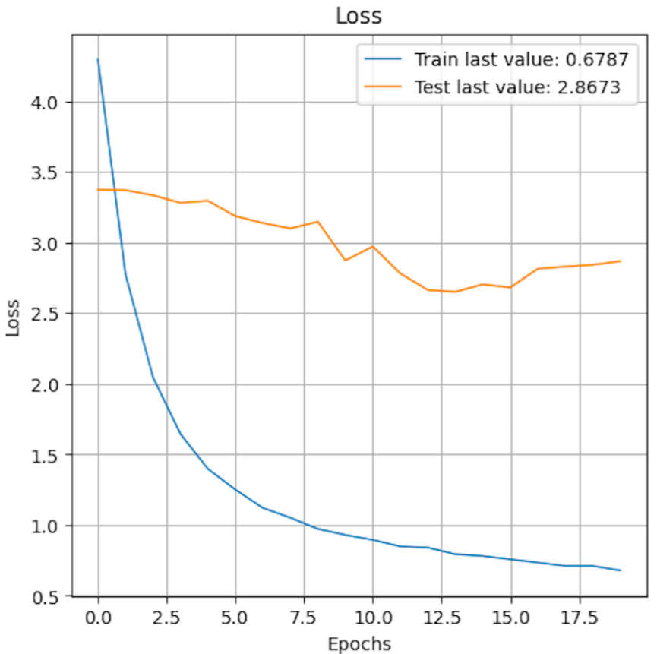
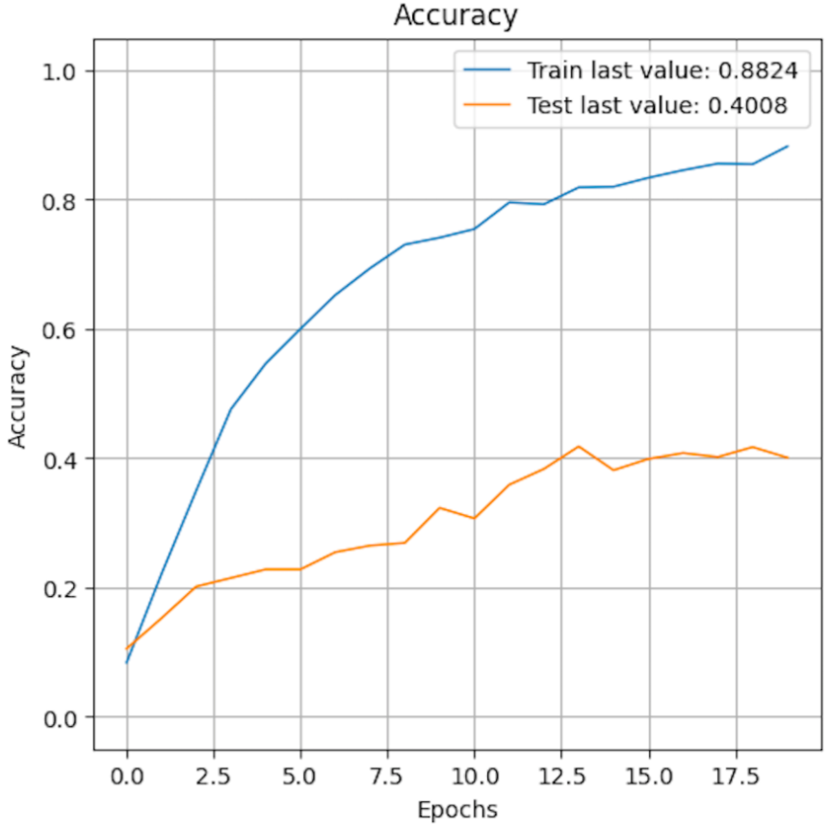
2.3. Methodology - Sequence based models
2. Protein Computational Neural Network (ProtCNN)
Problem: overfitting
Added cross validation (Kfold =5)
Added class weight
Intended up/downsampling
Added more regularization
Early Stopping

Slide 7
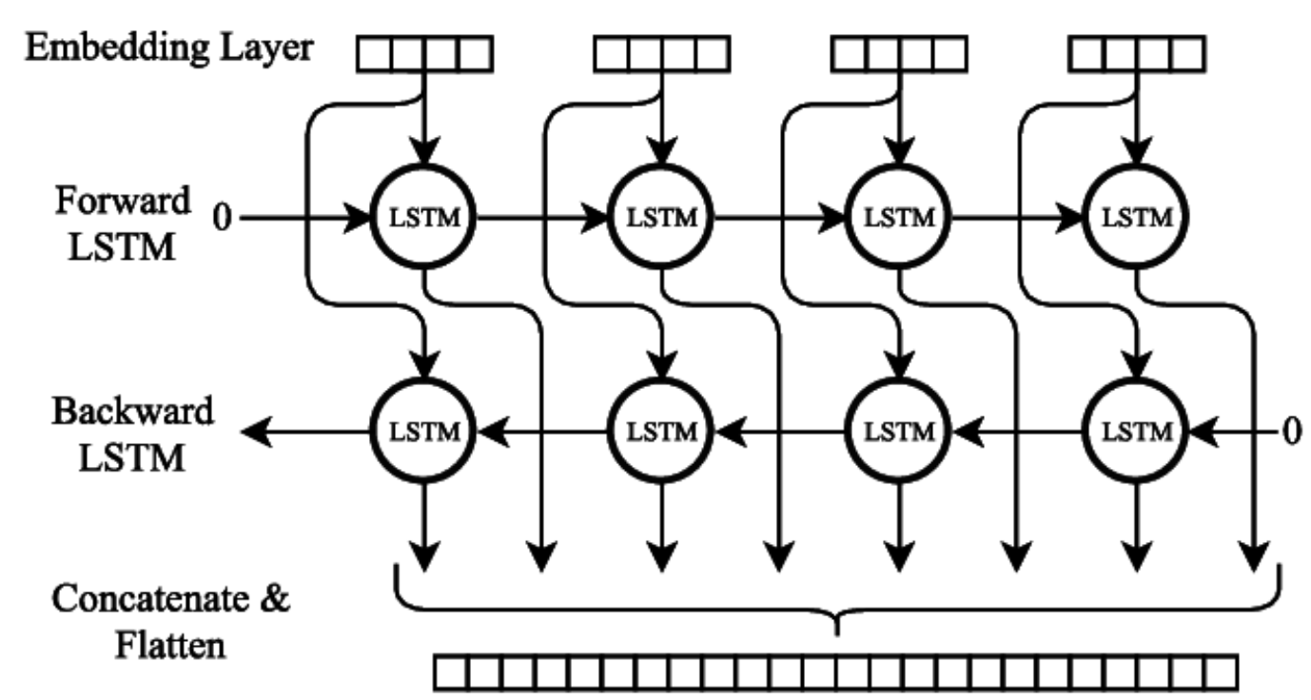
2.3. Methodology - Sequence based models
3. Bidirectional Long Short Term Memory (BiLSTM)
Problem: overfitting
Added cross validation (Kfold =5)
Added class weight
Intended up/downsampling
Added more regularization
Early Stopping
Added dropout
Notes:
creates a new bidirectional LSTM model, compiles it and fit the model with training data, using Early stopping callback.
It then evaluates the model on the validation set, and appends the validation score to the list of validation scores.
It starts with an Input layer, which defines the shape of the input data.
Then, an Embedding layer is used to convert the input data into a dense vector representation.
This allows the model to learn a dense, low-dimensional representation of the input data that is more suitable for the LSTM layer.
The Embedding layer is followed by a Bidirectional layer wrapped around an LSTM layer.
The LSTM layer is a type of recurrent neural network that is able to process sequential data by maintaining an internal state.
The Bidirectional layer allows the LSTM layer to process the input data in both forward and backward directions.
After the bidirectional LSTM layer, there is a Dropout layer which helps to prevent overfitting by randomly dropping out some of the units during training.
Finally, there is a Dense layer with 18 units and a 'softmax' activation function, which is used to classify the input data into 18 different locations.
The model is then compiled with 'adam' optimizer and 'categorical_crossentropy' loss.
It's also balanced the class weight, by using the compute_class_weight function, which helps to handle class imbalance problem.

Slide 8
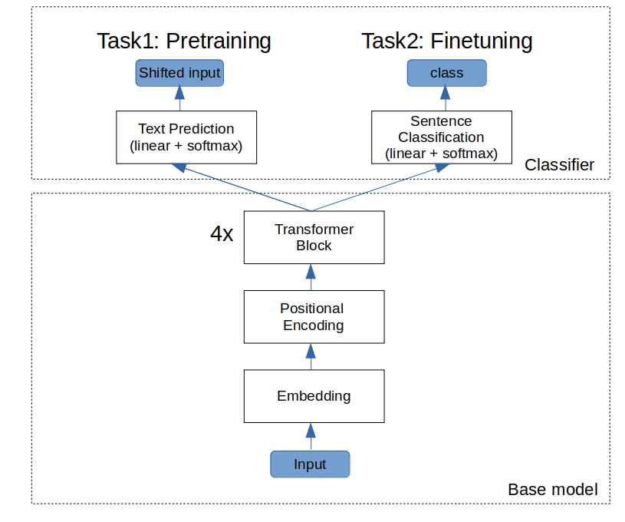
2.3. Methodology - Sequence based models
4. Fine-tuning pretrained models (Transfer Learning)
Use a ProtBERT pretrained model on BFD dataset (2.1 billion sequences).
Adding a classifier head automatically with Hugging Face AutoModelForClassification.
Freezing the pretrained model.
Using a starting learning rate of 10⁻³ with a decay of 10 every 5 epochs. We train for 25 epochs.
https://huggingface.co/Rostlab/prot_bert_bfd

Slide 9
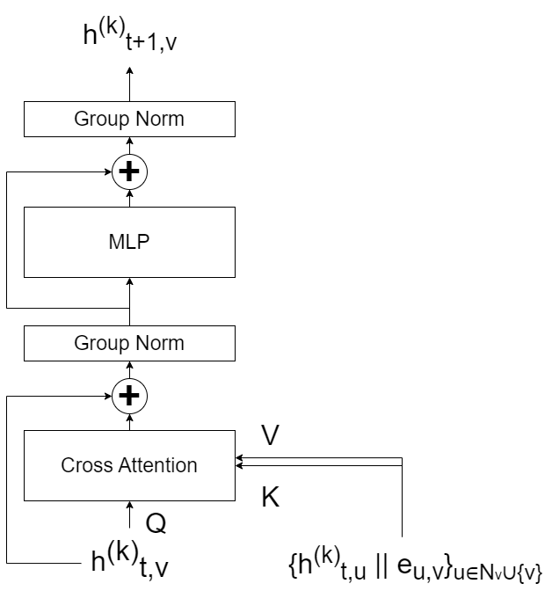

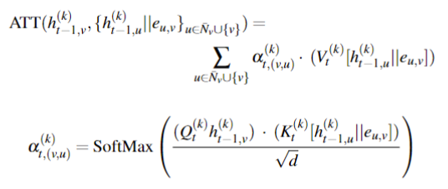


2.4. Methodology - Structure based models
Model
K Transformer blocks.
T Transformer encoder layers.
Input : [B, L+1, NF+NE]

Slide 10
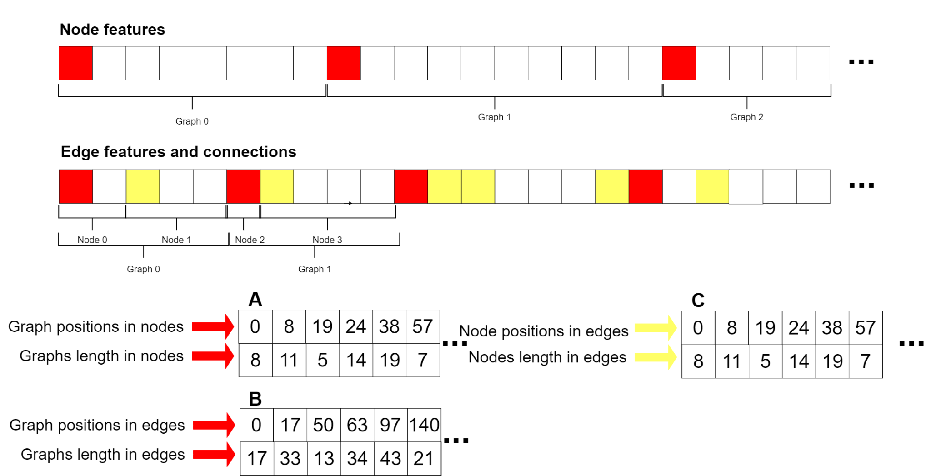
2.4. Methodology - Structure based models
Preprocessing

Slide 11
2.4. Methodology - Structure based models
Preprocessing
We construct an array D of size [E,K,|V|,L] = [Epochs, n_blocks, n_nodes, n_neighbors],
B[:, :, v, :] is a tensor with entries sampled U{0, …, B[v,1]}, where B[v,1]} represents the number of neighbors of node v.
We add D[...] + B[:,0] to obtain the positions of the generated node neighbors in the edge features and connections array. We access the values of the edge connections array for these indices and obtain the neighbors’ node positions in node features.
To create a batch, we shuffle [A, B, C], and concatenate sequentially graphs until the total number nodes in the batch overpass the max batch node length. We need to update the positions of graphs in sliced A and B arrays and nodes in sliced C array relative to the starting graph and node in the batch.
A batch is composed of the node and edge features, the updated sliced array A B graphs positions in node and edge features, and the updated sliced array C of nodes positions in edge features and edge connections, the sequence of labels corresponding to the graph found in the batch, the neighbors position list in nodes features and edge features for all nodes in the batch and blocks in the model.

Slide 12
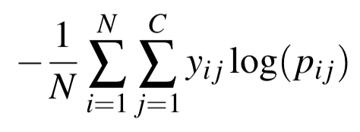
3.1. Results - Metrics used
Multi-class log: Mainly focused on as it is the one used in kaggle
Accuracy: In order to have a more concrete idea of what we were predicting

Slide 13
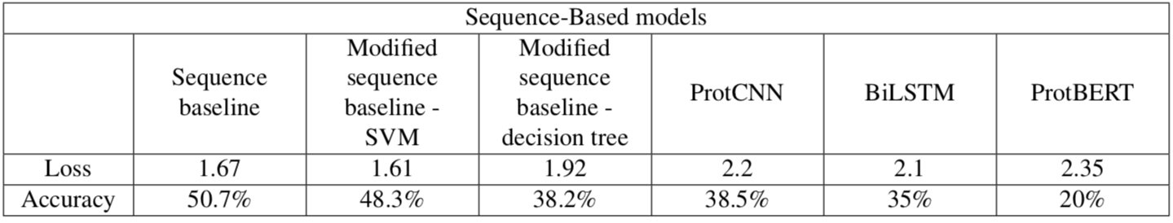
3.2. Results - On sequence-based models

Slide 14
4. Conclusion
We tried several methods for sequence and structure based models.
We didn’t manage to beat largely the sequence baseline (only a very low increase of performances with SVM classifier)
We think that our poor results mainly come from the sampling of the data.

Slide 15
5. References
[1] Maxwell L. Bileschi, David Belanger, Drew Bryant, Theo Sanderson, Brandon Carter, D. Sculley, Mark A. DePristo, and Lucy J. Colwell. Using deep learning to annotate the protein universe. May 2019.
[2] Protein sequence classification (2022). https://deepnote.com/@ronakv/protein-sequence-classification- 33797a33-7311-48d3-8794-79a1ee26f406.
[3] Ahmed Elnaggar, Michael Heinzinger, Christian Dallago, Ghalia Re- hawi, Yu Wang, Llion Jones, Tom Gibbs, Tamas Feher, Christoph An- gerer, Martin Steinegger, DEBSINDHU BHOWMIK, and Burkhard Rost. Prottrans: Towards cracking the language of life’s code through self-supervised deep learning and high performance comput- ing. bioRxiv, 2020.
[4] Dai Quoc Nguyen, Tu Dinh Nguyen, and Dinh Phung. Universal graph transformer self-attention networks, 2019.

