Slide 1
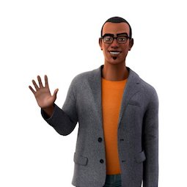
Hello there ! Let’s build a Virtual Concierge.

Slide 2
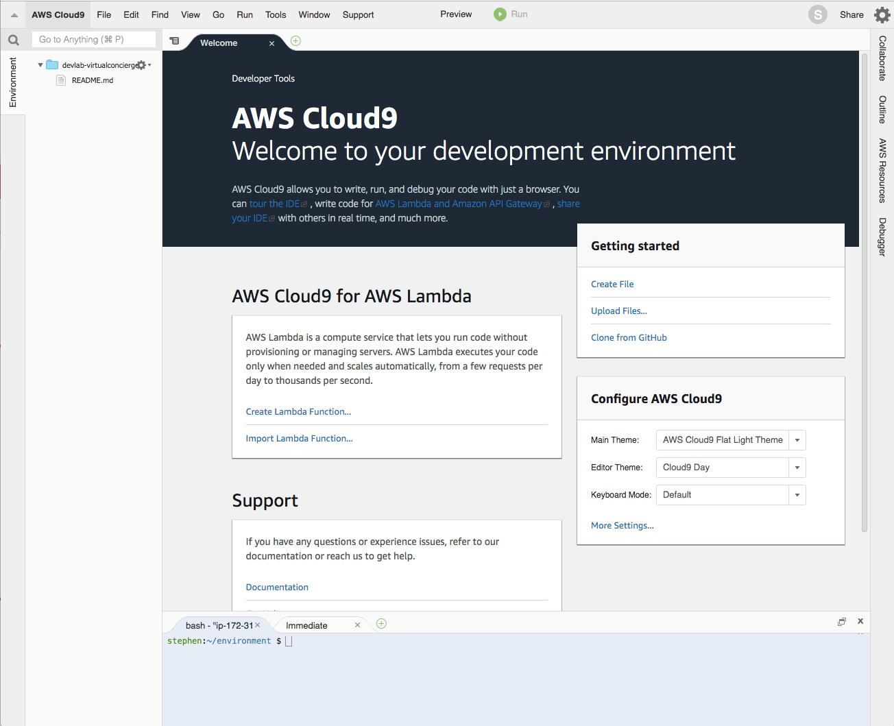
Folder & Files structure.
Text editor area.
Terminal Console ( AWS CLI already installed ).

Slide 3
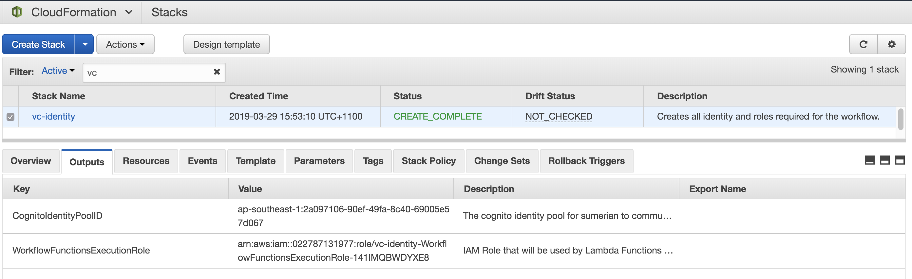
This will be the IAM role that will be used by lambda functions and other services in the workflow
This will be the Cognito Identity pool Sumerian environment will use to access the rest of the system

Slide 4
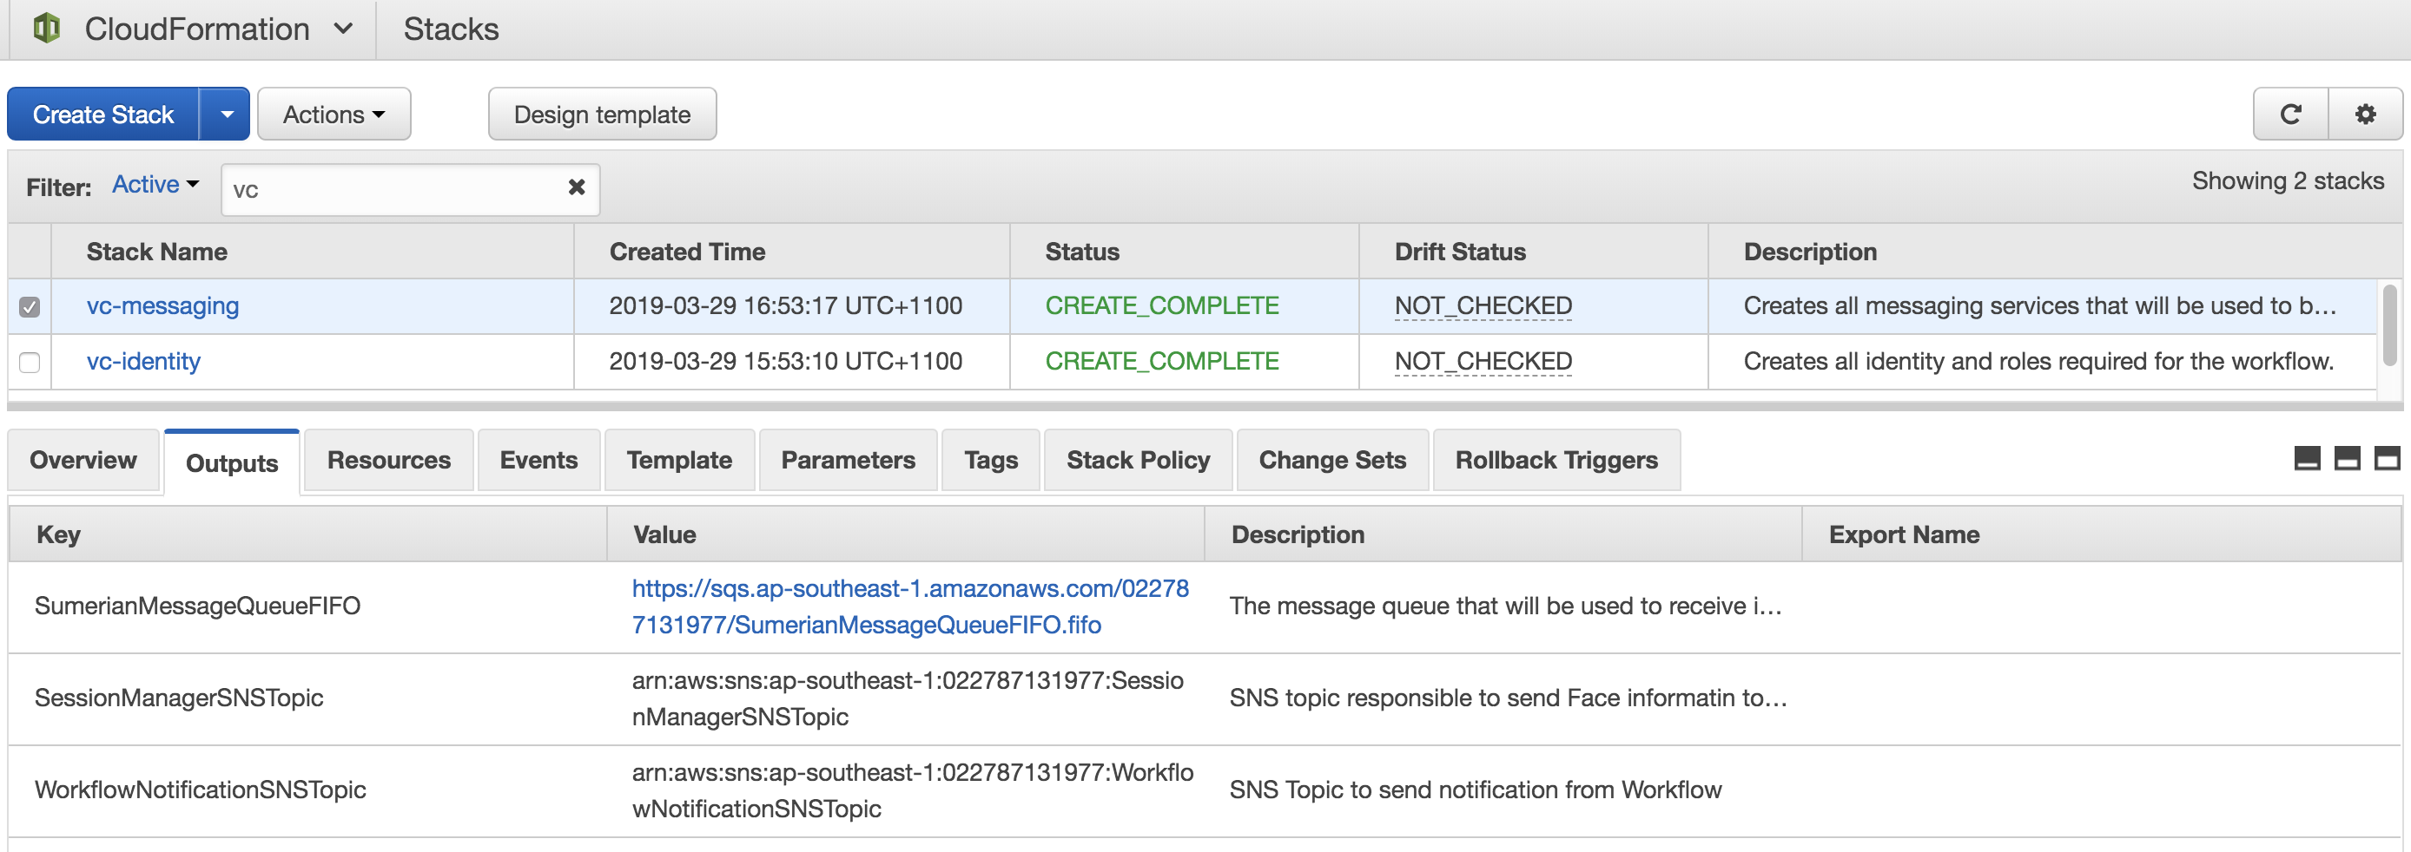
This will be the SQS Queue used to send instructions to Amazon Sumerian.
This will be the SNS Topic Interfacing the workflow from the face recognition mechanism.
This will be the SNS Topic for our workflow to send out notification to the host, of guest arrival.

Slide 5
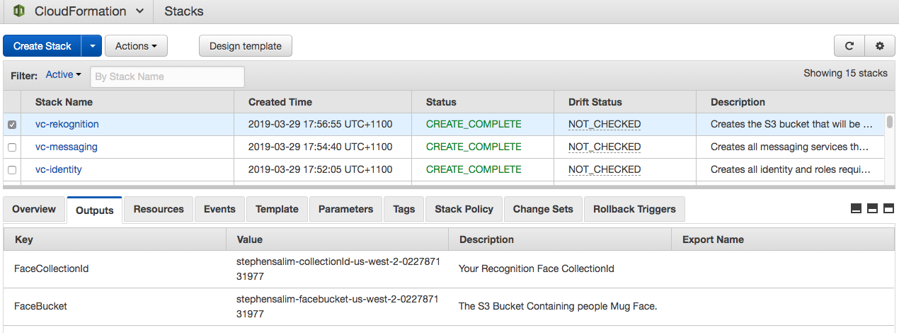
This will be Amazon Rekognition Face Collection to index visitor face .
This will be the S3 bucket to store visitor profile face.

Slide 6
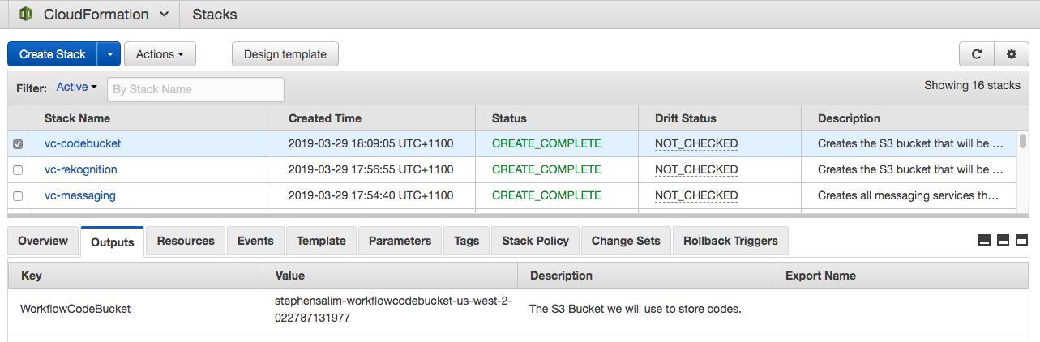
This will S3 Bucket where we will put all our workflow codes.

Slide 7
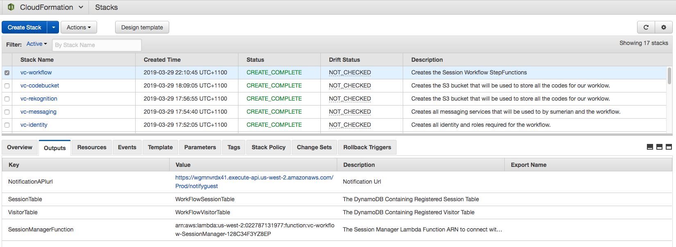
This is the API gateway URL for external entity to send a response back to the workflow.
This is the DynamoDB table containing Session Information.
This is the DynamoDB table containing Visitor Information.
This is the Session Manager Lambda function responsible in managing the session, this will have to be attached to the SNS topic for the workflow to start receiving event.

Slide 8
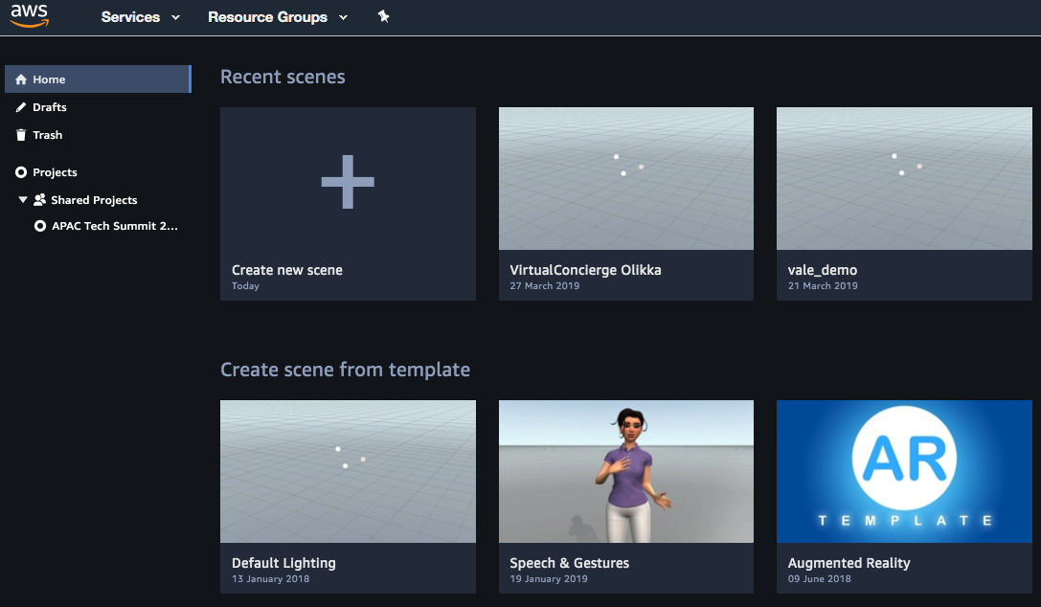
Click here to Create new scene

Slide 9
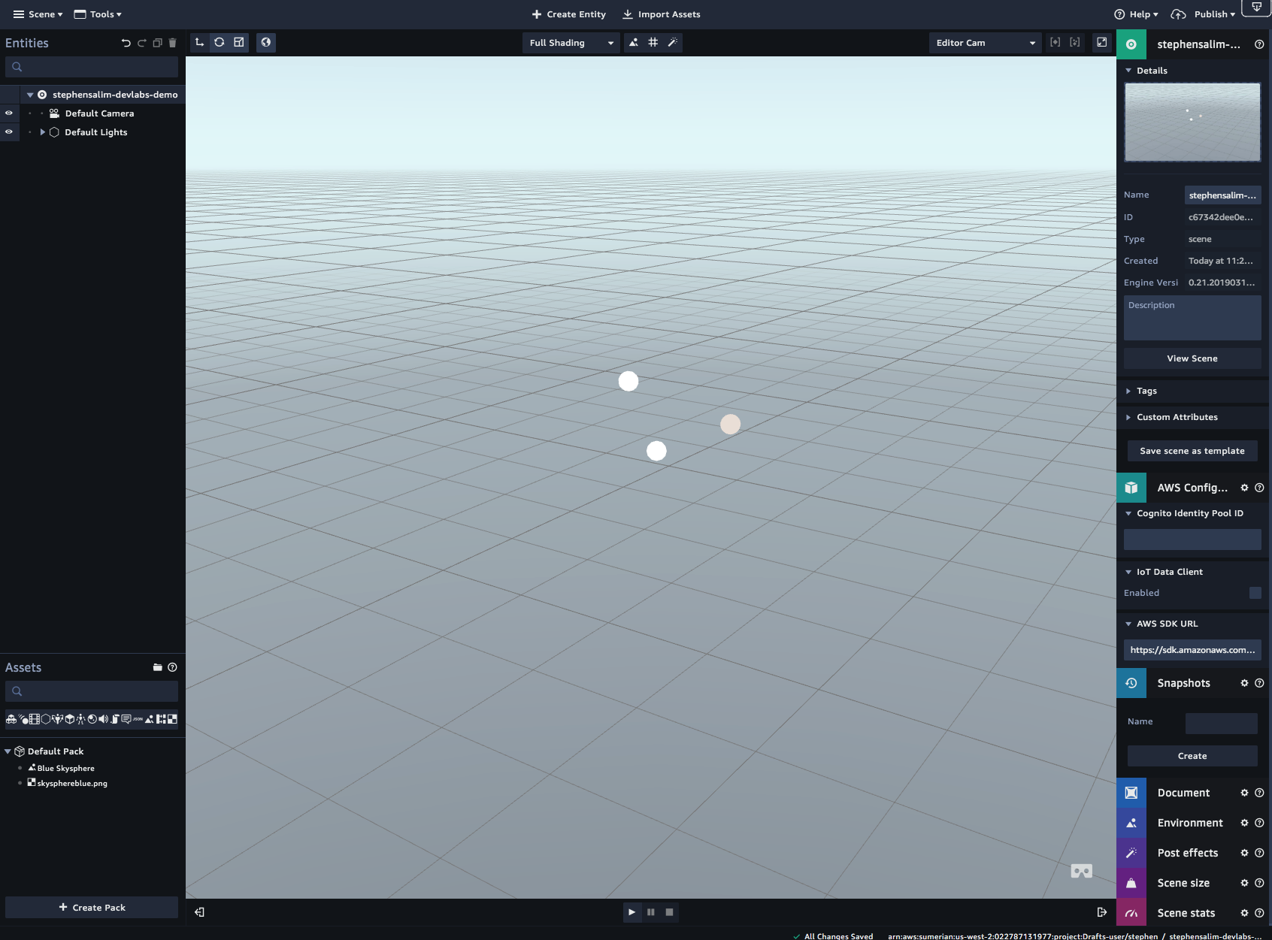

Slide 10
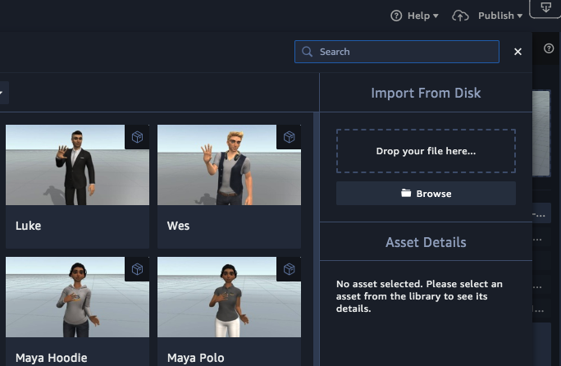

Slide 11
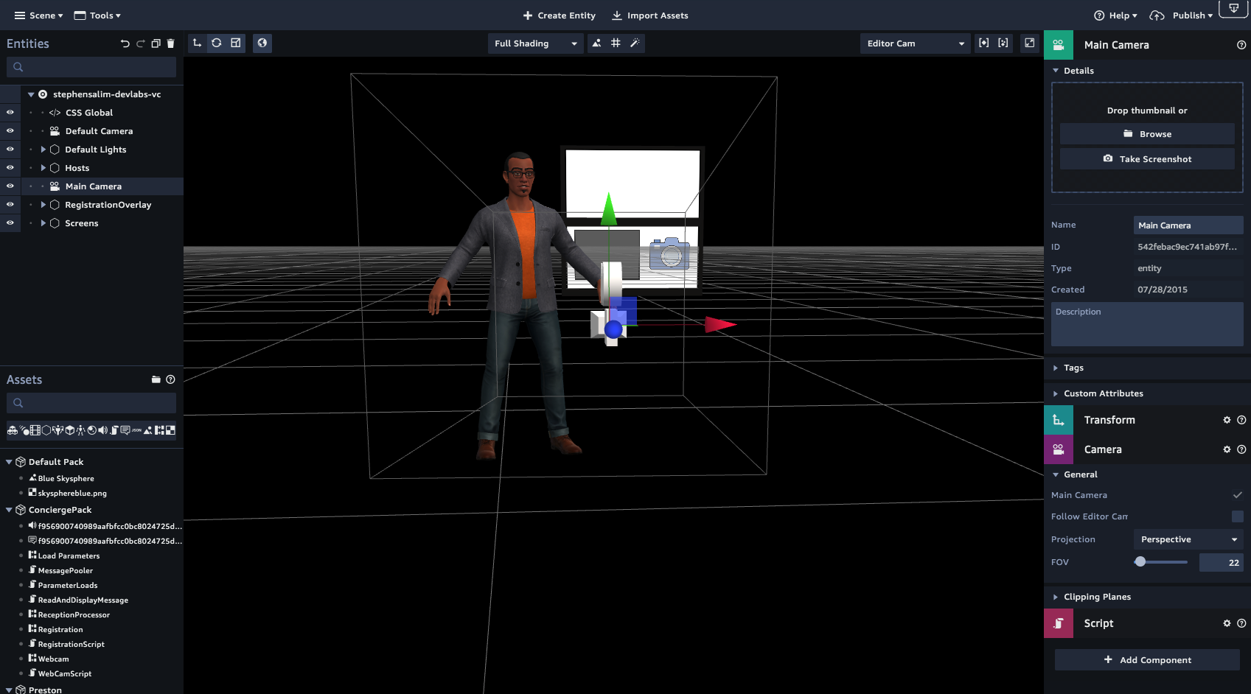

Slide 13
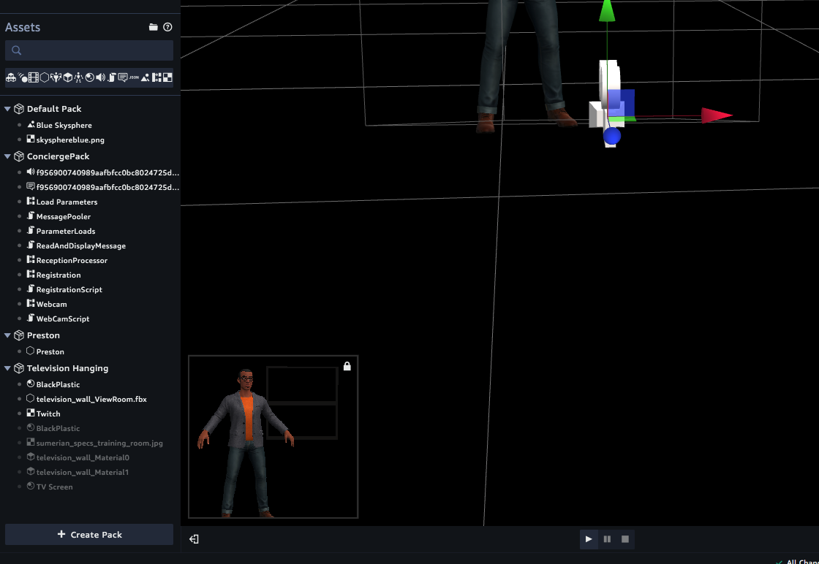
Click Play

