Slide 1
Doodle Easy scheduling
Worked through usage of Doodle for event scheduling.

Slide 2
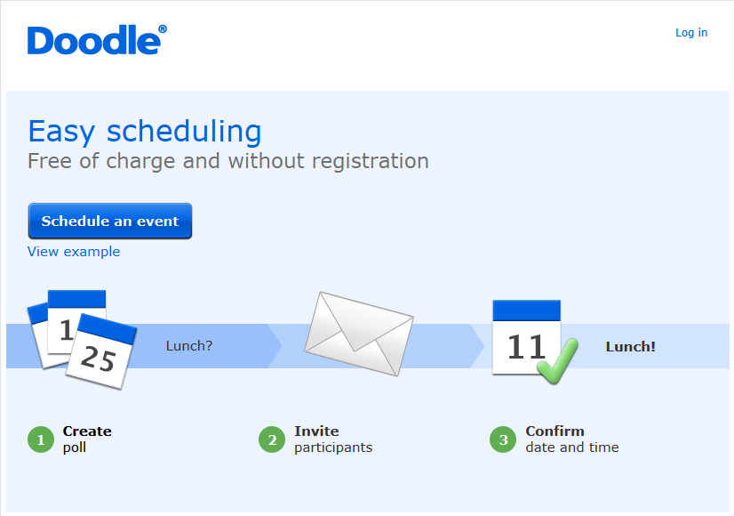
Initial steps
Login is not necessary to schedule an event.
Must login if you want to use “MeetMe” profile.
Can use existing gmail/facebook/twitter account etc.

Slide 3
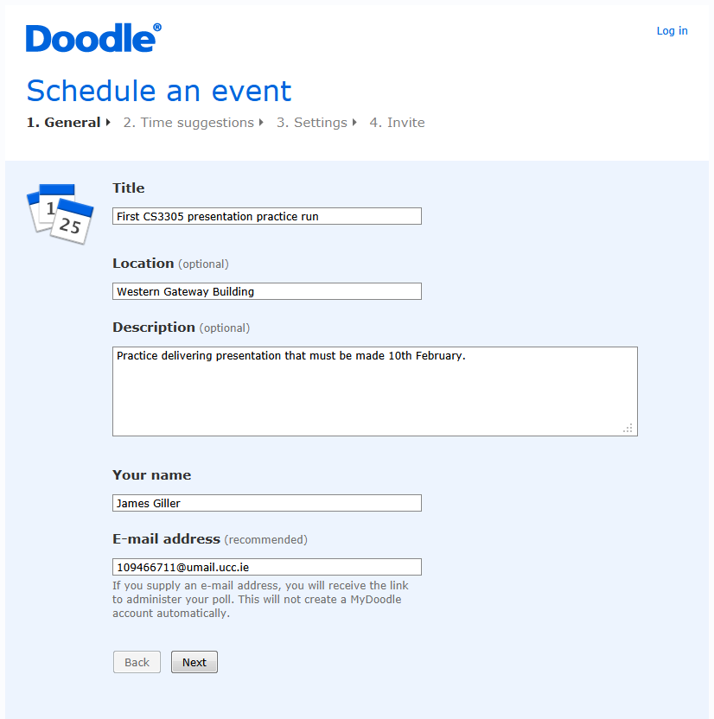
Scheduling an event – No login
Give basic details of event.
Title, Location, Description, Organiser’s name.
Email address to receive participate and administer links.

Slide 4
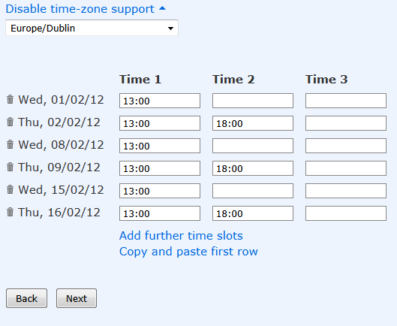
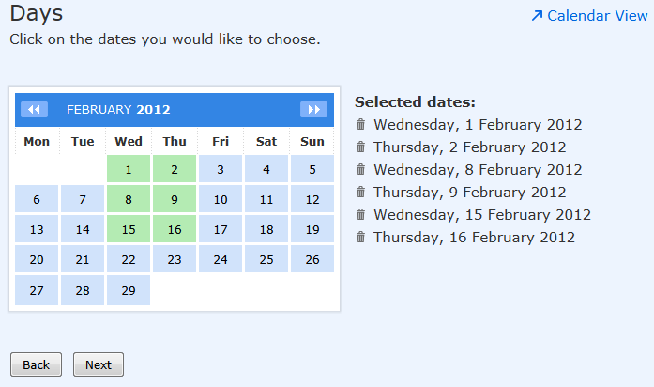
Dates & times
Use calendar interface
Enter times of day

Slide 5
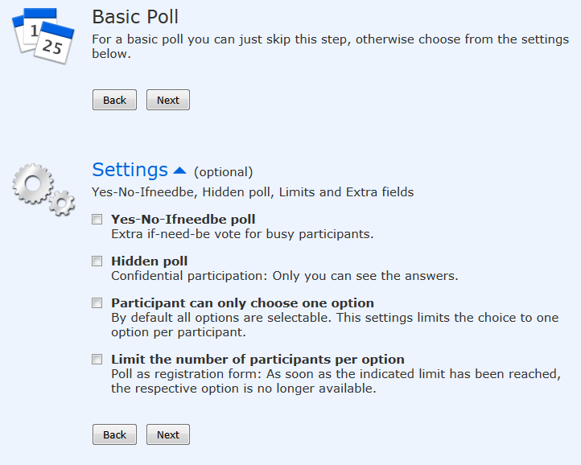
Poll settings
Use basic poll or extra settings.
Extra settings modify options available to participators for making choices.
Premium Doodle (cost) provides option to request contact info from guests.

Slide 6
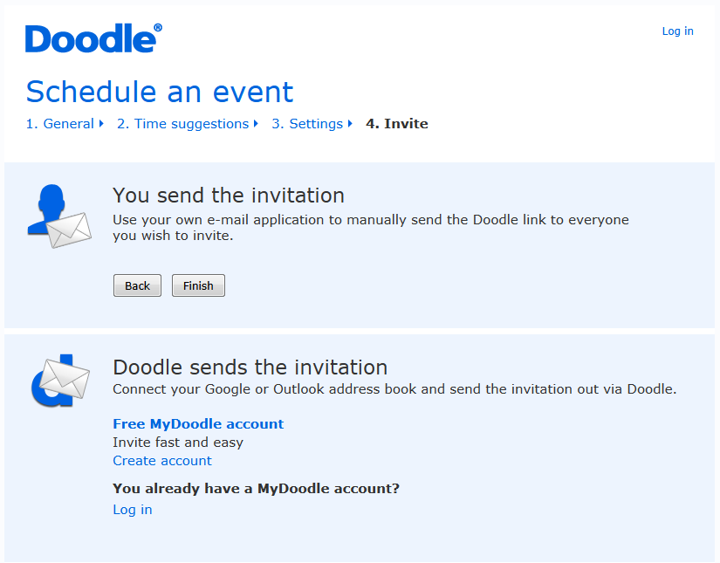
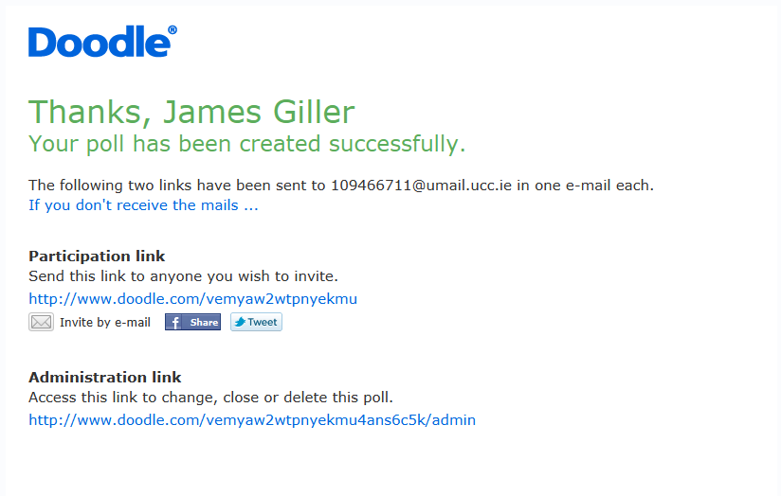
Inviting guests
Choose how to invite
Manual invite option

Slide 7
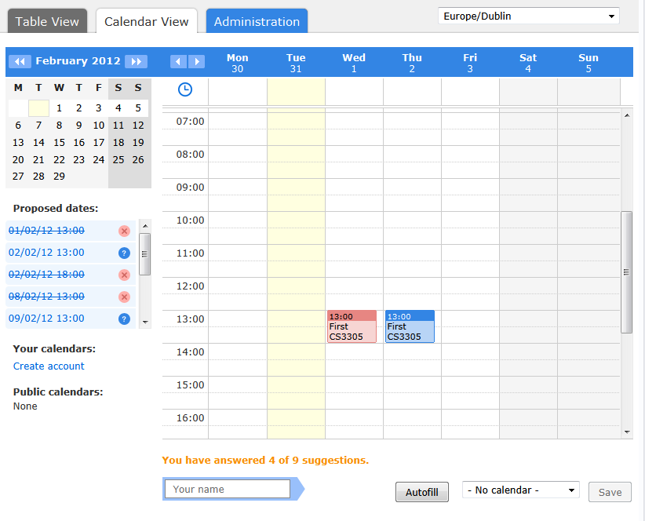
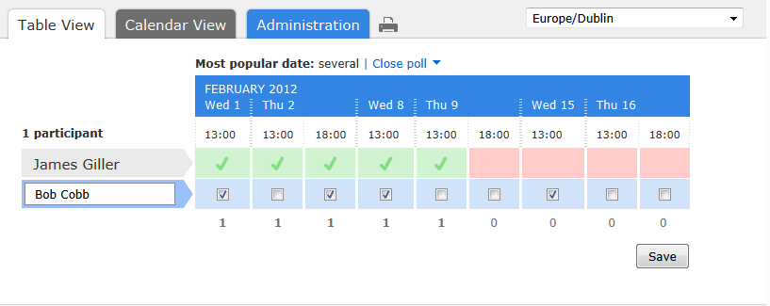
Participating in poll
Standard poll
Use calendar

Slide 8
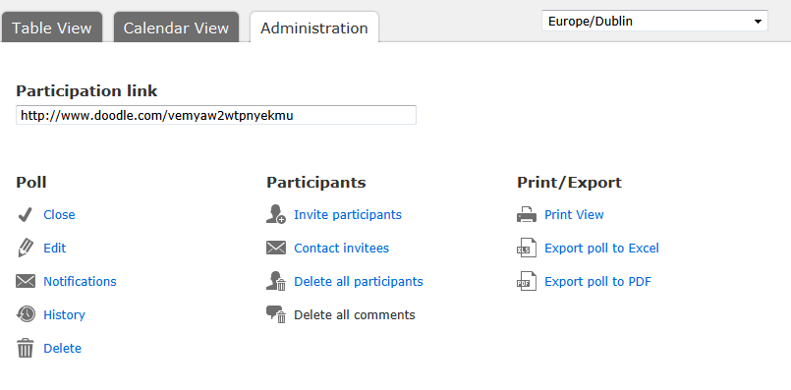
Administer the event
Interact with the poll: close, edit etc.
Interact with participants: invite more, contact etc.
Access poll in other formats.

Slide 9
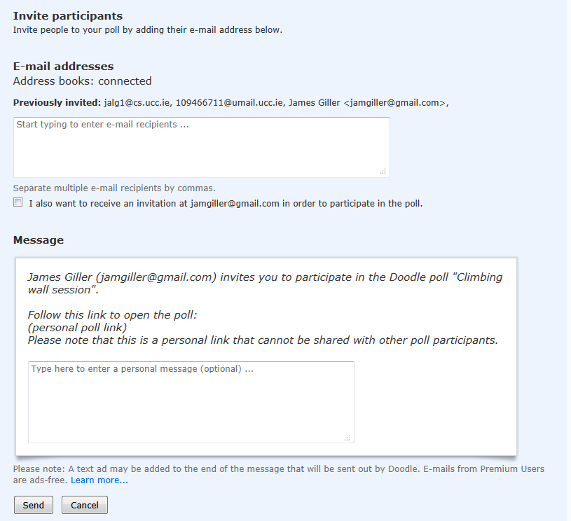
Scheduling an event - Login
Logging in using a Doodle, facebook or gmail account provides extra features.
One feature includes automated invite emails.

Slide 10
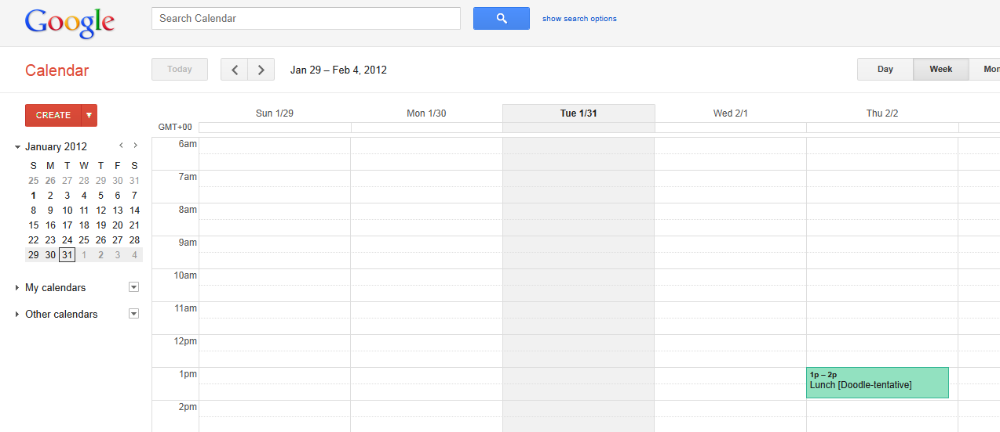
Integrating with other calendars
Doodle can be integrated with other calendars.
For example, updates Google calendar with a tentative date.

Slide 11
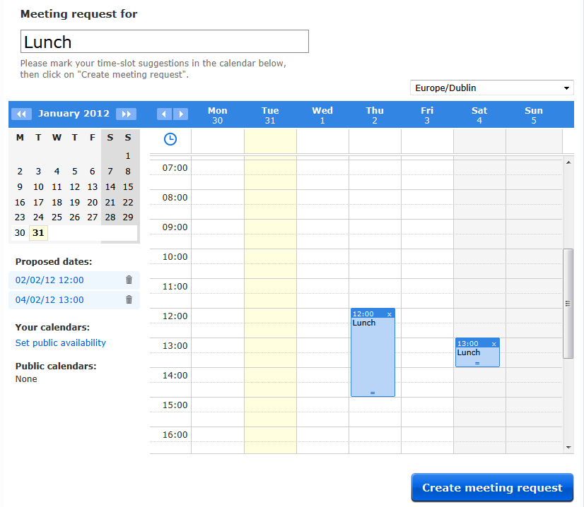
MeetMe meeting requests
Request meetings with an individual through a calendar interface.
Every Doodle account is entitled to a MeetMe page to host their calendar.

Slide 12
Summary
Scheduling using Doodle can be done in two ways
Distributing a poll of optional dates and times.
Requesting a one-to-one meeting via a calendar.
Scheduling an event using a poll does not require a Doodle account.
Having a Doodle account unlocks extra features.
Notifications are made via email.
Access to events is through links. Can be limited to invite-only.

Slide 13
Conclusions
Doodle
Meeting Planner
There is no initial context to an event.
Event creator chooses tentative and final date(s).
Selection of date(s) based on preference of creator.
Steps to scheduling an event are linear and deterministic.
Lends itself to organising social events etc.
Excellent GUI, usability, features. Great source of ideas, though not entirely applicable.
Context exists. Occupied slots influence selection of tentative event dates.
Tentative dates chosen through algorithm, final date agreed by user.
Selection of dates based on availability of attendees.
Concurrent access to individual and group timetables and complex interactions can lead to conflicts.
To be used by academic institutions.

