Slide 1
ICON LIBRARY
CURRENT AS OF MAY 26, 2004

Slide 2








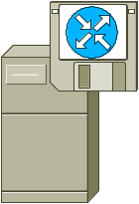









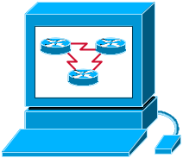









Icons: Cisco Products
Router-
Color and subdued
100BaseT
Hub
Workgroup
Director
Server
with
PC Router
Router
w/Silicon Switch
uBR910
Cable DSU
Network Management Appliance
Software-
Based Router on File Server
CDDI/
FDDI Concentrator
Wavelength
Router
Storage Solution
Engine
(SSE)
PC Adapter Card
Protocol Translator
TransPath
PC Router
Card
Bridge
CiscoWorks
Workstation
Wireless
Router
Workgroup
Switch
Color/Subdued
Cisco
Hub
Small Hub (10BaseT Hub)
Workgroup
Switch
Voice-Enabled
Access
Server
NetFlow
Router
IOS SLB
Terminal Server

Slide 3


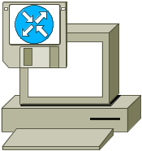
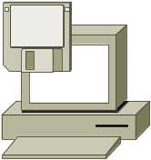






















Icons: Cisco Products (Cont.)
Route/Switch Processor
with and without Si
PC with Router-Based Software
PC with
Software
ATM
Switch
Cisco CA
MicroWeb
Server
Switch Processor
LAN2LAN Switch
PXF
MGX 8000
Multiservice
Switch
IP Transport Concentrator
ISDN
Switch
Voice Gateway
VIP
ASIC Processor
General Processor
BBSM
Content Engine
Cisco
5500
Family
Multi-
Switch
Device
ATA
Management Engine
(ME 1100)
Broadband
Router
ITP
SIP Proxy Server

Slide 4




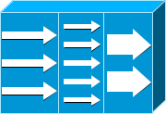


















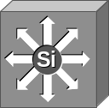
Icons: Cisco Products (Cont.)
System
Controller
Program Switch
NetRanger
IP
Standard
and Old
(Some Prefer)
Voice-Enabled
Access Server
(or Voice Enabled Communications Server)
Cisco 6920
RateMux
Router
with TDM
NetSonar
ADM
Cisco
Directory
Server
Cisco
7505
Cisco 1000
Cisco
7507
Voice-
Enabled
Router
Firewall
Services
Module
Cisco
7500
(7513)
Edge Label Switch
Router
Cisco 4310 End Office System
Edge Label
Switch
Router
with NetFlow
Cisco Unity Express
Multilayer Switch,
with and without Text
and Subdued

Slide 5

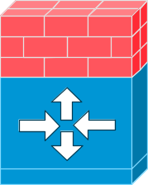













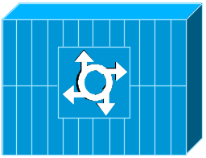



Icons: Cisco Products (Cont.)
Centri
Firewall
MGX 8220
IOS Firewall
MGX 8240
Cisco Security Manager
Router with Firewall
MGX 8260
Data Switch Processor,
AKA Data
Center Switch
PIX Firewall
Right and Left
Voice-Enabled ATM Switch
Cisco CallManager
Optical Transport
Data Center Switch,
Reversed
IP Telephony Router
Cisco 6732 Access Server
DSLAM
Cisco 6705 Access Server
Cisco 6701

Slide 6

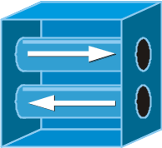




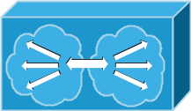















Icons: Cisco Products (Cont.)
IP DSL
Switch
VPN Concentrator
Cisco
VN 2900
Cisco 15200
SSL
Terminator
CSS 11000
Cisco
VN 5900
H.323
CDM
(Content Distribution Manager)
Cisco 15800
Cisco
VN 5902
IAD Router
Access
Gateway
Cisco
Storage
Router
BTS 10200 Softswitch
Content
Router
Content
Service
Module
ICS 7750
Content
Switch
ICM
Generic Softswitch
Content
Transformation Engine

Slide 7









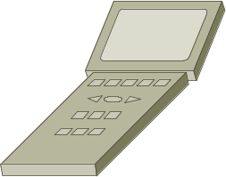

Icons: Cisco Products (Cont.)
DWDM Network Line
Detector
DWDM Filter
DWDM Ring
Wireless
Transport
AccessPoint
Dual Mode
AccessPoint
Wireless
Bridge
Wireless
Connectivity,
Different
Orientations
Scanner
EtherClient

Slide 8


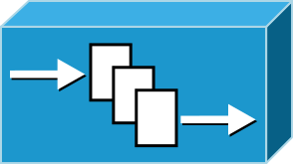










Icons: Cisco Products (Cont.)
SC2200 Signaling Controller
Mobile
Access
Router
IP/TV Content Manager
VSC3000 Virtual Switch Controller
IP/TV Broadcast
Server
Cisco Carrier Routing System
VSC3000 or
SC2200 Host
Universal Gateway
Unity
Server
Generic Softswitch
FC Storage
BTS 10200 Softswitch
Generic Softswitch
(Cisco Branded)
IntelliSwitch Stack
Detector
Guard

Slide 9







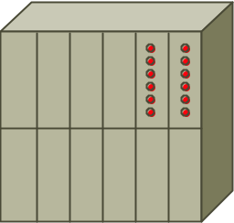




Icons: Cisco Products, Optical (Cont.)
Optical Services Router
Automatic
Protection Switching
WDM
Optical Fiber
Cisco 10700
Channelized
Pipe
ONS15104
SONET MUX
Concatenated Payload
Optical Amplifier
Optical Cross- Connect
Digital Cross-Connect

Slide 10


Icons: Cisco Products, Optical (Cont.)
Protected Optical
Unprotected Optical
Metro 1500
ONS 15540

Slide 11












Icons: Security
Secure Switch
(Cisco and Subdued Color Schemes)
Secure
Server
Secure Router
(Cisco and Subdued Color Schemes)
Security Management
(Cisco and Generic Color Schemes)
Secure Catalyst Switch
(Cisco and Subdued Color Schemes)
CSM-S
Secure Endpoints
(PC and Laptop)

Slide 12
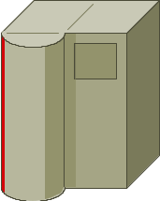

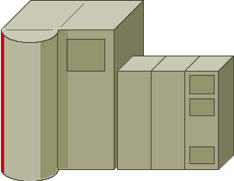
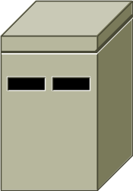
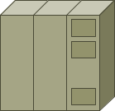

Icons: IBM
IBM
Mainframe
Cluster Controller/3174
(Desktop Model, Not Used Much)
IBM
Mainframe
with FEP
IBM Mini
(AS400)
FEP
(Front End Processor)
Cluster Controller/
3274 or 3174
(Most Common Type)

Slide 13
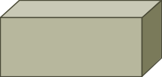


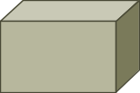


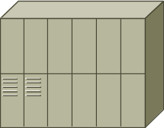

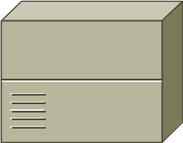
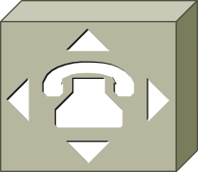

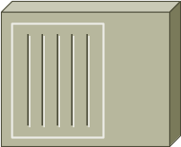



Icons: WAN
DSU/CSU
(Add Text in PowerPoint)
Network Cloud,
Dark
Distributed Director
WAN
Network Cloud,
Gold
Local Director
MUX
Network Cloud,
White
PBX/
Switch
PBX
(Small)
Network Cloud, Standard Color
Hub
Gray and Blue
DPT Ring
NAT

Slide 14
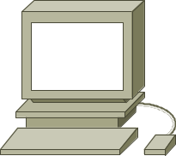
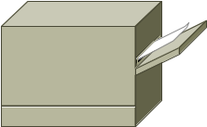




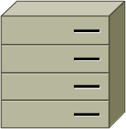

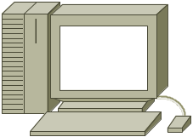

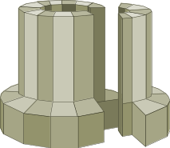

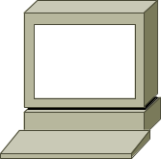
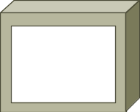
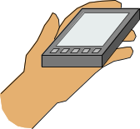

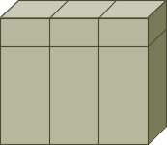
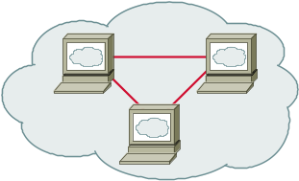



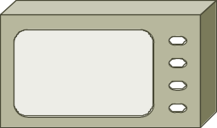
Icons: LAN
Workstation
(Sun)
Printer
ATM/FastGb Etherswitch
Web Server
PC
Laptop
HP Mini
Web Browser
Mac
File Server
Super-
computer
Repeater
Terminal
Monitor
Newton
LAN2LAN
Mini or
VAX/VMS
with DECnet
Web Cluster
Intelligence Engine 2100 Series
Tablet
PC Card
Handheld

Slide 15







Icons: Media
Token Rings, with and without Text
and Subdued
Line: Serial (Use Thicker where There Is Space)
FDDI Rings, with and without Text, Vertical and Horizontal
Line: Circuit-Switched
(Use Thicker where There Is Space)
Line: Ethernet
(Use Thicker where There Is Space)

Slide 16

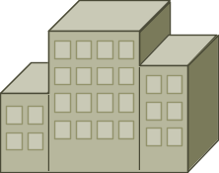
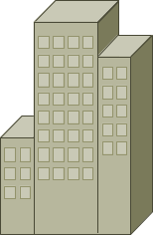
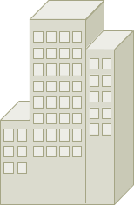
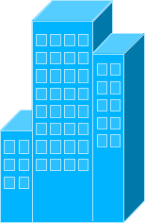
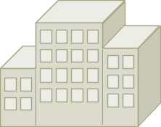





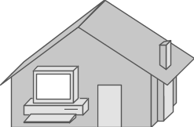
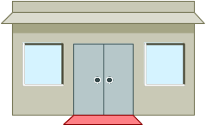
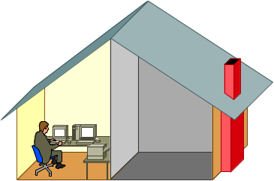
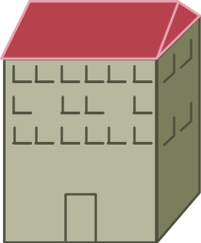
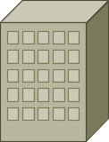


Icons: Buildings
Government
Headquarters, Regular, Subdued,
and Blue
University
House, Regular and Blue
Medium Building, Regular, Subdued,
and Blue
Small
Business
Telecommuter
House (Color and Subdued)
Branch
Office,
Regular, Subdued,
and Blue
MDU
Home Office

Slide 17

















Icons: People
Androgynous Person
Symbol Woman, Various Colors
Man
Woman
Symbol Man, Various Colors
End User Male,
Left and Right
End User Female,
Left and Right
Running Man
(Color and Subdued)
Running Woman
End User,
CiscoWorks

Slide 18


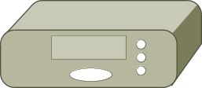

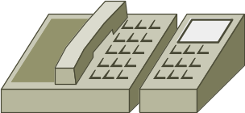
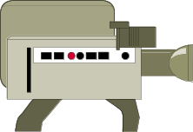



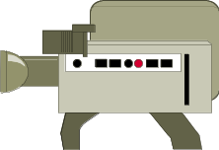

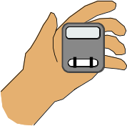
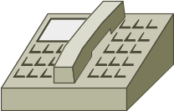












Icons: Multimedia/Voice/Phone
Phone
Camera
PC/Video
Set Top
Box (STB)
BBFW
Phone-Appliance
Television
Camera
PC/Video
BBFW
Media
Fax/
Phone
Speaker
Pager
Phone Feature
Cell Phone
Microphone
Class 4/5
Switch
Phone Ethernet
Phone 2
Fax
Headphones
Hoot and Holler Phone
Mobile
Access
Phone
Turret
Phone Polycom
IP Phone

Slide 19





















Icons: Miscellaneous
Firewall, Horizontal and Vertical, Subdued
Satellite
Dish
File Cabinet
Lock
Satellite
Breakout Box
UPS, RPS
Key
Host
MAU
Lock and Key
Database, Relational
PAD
Car
Modem
BBS
(Bulletin
Board
System)
Diskette
(3.5" Floppy)
Truck

