Slide 1
Computer Networks
Routing
Adrian Sergiu DARABANT
Lecture 9

Slide 2
Routing
Routing protocol
Goal: determine “good” path
(sequence of routers) thru
network from source to dest.
5
B
3
C
2
5
A
2
1
F
Graph abstraction for routing algorithms:
graph nodes are routers
graph edges are physical links
  link cost: delay, $ cost, or congestion level
3
1
2
D
E
1
“good” path:
  typically means minimum cost path
  other def’s possible

Slide 3
Routing Algorithm classification
Global or decentralized information?
Global:
all routers have complete topology, link cost info
“link state” algorithms
Decentralized:
router knows physically-connected neighbors, link costs to neighbors
iterative process of computation, exchange of info with neighbors
“distance vector” algorithms
Static or dynamic?
Static:
routes change slowly over time
Dynamic:
routes change more quickly
  periodic update
  in response to link cost changes

Slide 4
Routing tables - Campus
Destination | Gateway | Genmask | Flags | Metric | Iface
193.226.40.128 | * | 255.255.255.224 | U | 0 | eth1
192.168.1.0 | 172.30.5.19 | 255.255.255.0 | UG | 0 | eth1
192.168.0.0 | 172.30.1.4 | 255.255.255.0 | UG | 0 | eth1
193.231.20.0 | * | 255.255.255.0 | U | 0 | eth0
172.30.0.0 | * | 255.255.0.0 | U | 0 | eth1
169.254.0.0 | * | 255.255.0.0 | U | 0 | eth1
127.0.0.0 | * | 255.0.0.0 | U | 0 | lo
default | 193.231.20.9 | 0.0.0.0 | UG | 0 | eth0

Slide 5
Routing tables (static)
Destination | Gateway | Genmask | Flags | Metric | Ref | Use | Iface
172.16.25.1 | 172.30.0.4 | 255.255.255.255 | UGH | 0 | 0 | 0 | Eth1
193.226.40.128 | 0.0.0.0 | 255.255.255.224 | U | 0 | 0 |  | Eth0
193.0.225.0 | 0.0.0.0 | 255.255.255.0 | U | 0 | 0 |  | Eth0
193.231.20.0 | 0.0.0.0 | 255.255.255.0 | U | 0 | 0 |  | Eth0
172.30.0.0 | 0.0.0.0 | 255.255.0.0 | U | 0 | 0 |  | Eth1
169.254.0.0 | 0.0.0.0 | 255.255.0.0 | U | 0 | 0 |  | Eth1
0.0.0.0 | 193.0.225.9 | 0.0.0.0 | UG | 0 | 0 |  | Eth0
The route command – (Windows/Linux/other OS)

Slide 6
A Link-State Routing Algorithm
Dijkstra’s algorithm
net topology, link costs known to all nodes
  accomplished via “link state broadcast”
  all nodes have same info
computes least cost paths from one node (‘source”) to all other nodes
  gives routing table for that node
iterative: after k iterations, know least cost path to k dest.’s
Notation:
c(i,j): link cost from node i to j. cost infinite if not direct neighbors
D(v): current value of cost of path from source to dest. V
p(v): predecessor node along path from source to v, that is next v
N: set of nodes whose least cost path definitively known

Slide 7
Dijsktra’s Algorithm
1 Initialization:
2 N = {A}
3 for all nodes v
4 if v adjacent to A
5 then D(v) = c(A,v)
6 else D(v) = infinity
7
8 Loop
9 find w not in N such that D(w) is a minimum
10 add w to N
11 update D(v) for all v adjacent to w and not in N:
12 D(v) = min( D(v), D(w) + c(w,v) )
13 /* new cost to v is either old cost to v or known
14 shortest path cost to w plus cost from w to v */
15 until all nodes in N

Slide 8
Dijkstra’s algorithm: example
Step
0
1
2
3
4
5
start N
A
AD
ADE
ADEB
ADEBC
ADEBCF
D(B),p(B)
2,A
2,A
2,A
D(C),p(C)
5,A
4,D
3,E
3,E
D(D),p(D)
1,A
D(E),p(E)
infinity
2,D
D(F),p(F)
infinity
infinity
4,E
4,E
4,E
5
B
3
C
2
5
A
2
1
F
3
1
2
D
E
1

Slide 9
Dijkstra’s algorithm, discussion
Algorithm complexity: n nodes
each iteration: need to check all nodes, w, not in N
n*(n+1)/2 comparisons: O(n**2)
more efficient implementations possible: O(nlogn)
Oscillations possible:
e.g., link cost = amount of carried traffic
1
A
A
A
A
1+e
2+e
0
0
2+e
2+e
0
D
0
0
B
D
B
D
B
D
B
1+e
1
0
0
1+e
1
0
e
0
0
1
1+e
0
e
C
C
C
C
1
1
e
… recompute
routing
… recompute
… recompute
initially

Slide 10
Distance Vector Routing Algorithm
iterative:
continues until no nodes exchange info.
self-terminating: no “signal” to stop
asynchronous:
nodes need not exchange info/iterate in lock step!
distributed:
each node communicates only with directly-attached neighbors
Distance Table data structure
each node has its own
row for each possible destination
column for each directly-attached neighbor to node
example: in node X, for dest. Y via neighbor Z:
distance from X to
Y, via Z as next hop
X
=
D (Y,Z)
Z
=
c(X,Z) + min {D (Y,w)}
w

Slide 11
Distance Table: example
1
cost to destination via
B
C
E
7
D ()
A
B
C
D
A
1
7
6
4
B
14
8
9
11
D
5
5
4
2
A
8
2
1
E
D
2
E
D
D (C,D)
=
c(E,D) + min {D (C,w)}
destination
w
=
2+2 = 4
E
D
D (A,D)
=
c(E,D) + min {D (A,w)}
w
=
2+3 = 5
loop!
E
B
D (A,B)
=
c(E,B) + min {D (A,w)}
w
=
8+6 = 14
loop!

Slide 12
Distance table gives routing table
A | Next Hop | Dist
B | - | 7
C | - | ∞
D | - | ∞
E | - | 1
B | Next Hop | Dist
A | - | 7
C | - | 1
D | - | ∞
E | - | 8
C | Next Hop | Dist
A | - | ∞
B | - | 1
D | - | 2
E | - | ∞
D | Next Hop | Dist
A | - | ∞
B | - | ∞
C | - | 2
E | - | 2
E | Next Hop | Dist
A | - | 1
B | - | 8
C | - | ∞
D | - | 2
A | Next Hop | Dist
B | - | 7
C | B | 8
D | E | 3
E | - | 1
B | Next Hop | Dist
A | - | 7
C | - | 1
D | C | 3
E | - | 8
C | Next Hop | Dist
A | B | 8
B | - | 1
D | - | 2
E | D | 4
D | Next Hop | Dist
A | E | 3
B | C | 3
C | - | 2
E | - | 2
E | Next Hop | Dist
A | - | 1
B | - | 8
C | D | 4
D | - | 2
Distance table
Routing table

Slide 13
Distance Vector routing
A | Next Hop | Dist
B | - | 7
C | E | 5
D | E | 3
E | - | 1
B | Next Hop | Dist
A | - | 7
C | - | 1
D | C | 3
E | C | 5
C | Next Hop | Dist
A | D | 5
B | - | 1
D | - | 2
E | D | 4
D | Next Hop | Dist
A | E | 3
B | C | 3
C | - | 2
E | - | 2
E | Next Hop | Dist
A | - | 1
B | D | 5
C | D | 4
D | - | 2
A | Next Hop | Dist
B | E | 6
C | E | 5
D | E | 3
E | - | 1
B | Next Hop | Dist
A | C | 6
C | - | 1
D | C | 3
E | C | 5
C | Next Hop | Dist
A | D | 5
B | - | 1
D | - | 2
E | D | 4
D | Next Hop | Dist
A | E | 3
B | C | 3
C | - | 2
E | - | 2
E | Next Hop | Dist
A | - | 1
B | D | 5
C | D | 4
D | - | 2
B
1
C
7
A
8
2
1
E
D
2

Slide 14
Distance Vector
B
1
C
7
A
8
2
1
E
D
2
A | Next Hop | Dist
B | E | 6
C | E | 5
D | E | 3
E | - | 1
B | Next Hop | Dist
A | C | 6
C | - | 1
D | C | 3
E | C | 5
C | Next Hop | Dist
A | D | 5
B | - | 1
D | - | 2
E | D | 4
D | Next Hop | Dist
A | E | 3
B | C | 3
C | - | 2
E | - | 2
E | Next Hop | Dist
A | - | 1
B | D | 5
C | D | 4
D | - | 2

Slide 15
Distance Vector Routing: overview
Iterative, asynchronous: each local iteration caused by:
local link cost change
message from neighbor: its least cost path change from neighbor
Distributed:
each node notifies neighbors only when its least cost path to any destination changes
  neighbors then notify their neighbors if necessary
Each node:
wait for (change in local link cost of msg from neighbor)
recompute distance table
if least cost path to any dest has changed, notify neighbors

Slide 16
Distance Vector Algorithm:
At all nodes, X:
1 Initialization:
2 for all adjacent nodes v:
3 D (*,v) = infinity /* the * operator means "for all rows" */
4 D (v,v) = c(X,v)
5 for all destinations, y
6 send min D (y,w) to each neighbor /* w over all X's neighbors */
X
X
X
w

Slide 17
Distance Vector Algorithm (cont.):
8 loop
9 wait (until I see a link cost change to neighbor V
10 or until I receive update from neighbor V)
11
12 if (c(X,V) changes by d)
13 /* change cost to all dest's via neighbor v by d */
14 /* note: d could be positive or negative */
15 for all destinations y: D (y,V) = D (y,V) + d
16
17 else if (update received from V wrt destination Y)
18 /* shortest path from V to some Y has changed */
19 /* V has sent a new value for its min DV(Y,w) */
20 /* call this received new value is "newval" */
21 for the single destination y: D (Y,V) = c(X,V) + newval
22
23 if we have a new min D (Y,w)for any destination Y
24 send new value of min D (Y,w) to all neighbors
25
26 forever
X
X
w
X
X
w
X
w

Slide 18
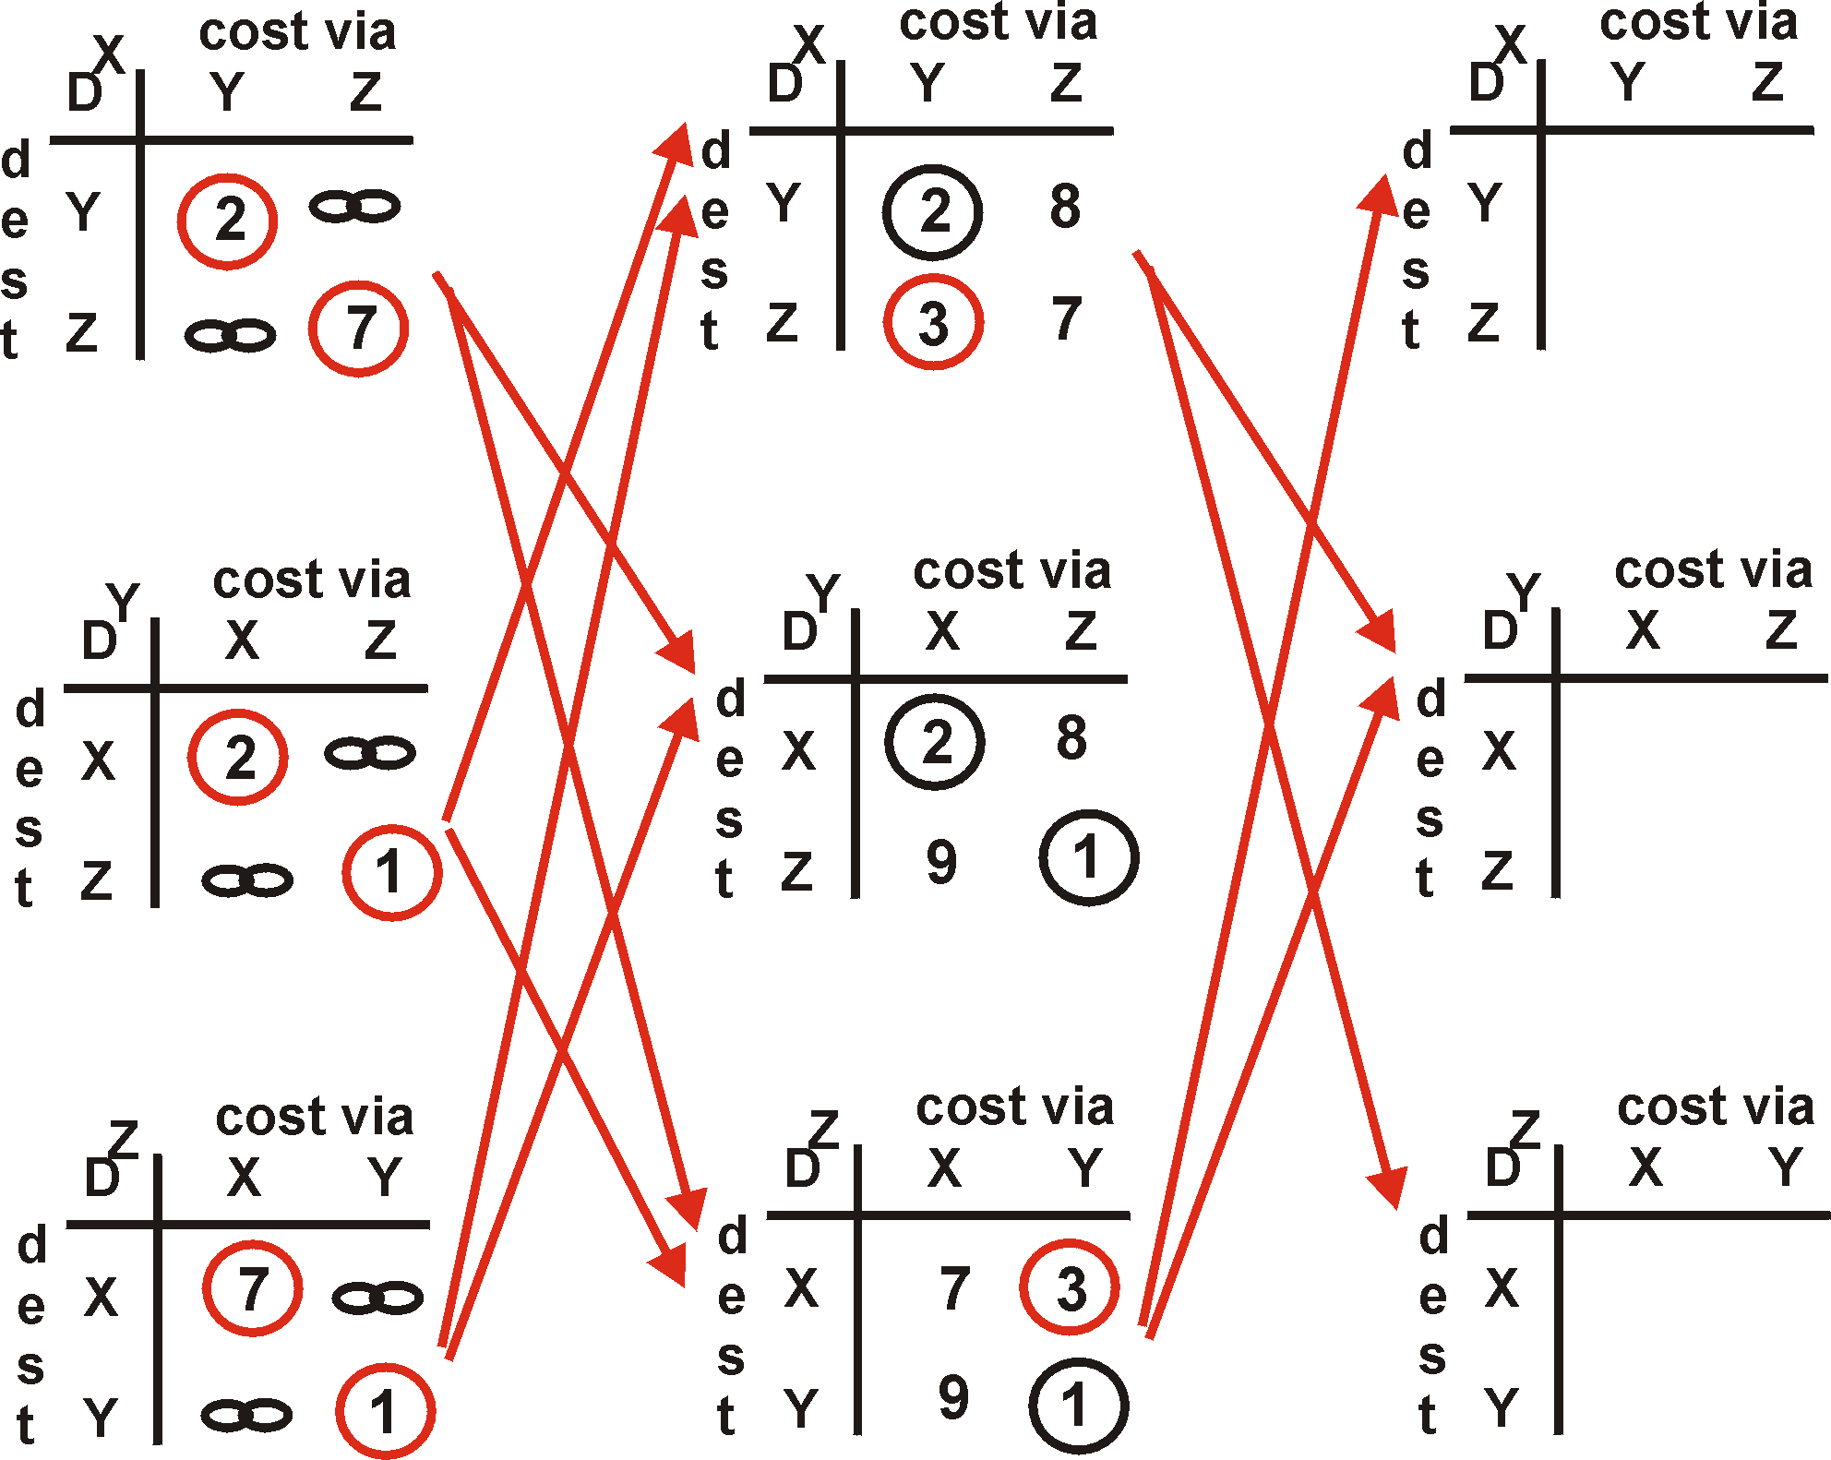
Distance Vector Algorithm: example
Y
2
1
X
Z
7

Slide 19
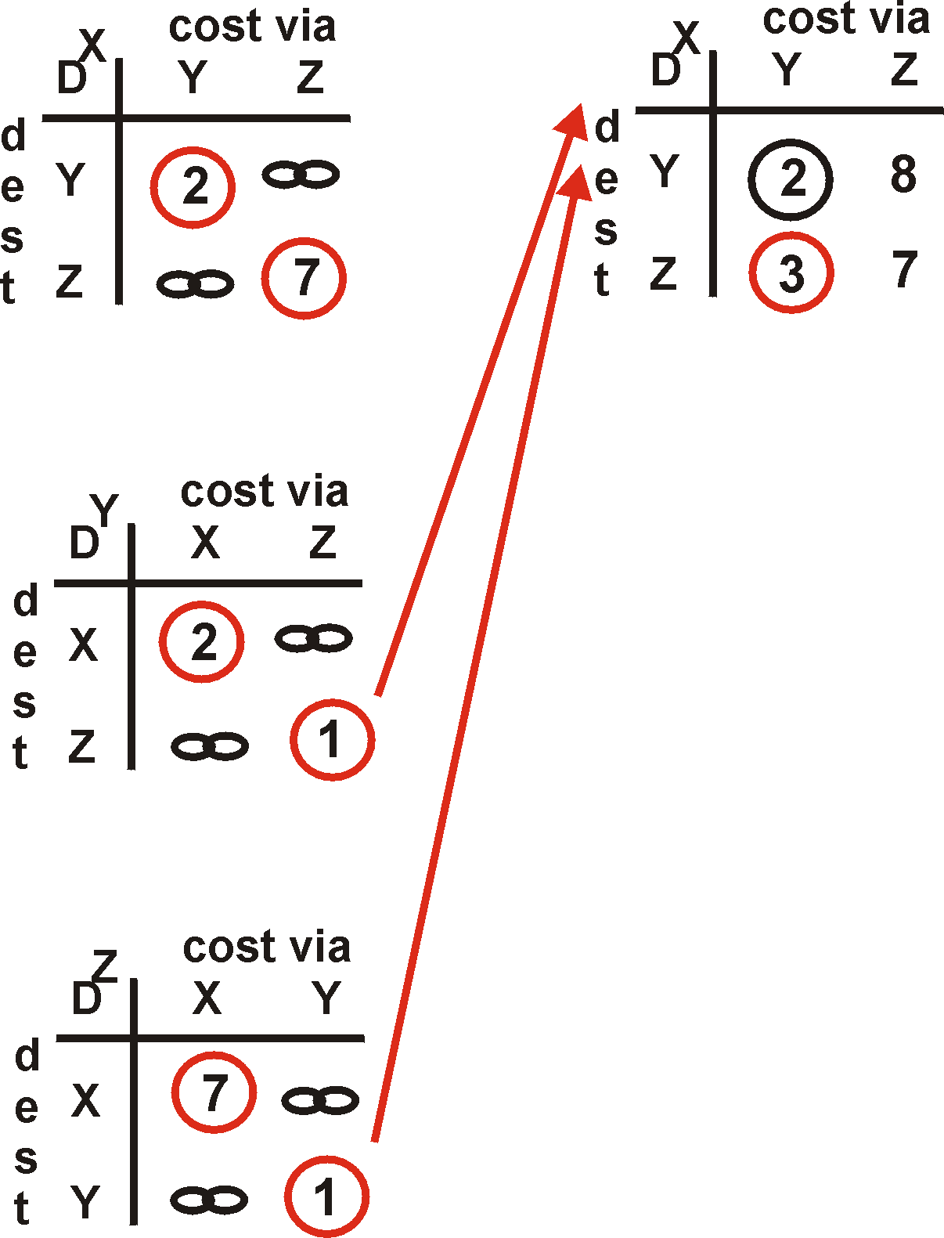
Distance Vector Algorithm: example
Y
2
1
X
Z
X
Z
7
D (Y,Z)
=
c(X,Z) + min {D (Y,w)}
w
=
7+1 = 8
X
Y
D (Z,Y)
=
c(X,Y) + min {D (Z,w)}
w
=
2+1 = 3

Slide 20
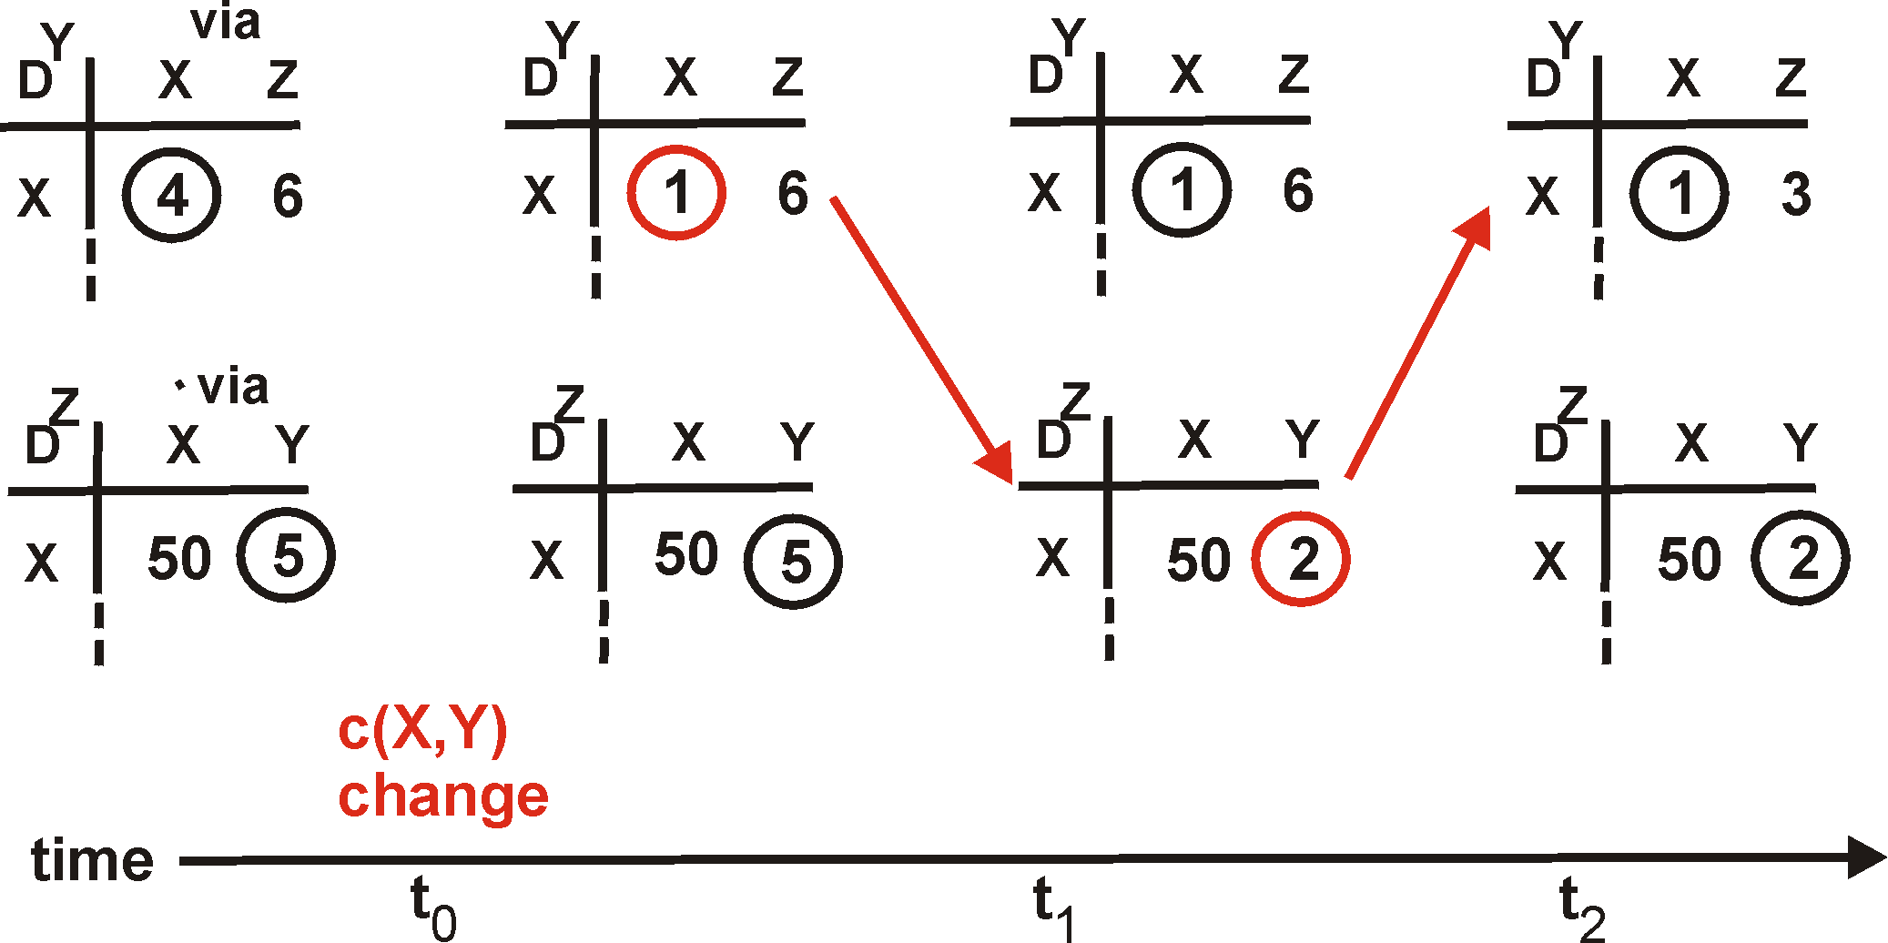
Distance Vector: link cost changes
Link cost changes:
node detects local link cost change
updates distance table (line 15)
if cost change in least cost path, notify neighbors (lines 23,24)
1
Y
4
1
X
Z
50
algorithm
terminates
“good
news
travels
fast”

Slide 21
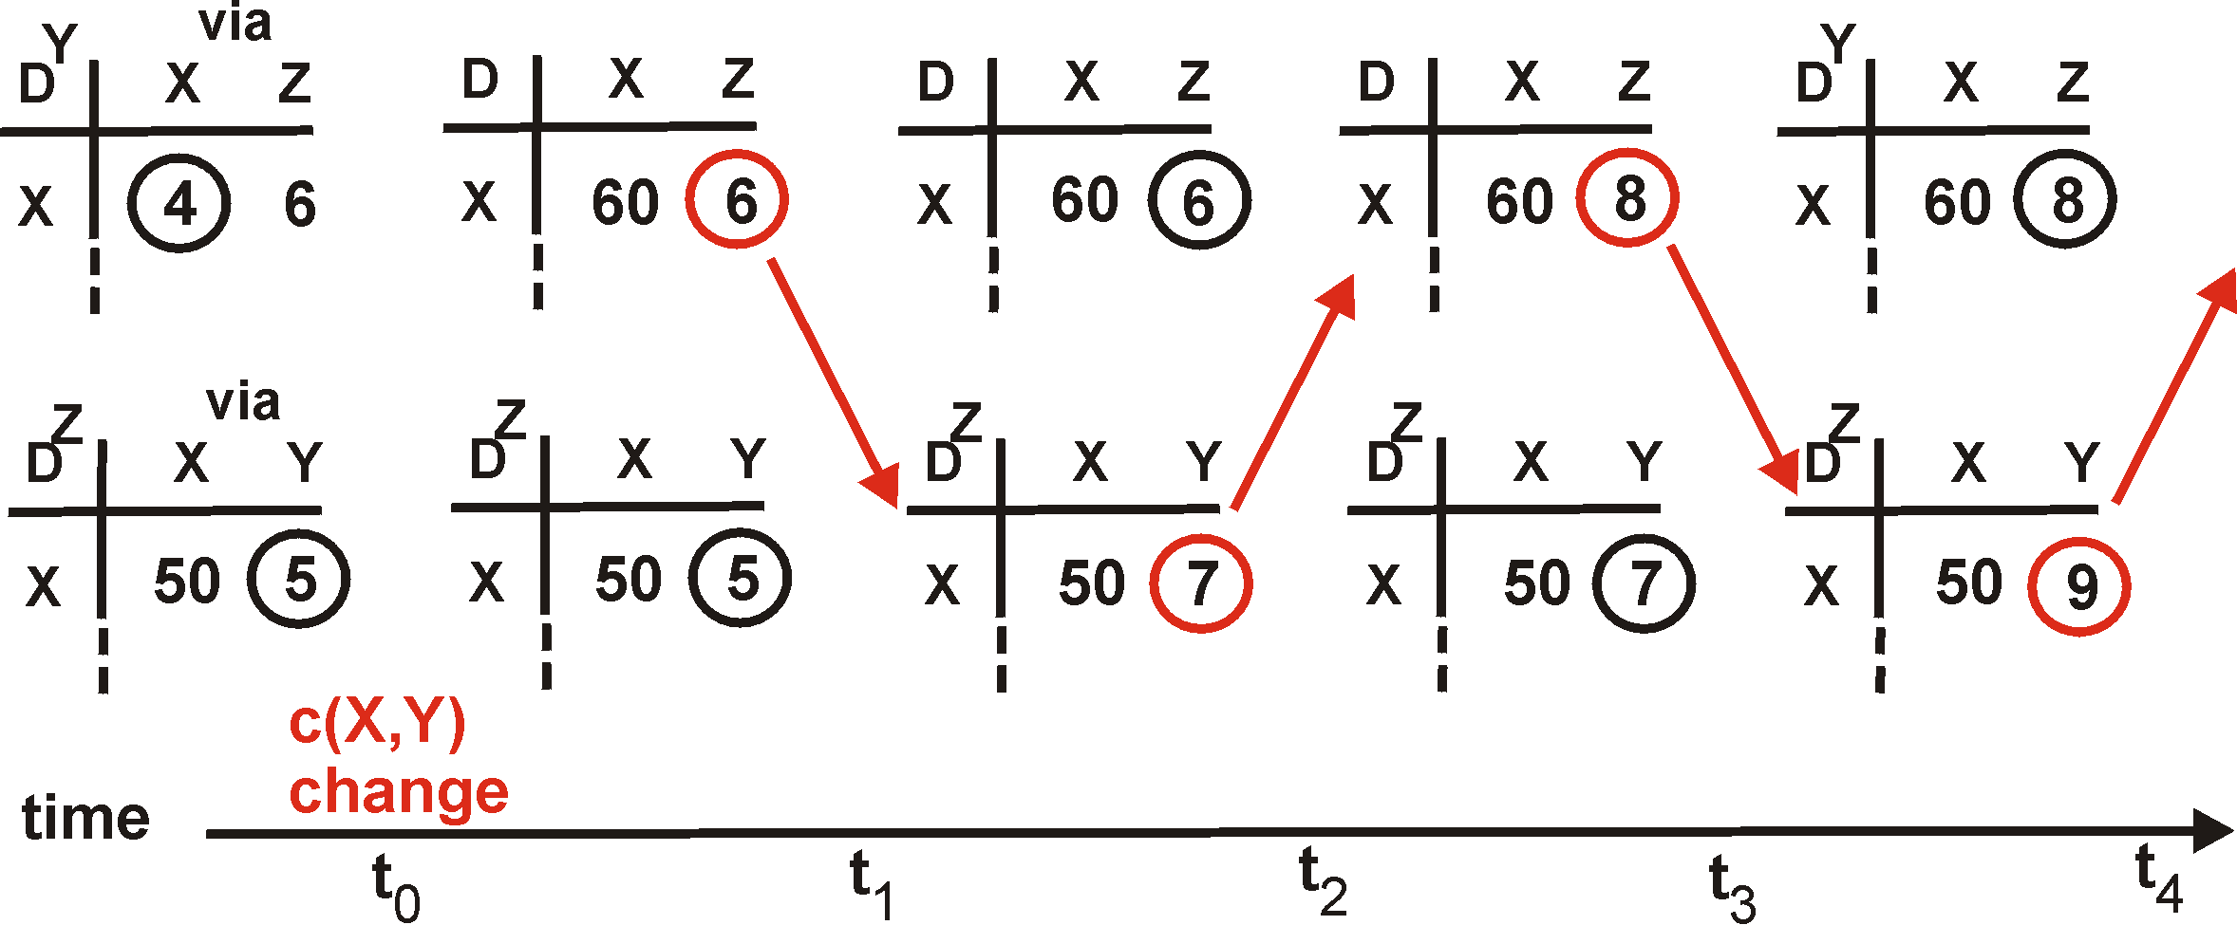
Distance Vector: link cost changes
Link cost changes:
good news travels fast
bad news travels slow - “count to infinity” problem!
60
Y
4
1
X
Z
50
algorithm
continues
on!

Slide 22
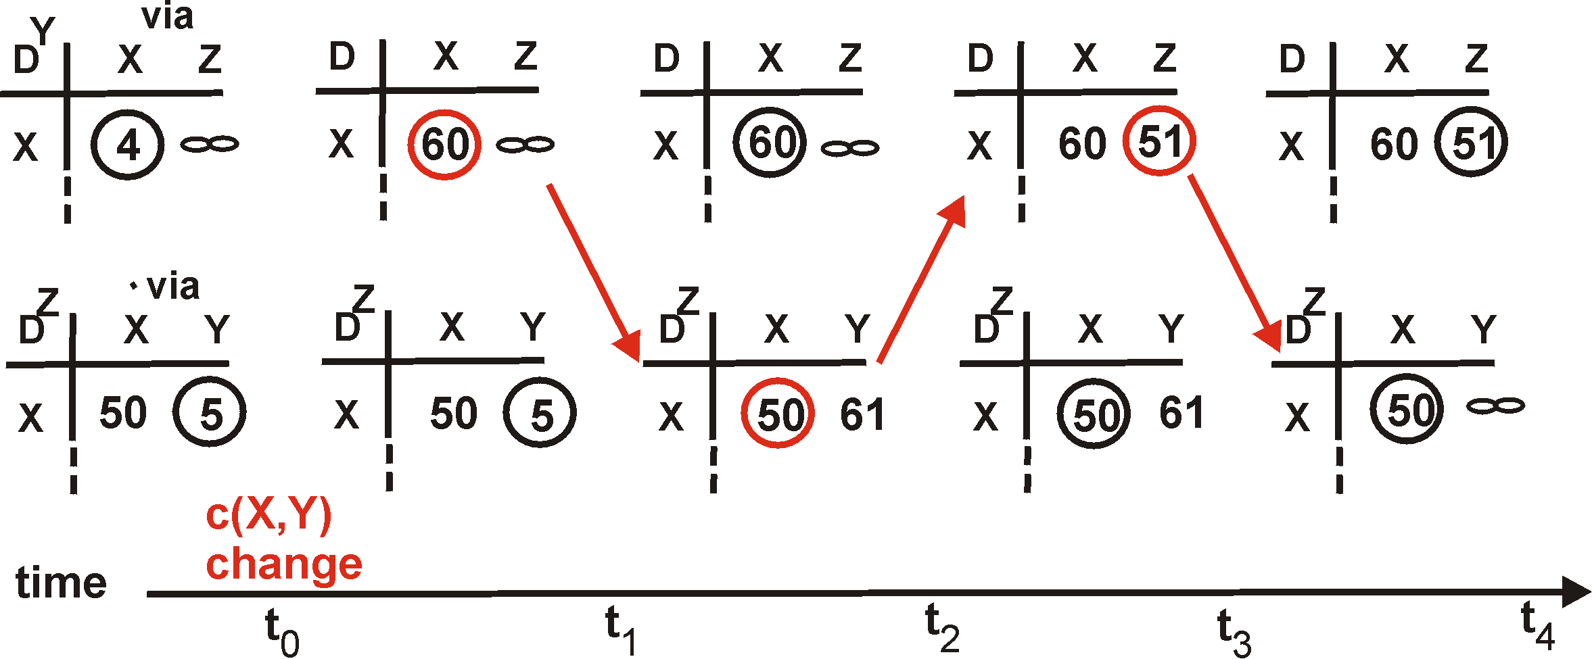
Distance Vector: poisoned reverse
If Z routes through Y to get to X :
Z tells Y its (Z’s) distance to X is infinite (so Y won’t route to X via Z)
will this completely solve count to infinity problem?
60
Y
4
1
X
Z
50
algorithm
terminates

Slide 23
Comparison of LS and DV algorithms
Message complexity
LS: with n nodes, E links, O(nE) msgs sent each
DV: exchange between neighbors only
  convergence time varies
Speed of Convergence
LS: O(n²) algorithm requires O(nE) msgs
  may have oscillations
DV: convergence time varies
  may be routing loops
  count-to-infinity problem
Robustness: what happens if router malfunctions?
LS:
  node can advertise incorrect link cost
  each node computes only its own table
DV:
  DV node can advertise incorrect path cost
  each node’s table used by others
    error propagate thru network

Slide 24
What is mobility?
spectrum of mobility, from the network perspective:
no mobility
high mobility
mobile user, using
same access point
mobile user, connecting/ disconnecting from network using DHCP.
mobile user, passing through multiple access point while maintaining ongoing connections (like cell phone)

Slide 25



Mobility: Vocabulary
home network: permanent “home” of mobile
(e.g., 128.119.40/24)
home agent: entity that will perform mobility functions on behalf of mobile, when mobile is remote
wide area network
Permanent address: address in home network, can always be used to reach mobile
e.g., 128.119.40.186
correspondent

Slide 26
Mobility: more vocabulary
visited network: network in which mobile currently resides (e.g., 79.129.13/24)
Permanent address: remains constant (e.g., 128.119.40.186)
Care-of-address: address in visited network.
(e.g., 79.129.13.2)
wide area network
home agent: entity in visited network that performs mobility functions on behalf of mobile.
correspondent: wants to communicate with mobile

Slide 27



How do you contact a mobile friend:
Consider friend frequently changing addresses, how do you find her?
I wonder where Alice moved to?
search all phone books?
call her parents?
expect her to let you know where he/she is?

Slide 28
Mobility: approaches
Let routing handle it: routers advertise permanent address of mobile-nodes-in-residence via usual routing table exchange.
  routing tables indicate where each mobile located
  no changes to end-systems
Let end-systems handle it:
  indirect routing: communication from correspondent to mobile goes through home agent, then forwarded to remote
  direct routing: correspondent gets foreign address of mobile, sends directly to mobile

Slide 29
Mobility: approaches
Let routing handle it: routers advertise permanent address of mobile-nodes-in-residence via usual routing table exchange.
  routing tables indicate where each mobile located
  no changes to end-systems
let end-systems handle it:
  indirect routing: communication from correspondent to mobile goes through home agent, then forwarded to remote
  direct routing: correspondent gets foreign address of mobile, sends directly to mobile
not
scalable
to millions of
mobiles

Slide 30
Mobility: registration
visited network
home network
1
2
wide area network
mobile contacts foreign agent on entering visited network
foreign agent contacts home agent home: “this mobile is resident in my network”
End result:
Foreign agent knows about mobile
Home agent knows location of mobile

Slide 31
Mobility via Indirect Routing
foreign agent receives packets, forwards to mobile
home agent intercepts packets, forwards to foreign agent
visited
network
home
network
3
wide area network
2
1
correspondent addresses packets using home address of mobile
4
mobile replies directly to correspondent

Slide 32
Indirect Routing: comments
Mobile uses two addresses:
  permanent address: used by correspondent (hence mobile location is transparent to correspondent)
  care-of-address: used by home agent to forward datagrams to mobile
foreign agent functions may be done by mobile itself
triangle routing: correspondent-home-network-mobile
  inefficient when
  correspondent, mobile
  are in same network

Slide 33
Forwarding datagrams to remote mobile
foreign-agent-to-mobile packet
packet sent by home agent to foreign agent: a packet within a packet
dest: 128.119.40.186
dest: 79.129.13.2
dest: 128.119.40.186
Permanent address: 128.119.40.186
Care-of address: 79.129.13.2
dest: 128.119.40.186
packet sent by correspondent

Slide 34
Indirect Routing: moving between networks
suppose mobile user moves to another network
  registers with new foreign agent
  new foreign agent registers with home agent
  home agent update care-of-address for mobile
  packets continue to be forwarded to mobile (but with new care-of-address)
Mobility, changing foreign networks transparent: on going connections can be maintained!

Slide 35
Mobility via Direct Routing
foreign agent receives packets, forwards to mobile
correspondent forwards to foreign agent
visited
network
home
network
4
wide area network
2
3
correspondent requests, receives foreign address of mobile
1
4
mobile replies directly to correspondent

Slide 36
Mobility via Direct Routing: comments
overcome triangle routing problem
non-transparent to correspondent: correspondent must get care-of-address from home agent
  What happens if mobile changes networks?

Slide 37
Mobile IP
RFC 3220
has many features we’ve seen:
  home agents, foreign agents, foreign-agent registration, care-of-addresses, encapsulation (packet-within-a-packet)
three components to standard:
  agent discovery
  registration with home agent
  indirect routing of datagrams

Slide 38

Mobile IP: agent discovery
agent advertisement: foreign/home agents advertise service by broadcasting ICMP messages (typefield = 9)
H,F bits: home and/or foreign agent
R bit: registration required

Slide 39

Mobile IP: registration example

