Slide 1
Increasing Revenue at Big Mountain Resort: A Data-Driven Recommendation
Paul Haefele
Data Scientist

Slide 2
Problem Identification
Current Situation: Big Mountain Resort charges a premium above the average price of resorts in its market segment, but they suspect they are not capitalizing on their facilities as much as they could. The resort wants to implement a more data-driven business strategy to select a better value for their ticket price.
Objective: To increase revenue for Big Mountain Resort through a combination of optimizing pricing, cutting costs efficiently, and upgrading/adding facilities according to a data-driven prediction model.

Slide 3
Recommendation and Key Findings
Recommendation: Increase ticket prices from the current price of $81 to $95.87, which is in line with the predicted value from our model.
Key findings:
The resort offers above-average facilities compared to other resorts in the region.
The resort's current ticket prices are lower than the modeled price.
Increasing ticket prices to the predicted value is expected to result in increased revenue for the resort.

Slide 4
Modeling results and analysis - Part 1
Description of the key features used in the model:
AdultWeekend: Ticket price for adults on the weekend
Snow Making_ac: Total acres covered by snow making
LongestRun_mi: Length of the longest run in miles
fastQuads: Number of fast quad chairlifts
vertical_drop: Height from summit to base(from highest lift-point)
Model performance metrics:
Initial MAE: 19.13
Final MAE: 10.39
Random Forest Regressor most important features:
Fast Quads
Runs
Snow Making Area
Vertical Drop

Slide 5
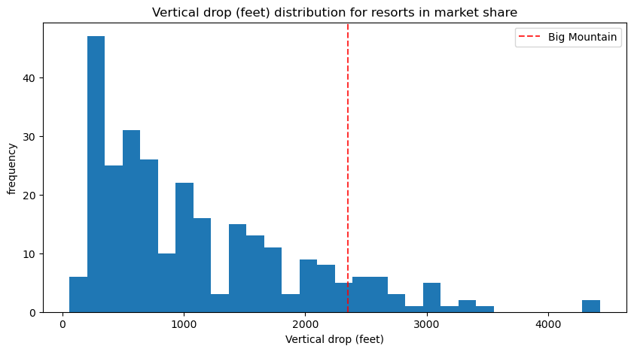
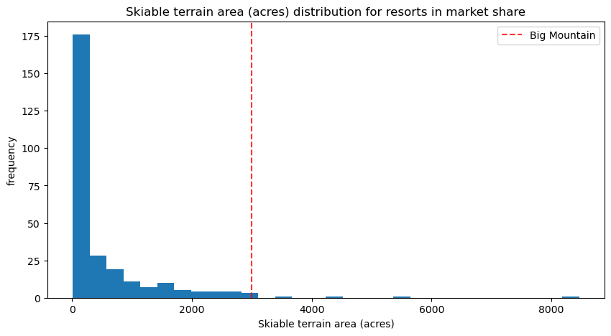
Modeling results and analysis - Part 2
Big Mountain Resort compared to its competitors in key ticket price predicting features.

Slide 6
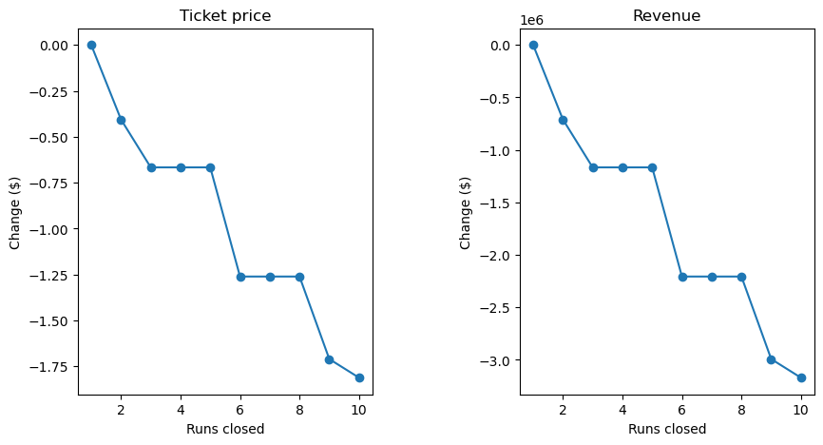
Modeling results and analysis - Part 3
Scenario 1: Permanently closing down up to 10 of the least used runs.

Slide 7
Modeling results and analysis - Part 4
Scenario 2: Adding a run, increasing the vertical drop by 150 feet, and installing an additional chair lift
Increase in ticket price by 1.99
Increase in revenue by $3,474,638
Increase in operating costs by$1,540,000
A combination of raising ticket prices to the optimal level according to current facilities, upgrading facilities based on scenario 2, and potentially cutting costs based on scenario 1 on the previous slide would be the most efficient way of increasing profits for Big Mountain Resort

Slide 8
Summary and Conclusion
Recap of the problem, recommendation, and key findings
Discussion of the potential impact of the recommendation on revenue and profitability
Call to action: Implement the recommended ticket price increase and monitor its impact on revenue, and gather more cost information to refine the model and make more accurate recommendations.

