Slide 1
Home Price Predictions-Regression Techniques
By: Paul Haefele
07/30/2023

Slide 2
Introduction
Problem Statement: Predict house sale prices based on various features.
Objective of the Project: Develop a robust model to assist buyers, sellers, agents, and investors in making informed decisions in the housing market.
Target Audience: Potential Buyers, Sellers, Real Estate Agents, Investors

Slide 3
Data Collection and Pre-Processing
Data Sources: Kaggle Competitions
Data Preprocessing Steps:
Handling Missing Values
Encoding Categorical Variables

Slide 4
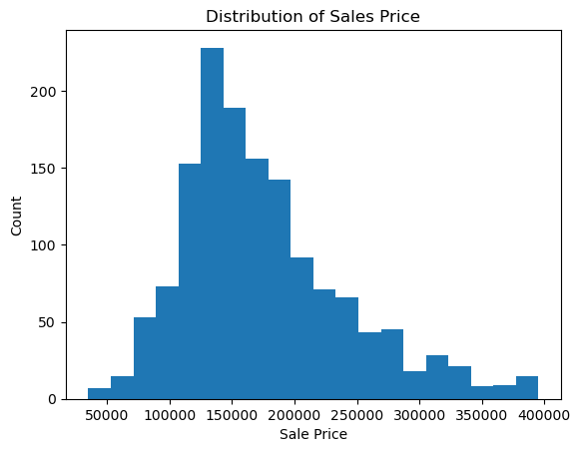

Slide 5
Feature Engineering
We performed feature engineering to enhance the predictive power of our model.
Engineered features captured important interactions and relationships between variables.
These engineered features significantly contributed to improving model performance.

Slide 6
Dimensionality Reduction with PCA
To handle high dimensionality in the dataset, we applied Principal Component Analysis (PCA).
PCA reduced the number of features while preserving the most essential information.
This dimensionality reduction technique helped to avoid overfitting and improved model efficiency.

Slide 7
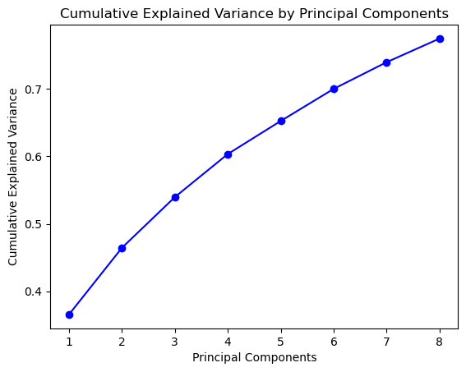

Slide 8
Model Selection and Evaluation
Regression Models: Linear, Decision Tree, Random Forest, XGBoost
Performance Metrics:
RMSE (Root Mean Squared Error)
R-squared (Coefficient of Determination)

Slide 9
Best Performing Model- Random Forest Regression
Hyperparameters: Max Depth: 15, Min Samples Leaf: 2, Min Samples Split: 2, n_estimators: 150
Performance Metrics: RMSE: 25,809.45, R-squared: 0.8547

Slide 10
Recommendations for Stakeholders
Buyers: Utilize our model for fair market value estimates during negotiations.
Sellers: Set competitive yet realistic listing prices using our accurate predictions.
Real Estate Agents: Enhance client services with data-driven guidance from our model.
Investors: Exercise caution in short-term investment decisions, consider market uncertainties.

Slide 11
Future Research and Improvements
Explore Advanced Regression Techniques: SVM (Support Vector Machine)
Additional Feature Engineering
Incorporate External Data Sources
Improvement for Real Estate Investors

Slide 12
Conclusion
Summary of Findings: Our analysis explored various regression models to predict house sale prices, with Random Forest Regression emerging as the top performer, achieving an RMSE of 25,809.45 and an R-squared of 0.8547.
Impactful Insights: Our model's predictions provide valuable tools for buyers, sellers, and agents to make informed decisions in the real estate market.

Slide 13
Conclusion Pt.2
Key Takeaways: Accurate house price predictions enable fair negotiations, informed listings, and improved investment decisions.
Continuous Refinement: Further research and model enhancements can lead to even more precise predictions and better serve stakeholders.
Future Directions: Leveraging external data and advanced techniques may further elevate our model's predictive power.

