Slide 1
Sentiment Analysis of Amazon Product Reviews
Capstone Project by Paul Haefele

Slide 2
Agenda
Introduction and Problem Statement
Data Overview
Data Wrangling
Exploratory Analysis
Modeling Approach
Analysis Results
Recommendations
Practical Considerations and Future Work

Slide 3
Problem Overview
Problem Statement: Developing an effective sentiment analysis model for customer reviews.
Context: Analyzing customer sentiment aids businesses in understanding user experiences and improving products/services.
Success Metrics: Accuracy, precision, recall, and F1-score will be used to evaluate the model's performance.

Slide 4
Stakeholders and Constraints
Stakeholders: Our primary stakeholders include businesses relying on customer reviews and product/service development teams.
Constraints:
Limited labeled data for training.
Potential biases in customer feedback.
The need for a scalable and interpretable model.
Mismatch between star ratings and user review text, posing a challenge in accurately capturing sentiment.

Slide 5
Data Science Problem Formulation
Objective: Apply sentiment analysis to customer reviews for product improvement.
Data Science Problem: Develop a machine learning model to predict sentiment labels (star ratings) based on user reviews.
Dataset: The dataset comprises user reviews with associated star ratings for analysis.

Slide 6
Data Wrangling Steps and Key Takeaways (1 of 2)
Column Selection: We focused on the 'userRating' and 'reviewText' columns for sentiment analysis.
Handling Missing Values: Rows with missing 'userRating' values were dropped to ensure a clear target variable.
Text Processing: Utilized lemmatization instead of stemming to maintain contextual richness.

Slide 7
Data Wrangling Steps and Key Takeaways (2 of 2)
Stop Words: Opted against dropping stop words in text data for context preservation.
Sentiment Analysis: Employed VADER sentiment analysis to generate an additional sentiment column.
Text Vectorization: Applied TF-IDF to convert textual data into numerical features.
Class Imbalance: Addressed class imbalance using SMOTE to enhance model training.

Slide 8
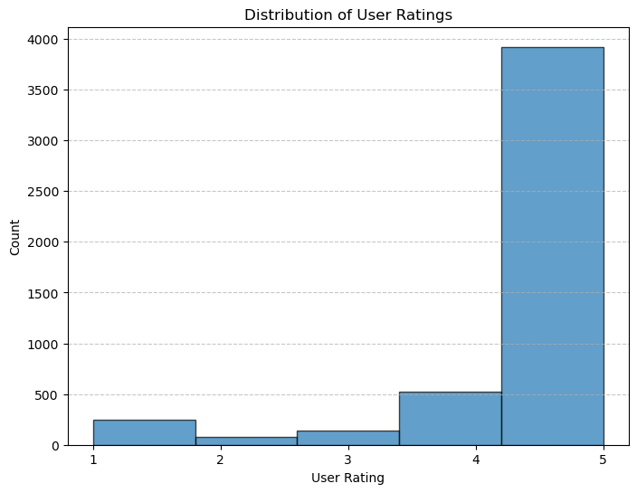
Exploratory Analysis Overview
Distribution of Ratings
Heavy class imbalance

Slide 9
Review Length vs. Review Results
Observations:
Analysis of review length did not show a clear correlation with user ratings.
Distribution of review lengths across different ratings was examined.
**Review length vs userRating was removed for organization. Lack of actionable insights along with documentation did not require the code to remain.

Slide 10
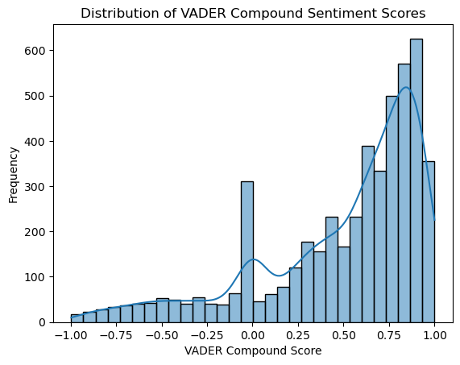
VADER Sentiment Analysis Distribution
Explore the overall distribution of Vader sentiment compound scores
Observe alignment with the class imbalance in user ratings
Utilize a histogram to visualize the distribution pattern

Slide 11
Detailed Vader Sentiment Analysis
Analyze the distribution of Vader sentiment compound scores
Heavily right-tailed distribution on histogram aligns well with the overall distribution from the userRating(target variable) right-tailed distribution.
This indicates the potential to use vader sentiment compound scores as an additional column for modeling.

Slide 12
Model Selection
Models Chosen:
Random Forest Classifier
Support Vector Machine (SVM)
Logistic Regression
Reasons for Model Selection:
Random Forest Classifier: Robust ensemble method suitable for classification tasks, handles non-linear relationships well.
Support Vector Machine (SVM): Effective for high-dimensional data, especially beneficial when dealing with text data for sentiment analysis.
Logistic Regression: Well-suited for binary and multiclass classification, interpretable, and computationally efficient.

Slide 13
Hyperparameter Tuning
Grid Search for Optimal Hyperparameters:
Conducted grid search for Random Forest and SVM models.
Tuned parameters like n_estimators, max_depth, C, and gamma.
Optimal Hyperparameters:
Random Forest: {'max_depth': None, 'n_estimators': 200}
SVM: {'C': 10, 'gamma': 1}
Insights:
Fine-tuned Models: Optimized models for improved performance.
Balancing Complexity: Achieved a balance between model complexity and accuracy.

Slide 14
Model Performance Evaluation
Random Forest Classifier:
Accuracy: 97%
Key Strengths: High overall accuracy, robust performance across classes.
Considerations: Slight variability in class-specific metrics.
Support Vector Machine (SVM):
Accuracy: 99.5%
Key Strengths: Exceptional accuracy, especially in predicting positive and neutral sentiments.
Considerations: Potential overfitting, further investigation needed.

Slide 15
Comparative Analysis
Model Comparison:
Random Forest vs. SVM: Both models show strong performance.
Decision Criteria: Consider trade-offs between accuracy and potential overfitting.
Recommendation:
Random Forest: Robust overall performance, suitable for deployment.
SVM: Caution advised due to potential overfitting.
Insights:
Optimal Model Selection: Decision based on a balance between accuracy and model complexity.
Future Exploration: Investigate SVM's potential overfitting for fine-tuning.

Slide 16
Cross-Validation for Overfitting Check
Support Vector Machine (SVM) Results:
Mean Accuracy: 98.97%
Fold-wise Accuracy: [95.74%, 99.64%, 99.82%, 99.80%, 99.82%]
Random Forest Results:
Mean Accuracy: 97.28%
Fold-wise Accuracy: [89.36%, 99.18%, 99.31%, 99.26%, 99.29%]
Purpose:
Overfitting Check: Utilized cross-validation to assess generalization performance.
High Consistency: Strong consistency in accuracy across folds supports robust model performance.
Implications:
Model Reliability: Cross-validation adds confidence in the models' generalization.
Further Assessment: Continue monitoring model performance in real-world scenarios.

Slide 17
Utilize Sentiment Analysis for Improved Customer Understanding:
Implement sentiment analysis tools to gain deeper insights into customer sentiments expressed in reviews.
Leverage these insights to enhance product features, customer service, and overall user experience.
Identify areas of strength and improvement, enabling targeted strategies to address customer needs and concerns.

Slide 18
Optimize Marketing Strategies through Feature Preferences:
Analyze the sentiment analysis results to identify customers' favorite and least liked features.
Develop targeted marketing campaigns highlighting popular features and addressing concerns associated with less liked aspects.
Maximize marketing capital by tailoring promotional efforts to align with customer preferences, ultimately driving product awareness and sales.

Slide 19
Practical Considerations and Future Work:
Practical Considerations:
Regularly update sentiment analysis models to adapt to evolving language and customer expressions.
Monitor and address any potential bias in sentiment analysis models to ensure fair and accurate results.
Suggestions for Improvement:
Explore advanced natural language processing (NLP) techniques for even more nuanced sentiment analysis.
Conduct A/B testing on marketing strategies to measure the impact of feature-focused campaigns.
Future Work:
Investigate the impact of sentiment analysis on long-term customer loyalty and retention.
Expand the analysis to include additional data sources, such as social media, for a more comprehensive understanding of customer sentiments.

Slide 20
Conclusion
The project successfully addressed the challenge of sentiment analysis for customer reviews, providing valuable insights into customer sentiments.
Utilizing machine learning models, we achieved high accuracy rates, particularly with Support Vector Machine (SVM) and Random Forest models.
The incorporation of Vader sentiment analysis enhanced our understanding of customer sentiments, aligning well with userRating distributions.
Recommendations include leveraging sentiment analysis for customer communication improvement and implementing targeted marketing strategies.
Ongoing model updates and exploring advanced NLP techniques are essential for maintaining effectiveness in a dynamic linguistic landscape.

