Slide 1
FWIP adVenture
Presentation Overview
Team Roles
Selected Topic
Why we chose the topic
Description of source data
Technologies that will be used
Questions we hope to answer

Slide 2
Team Roles
Square: Paul Isenberg
Triangle: Irina Tilak
Circle: Fahima Muthuvappa
X: Winston Shih

Slide 3
Selected Topic
After some extensive searches through Kaggle, we settled on Startup Investments data. The majority of the team has a background in finance and the dataset piqued our interest. In addition, we believe that the dataset is complex and would give us an opportunity to get more experience with the ETL process, and provide good visualizations. Also, we felt that we could apply machine learning technologies after cleaning and merging the data. We want to see if we can predict which companies will be successful and determine which features would contribute to a successful project. The csv’s each have at least one primary key that should allow us to combine the datasets for when we start preprocessing.
Notes:
We selected it because we can apply machine learning technologies, cleaned merged, applied, job hunt-what companies to avoid. We hoped to be able to use the dataset is complex and thought that we could get more experience with ETL process, good visualizations, and we want to know if can predict successful projects and figure out what features contribute to a successful project.

Slide 4
Description of Source Data
11 csv’s
CSV’s contain
Acquisitions
IPO’s
Degree level of individuals in startup world
Funding
Location
Primary Keys

Slide 5
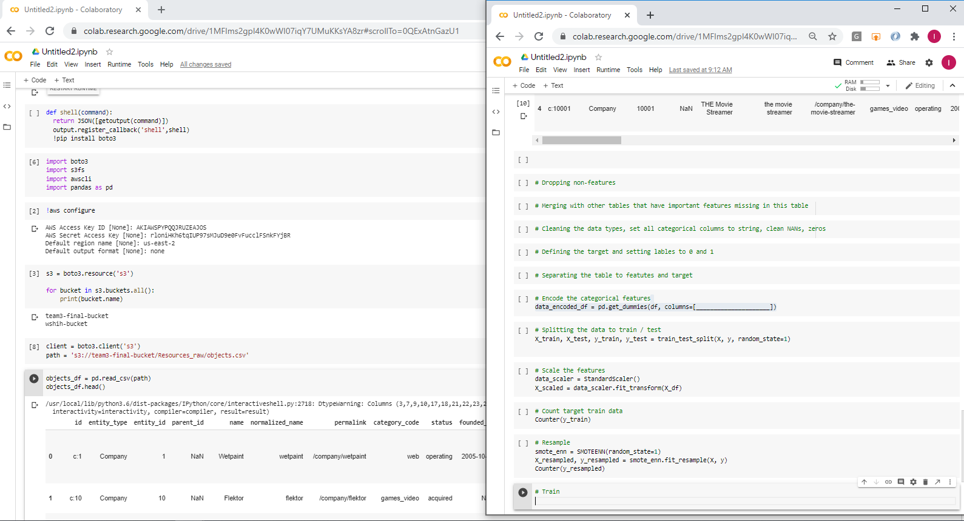
Accessing the Data
The dependencies we’ll be using to directly connect to the S3 bucket are boto3, s3fs, and awscli.

Slide 6
Mockup of Commands
These are the preliminary steps we will take to process our datasets before applying machine learning.

Slide 7
Technologies
AWS S3
GitHub
Jupyter Notebook or Google Colab
PostgreSQL/pgAdmin4
Supervised Machine Learning
Neural Networking
Tableau
Leaflet
Slack/Zoom

Slide 8
Questions We Hope to Answer
With machine learning techniques we would want to know:
What attributes lead to a startup failure?
With analysis and visualization we would like to find out:
What does it take to be successful? Any correlation with:
How much time
Education level
Location
Industry
ROI for investors
Investments vs Valuation
Notes:
We hope to use machine learning to answer these questions

Slide 9
Visualizations with Tableau
1: Geography
Bubble map by mega-region
2: Financial
Bar chart: Investment Rounds by Funding $ Amount
3: Time
A temporal measure of how long companies remained operating (0-6 months, 7-12 months, 1-2 years, 3-5 years, 5+ years
Notes:
Visualizations will focus on 3 areas.

Slide 10
Visualizations with Tableau
4: Interactive (map)
By Zip Code, hover will display company names
5: Best location to launch a startup
Reason 1
Reason 2
6: Success rate by degree
7: Prediction
Training, testing sets plot as a line chart for best model

Slide 11
Machine Learning Model
Preliminary Data Processing:
We verified primary keys across all tables to establish a baseline form of consistency within the data and to allow joining of tables/dataframes in SQL/Python respectively.
Most categorical values were encoded. We plan on applying a scale of values (0-5) to C-level employee degrees to quantify the categorical values.
Due to various inconsistencies within the data, we narrowed our scope to US startups with an inception date of no earlier than 01-01-2000.
Binning was used for US regions based off of company locations and the lifespan of each company.

Slide 12
Machine Learning Model
Splitting Data:
Our first ML tested for acquisitions, isolating startups with an ‘acquired’ status and compared to:
1. If the company sold a product.
2. Region
3. Company age
4. Total rounds of funding
5. Total number of participants over all rounds of funding.

Slide 13
Machine Learning Model
Model Choice: Logistic Regression
Limitation: Potentially oversimplified and tends to not do well with binary data, and more prone to overfit in high dimensional dataset.
Benefits: Simplified, memory efficient, 0.977 accuracy (vs DL, SVM, RF 0.96 accuracy)
Progress: We will continue to explore into Neural Networks and explore further modeling.

