Slide 1
Hackathon Project
Team: All Your Base Are Belong to Taco Bell
Version: 2.0
Last Updated: 4/10/17
Team: Paul Dix, Matt Koster, Scott Seifert, Patrick Kaufman, Derek Higgins, Jeff Rose

Slide 2
Event Details
SharePoint Site: http://community.nml.com/sites/etm/innovation_framework/hackathon/SitePages/BotHackathon2017.asp
Hackathon Dates (April 27th and 28th)
Those two days will be 2 work days where we spend the entire day ‘hacking’ to complete the app.
Location: Potawatomi
Detailed Schedule: http://community.nml.com/sites/etm/innovation_framework/hackathon/_layouts/15/start.aspx#/SitePages/EventSchedule.aspx

Slide 3
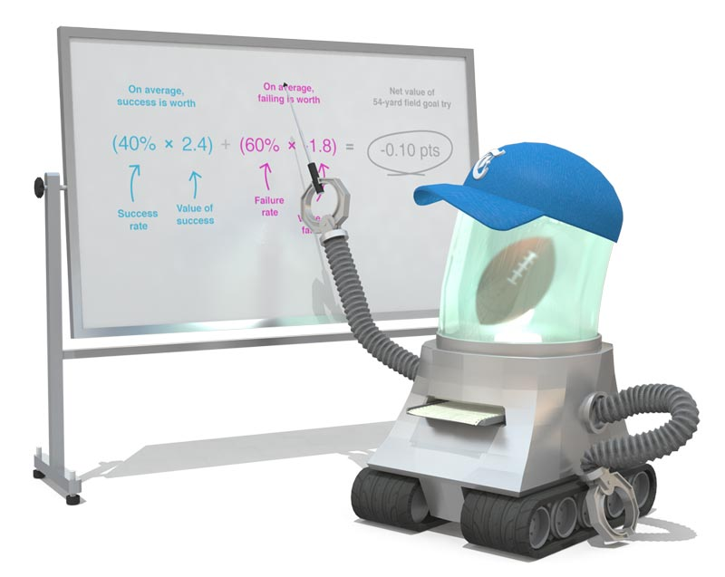
Concept: NFL and the 4th Down Bot
NYT 4th Down Bot
Created by Brian Burke, founder of AdvancedNFLStats.com.
Analysis of all games since 2002.
A coach should be trying to maximize the point spread between his team and his opponent – that is, scoring as many points as possible while suppressing his opponent’s opportunities for points.
Early in the fourth, point maximization is the name of the game.
http://www.nytimes.com/newsgraphics/2013/11/28/fourth-downs/post.html

Slide 4
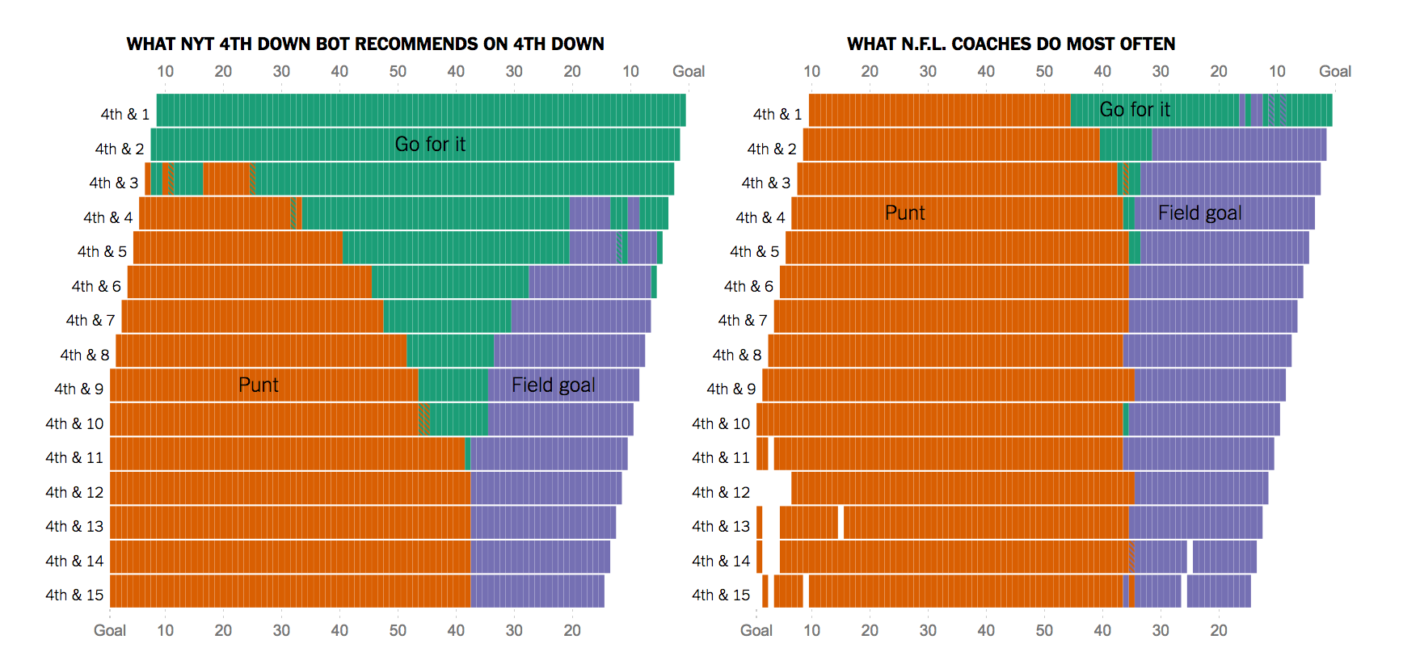
Concept : NFL and the 4th Down Bot - Comparison
NFL Coaches need good advice in every game to maximize their chances for success
Look at the difference
Left hand side – What the bot recommends
Right hand side – What NFL coaches do most often
http://www.nytimes.com/newsgraphics/2013/11/28/fourth-downs/post.html

Slide 5
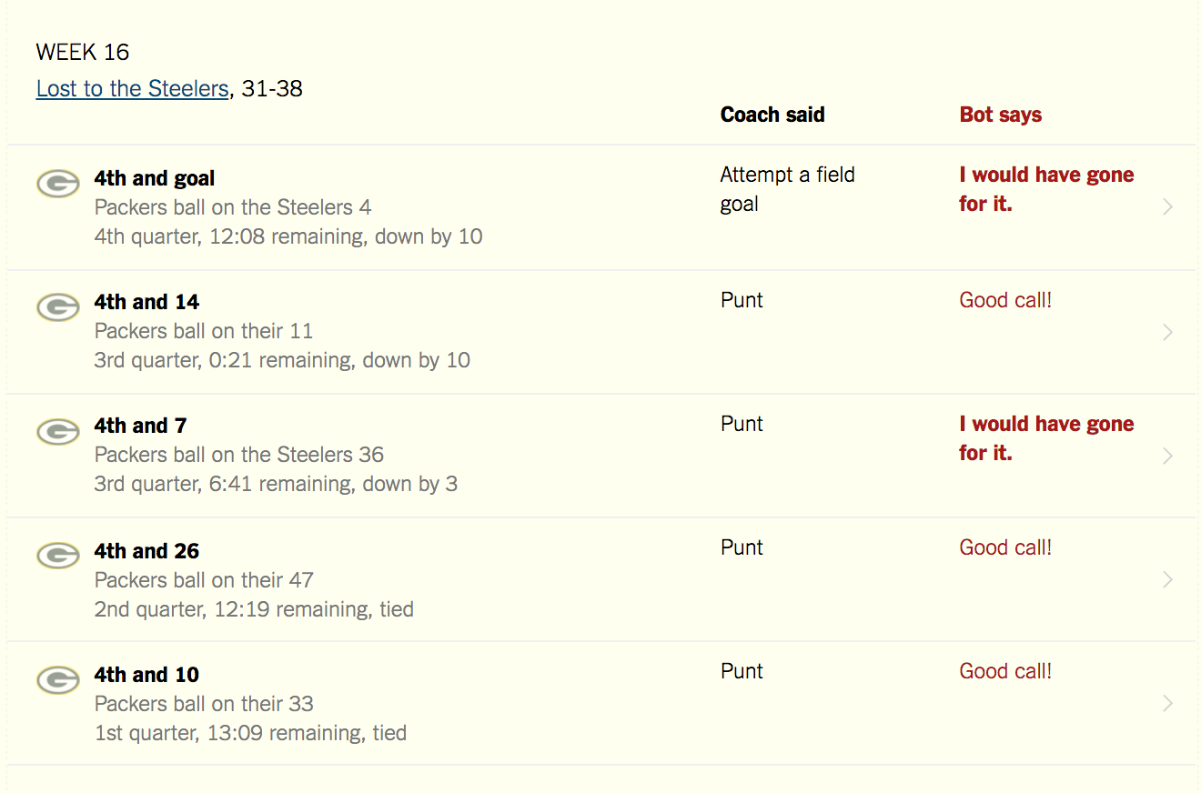
Concept : NFL and the 4th Down Bot – Sample Game
Example Game – 2013 Season – Week 16 vs. Steelers
Six tries – Two times the coach and bot disagreed on the right call
http://www.nytimes.com/newsgraphics/2013/11/28/fourth-downs/post.html

Slide 6

Hackathon Idea : NM Virtual Coach
NM needs to retain and develop young talent for our field force
Millennial FR’s need coaching and are open to using new technology such as bots
Al Granum ‘one card’ system is a proven client builder tool but how do we get Millennial FR’s to use it?
What if we developed a coach for young FR’s to help them on a daily basis feedback based upon:
One Card
Personalized feedback
Daily, Weekly and Monthly Production Goals
Gamify it to keep the Millennial FR’s coming back for more!!!

Slide 7
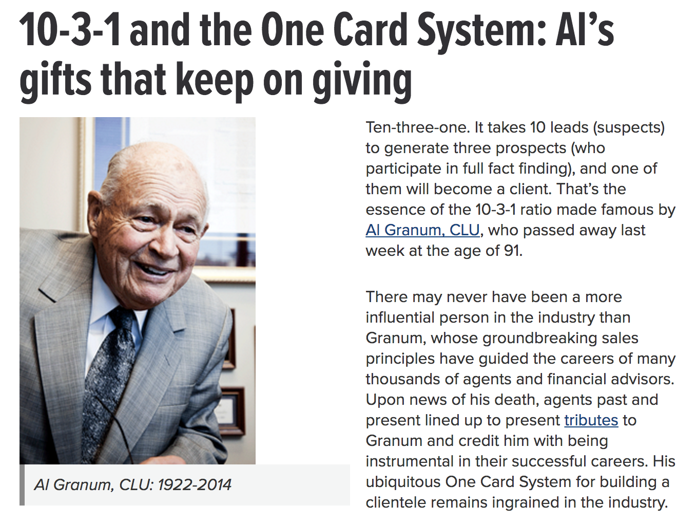
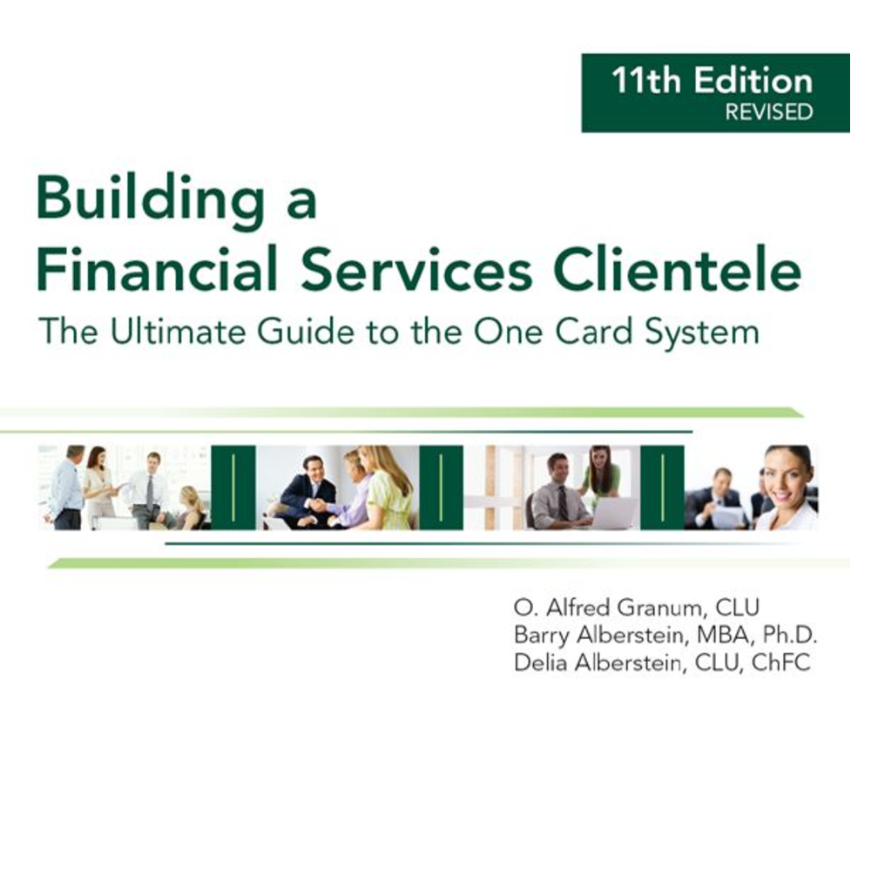
Hackathon Idea: One Card Background
Al Granum – NM Rep and creator of the One Card System
Coach FR’s Pipeline

Slide 8
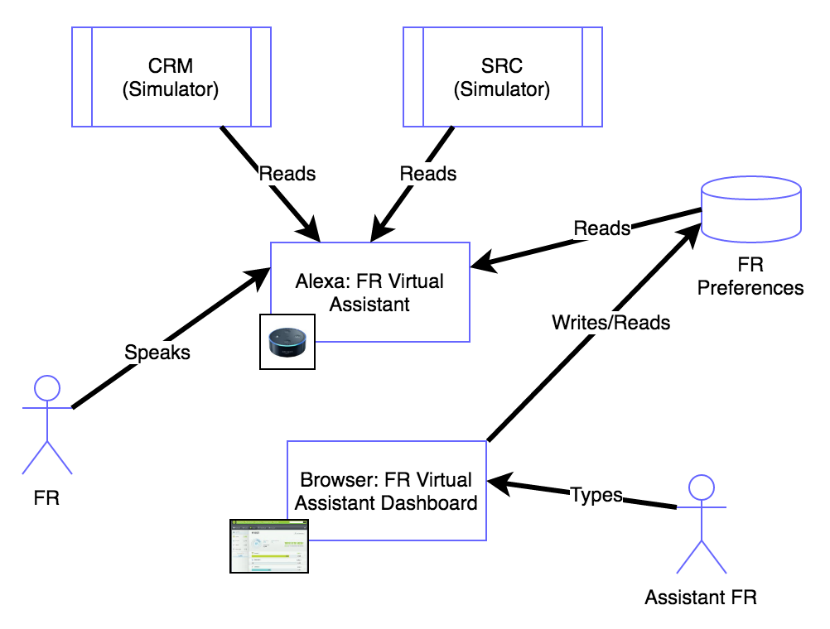
High Level Architecture (Full)
FR does voice commands with Alexa
Assistant FR uses Virtual Assistant Dashboard to optimize FR’s experience (think preferences, tailoring, etc…)
FR Preferences DB stores this information for FR Virtual Assistant skill to use when interacting with the FR
Integrations with CRM, SRC and other NM systems are used to perform varoius tasks
Could be Alexa or another technology
Use from mobile device, car, dedicated device (AWS, Google), etc....
Notes:
multiple devices
Picked one here today,
In the car, wouldn’t it be nice to just talk to the bot to help out the FR

Slide 9
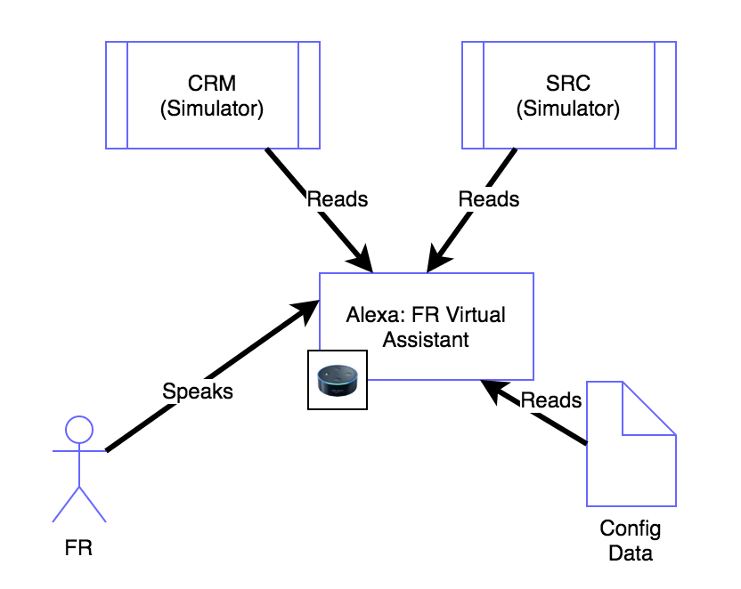
High Level Architecture (MVP)
FR does voice commands with Alexa
IT support team sets up preferences as config data
Integrations with CRM, SRC and other NM systems are used to perform various tasks

Slide 10
Tools
Alexa (actual or Amazon Developer Console tester)
Python Alexa Skill
Python, Flask, Ask Flask packages
ngrok
Reverse proxy for exposing locally running flask server for testing skills
Atom
Editor
Github
Store all code and doc in public github
Sample: https://github.com/PaulJDix/nmhack17-sample-memorygame
Don’t need NM network connection or resources
AWS Lamda function (python)

Slide 11
CI/CD
MVP
Use tools indicated to do all tests runs locally
Use Github to merge code base, single developer machine becomes prod
Rel v 2.0
Use AWS Lamda python support
Deploy code to AWS Lamda manually
Rel v 3.0
Pipeline (Frank’s CI/CD toolset except with python)
Refer to recording of Alexa lunch and learn for more details

Slide 12
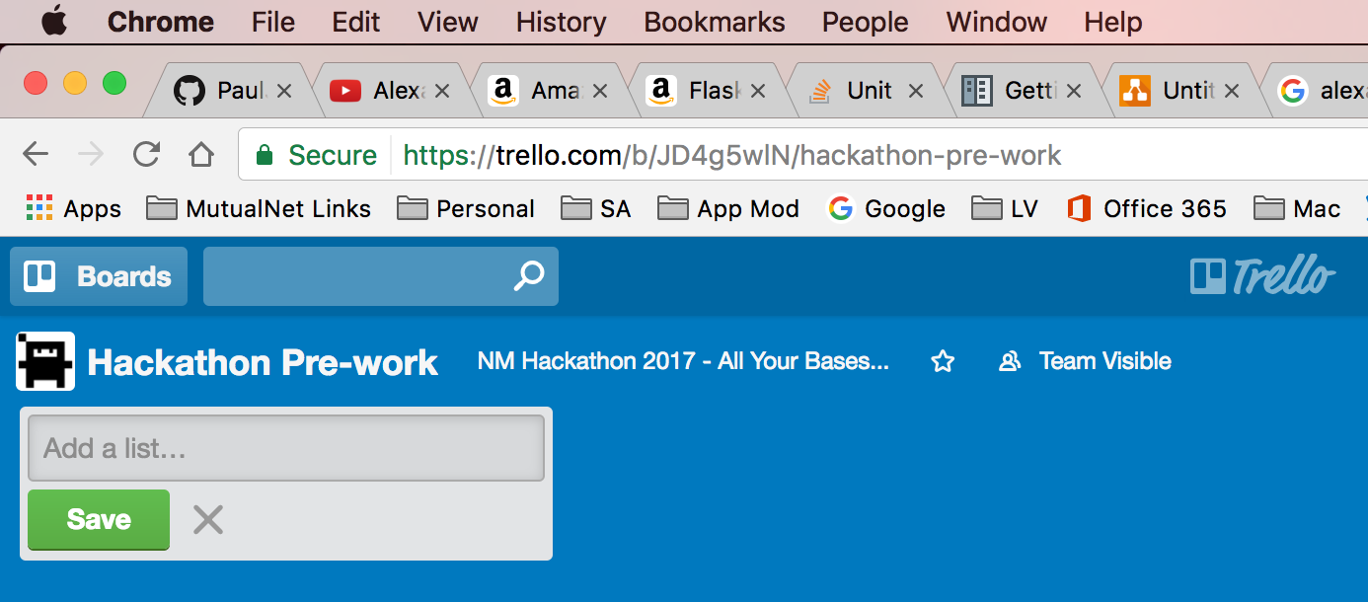
Team Tasks
Number | Task | Assigned/Status
1 | Alexa Python Service prototypes | ???
2 | Database and REST service | ???
3 | UX Flask Application | ???
4 | CI/CD Pipeline | ???
5 | Etc… | ???
Trello Board:
https://trello.com/nmhackathon2017allyourbases
Board for pre-work tasks
Board for 2 day event
Helps keep team organized
Simple, easy to use

Slide 13
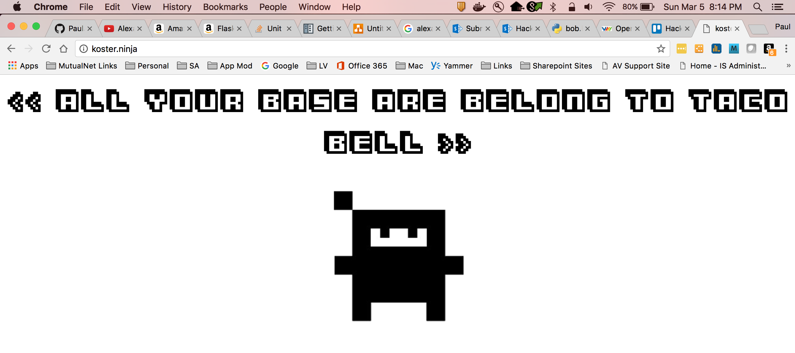
Team Name

Slide 14
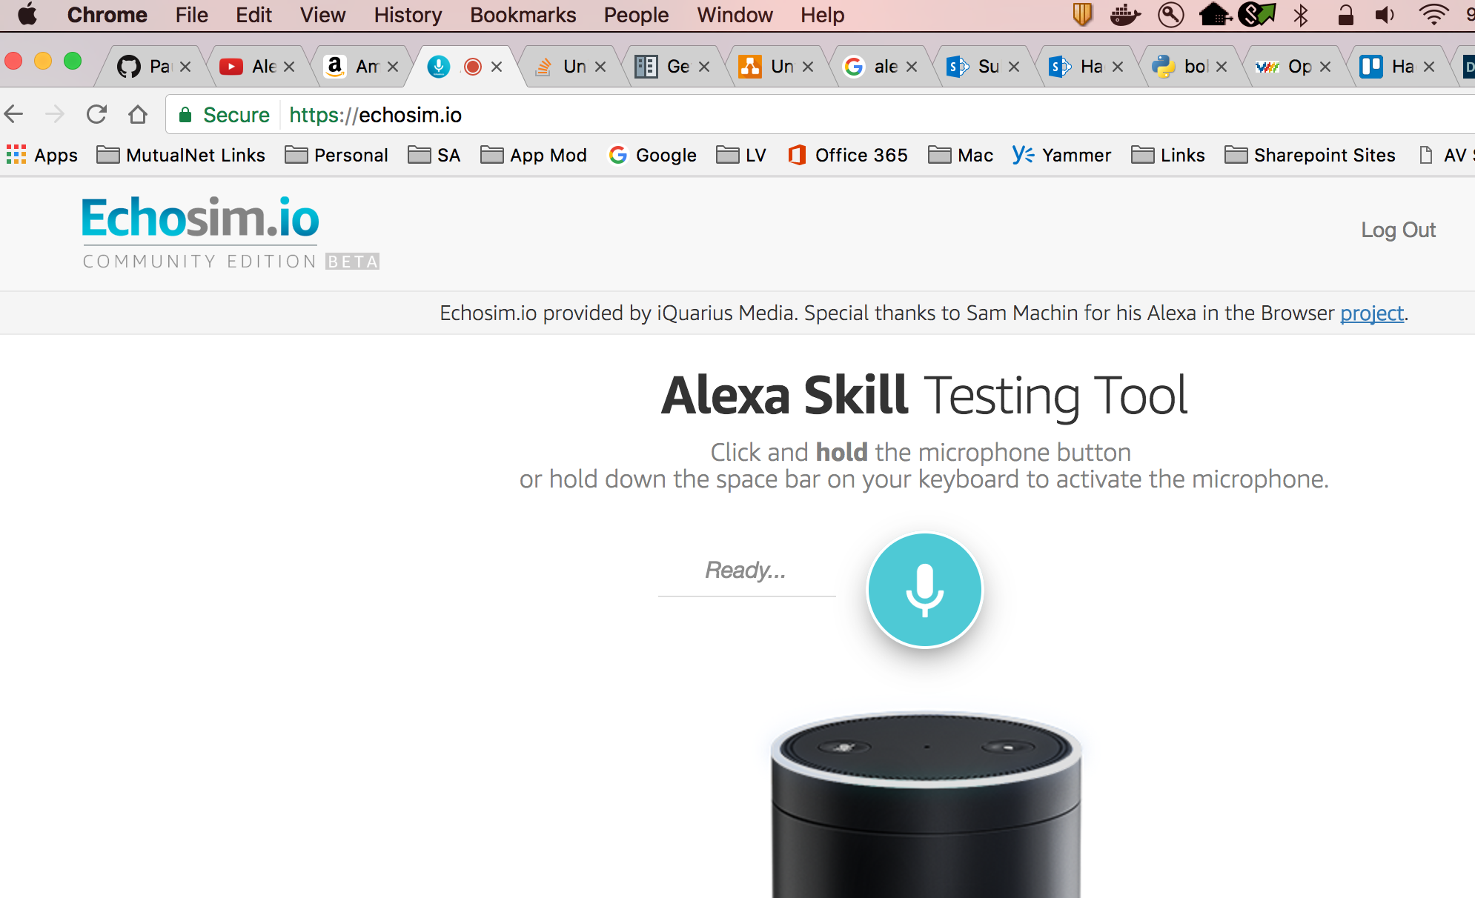
Another Testing Tool… (https://echosim.io/)

Slide 15
Appendix

Slide 16
Idea: FR Virtual Assistant
FR’s are very busy people
They are often out of the office
They lack time to spend with their AFR’s (Assistant FR’s)
They have a lot of time where the cannot see and interact with traditional devices such as a computer or mobile device
A voice controlled bot (i.e. Alexa) can act as a AFR and…
Communicate important information
Take actions on the FR’s or AFR’s behalf
Etc...

Slide 17
Use Cases (old list)
Calendaring
Setting: Early AM, FR coming into work
Alexa reads all schedule meetings for the day so the FR does not need to open his calendar.
Service Requests
Setting: Anytime
Alexa reads all open service requests where the FR is listed as the primary or secondary rep
Underwriting
Setting: Anytime
Alexa reads all open UW cases where the FR is listed as the primary or secondary rep.
Next team meeting: Generate more ideas. What’s reasonable and doable?

Slide 18
Interviews with CRM Team (April 2017)
Discussed our teams Hackathon with CRM Bus Analysts
Ran the initial ideas we have past them
Endorsed those, refined those, etc…
Have resources that we can discuss our use cases with further
May discover a few more deals or new ideas when we speak with them further
Started 4/5 to present and till Hackathon date….

Slide 19
Use Case #1 – Appointment Assistant
Call Queue
Daily status briefing – Read off call queue for an FR for the day
Highlight A and A+ clients on this list
Follow Up Activities (CRM Workflow?)
List of follow up activities and due dates
What’s behind, status, etc….
It’s an NM Mobile App already (Posting Plus)
Can get demo of that for the team
See that and how to incorporate our bot into Posting Plus
CRM Resource: Joe Manning

Slide 20
Use Case #2 – SRC Status / CRM Opportunity Record
Status on Service Requests on A+ and A Clients
Important enough to be on their daily status briefing
CRM Opportunities Record
Tie SRC request to opportunities record
Need to research this integration for this
CRM Resource: Luke Kovarik / Joe Manning

Slide 21
Use Case #3 – Book of Business - Goals
Book of Business is…
Tracks Sales to Sales Goals for FR’s
Goals vs. Actuals
Idea: Daily status – “Did you know you two DI sales short of your goal for this month?”
Idea: Daily status – “Did you know you are in 2nd place in your region for top LTC sales this quarter?”
Discuss with BoB what are our actual use cases
Discuss how to expose these ‘Alerts’ to the Daily Status Briefing we do
CRM/BoB Resource: Kim Salmons

