Slide 1

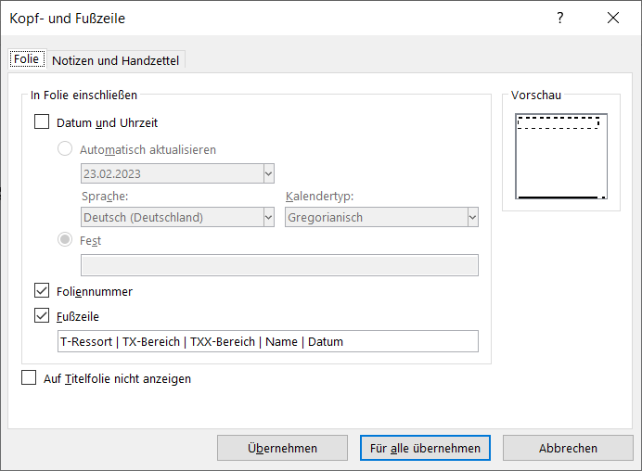
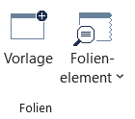
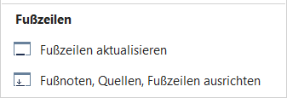
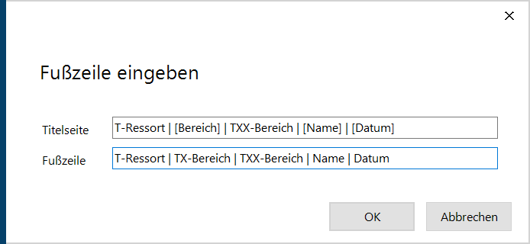
T-Vorgaben für die Masternutzung
Wir differenzieren uns zukünftig über eine individuelle Fußzeilenlogik. Logos, Visuals, Signets werden zukünftig nicht mehr auf den Charts gezeigt!
Individualisierung für nicht easySlides Nutzer
Individualisierung für easySlides Nutzer

Slide 2

T-Ressort | [Bereich] | TXX-Bereich | Digital Team | 02.07.2024

Slide 4
Leadership
Responsibility
Driver for a Vision
Alignment & Decision -Making
1
Finding the best Solution
2
A Great Group
3
4

Slide 5
1
Driver for a Vision
Alignment & Decision -Making
Finding the best Solution
Leadership
Responsibility
2
3
A Great Group
4

Slide 6
1
Driver for a Vision
Alignment & Decision -Making
Finding the best Solution
Leadership
Responsibility
2
3
A Great Group
4

Slide 7
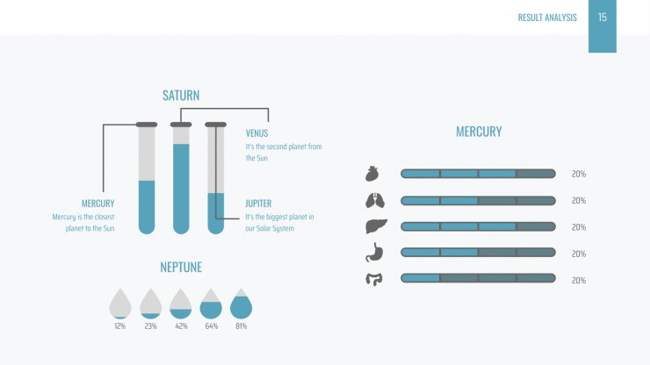
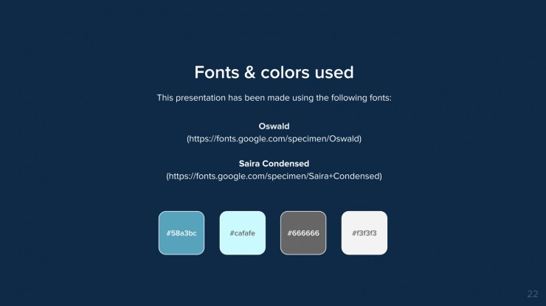
Motivate Internally and Externally
Set path
Risk: Not having one
1
Driver for a Vision
Delegation & Accountability
Memo: Coherent Decision Framework
Information Integration
Alignment & Decision -Making
Finding the best Solution
Leadership
Responsibility
2
3
Closer to the Truth: Pushing against Social Equilibrium
Constant Alignment
Decision Making: Information-Flow
Take the left decision
A Great Group
4
Protect the vision and the Group: Keeping the promise
*Joining

Slide 8
Motivate Internally and Externally
Set path
Risk: Not having one
1
Driver for a Vision
Delegation & Accountability
Memo: Coherent Decision Framework
Information Integration
Alignment & Decision -Making
Finding the best Solution
Leadership
Responsibility
2
3
Closer to the Truth: Pushing against Social Equilibrium
Constant Alignment
Decision Making: Information-Flow
Take the left decision
A Great Group
4
Protect the vision and the Group: Keeping the promise
*Joining

Slide 9
Vision
Alignment & Decision Making
Driver for a Vision
Decision
Solution
LR
Team
A Great Team
Finding the Best Solution
Notes:
Option 1: Cool and Professional
Driver for a Vision: Teal (#008080) – Calm and focused.
Alignment & Decision-Making: Soft Purple (#6A5ACD) – Reflecting balance and creativity.
Finding the Best Solution: Light Blue (#5DADE2) – Symbolizing clarity and insight.
A Great Team: Dark Blue (#2E86C1) – Evoking trust and teamwork.
Connecting Arrows or Circles: Dark Gray (#2F4F4F) – Neutral but strong, tying the elements together.
Central “LR” Text: Dark Gray or Black (#000000) – For contrast and emphasis.

Slide 10
Team
Collaboration
Alliance
1
Driver for a Vision
2
Alignment
& Decision -Making
3
Finding the best Solution
4
A Great Group
Responsible
Not responsible, but some aspect of the module are useful
Degree of responsibility/ usefulness

Slide 11
AIDA Model Diagram
Marketing is the study and management of exchange relationships. Marketing is the business process of creating relationships with and satisfying customers.
Driver for a Vision
Alignment & Decision -Making
Finding the best Solution
A Great Group
Your Title
To get your company’s name out there, you need to make sure, that’s why we provide point.
You need to make sure, that’s why we provide point.
Promotions only work as well as the marketing.
Promotions only work as well as the marketing.
Promotions only work as well as the marketing.
Promotions only work as well as the marketing.

Slide 12
Driver for a Vision
Alignment & Decision -Making
Finding the best Solution
A Great Group
Promotions only work as well as the marketing.
Promotions only work as well as the marketing.
Promotions only work as well as the marketing.
Promotions only work as well as the marketing.

Slide 13

Name
Team VDT
Tel. 069 265-xxxxx Mobil xxxxxxxxxxxxx
xxxxxxx.xxxxx@deutschebahn.com
TX Bereich
Jürgen-Ponto-Platz 2 | 60329 Frankfurt am Main
Name
Team VDT
Tel. 069 265-xxxxx Mobil xxxxxxxxxxxxx
xxxxxxx.xxxxx@deutschebahn.com
TX Bereich
Jürgen-Ponto-Platz 2 | 60329 Frankfurt am Main

