Slide 1
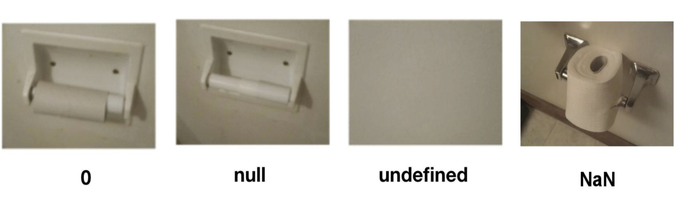
Pandas
Pandas.DataFrame.isna()
=
Pandas.DataFrame.isnull()
np.isnan()
NumPy
Dataframe
R
NULL
NaN
1. Missing or undefining Values
2. Does not return a value, when evaluatet though a expression.
1. Logical Statement: Nor True or False.
2. If a expression checks for NaN, the return is not true or false, but NaN.

