Slide 1
Generation of Challenging Networks for Optimization problems
Security Level:

Slide 2
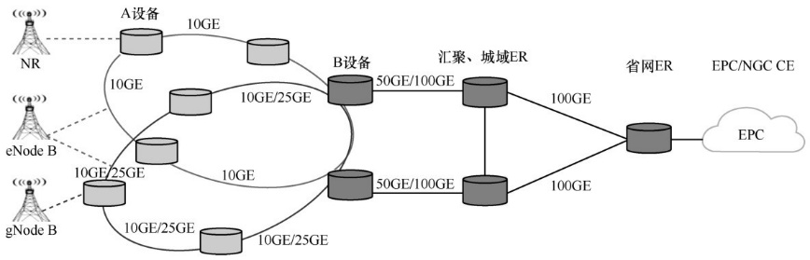
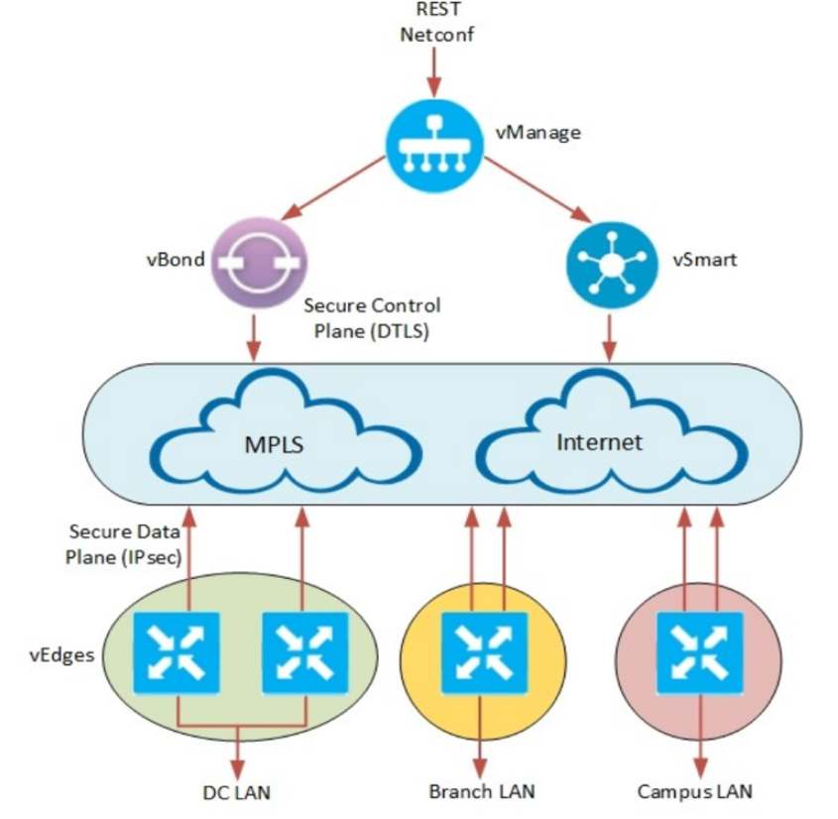
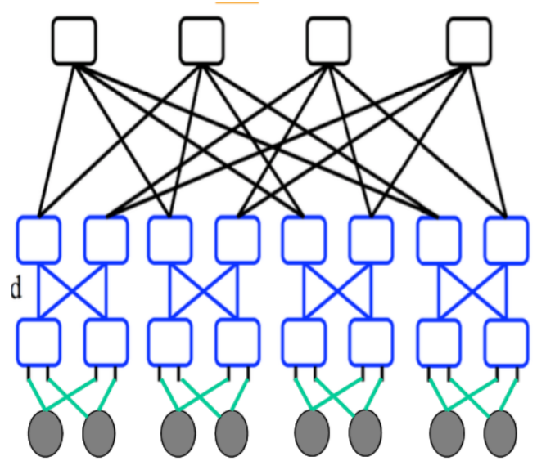
Context
(Network structures)

Slide 3
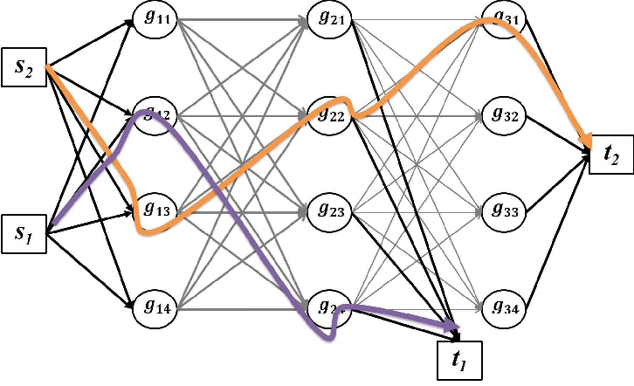
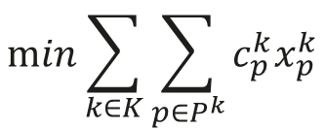
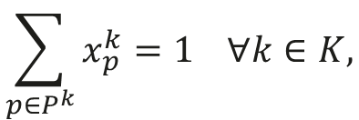

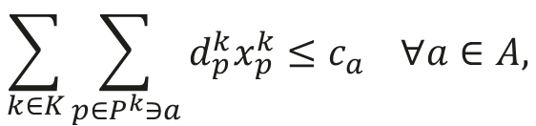
Context
(Optimization problems)
Multi-Commodity flow problem
$$\min{\sum_{k∈K}{\sum_{p∈P^{k}}{c_{p}^{k}x_{p}^{k}}}}$$
$$\sum_{p∈P^{k}}{x_{p}^{k}}=1 ∀k∈K,$$
$$\sum_{k∈K}{\sum_{p∈P^{k}∋a}{d_{p}^{k}x_{p}^{k}}}≤c_{a} ∀a∈A,$$
$$x_{p}^{k}∈\{0,1\}$$
For a given number of nodes, density and demand matrix, Generate 10 Challenging networks for the Multi-Commodity flow problem.

Slide 4
Generative Adversarial Network (GAN)
Input Noise
Generator
Generator Result
Generator Loss
Descriminator
Descriminator Loss
Real Result

Slide 5
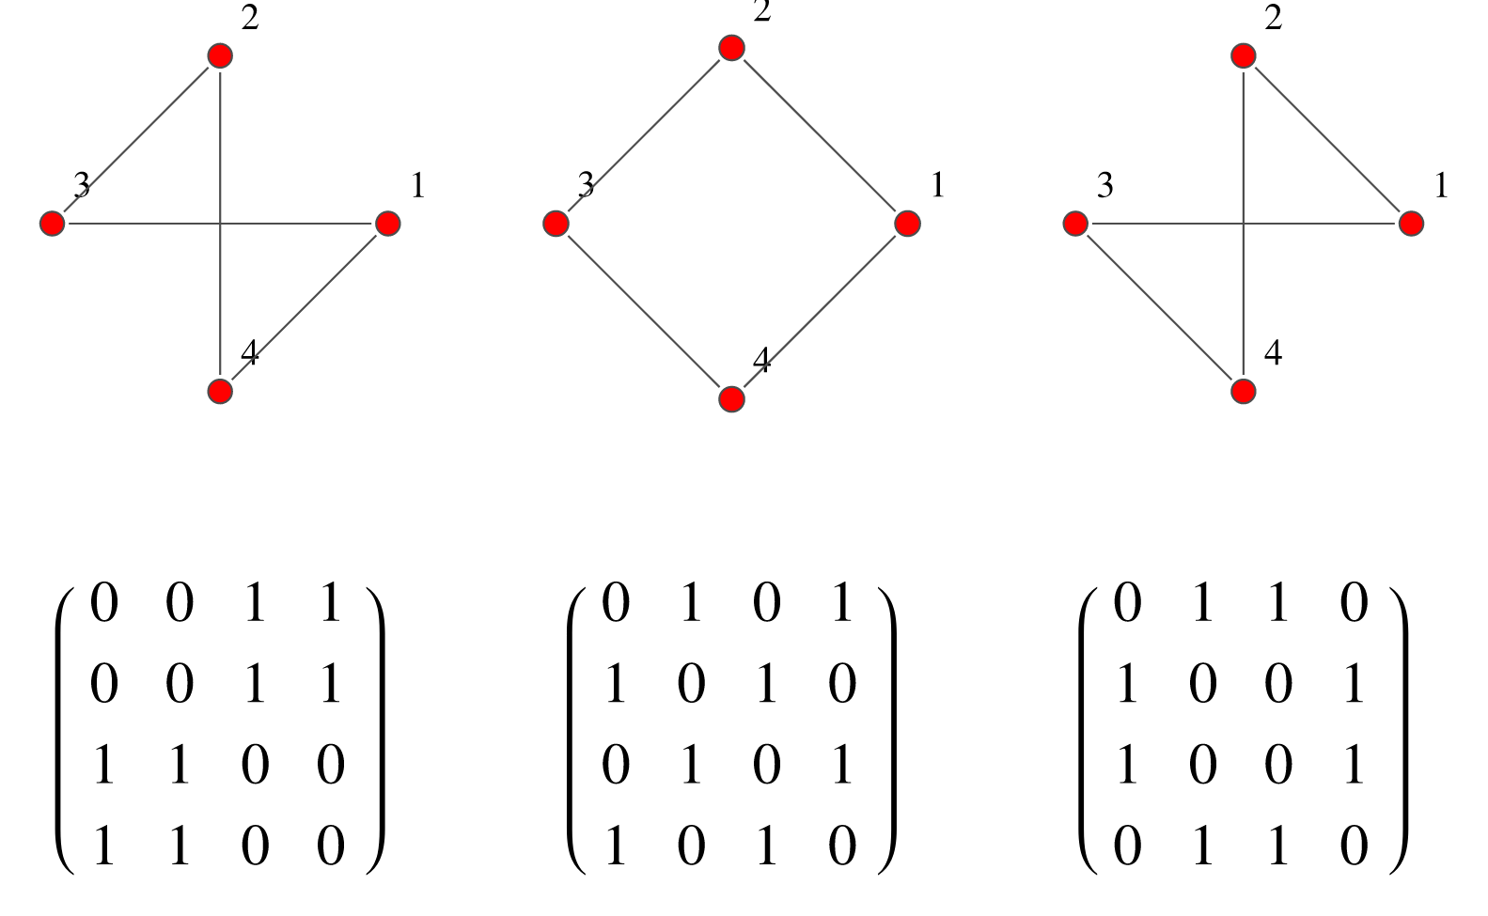
How to encode the network ?
Adjencency Matrix
Pictures
Is there other options ?
Is it necessary to add further information (Density, Min\Max Node degree, ….)

Slide 6
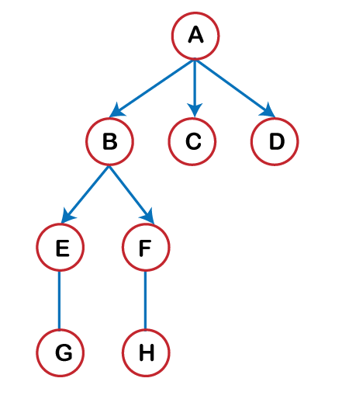
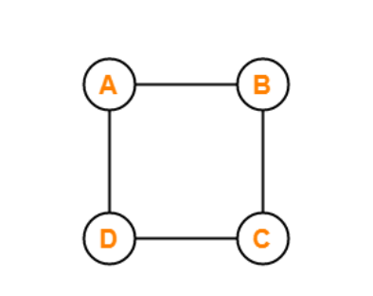
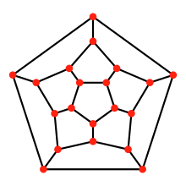
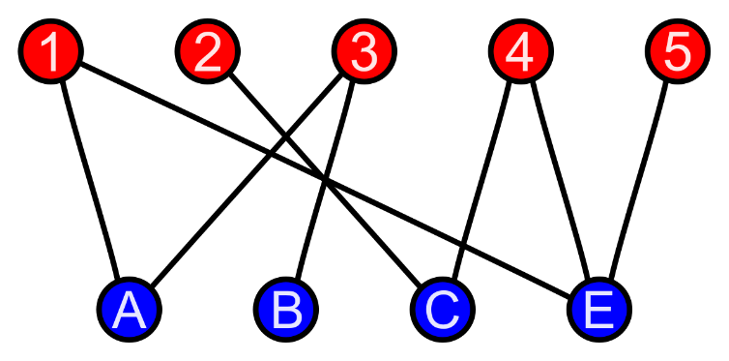
Starting Structures
Trees
Cycles
Bipartite
Planar

Slide 7
What about Optimization ?
Binary Variable (Hard\Easy)
Input Noise
Input Noise
Optimization model
GAN
Network
An instance is hard if :
CPU > 10 seconds
Optimality Gap > 40% at the time limit

