Slide 1
Clustering of YouTube News Channel Videos based on Title & Description
Jan Paul Kieffer Kong Hyeon Kim Chi Ying Zoe Lai Max Wurthmann

Slide 2
AGENDA
Motivation & Goals
Exploratory Data Analysis
Models & Methods
Tasks & Plan
Potential Problems

Slide 3
Motivation
What contents do English news channels post on YouTube?
Is there any focus on what topics they post?

Slide 4
Goals
Clustering by Topics
Comparing Clusters of each Channel
Comparing Clusters across Channels
Training-based Models
Non-training-based Models
Distance
Size, Popularity
Development over time
Relation between Title and Views
Differences
Similarities

Slide 5
Data collection
YouTube Channels covered:
DW-News
CNN-News
BBC-News
Al-Jazeera-English
Fox-News
CCTV-Videos-News-Agency
Dated:
Since 25.03.2023
Current dataset up to 17.05.2023
To be updated until modelling starts
Content includes: Title, Description, Views , Video Length, Upload Time, Data Retrieval Time

Slide 6
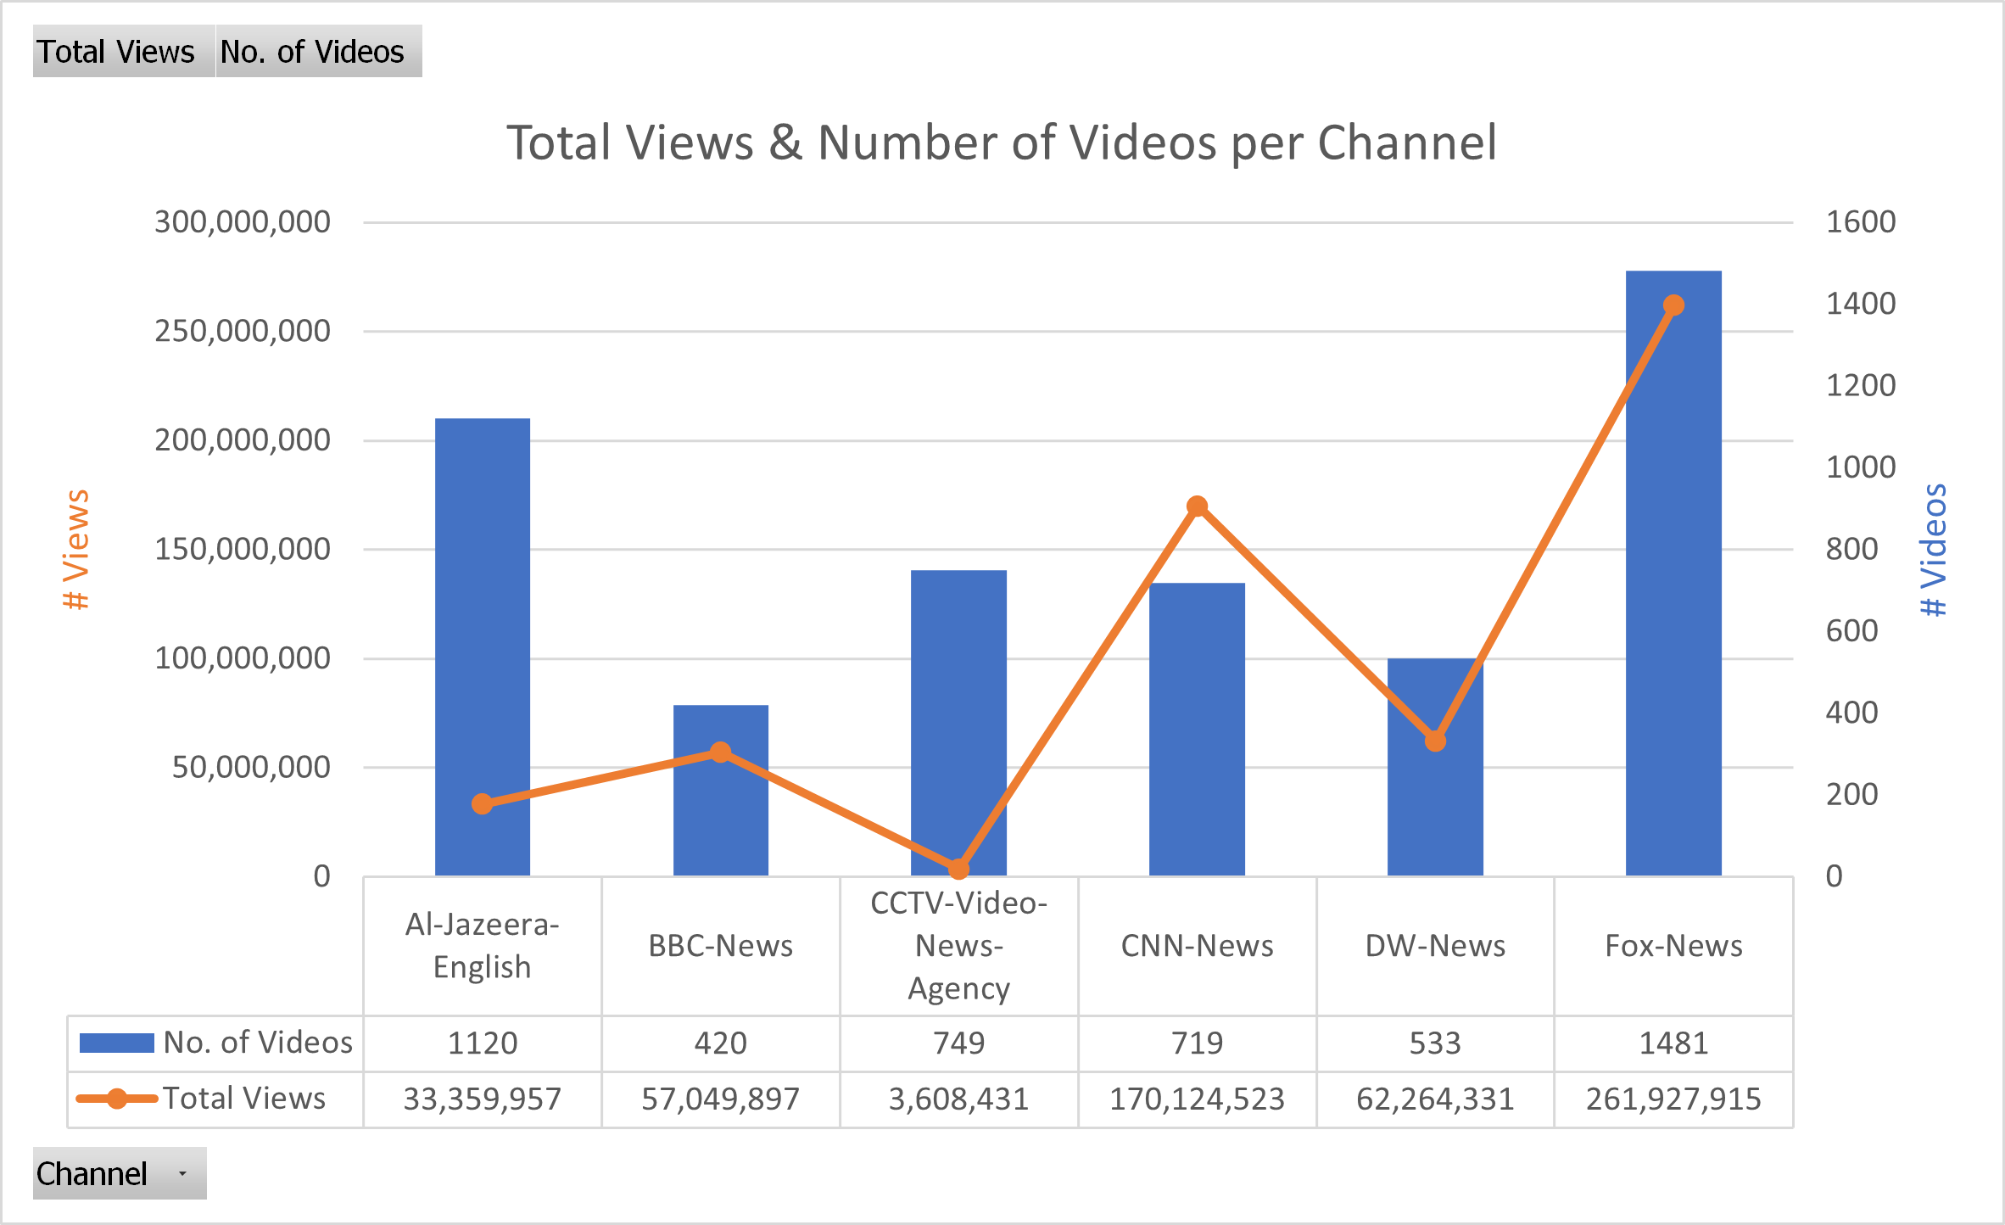
Exploratory data analysis

Slide 7
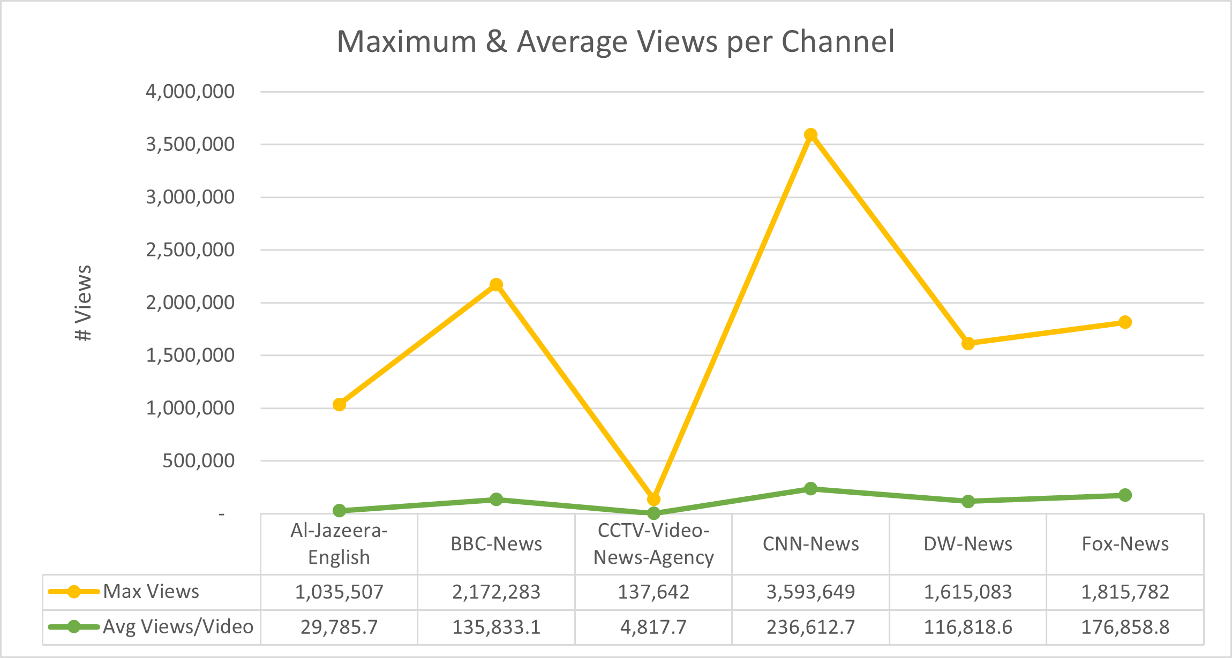
Exploratory data analysis

Slide 8
Models & Methods
Embeddings
Visualization
Doc2Vec
Contextual sentence embeddings using a pretrained Model
BERT, T5
Concatenate title and description, or
Input separately and then combine results
Wordcloud
Self-organizing Maps
Reduction and Plot
PCA
t-SNE

Slide 9
Models & Methods
Clustering
Topic Inference
Whole dataset: Representation of overall news
Separate dataset: Insights about each news channel
Unsupervised methods
K-Means Clustering
Self-organizing Maps
Path 1 (unsupervised):
Perform clustering
Extract an n-gram or tokens that are especially frequent
Path 2 (supervised):
Annotate parts of the data
Finetune a retrained model to predict the topic

Slide 10
Tasks
Paul
Problem Formulation, Model Overview
Zoe
Data Preprocessing, Slides Preparation
Max
Models and Methods
All
Model Application

Slide 11
Schedule
Timeline | Progress
End of May | Data preprocessing
Mid-June | Model selection
End of June | Model application
Mid-July | Evaluation

Slide 12
Potential problems
Insufficient dataset
Incomplete video descriptions
During scraping deleted commas and semicolons.

Slide 13
THANK YOU

