Slide 1
Clustering of YouTube News Channel Videos based on Title & Description
Jan Paul Kieffer Kong Hyeon Kim Chi Ying Zoe Lai Max Wurthmann

Slide 2
AGENDA
Motivation & Goals
Exploratory Data Analysis
Models & Methods
Tasks & Plan
Potential Problems

Slide 3
Motivation
What contents do English news channels post on YouTube?
Is there any focus on what topics they post?

Slide 4
Goals
Clustering by Topics
Comparing Clusters of each Channel
Comparing Clusters across Channels
Training-based Models
Non-training-based Models
Distance
Size, Popularity
Development over time
Relation between Title and Views
Differences
Similarities

Slide 5
Data collection
YouTube Channels covered:
DW-News
CNN-News
BBC-News
Al-Jazeera-English
Fox-News
CCTV-Videos-News-Agency
Dated:
Since 25.03.2023
Current dataset up to 17.05.2023
To be updated until modelling starts
Content includes: Title, Description, Views , Video Length, Upload Time, Data Retrieval Time

Slide 6
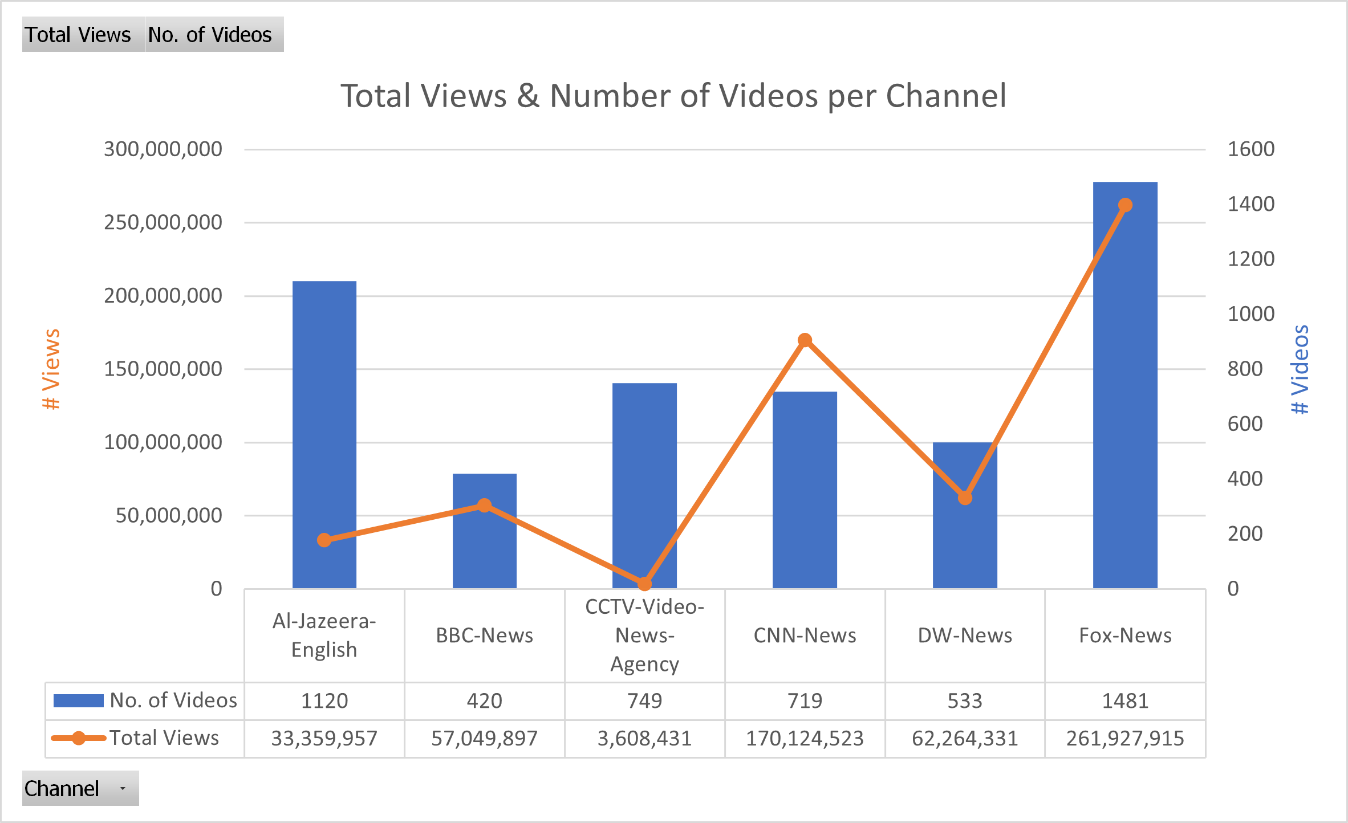
Exploratory data analysis

Slide 7
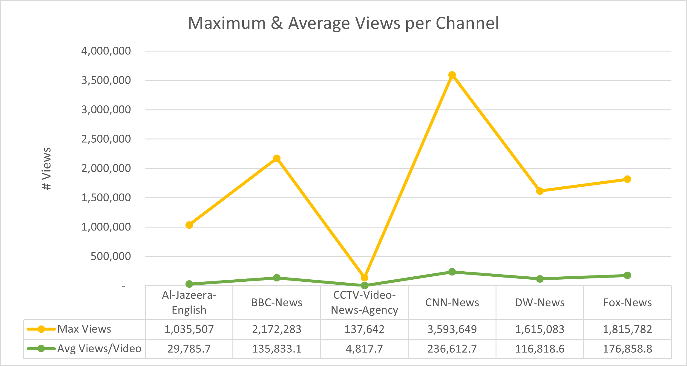
Exploratory data analysis

Slide 8
Models & Methods
Embeddings
Visualization
Doc2Vec
Contextual sentence embeddings using a pretrained Model
BERT, T5
Concatenate title and description, or
Input separately and then combine results
Wordcloud
Self-organizing Maps
Reduction and Plot
PCA
t-SNE

Slide 9
Models & Methods
Clustering
Topic Inference
Whole dataset: Representation of overall news
Separate dataset: Insights about each news channel
Unsupervised methods
K-Means Clustering
Self-organizing Maps
Path 1 (unsupervised):
Perform clustering
Extract an n-gram or tokens that are especially frequent
Path 2 (supervised):
Annotate parts of the data
Finetune a retrained model to predict the topic

Slide 10
Tasks
Paul
Problem Formulation, Model Overview
Zoe
Data Preprocessing, Slides Preparation
Max
Models and Methods
All
Model Application

Slide 11
Potential problems
Insufficient dataset
Incomplete video descriptions
During scraping deleted commas and semicolons.

Slide 12
THANK YOU

