Slide 1



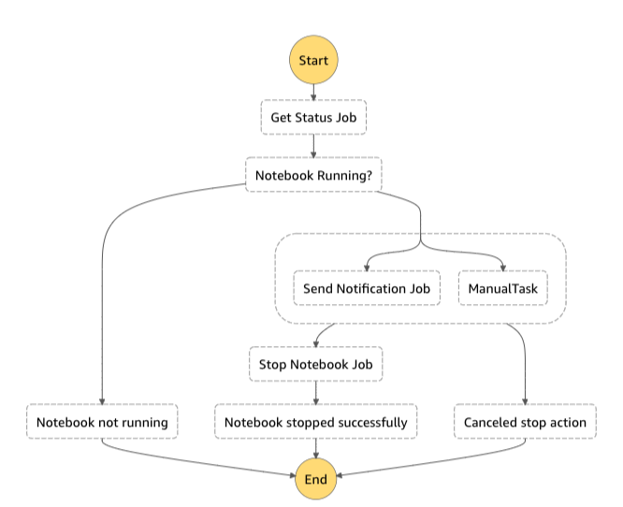



AWS Step Functions
workflow
Manual Step
Event (time-based)
Email
Succeed/Fail
StopInstance
SendTaskSuccess
SendTaskFailure

Slide 2
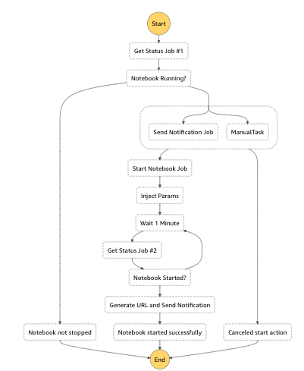
AWS Step Functions
workflow
Manual Step
Event (time-based)
Email
Succeed/Fail
SendTaskSuccess
SendTaskFailure
StopInstance

