Slide 1
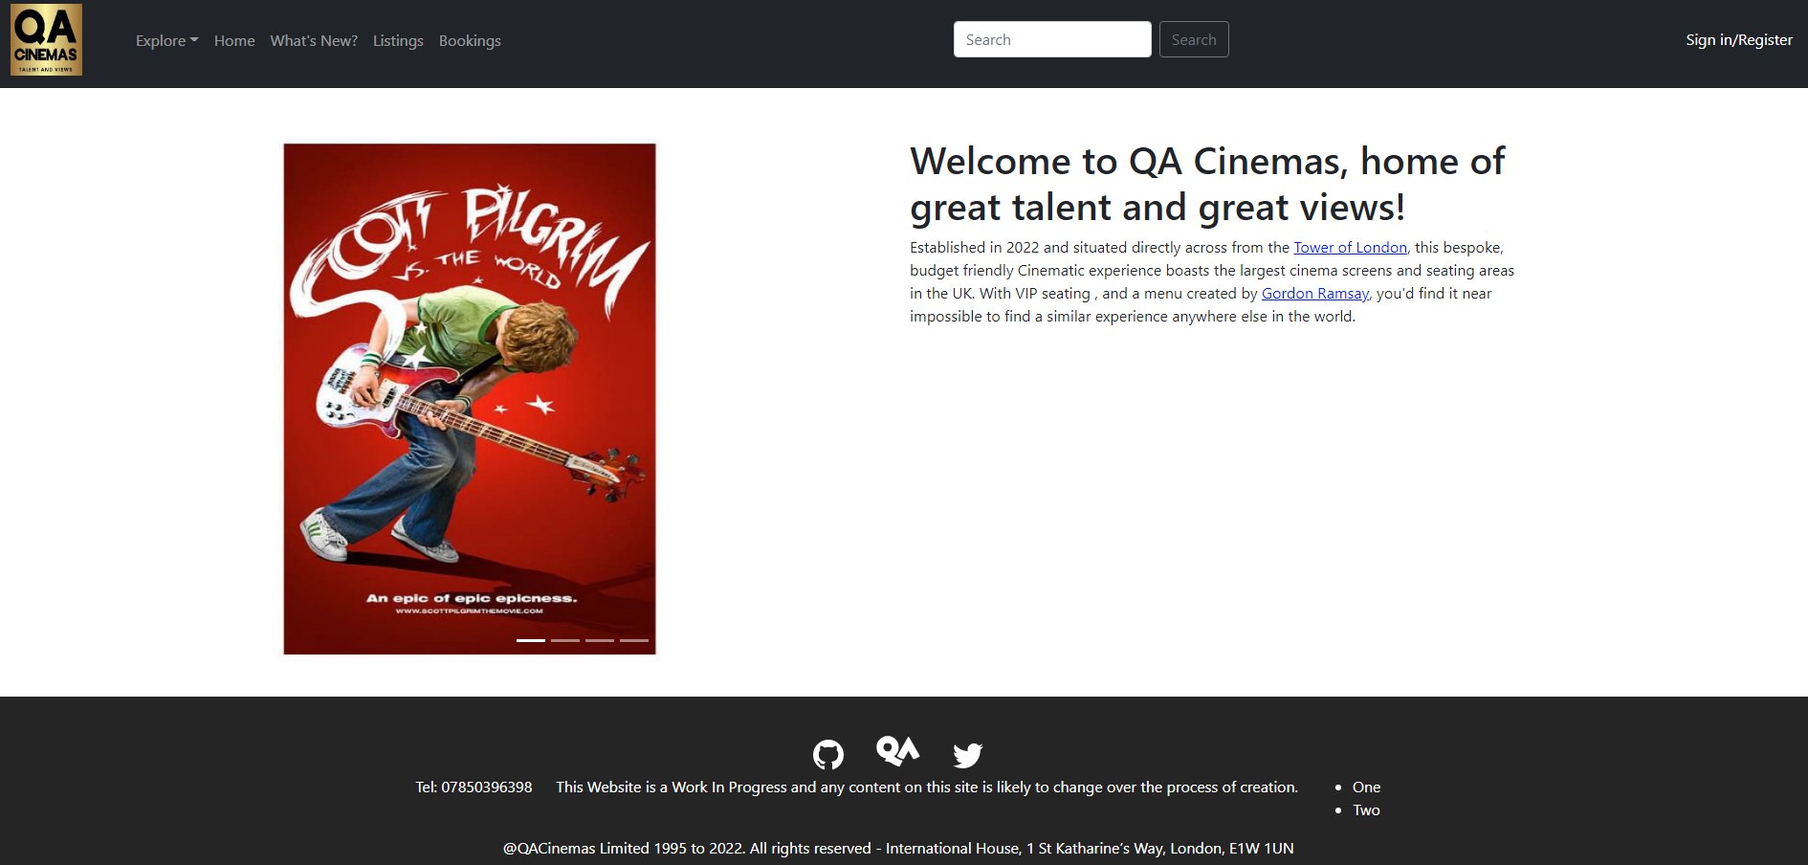
QA Cinema Website Project

Slide 2
Dev Team
Lee – Front End Development
Paul – Front End Development
Sayed – Scrum Leader and Back End Developer
Abdul – Back End Development
Daigor – MongoDB, Documentation, and Support.

Slide 3
Technologies Used and Learned
React Bootstrap (JSX)
Javascript, utilised for building APIs
Node/Express/MongoDB
Github used for version control
Jira for planning purposes

Slide 4
Dependencies

Slide 5
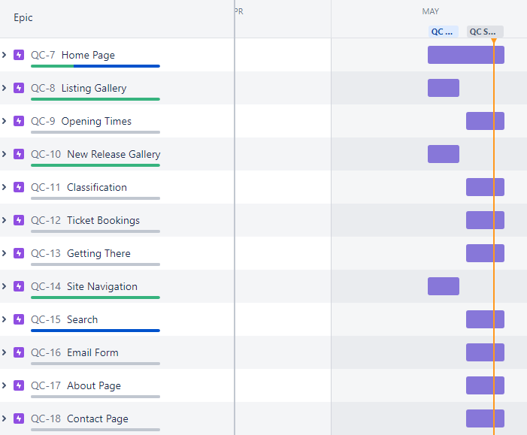
Jira Board
https://sayedsakkaf.atlassian.net/jira/software/projects/QC/boards/5

Slide 6
Inspiration
  Vue
  Cineworld
  Odeon
  Showcase Cinema

Slide 7
Risk Assessment Run Through

Slide 8
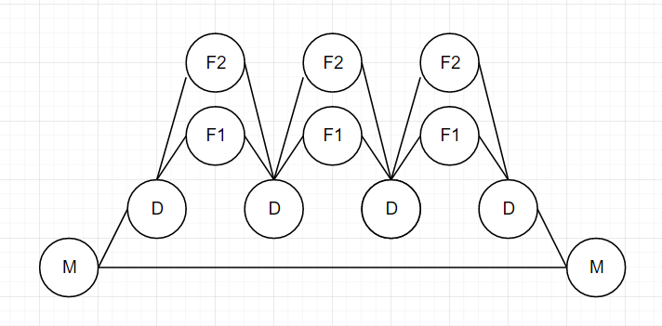
Github Structure

Slide 9
Back End Demo

Slide 10
Front End Demo

Slide 11
Current Functionality
Home Page [X]
Listings Gallery [X]
Opening Times[X]
New Releases[X]
Classifications[X]
Ticket Bookings[O] (One type of ticket available at this time)
Getting There[X]
Site Navigation[X]
Search[O]
Email Form[X]
About Page[X]
Contact Page[X]

Slide 12
Future iterations
Implement variable ticket prices (i.e. Child/Concession/Carer tickets)
Search Functionality
Seat selection system
More of the Wish list implemented

Slide 13
Project Review
We are happy with the way we approached this, we utilised a divide and conquer method to ensure that there wasn’t any stepping on toes or speaking over each other in teams calls.

Slide 14
Any Questions?

