Slide 1

QA CINEMAS
TEAM LIGHTNING

Slide 2




THE TEAM
BACK-END DEVELOPMENT, DOCUMENTATION AND DATABASE
FRONT-END DEVELOPMENT AND DOCUMENTATION
DIAGOR
PAUL
ABDUL
LEE
SAYED
BACK-END DEVELOPMENT
FRONT-END DEVELOPMENT
BACK-END DEVELOPMENT AND SCRUM MASTER

Slide 3



TECHNOLOGIES USED
JAVASCRIPT
Git - GitHub
Programming language used for web development, specifically used for our API.
Git was used as our version control system and GitHub was used for our repositories
JIRA
Jira was used to create our Kanban board and set up our sprints from the SCRUM template

Slide 4
TECHNOLOGIES USED - THE MERN STACK
MONGODB | EXPRESS.JS | NODE.JS | REACT JS
Open source, NO-SQL database management program. | Back-end framework for building web applications and API’s. | Open source, cross-platform, back-end JavaScript runtime environment. | Front-end JavaScript library for building user interfaces based on UI components.

Slide 5
PROJECT TIMELINE
Pre-planning, creation of Jira Board and Git Repositories.
16/05/2022
18/05/2022
SPRINT 1: Back-end focus on completing functionality for all required features. Front-end started.
SPRINT 2: Front-end pages completion and API implementation.
23/05/2022
27/05/2022
Final deliverable presented

Slide 6
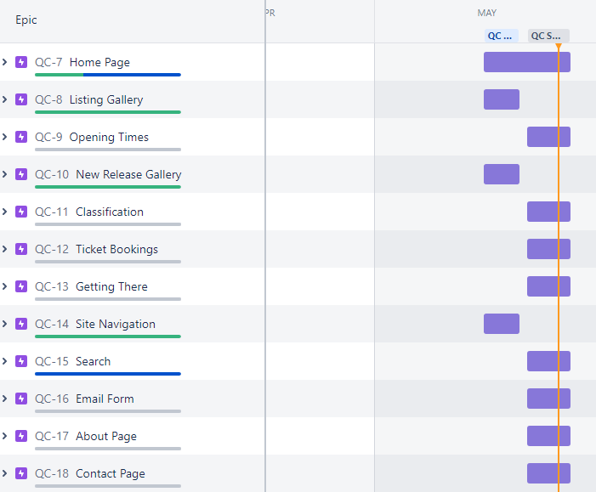
JIRA BOARD
https://sayedsakkaf.atlassian.net/jira/software/projects/QC/boards/5

Slide 7
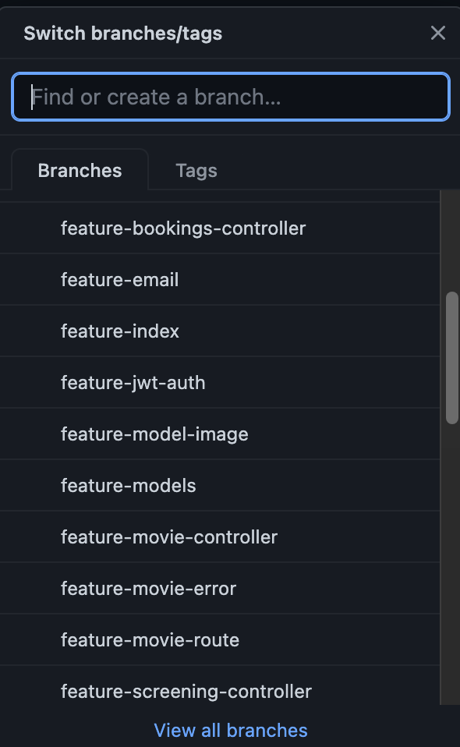
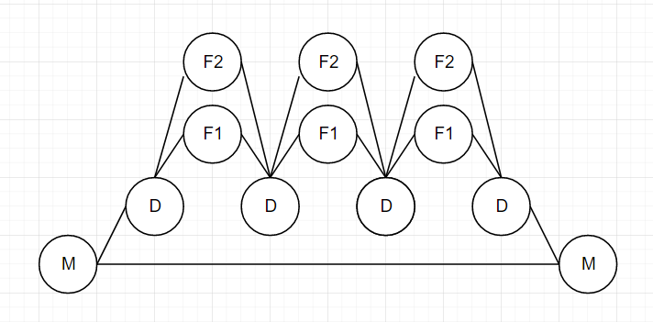
VERSION CONTROL – FEATURE-BRANCH-MODEL

Slide 8

RISK ASSESSMENT

Slide 9
BACK-END DEMO

Slide 10
FRONT-END DEMO

Slide 11
CURRENT FUNCTIONALITY
HOME PAGE
OPENING TIMES
LISTINGS GALLERY
NEW RELEASES
CLASSIFICATIONS
GETTING THERE
SITE NAVIGATION
EMAIL FORM

Slide 12
FUTURE SPRINTS
IMPLEMENT VARIABLE TICKET PRICES (I.E. CHILD, CONCESSION/ CARER TICKETS) SEARCH FUNCTIONALITY SEAT SELECTION SYSTEM MORE FEATURES FROM WISHLIST IMPLEMENTED

Slide 13
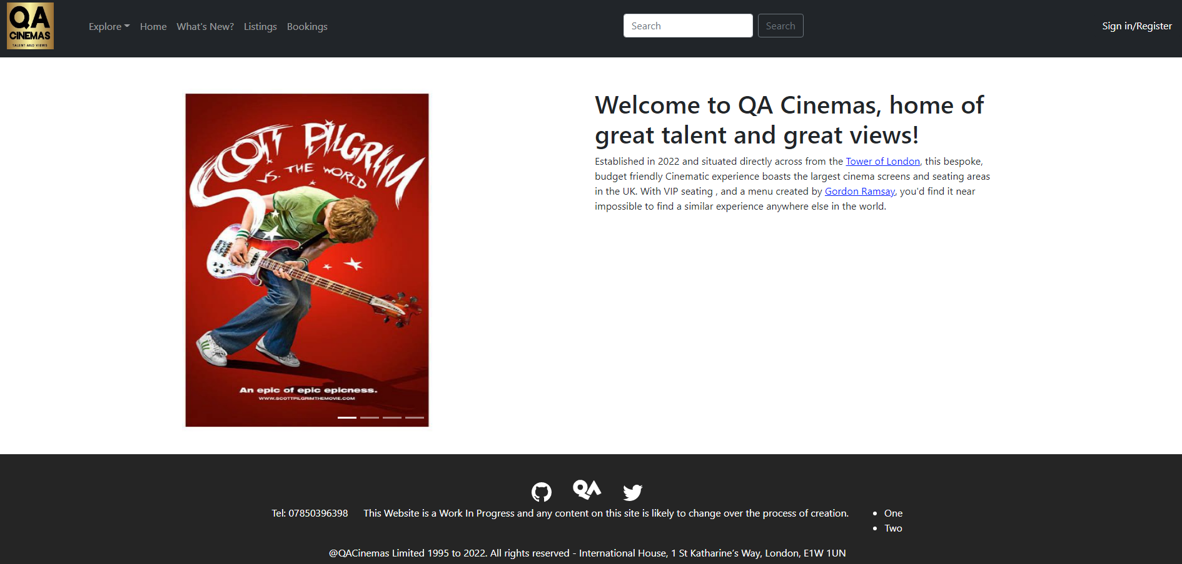
PROJECT REVIEW
Good team-work with utilisation of divide and conquer method to ensure tasks were done in a timely manner.
Most function in requirement implemented with features yet to be added.
Great use of version control to ensure there were conflicting when it came to contributing work.

