Slide 1
Algorithms & Data Structures (M)
2018
Dr. Alice Miller
Moodle: Computing Science → Algorithms & Data Structures (IT)
© 2008 David A Watt, University of Glasgow

Slide 2
Aims
To study the concept of algorithms, and how to analyze their efficiency.
To study the concept of abstract data types, and the abstract data types most commonly used in software development (stacks, queues, lists, sets, maps, trees, graphs).
To study the basic data structures most commonly used to represent these abstract data types (arrays, linked-lists, binary-search-trees, hash-tables), together with algorithms operating on these data structures.

Slide 3
Contents
Introduction (1 lecture)
Algorithms and Complexity (1)
The Array Data Structure (3)
Linked-List Data Structures (2)
Abstract Data Types (ADTs) (1)
Stack ADTs (1)
Queue ADTs (1)
List and Iterator ADTs (2)
Set ADTs (1)
The Binary-Search-Tree Data Structure
(including AVL trees) (3)
11. Map ADTs (1)
12. Hash-Table Data Structures (1)
13. Tree ADTs (1)
14. Graph ADTs (1)

Slide 4
Coursework and assessment
Tutorial exercises
sample solutions available.
Exercise 1 – single exercise, consisting of 3 parts, total
weight = 0.3.
Due 19th March, will be available early – mid February (officially Feb 27th).
Examination
weighting 0.7.
From this year, all multiple choice

Slide 5
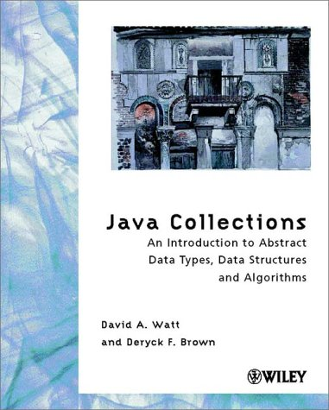
Reading (1)
D.A. Watt & D.F. Brown Java Collections Wiley (2002)
required reading
but does not cover generic classes
Some of the later example programs
are not “correct” (will discuss this later
in the course).

Slide 6
Reading (2)
M.T. Goodrich & R. Tamassia Data Structures and Algorithms in Java (4th edn) Wiley (2006) or any later edition!
optional background reading (more advanced and mathematical)
C. Horstmann Big Java (3rd edn) Wiley (2008)
supplementary reading on Java (covers interfaces, collections, inner classes, generic classes, etc.)

