Slide 1
Assessed Exercise 1
Worth 10% of the overall mark for the Programming course
Wine merchant sells bottles of wine at a variety of prices on a sale or return basis
Customers are allowed to trade on credit
Wine merchants require an interface that will allow
  enter details of a series of sales and/or returns
  update the customer balance as appropriate
Sale/return involves one or more bottles of a single type of wine, giving the cost for one bottle

Slide 2
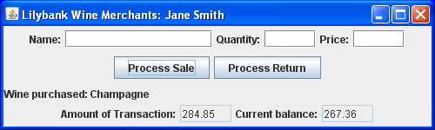
Specification (cont)
Interface should display cost of sale (or amount to be refunded) and total cost of all sales and returns to date
On running program, customer’s name and initial balance are to be obtained via two input dialog boxes (from the JOptionPane class)
Name appears on title bar
Initial balance appears in “current balance” when GUI launched

Slide 3
Specification (cont)
Here, initial balance was -£17.49 (credit balance)
Customer purchased 15 bottles of champagne at £18.99 per bottle (total £284.85)
Returns are subject to a service charge of 20%

Slide 4
Getting started
Launch Eclipse
Ensure that your workspace is set to H:\Workspace\Prog
Switch workspace if required
Create a new project called AE1
You will obtain folder Workspace\Prog\AE1
You should develop your code within this folder

Slide 5
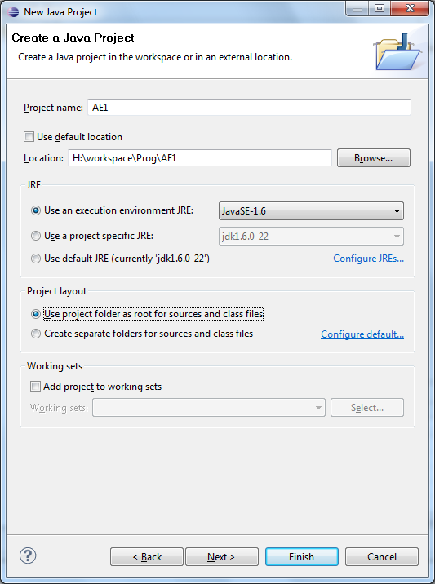
Creating the project
Make sure this
is selected!

Slide 6
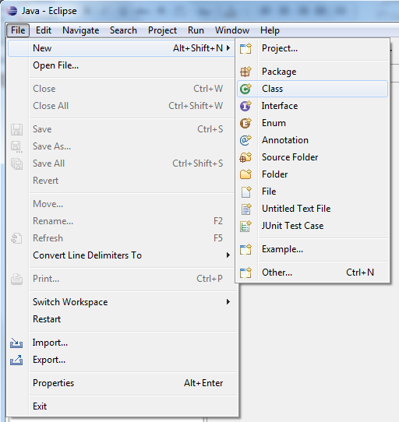
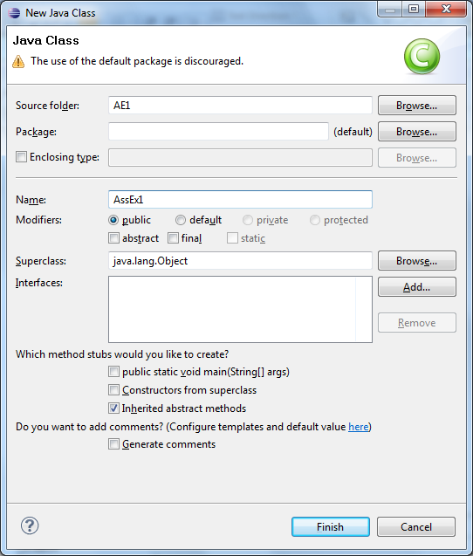
Creating multiple classes in Eclipse
See demo programs from Lecture 4 of Part II for an example of passing objects between classes

Slide 7
Program design
Project should contain the following four classes:
  CustomerAccount: to store the customer’s name and current balance, and to perform operations on the balance in the case of a sale or return
  Wine: to represent information about a wine type that is purchased / returned
  LWMGUI: to provide the user interface and methods to handle events
  AssEx1: to contain the main method
The first three classes should contain appropriate instance variables and methods

Slide 8
Status report
Your name and student number at the top
Short summary of the final state of your program
Should indicate how closely your program matches the specification
Any assumptions you have made that have affected your implementation
Any known deficiencies and how you might correct them
Details of the test data used and the results expected and obtained should be provided
Provide corresponding screen dumps to give evidence of functionality
At most one page, excluding screen dumps

Slide 9
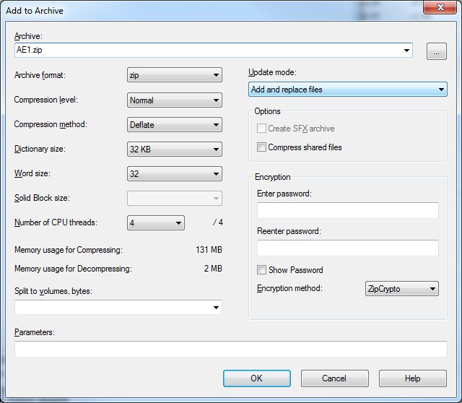
Submitting the exercise
Submission handled entirely electronically
You need to submit a zip file containing:
  Your .java files from H:\Workspace\Prog\AE1
  Your status report (probably saved as a .doc or .docx file)
  A pdf of your code listing
To create the zip file:
  Select files for inclusion from
  folder H:\Workspace\Prog\AE1
  Right-click on highlighted files
  Use “7-zip -> Add to archive”
  Choose zip as the archive format
  Use filename AE1_FamilyName_GivenName.zip

Slide 10
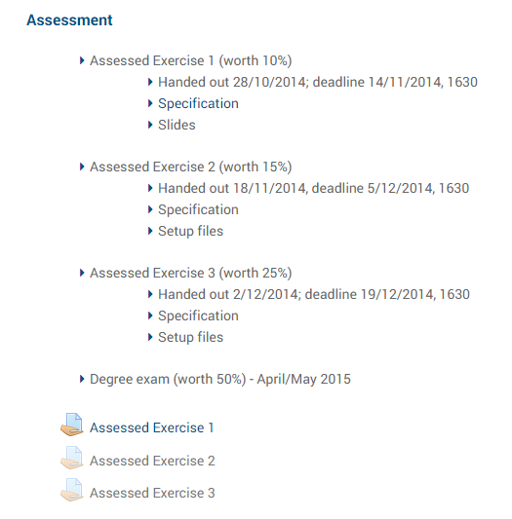
Submitting the exercise (cont)
Code must be submitted via Programming Moodle page http://moodle2.gla.ac.uk/course/view.php?id=1831
click here!

Slide 11
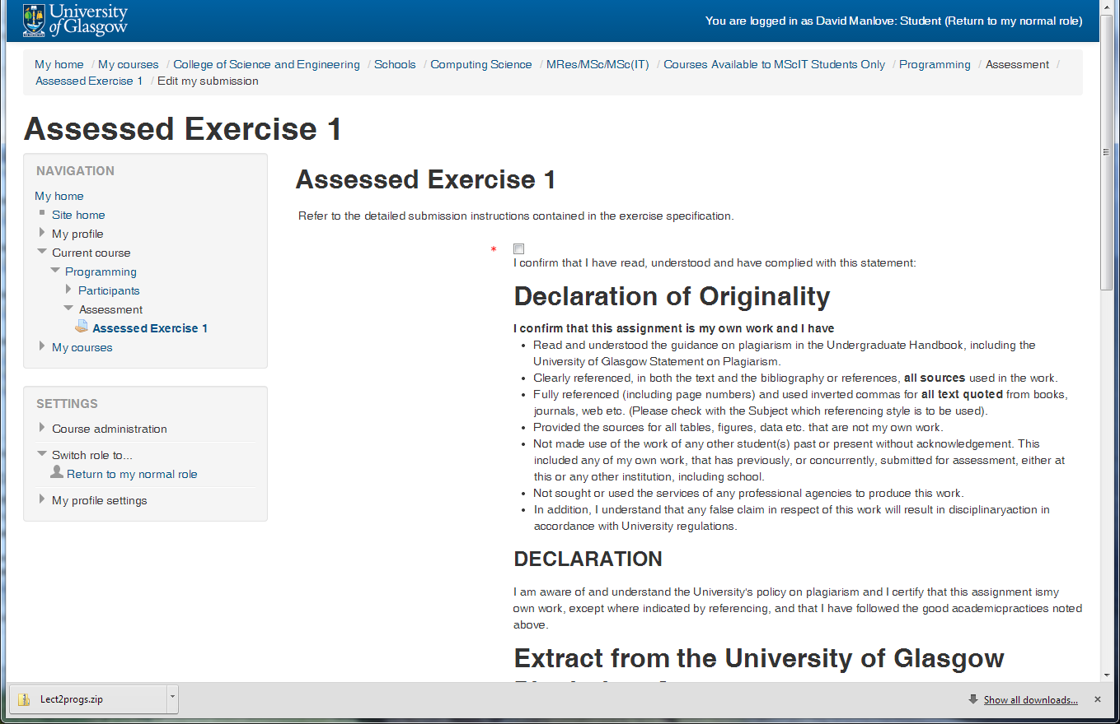
Submitting the exercise (cont)
Confirm declaration of originality statement
confirm here

Slide 12
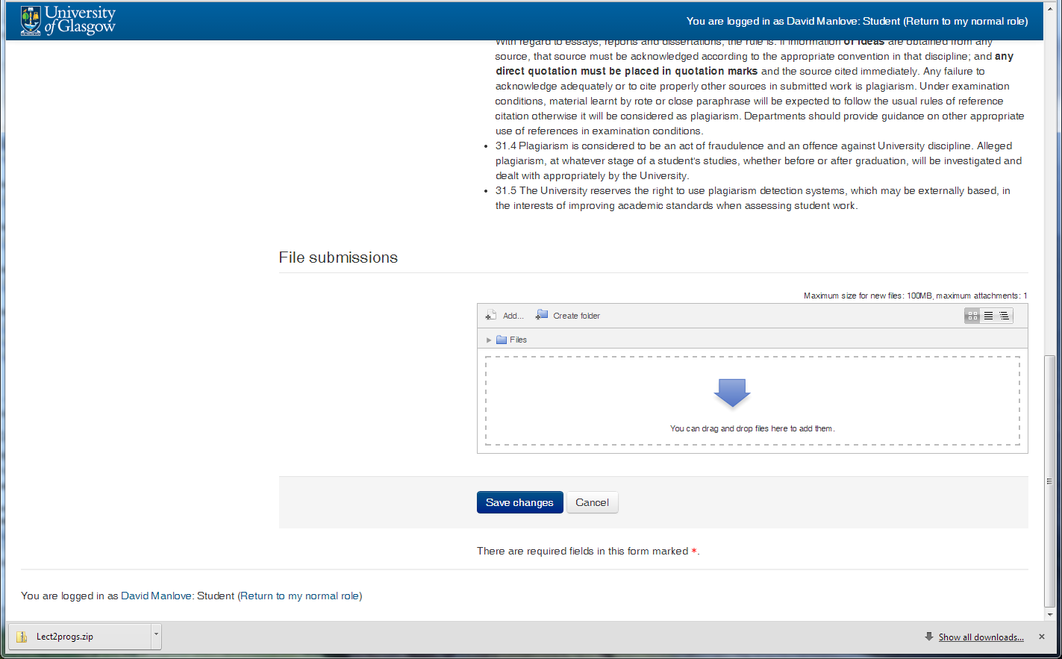
Submitting the exercise (cont)
Scroll down, browse for file and upload
drag zip file here
and click “save changes”

Slide 13
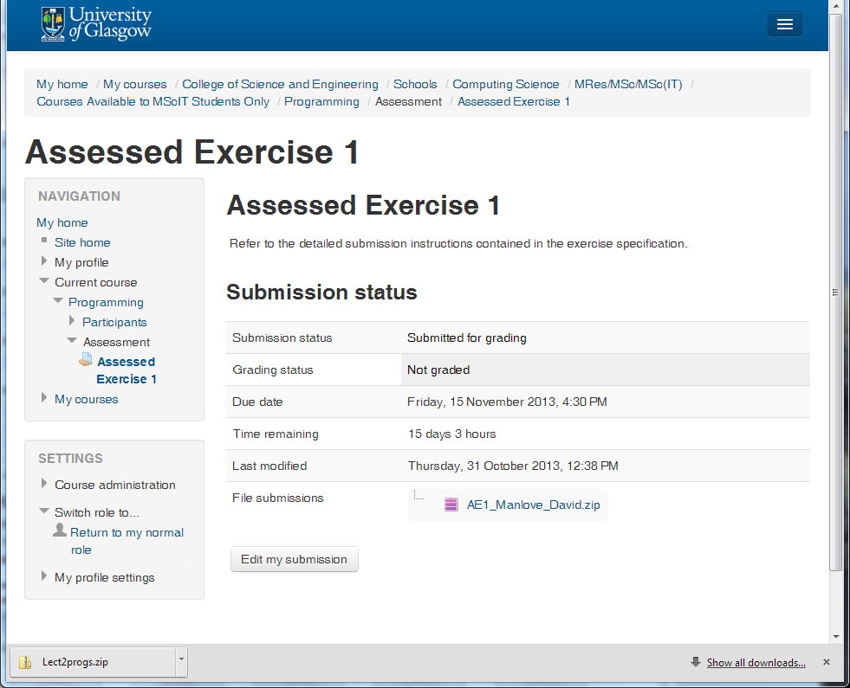
Submitting the exercise (cont)
After pressing “save changes”:

Slide 14

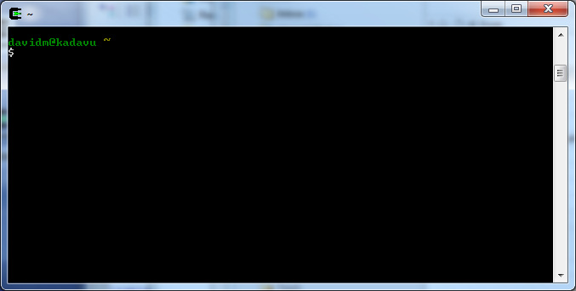
Creating the code listing pdf file
Double-click on the Cygwin icon on the desktop (on the lab machines)
Enter these commands:
  cd H:/Workspace/Prog/AE1
  code2pdf –o AE1 *.java
Produces AE1.pdf in H:/Workspace/Prog/AE1

Slide 15
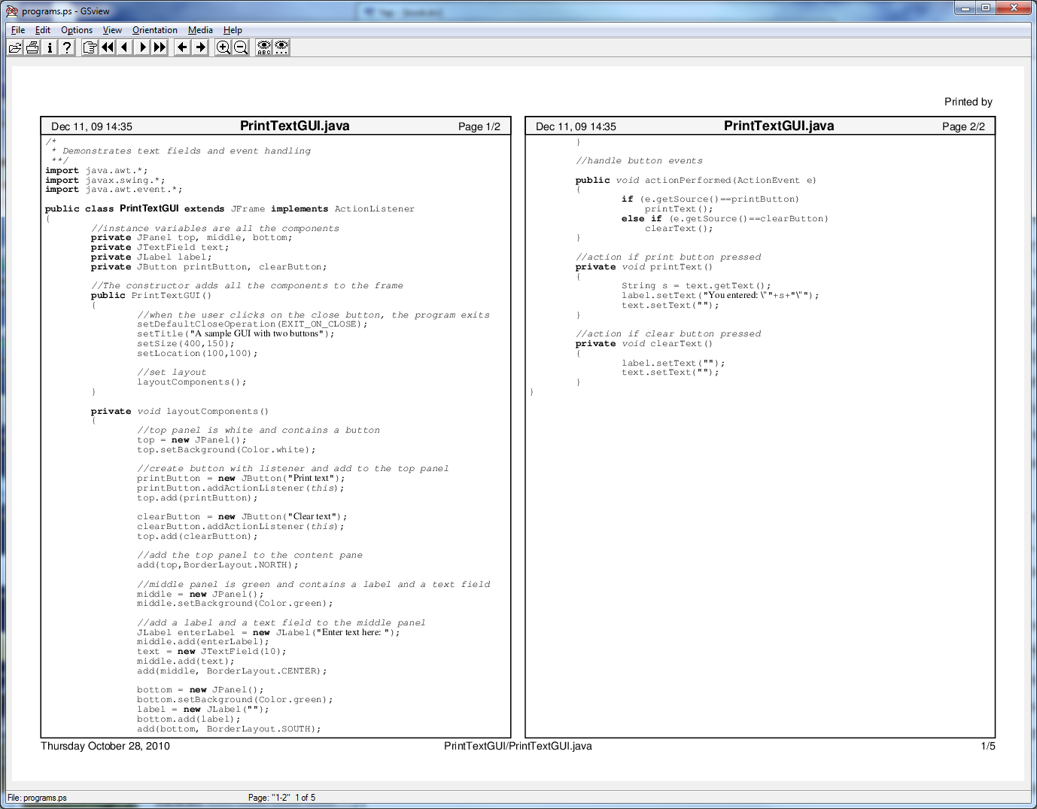
Appearance of the code listing pdf file

Slide 16
Marking scheme
Element | Weighting | Contents
Functionality | 40% | Proportion of the specified functionality implemented, and program correctness
Design | 34% | Choice of methods and instance variables within classes, design of methods
Documentation and Testing | 26% | Readability of code (incl. comments), quality of status report, selection of test data
The overall mark will be a band (A1-H)

Slide 17
Plagiarism: collusion
Ok to discuss the exercise with friends
But, submitted code must be your own
What is collusion?
  Students A and B are said to be colluding on an exercise if:
    A completes the exercise (or part of the exercise) and provides his/her code to B
    B makes only trivial changes (see later) and submits the resulting code as his/her own
Provider and recipient are penalised equally
Take care over discarded printouts / missing pen drives!
What is reasonable discussion?
  students A and B discuss on paper at a higher level than Java code as to how to solve the problem
  each implements the solution separately at their own machine

Slide 18
Plagiarism: collusion (cont)
If A and B end up with code that is basically the same, they have not discussed, they have colluded
See plagiarism policy and guidelines for more information
  https://webapps.dcs.gla.ac.uk/LTC/policies/PLAGIARISM_Policy_2011.pdf
  Plagiarism detection program
  will be run on all pairs of solutions after submission
  see demo
Note: program not fooled by:
  renaming variables
  changing comments
  reordering code

Slide 19
Plagiarism: use of external sources
Your code should involve only techniques that have been covered in the course. Only classes or methods that have been covered in the course should be used.
Usage of code that is not your own:
  proportionate penalty for acknowledged use of code that is not your own (within status report)
    e.g., snippets of code from internet
  higher penalty for unattributed use of other code
  blocks of code from lecture notes or demo programs do not need to be acknowledged
Zero-tolerance approach to plagiarism

Slide 20
Difficulty with completing?
Review your lecture notes
Read over relevant sections of Horstmann
Look at demo programs
Seek help from a tutor / demonstrator
Hand in a partial solution
  incomplete solutions are bound to result in higher marks compared to plagiarised solutions

Slide 21
Miscellaneous advice
Support provided:
  Lab sessions on 1 Nov, 8 Nov and 15 Nov
Limit time spent on the coursework (at most 15 hours!)
Importance of time away from the computer
  taking breaks
  studying notes away from the screen
Don’t spend time implementing functionality that is not required
Importance of keeping coming to lectures / tutorials

Slide 22
Deadline
Tuesday15 Nov at 5.30pm
Extensions only given for medical and related mitigating circumstances, not for
  hardware failures (e.g., pen drive corrupted)
  visa problems
Penalties for late / incomplete submission:
  2-band penalty per working day or part thereof for late submission
  up to five working days late (then H)
  2-band penalty for incomplete submission,
    e.g., missing class files or missing status report

Slide 23
Submission system
Try it out as early as possible: do not leave this to the last minute!
You can submit as many times as you like before the deadline; only the last submission will be stored
If you have any problems with your submission,
do not email me (unless I am your lab group tutor);
email your lab group tutor
Lab group tutors will be advised later
Your lab group tutor will mark your exercise
He will also be at your lab session

Slide 24
After the deadline
We will run the plagiarism detection program
We will execute your submitted program and mark the functionality
We will read over your status report and code and apply feedback to it

