Slide 1
MSc / PGDip IT/SD PROGRAMMING – Part II
Outline of topics
Graphical user interfaces (introduction)
  GUI components, JOptionPane
  Layout managers
  GUI events, action listeners
  Model-View-Controller
Console and file I/O
Arrays
  storing integers and other primitive types
  simple array algorithms
  storing objects; 2D arrays
  sorting arrays

Slide 2
Outline of Part II topics (cont)
String handling
  toString() method
  tokenizing strings
Recursion
Interfaces and inheritance
  using interfaces for code reuse
  inheriting / overriding methods and fields
More on GUIs
  GUI graphics
  More GUI components, e.g. JComboBox, JTable
Misc topics:
  JVM
  jar files
  packages
  java at the command prompt

Slide 3
Graphical User Interfaces
Introduction to a GUI
  creating a JFrame
  using simple components
Horstmann
  Section 10.1

Slide 4

JTextField
JRadioButton
JComboBox
JButton

Slide 5
GUI programs are different
They are graphical. The user can interact with several user interface objects (components)
The user controls the sequence of activities
The program displays the user interface and waits
The user has several different choices of what to do next
Up to now our programs have been in control
The program tells the user what to do next
The user can only do what the program says
In most cases, they do not have a choice

Slide 6
Components of a GUI
An object having a graphical representation that can be displayed on the screen and that can interact with the user
User interface components familiar from the web
  buttons, textboxes, combo boxes.......
User input not merely text oriented
  pointing, clicking......
java supplies libraries of classes
  javax.swing, java.awt, java.awt.event...........

Slide 7
Creating a GUI in Java
The program creates a window object (JFrame), the basis for interaction
  There can be more than one window
The program creates several component objects (JComponents)
  These components are given names and other properties
Each component is added to the window
  It must be positioned in the right place
  Layout Managers are used to facilitate this
Event Listener objects are added to each component
  They process each event when it arrives

Slide 8
Class JFrame
A JFrame object is an independent window
A JFrame object looks like a standard ‘window’
  It has a border, a title bar, a ‘close’ box
Each GUI program must have at least one JFrame object.
  A complicated program will have several windows; each is a different JFrame object
We must customise the Java JFrame class
  public class JustFrame extends JFrame
The Java keyword extends means that our new class will
  Build on JFrame, extending it
  Add our own application-specific code
Extending an existing class means that we can use all of the methods that the existing class has

Slide 9
Methods of JFrame
setTitle(String)
setSize(int dimx, int dimy)
  The number of pixels in the x and y directions.
setLocation(int x, int y)
  The distance of the top left hand corner of the frame from the top left hand corner of the monitor, in pixels.
setVisible(boolean)
  You won’t see the window unless you setVisible(true)
  You can make it invisible by setVisible(false)
  Use this in the main method after creating the JFrame object
setDefaultCloseOperation
  Ensure that the system exits the application when the user closes the JFrame – this is done by calling the method with the (integer) parameter EXIT_ON_CLOSE (a field of JFrame)

Slide 10
Creating a JFrame
Let’s call our new class JustFrame
  We need a new file called JustFrame.java, as usual
We need to import javax.swing.* to get JFrame
import javax.swing.*;
public class JustFrame extends JFrame
{
public JustFrame() {
setDefaultCloseOperation(JFrame.EXIT_ON_CLOSE);
setSize(300,300);
setLocation(100,100);
setTitle("Just a JFrame");
}
}

Slide 11
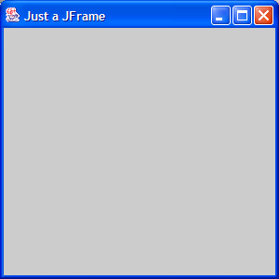
The main class
The main class just creates a JustFrame object and makes it visible
public class ShowJustFrame
{
public static void main(String [] args)
{
JustFrame frame = new JustFrame();
frame.setVisible(true);
}
}

Slide 12
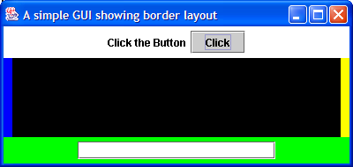
More complex GUIs
In general we will want to add components to our JFrame
  Buttons, labels, text fields, etc.
JLabel
JButton
JTextField
JPanel
The GUI class (i.e. the one extending JFrame) can achieve this:
  create your own instance variables that describe the text fields, labels, buttons and panels, etc.
  use the constructor to lay out the components as required
  create your own ‘helper’ methods if necessary

Slide 13
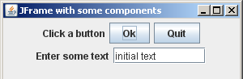
GUI Components 1: JButton
A JButton object is a button
  It has a label, e.g. “Click”
  It reacts to mouse clicks (see later)
We can declare two buttons in ButtonFrame
  private JButton button1, button2;
  Instance fields of ButtonFrame
We can create them in the ButtonFrame constructor
  button1 = new JButton("Ok");
  button2 = new JButton("Quit");

Slide 14
GUI Components 2: JTextField
A JTextField object displays a text input box
  The user can type in a string
  The user can signify that the input is complete by pressing <enter> or pressing a button
The constructor specifies the number of columns in the input box
  It can also specify an initial string
There are 3 constructors:
  JTextField(int ncol);
  JTextField(String text);
  JTextField(String text, int ncols);
The program can set the text in a JTextField object with setText
When the input is complete the text entered can be read using getText

Slide 15
GUI Components 3: JLabel
This is very simple - it just displays text with no user input
Useful next to a JTextField or a JButton
E.g.
  JLabel label1 = new JLabel("Enter some text");

Slide 16
Disabling components
Components such as buttons can be disabled
  They are greyed out
  They do not accept any interaction with the user
  button1.setEnabled(false);
They can then be enabled again
  button1.setEnabled(true);
This allows us to control which input is allowed
Components are enabled when they are created
A JTextField is normally editable
  The user can enter information and change existing information
Editing can be disabled by calling the method
  field.setEditable(false);
Naturally, using a true parameter makes it editable again

