Slide 1
Lecture 13
Interfaces
  Using interfaces to make your code re-usable
Inheritance
  Reuse and extend existing code
  Inheritance hierarchies
Horstmann, Sections 8.1, 9.1, 9.2

Slide 2
Using interfaces for code reuse
Use interface types to make code more reusable
Example: consider a simple class DataSet to find the average and maximum of a set of integers
public class DataSet
{
private int sum;
private int maximum;
private int count;
public DataSet()
{
sum = 0;
count = 0;
maximum = 0;
}
Continued…
Notes:
Interface types: allow you to make a service available to a wider set of inputs by focusing on the essential operations that the service requires

Slide 3
Using interfaces for code reuse
public void add(int x)
{ sum = sum + x;
if (count == 0 || maximum < x)
maximum = x;
count++;
}
public int getMaximum()
{ return maximum;
}
public double getAverage()
{ if (count == 0) return 0;
else return (double) sum / count;
}
}
What if we want to find the average and maximum of a set of BankAccount values?

Slide 4
The (simplified) BankAccount object
public class BankAccount
{
private int balance;
/**
Constructs a bank account with a zero balance.
*/
public BankAccount()
{
balance = 0;
}
...

Slide 5
Adapting DataSet for BankAccount objects
public class DataSet // Modified for BankAccount objects
{
private int sum;
private BankAccount maximum;
private int count;
. . .
public void add(BankAccount x)
{ sum = sum + x.getBalance();
if (count == 0 || maximum.getBalance() < x.getBalance())
maximum = x;
count++;
}
public BankAccount getMaximum()
{ return maximum;
}
. . . // getAverage is unchanged
}

Slide 6
The Coin object
public class Coin
{
private int value;
private String name;
/**
Constructs a coin
*/
public Coin(int aValue, String aName)
{
value = aValue;
name = aName;
}
...

Slide 7
Or suppose we wanted to find the coin with the highest value among a set of coins. We would need to modify the DataSet class again
public class DataSet // Modified for Coin objects
{
private int sum;
private Coin maximum;
private int count;
. . .
public void add(Coin x)
{ sum = sum + x.getValue();
if (count == 0 || maximum.getValue() < x.getValue())
maximum = x;
count++;
}
public Coin getMaximum()
{ return maximum;
}
. . . // getAverage is unchanged
}

Slide 8
Using interfaces for code reuse
The mechanics of analysing the data is the same in all cases; the details of measurement differ
Classes could agree to have a method getMeasure that obtains the measure to be used in the analysis
We can implement a single reusable DataSet class whose add method looks like this:
sum = sum + x.getMeasure();
if (count == 0 || maximum.getMeasure() < x.getMeasure())
maximum = x;
count++;
Continued…
Notes:
DataSet provides a service – calculating the maximum and average. We want to extend it to a wider range of inputs, i.e., not just integers and BankAccount and Coin objects too. To do this we need to look at the essential operation that the service needs, i.e., some notion of “measurement”.

Slide 9
Using interfaces for code reuse
What is the type of the variable x?
  x should refer to any class that has a getMeasure method
In Java, an interface type is used to specify required operations
Interface declaration lists all methods (and their signatures) that the interface type requires
public interface Measurable
{
int getMeasure();
}

Slide 10
Interfaces vs. classes
An interface type is similar to a class, but there are several important differences:
All methods in an interface type are abstract; they don’t have an implementation
All methods in an interface type are automatically public
An interface type does not have instance fields (though it can have constants)
Notes:
If you have a constant in an interface, need to omit public static final

Slide 11
Generic Dataset for measurable objects
public class DataSet
{
private int sum;
private Measurable maximum;
private int count;
public void add(Measurable x)
{ sum = sum + x.getMeasure();
if (count == 0 || maximum.getMeasure() < x.getMeasure())
maximum = x;
count++;
}
public Measurable getMaximum()
{ return maximum;
}
public double getAverage() // as before
}

Slide 12
Implementing an interface type
Use implements keyword to indicate that a class implements an interface type
A class can implement more than one interface type
  class must define all the methods that are required by all the interfaces it implements
public class BankAccount implements Measurable
{
public int getMeasure()
{
return balance;
}
// Additional methods and fields
}
Continued…

Slide 13
Implementing an interface type
Another example:
public class Coin implements Measurable
{
public int getMeasure()
{
return value;
}
. . .
}

Slide 14
Introduction to inheritance
Inheritance: extend classes by adding methods and fields
Example: savings account – bank account with interest
SavingsAccount automatically inherits all methods and instance variables of BankAccount
Extended class = superclass (BankAccount),
extending class = subclass (SavingsAccount)
public class SavingsAccount extends BankAccount
{
new methods
new instance variables
}

Slide 15
SavingsAccount constructor
public class SavingsAccount extends BankAccount
{
private int interestRate;
public SavingsAccount(int rate)
{ interestRate = rate;
}
}
Subclass inherits behaviour and state
One advantage of inheritance is code reuse
SavingsAccount collegeFund = new SavingsAccount(10);
// Savings account with 10% interest
collegeFund.deposit(500);
// OK to use BankAccount method with SavingsAccount object

Slide 16
New method in SavingsAccount
In subclass, specify added instance variables, added methods, and changed or overridden methods
Encapsulation: addInterest calls getBalance rather than updating the pounds and pence fields of the superclass (which are private)
Note that addInterest calls getBalance without specifying an implicit parameter (the calls apply to the same object)
public class SavingsAccount extends BankAccount
{
public void addInterest() // new method
{
double interest = getBalance() * interestRate / 100.0;
deposit(interest/100.0);
}
Notes:
Modifier Class Package Subclass World
Public Y Y Y Y
Protected Y Y Y N
no modifier Y Y N N [means “package access”]
Private Y N N N

Slide 17
Layout of a subclass object
SavingsAccount object inherits the pounds and pence instance fields from BankAccount, and gains one additional instance field: interestRate
SavingsAccount
pounds
pence
BankAccount portion
interestRate

Slide 18
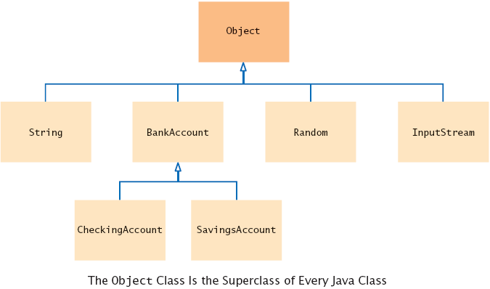
General inheritance syntax
public class SubclassName extends SuperclassName
{
instance variables
methods
}
Inheritance hierarchies
Sets of classes can form complex inheritance hierarchies
Example:
CurrentAccount

Slide 19
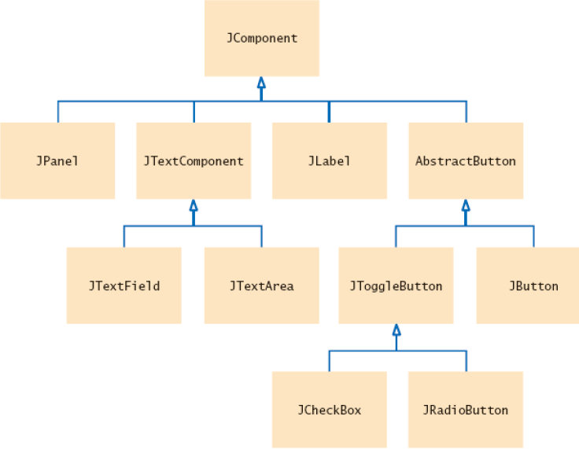
Swing hierarchy
Superclass JComponent has methods getWidth, getHeight
AbstractButton class has methods to set/get button text and icon

