Slide 1
Lecture 14
Inheritance (continued)
  Inheriting / overriding methods and fields
  Subclass / superclass constructors
  Converting between subclass and superclass types
  GUIs: inheritance and interfaces in action
Horstmann, Sections 9.1-9.3
Notes:
Chapter Goals
To learn about the method of recursion
To understand the relationship between recursion and iteration
To analyze problems that are much easier to solve by recursion than by iteration
To learn to "think recursively"
To be able to use recursive helper methods
To understand when the use of recursion affects the efficiency of an algorithm

Slide 2
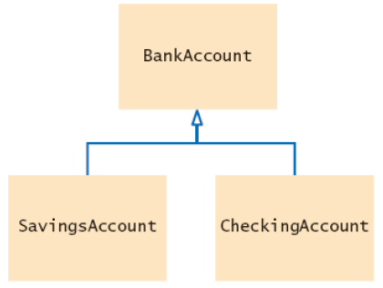
A simpler hierarchy:
Hierarchy of bank accounts
Consider a bank that offers its customers the following account types:
  Current account: no interest; small number of free transactions per month, additional transactions are charged a small fee
Savings account: earns interest that compounds monthly
CurrentAccount

Slide 3
A simpler hierarchy:
Hierarchy of bank accounts
All bank accounts support the getBalance method
All bank accounts support the deposit and withdraw methods, but the implementations differ
Current account needs a method deductFees; savings account needs a method addInterest
Inheriting / overriding / adding methods
Inherit method:
  Don’t supply a new implementation of a method that exists in superclass
  Superclass method can be applied to the subclass objects

Slide 4
Inheriting / overriding / adding methods (cont)
Override method:
  Supply a different implementation of a method that exists in the superclass
  Must have same signature (same name and same parameter types)
  If method is applied to an object of the subclass type, the overriding method is executed
Add method:
  Supply a new method that doesn’t exist in the superclass
  New method can be applied only to subclass objects

Slide 5
Inheriting / adding instance fields
Inherit field: All fields from the superclass are automatically inherited
  no visibility to subclass if they are private though!
Can’t override fields
Add field: Supply a new field that doesn't exist in the superclass
What if you define a new field with the same name as a superclass field?
  Each object would have two instance fields of the same name
  Fields can hold different values
  Legal but extremely undesirable

Slide 6
Implementing the CurrentAccount class
Overrides deposit and withdraw to increment the transaction count:
Each CurrentAccount object has three instance fields:
  pounds, pence (inherited from BankAccount)
  transactionCount (new to CurrentAccount)
public class CurrentAccount extends BankAccount
{
private int transactionCount; // new instance field
public void deposit(double amount) {. . .}
public void withdraw(double amount) {. . .}
public void deductFees() {. . .} // new method
}

Slide 7
Implementing the CurrentAccount class
You can apply four methods to CurrentAccount objects:
  getBalance() (inherited from BankAccount)
  deposit(double amount) (overrides BankAccount method)
  withdraw(double amount) (overrides BankAccount method)
  deductFees() (new to CurrentAccount)

Slide 8
Private superclass fields
Consider deposit method of CurrentAccount
Can’t just add amount to pounds and pence
These are private fields of the superclass
A subclass has no access to private fields of its superclass
Subclass must use public accessor / modifier methods
public void deposit(double amount)
{
transactionCount++;
// now add amount to balance
. . .
}

Slide 9
Invoking a superclass method
Can’t just call deposit(amount) in deposit method of CurrentAccount
That is the same as this.deposit(amount)
Calls the same method (infinite recursion)
Instead, invoke superclass method
super.deposit(amount)
In this case, deposit method of BankAccount class
Complete method:
public void deposit(double amount) {
transactionCount++;
// Now add amount to balance
super.deposit(amount);
}

Slide 10
Common error: shadowing instance fields
A subclass has no access to the private instance fields of the superclass
Beginner’s error: “solve” this problem by adding another instance field(s) with same name:
public class CurrentAccount extends BankAccount
{
private int pounds; // Don't
private int pence; // Don't
. . .
public void deposit(double amount)
{
transactionCount++;
int currentBalance = (pounds*pencePerPound) + pence;
currentBalance += (int) Math.round(amount*pencePerPound);
pounds = currentBalance / pencePerPound;
pence = currentBalance % pencePerPound;
}
}
Continued…

Slide 11
Common error: shadowing instance fields
Now the deposit method compiles, but it doesn’t update the correct balance!
CurrentAccount
pounds
pence
BankAccount portion
= 0
= 0
transactionCount
pounds
pence
= 1
= 54
= 35

Slide 12
Subclass constructors
super followed by a parenthesis indicates a call to the superclass constructor
public class CurrentAccount extends BankAccount
{
public CurrentAccount(double initialBalance)
{
// Call superclass constructor
super(initialBalance);
// Initialize transaction count
transactionCount = 0;
}
. . .
}
Continued…

Slide 13
Subclass construction
If used, super(…) must be the first statement in subclass constructor
If subclass constructor doesn’t call superclass constructor, default superclass constructor is used
  Default constructor: constructor with no parameters
  If all constructors of the superclass require parameters, then the compiler reports an error
Note: SavingsAccount constructor didn’t call its superclass constructor explicitly
  It was content to use the default constructor of the superclass, which sets the balance to zero

Slide 14
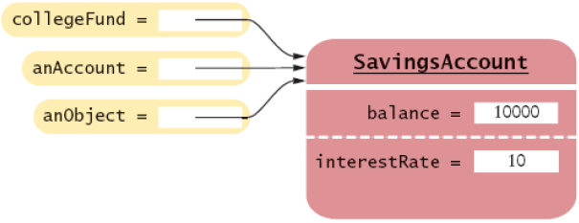
Converting between subclass and superclass types
Ok to convert subclass reference to superclass reference
The three object references stored in collegeFund, anAccount, and anObject all refer to the same object of
SavingsAccount collegeFund = new SavingsAccount(10);
BankAccount anAccount = collegeFund;
Object anObject = collegeFund;
class SavingsAccount

Slide 15
Converting between subclass and superclass types
Superclass references don’t know the full story:
When you convert from a subclass object to its superclass type:
  The value of the reference stays the same – it is the memory location of the object
  But, less information is known about the object
anAccount.deposit(1000); // OK
anAccount.addInterest();
// No--not a method of the class to which anAccount belongs
anObject.deposit(1000);
// No--not a method of the class to which anObject belongs

Slide 16
Converting between subclass and superclass types
Why would anyone want to know less about an object?
  Enables the reuse of code that knows about the superclass but not the subclass:
Can be used to transfer money from any type of BankAccount
public void transfer(double amount, BankAccount other)
{
withdraw(amount);
other.deposit(amount);
}
Notes:
Note that the particular version of the deposit method that is called will depend on the original type of other (this is an example of polymorphism at work). For example in AccountTester in the demo programs, the transaction count is increased when jimsCurrentAccount is passed as object other. This is because the version of deposit that is called comes from CurrentAccount, which is the original type of other (rather than the superclass reference). However if we were to try to call deductFees on other, this would give a compile error (method not supported by BankAccount) unless we cast back to the subclass.

Slide 17
Converting between subclass and superclass types
Occasionally you need to convert from a superclass reference to a subclass reference
This cast is dangerous: if you are wrong, an exception is thrown
Solution: use the instanceof operator
instanceof: tests whether an object belongs to a particular type
BankAccount anAccount = (BankAccount) anObject;
if (anObject instanceof BankAccount) {
BankAccount anAccount = (BankAccount) anObject;
. . .
}

Slide 18

Using inheritance with JFrames
Recall PrintTextGUI from
Class declaration includes the following:
  public class PrintTextGUI extends JFrame
PrintTextGUI therefore extends a JFrame class
Inherits fields and methods from the class JFrame, such as
  EXIT_ON_CLOSE
  setLayout
Many other fields and methods from JFrame are themselves inherited from superclasses of JFrame
Week 6

Slide 19
Using inheritance with JFrames
The class PrintTextGUI
  extends JFrame - a window with a title and border
  which extends Frame - an earlier version of JFrame
    Provides the method setTitle
  which extends Window - a window with no borders
    Provides the methods dispose, setSize, setVisible
  which extends Container - can contain other components
    Provides method add
  which extends Component - gui object
    Provides method isEnabled
  which extends Object - root class

Slide 20
The interface ActionListener
ActionListener is an interface
Its sole method is actionPerformed
PrintTextGUI implements this interface
Thus the whole class declaration for PrintTextGUI is:
  public class PrintTextGUI extends JFrame implements ActionListener
The implementation of actionPerformed tells Swing what to do when the button is pressed
The code reuse in this case is the actual mechanics of reacting to a button press, should it occur

