Slide 1
Lecture 15
Displaying graphics in a GUI
  graphical shapes such as lines and ellipses
  using colors
  displaying drawings consisting of many shapes
Horstmann, Sections 2.13 – 2.16

Slide 2
Adding graphics
Graphics are displayed in a JComponent via a JFrame
  The JComponent must be defined in a separate class that extends the basic JComponent
You need to write your own version of the paintComponent method
  Your paintComponent method is called automatically when the JComponent is created
  It is also called whenever the component needs to be redrawn
    whenever you update the details displayed on it in your program
    whenever the operating system needs to redraw the component
  The paintComponent method is not called directly

Slide 3
JFrame
Methods such as
setTitle
setDefaultCloseOperation
JComponent
Methods such as
repaint
paintComponent
Your GUI Frame extends JFrame and can therefore use the JFrame methods
Your own component extends JComponent and can therefore use the JComponent methods
Your GUI Frame
Your own (helper) methods
e.g. layoutComponents
Your own component
Your own version of paintComponent
Any helper methods (if complex drawing)

Slide 4
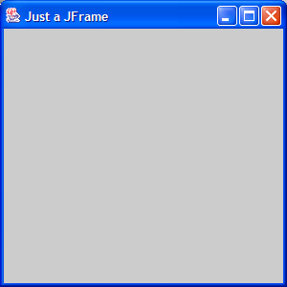
Frame windows
Recall from Lecture 1: the JFrame class defines a basic (empty, dull grey) top level window.
import javax.swing.*;
public class ShowJustFrame {
public static void main(String [] args)
{
JFrame justAFrame = new JFrame();
justAFrame.setDefaultCloseOperation
(JFrame.EXIT_ON_CLOSE);
justAFrame.setSize(300,300);
justAFrame.setLocation(100,100);
justAFrame.setTitle("Just a JFrame");
justAFrame.setVisible(true);
}
}

Slide 5
Implementing a graphics component
In the main class
// declare and instantiate
// an object of the
// JComponent class
MyComponent component = new MyComponent();
// create a frame
JFrame frame = new JFrame();
// add your own component
// to the frame
frame.add(component);
// make the frame visible
frame.setVisible(true);
In the MyComponent class (extends JComponent)
// import statements
public class MyComponent extends JComponent {
// other declarations
// constructor
public MyComponent() {
}
public void
paintComponent (Graphics g)
{
}

Slide 6
The paintComponent method
Has a Graphics object as a parameter
  this contains all the details needed for drawing to the component
  you can use the methods of the Graphics object to write text, draw shapes, set colours etc
This method is not called directly
Whenever the component display needs to be updated, make the method call
  myComponent.repaint();
  myComponent is the name of the component
paintComponent is called automatically if the frame is resized

Slide 7
Drawing shapes
Graphics class lets you manipulate the graphics state (such as current color)
Graphics2D class (subclass of Graphics) has methods to draw shape objects
Use a cast to recover the Graphics2D object from the Graphics parameter
Graphics and Graphics2D are part of the
java.awt package
Graphics2D g2 = (Graphics2D) g;
Rectangle box = new Rectangle(5, 10, 20, 30);
g2.draw(box);
20
30
(5,10)

Slide 8
Some methods from the Graphics class
Put a String on the panel with its base line at y and its left edge at x
drawString (String s, int x, int y)
Draw a line joining the points (x₁, y₁) and (x₂, y₂)
drawLine (int x1, int y1, int x2, int y2)
Draw an outline of a rectangle with top left hand corner at (x,y) and width w, height h
drawRect (int x, int y, int w, int h)
Use fillRect to draw a filled-in rectangle
Try to avoid ‘magic numbers’ as much as possible

Slide 9
Coordinates on a Graphics component
(0,0)
(this.getWidth()-1,0)
increasing x
Shape coords start top left
increasing y
x,y
String coords start left baseline
(0,this.getHeight()-1)
(this.getWidth()-1,
this.getHeight()-1)

Slide 10
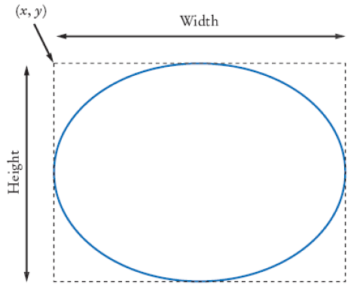
Graphical shapes
Rectangle, Ellipse2D.Double, and Line2D.Double describe graphical shapes
Need to import java.awt.geom for the last two
Must construct and draw
the shape
Ellipse2D.Double ellipse =
new Ellipse2D.Double(x, y, width, height);
g2.draw(ellipse);

Slide 11
Drawing lines
To draw a line:
or,
Line2D.Double segment = new Line2D.Double(x1, y1, x2, y2);
// allows co-ordinates to be of double type
g2.draw(segment)
Point2D.Double from = new Point2D.Double(x1, y1);
Point2D.Double to = new Point2D.Double(x2, y2);
Line2D.Double segment = new Line2D.Double(from, to);
g2.draw(segment);
(x2,y2)
(x1,y1)

Slide 12
Using colors
Standard colors Color.BLUE, Color.RED, Color.PINK etc.
Set colour in graphics context
Colour is used when drawing and filling shapes
g2.setColor(Color.BLUE);
g2.fill(rectangle); // filled with current color

Slide 13
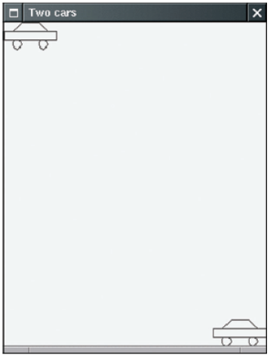
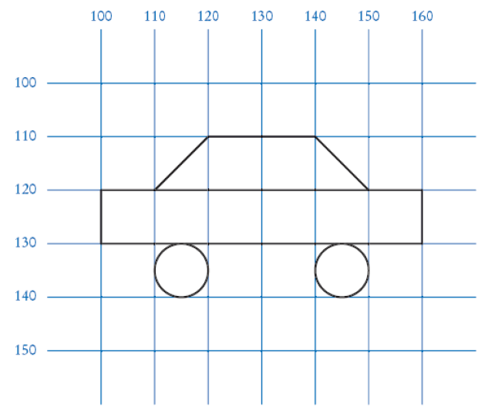
Drawing complex shapes
Good practice: make a class for each graphical shape
public class Car
{
. . .
public void draw(Graphics2D g2)
{
// Drawing instructions
. . .
}
}
Plan complex shapes by making sketches on graph paper

Slide 14
Scaling to fit the window size
The user can alter the size of your window
  With a bit more effort, you can find the width and height of the frame
  The size of the items can be calculated with respect to the size of the frame
  Whenever the component is redrawn, the details are redrawn in proportion
  A centralised rectangle is demonstrated, which is always drawn in proportion to the frame size (rectangle width and height are 75% of the frame width and height respectively)

