Slide 1
Lecture 2
Layout managers
  BorderLayout
  FlowLayout
  GridLayout
The JPanel container
Horstmann
  Section 11.1

Slide 2
The ContentPane container
The ContentPane is a logical ‘layer’ of a JFrame window
  you add the other components to it
    NOT directly to the underlying JFrame
Code to add a component to the ContentPane of a JFrame:
  import java.awt.*;
  this.add(component, BorderLayout.position); // position is ″NORTH″, ″SOUTH″, ″EAST″, ″WEST″, ″CENTER″
Notes:
Old method (before Java 5):
Container pane = this.getContentPane();
pane.add(component,position);
// position is “North”, “South”, “East”,
“West”, “Center”

Slide 3
Border layout on a ContentPane
Default layout for JFrame
NORTH
The ContentPane is divided into 5 areas as shown on the diagram. This is called Border Layout
Only one component can be added to each area
W
E
S
T
E
A
S
T
CENTER
SOUTH
Components fill areas as shown
  North and South grow vertically as required
  East and West grow horizontally as required
  Center gets space left over

Slide 4
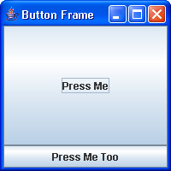
Example: adding buttons to a frame
Add the “Press Me” button to the centre and the “Press Me Too” button to the south
  add(button1, BorderLayout.CENTER);
  add(button2, BorderLayout.SOUTH);
Remember, only one component can be added to each area
To place multiple components you must add them to a JPanel (which is a Container) and then add the JPanel to the appropriate area.
Note American spelling!

Slide 5
Windows within windows
We can divide our window into sub-windows
A sub-window (JPanel) can be placed anywhere that a component can be placed
  E.g. we can put a sub-window in the “North” position of our main window
  We can then place several components in this sub-window, rather than just one
This way we can get more than 5 components in our main window
The default layout for a sub-window is Flow Layout (see later)
  Components are displayed side by side
We can divide a sub-window into sub-sub-windows, etc

Slide 6
Using the JPanel class
A JPanel container is a window
  with no border or title bar
  used to contain other components
  can be used for graphics
  cannot be a top level container (must use a JFrame)
To instantiate a JPanel object:
  JPanel myPanel = new JPanel();
Useful methods:
  setBackground(Color);
  getHeight();
  getWidth();

Slide 7
Flow layout on a panel
Default layout for JPanel containers
Components are placed on a JPanel centred and in the order in which they are added
  N.B. different to Border Layout: there are no defined areas in Flow Layout
  Many components can be added to one JPanel
  To add a component to a JPanel
      myPanel.add(myComponent);
Within the limits of the containing JFrame the JPanel expands to fit in the components
  Otherwise the components are added but not visible!

Slide 8
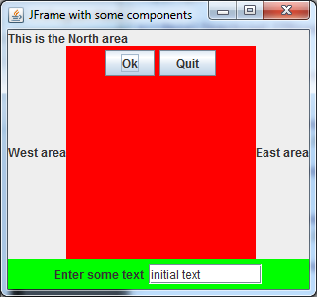
Flow layout (cont)
Any number of components
  displayed in order added from left to right
    components given exactly the space they need
  if space not filled then components centred
  if horizontal space filled then a new line is started vertically below original line

Slide 9
Example GUI with flow layout
JPanel1 with flow layout containing two components (JButtons)
Center area
South area
JPanel2 with flow layout containing two components: JLabel and JTextField

Slide 10
Changing the layout manager
Any container can be given a non-default layout
  instantiate a Layout object of the desired type
  use the container’s setLayout method
e.g. to give a JPanel object a BorderLayout
  BorderLayout bl = new BorderLayout();
  myPanel.setLayout(bl);
or
  myPanel.setLayout(new BorderLayout());

Slide 11
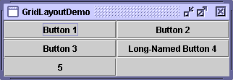
Grid layout
GridLayout simply makes a group of components equal in size and displays them in the requested number of rows and columns.
We can put one component in each position

Slide 12
Instantiating a GridLayout
A GridLayout manager is instantiated with a fixed number of rows and columns
GridLayout gl = new GridLayout(rows,cols);
  the parameters rows and cols must be integers
  you can also add two extra parameters which fix gaps between the cells (in pixels)
GridLayout gls = new GridLayout(rows, cols,
hGap, vGap)
  hGap and vGap must also be integers

Slide 13
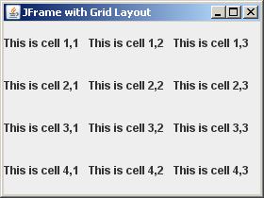
Adding components to a grid layout
Components are placed on the container in the order in which they are added (left to right)
Add a component using
  add(component)
A row is filled across all columns before starting on the next row.
JFrame with GridLayout comprising 4 rows and 3 columns, each cell containing a JLabel

Slide 14
Designing a complex GUI
The basic technique is to layer panels on top of panels
  each with their own appropriate layout manager
Often there are many panels on a GUI whose only purpose is to help with the layout
  they are not ‘important’ for the functionality of the GUI
Panels (and also sometimes labels) with no event functionality in the GUI
  do not have to be instance variables of the GUI
  they can be declared locally in the ‘layout’ method

Slide 15
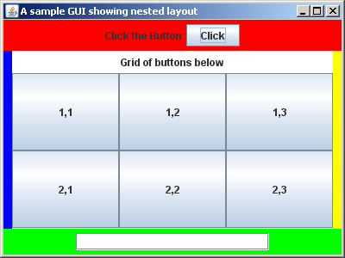
Example GUI with nested layout
JFrame has Border Layout as usual
Centre area is a JPanel (“middle”) with Border Layout
JLabel “Grid of buttons” in North area of panel
Centre area of “middle” is a JPanel having Grid Layout with 2 rows and 3 columns

