Slide 1
Lecture 6
Arrays of primitive objects
Generalised for
Copying arrays
Horstmann sections 6.1, 6.4 and 6.6.7-6.6.9

Slide 2
Arrays
Arrays are fixed-length structures for storing multiple values of the same type.
Useful for keeping collections (lists) of items
  all items must be of same type
  e.g. int, double, char, String, Rectangle, Calendar, JTextField……
An array is a special kind of object, with a unique syntax
Today we will consider mainly arrays of integers and doubles as examples of arrays of primitive types
0 1 2 3 4 5 6 7 8 9
43
-2
5
18

Slide 3
Why use arrays
There are other ways of representing lists of items
  e.g. ArrayList, LinkedList, Stack, Queue
    Algorithms and Data Structures course
    Advanced Programming course
We are teaching arrays from first principles using Java
Some programming languages only provide arrays as a form of list
Fast for accessing elements directly
Slow for adding and deleting elements if we want to keep the list in a sorted order
  This comes later

Slide 4
Declaring an array
type
variable name
defines length only
int [] sunHours = new int [7];
array
Declares an array called sunHours, of length 7, each element of which stores an int
Arrays are indexed from 0
For integers, the default value in each element of the array is 0
7 is the length of the array
The largest array index is 6
sunHours[4]
0 1 2 3 4 5 6
sunHours
0
0
0
0
0
0
0

Slide 5
Accessing individual items
Consider as 7 separate variables called
  sunHours[0], sunHours[1], sunHours[2], sunHours[3], sunHours[4], sunHours[5], sunHours[6]
Storing data into an element of the array
  sunHours[4] = 2;
  int numHours = 3;
  sunHours[5] = numHours;
Extracting data from an element of the array
  System.out.println(sunHours[3]);
  int lastDayHours = sunHours[6];

Slide 6
Accessing illegal array entries
Array index out of bounds exception
  If you use an index that is greater than or equal to the length of the array (or a negative index)
  System.out.println(sunHours[7]);
  System.out.println(sunHours[-2]);
  The error message tells you the index number that is causing the problem
  java.lang.ArrayIndexOutOfBoundsException: 7
  at SunHours.main(SunHours.java:14)

Slide 7
Length of an array
Arrays in Java must be created with a fixed length
  either we refuse to add additional items when the array is full
  or we copy the entire array and recreate a bigger area when required
Our approach will usually be:
  to assume that we can realistically create an array that will be big enough
  however, always need to check that there is room in the array and produce an error message if necessary

Slide 8
Setting the length of an array
Declaring an array only
  int [] sunHours;
Instantiating an array
  sunHours = new int [7];
Once an array is instantiated its length is fixed and cannot be changed
Sometimes the length of the array to be instantiated could depend on other factors, e.g.
  int [] sunHours;
  int len;
  if (numWeeks == 1)
    len = 7;
  else if (numWeeks == 2)
  len = 14;
  sunHours = new int[len];
  ...

Slide 9
Initialising an array
Compilation error : Array not initialised
  if you refer to an array that you have declared but not instantiated, e.g.
    int [] sunHours;
    System.out.println(sunHours[0]);
If the values are known initially, the array can be instantiated and initialised as follows:
Recall, all array entry values are initialised to 0 if the array is instantiated using new:
int [] sunHours = new int[7];
type
variable name
defines length and values
int [] sunHours = {2,8,6,9,4,8,0};
array

Slide 10
Assigning memory to an array
When an array is declared with no values and no size, a small amount of space is allocated to it to hold a ‘pointer’
  The pointer is the address in memory of the full details for the object, and is initially null
int [] sunHours;
Memory is only allocated once the array is instantiated
int [] sunHours = {1,3,0,9,8,6,0};
sunHours
Points nowhere
sunHours
Points to details
1
3
0
9
8
6
0

Slide 11
Getting the length of an array
Use the .length attribute of the array, e.g.
  int [] sunHours = {2,8,6,9,4,8,0};
  int arrayLen = sunHours.length; // stores 7
Particularly useful if the length of the array upon instantiation was dependent on other factors, e.g.
  int [] sunHours;
  if (numWeeks == 1)
    sunHours = new int[7];
  else
  sunHours = new int[14];
  int arrayLen = sunHours.length; // stores 7 or 14

Slide 12
Indexing items in a list
Indexing the items (numbering as for charAt with Strings)
  The first index is 0
  The last index is one less than the number of entries in the array
  The ith element is stored using index i-1
    first element : sunHours[0], third element : sunHours[2]
The index can be calculated at runtime
for (int index = 0; index < sunHours.length; index++)
System.out.print(sunHours[index]+" ");

Slide 13
Other primitive types
Storing doubles
  double [] data = new double[10];
  all entries are initially 0
  data[5] = 29.95;
  if (data[3] < 30)
    System.out.println(data[3]);
Storing booleans
  boolean [] boolArray = new boolean[5];
  all entries are initially false
  boolArray[3] = true;
  if (!boolArray[1]) ...

Slide 14
Generalised for loop
New to Java 5
  for (type v : arrayName)
Replaces
  for (int index = 0; index < arrayName.length; index++)
  type v = arrayName[index];
E.g.
  for (int hours : sunHours)
  System.out.print(hours + " ");
Replaces
  for (int index = 0; index < sunHours.length; index++)
  { int hours = sunHours[index];
  System.out.print(hours + " ");
  }

Slide 15
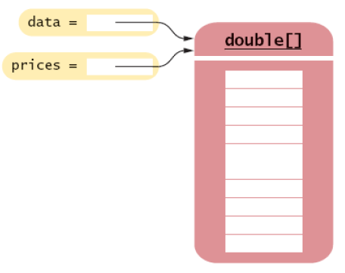
Copying arrays: array references
Copying an array variable yields a second reference to the same array
E.g.
  double [] data = {10,9,8,7,6,5,4,3,2,1};
  double [] prices = data;
  prices[2] = 99;
  System.out.println(data[2]);
  // prints 99, not 8!
Prices is merely a pointer to the same block of memory that is allocated for data

Slide 16
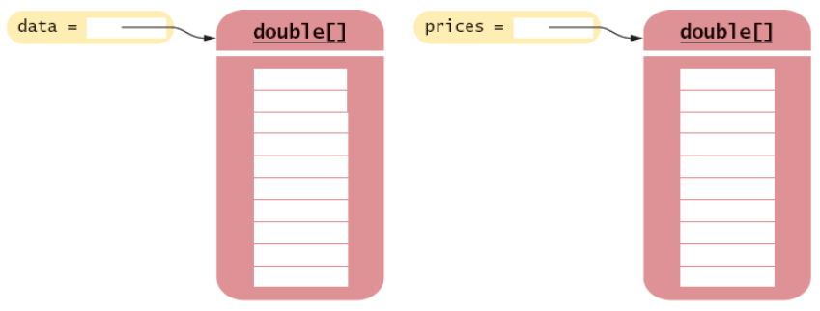
Copying arrays: cloning
Use clone to make a true copy, e.g.
  double [] data = {10,9,8,7,6,5,4,3,2,1};
  double [] prices = (double []) data.clone();
    prices[2]=99;
    System.out.println(data[2]);
    // prints 8

Slide 17
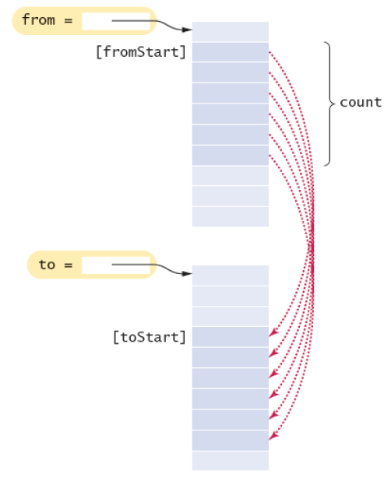
Copying portions of an array
System.arraycopy(from, fromStart, to, toStart, count);
E.g.
int [] data1 = {5,4,3,2,1};
int [] data2 = new int[5];
System.arraycopy(data1, 2,
data2, 3, 2);
for (int e : data2)
System.out.print(e+″ ″);
// prints 0 0 0 3 2

Slide 18
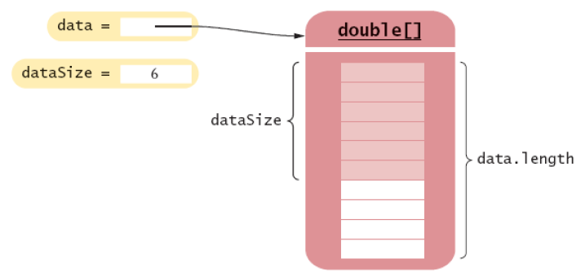
Partially Filled Arrays
Array length = maximum number of elements in array
Usually, the array is partially filled
Need companion variable to keep track of the current size (i.e. how many entries have actually been stored)
final int DATA_LENGTH = 10;
double[] data = new double[DATA_LENGTH];
int dataSize = 0;

Slide 19
Adding an element to an array
If the list must be sorted then we may need to add the element in the middle (see later)
Otherwise we can add the element to the end
If dataSize = data.length then there is no room for x
  an attempt to add a new element will throw an ArrayIndexOutOfBoundsException
  we could test whether dataSize = data.length before trying to add the new item, or
  catch the exception and use it to generate an error message
Otherwise there is room for an additional item
  put the new element into the empty slot THEN increment the value of the counter
    data[dataSize] = x;
    dataSize++;

Slide 20
Removing an element from an array
Again we assume that the array need not be sorted
Suppose we want to remove an entry at index i
If i >= datasize then no entry at index i has been stored
Otherwise an entry at index i has been stored
  decrement the value of datasize THEN overwrite the item at entry i by the very last entry
dataSize--;
data[i] = data[datasize];
0 1 2 3 4 5 6
4
3
7
X
8
1
2
5
datasize=7
0 1 2 3 4 5 6
4
3
7
5
1
2
5
datasize=6

Slide 21
Growing an array
If the array is full and you need more space, you can grow the array:
  Create a new, larger array.
  Copy all elements into the new array
  Store the reference to the new array in the array variable
double[] newData = new double[2 * data.length];
System.arraycopy(data, 0, newData, 0, data.length);
data = newData;

Slide 22
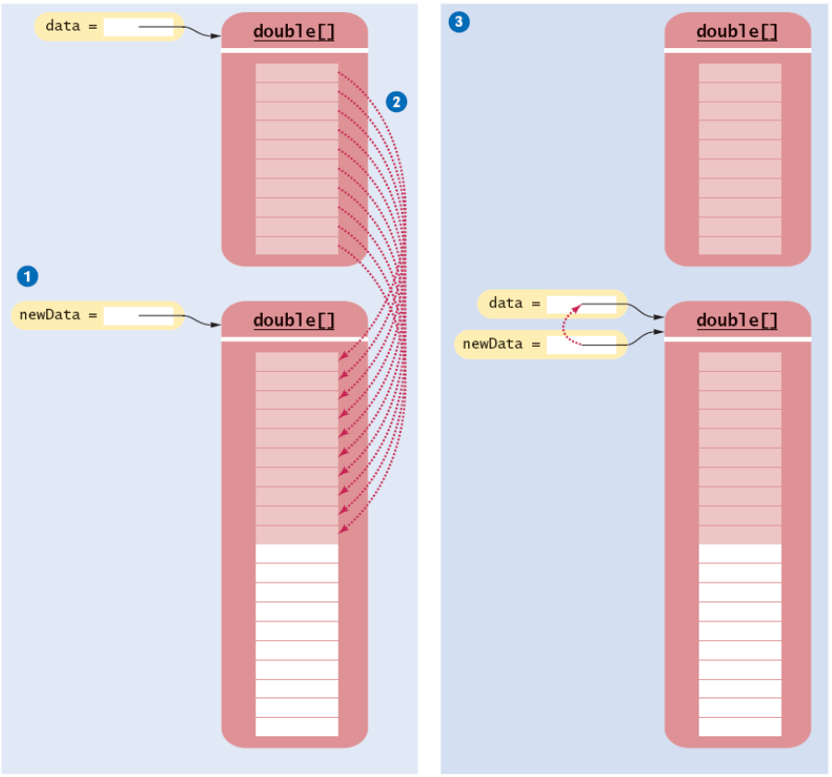
Growing an array

Slide 23
Shrinking an array
Suppose we wish to delete entry i and remove the extra space. Suppose len is the length of the array data:
  Overwrite contents of index i with the last entry
  Decrement len
  Create a new array with one fewer element
  Copy all elements into the new array
  Store the reference to the new array in the array variable
data[i] = data[len-1];
double[] newData = new double[len];
System.arraycopy(data, 0, newData, 0, len);
data = newData;

