Slide 1
Lecture 9
Accumulating totals of non-numerical items
Data encapsulation
Arrays of objects
Horstmann
  pp 561-562

Slide 2
Accumulating frequencies of non-numerical items
E.g., given a file containing a list of types of family pets, determine which is the most common type of pet
Need to accumulate frequencies (of pet types) in an array as before
0 | rabbit
1 | goldfish
2 | cat
3 | dog
4 | …
5
6
7
8
9
0 | 2
1 | 4
2 | 3
3 | 1
4 | …
5
6
7
8
9
But… how should we index our array of frequencies?
Need a second array to store pet types (array of Strings)
Both arrays can be populated as the file is read in

Slide 3
Accumulating frequencies of non-numerical items (cont)
Key data structures:
String [] petTypes = new String [MAX_PET_TYPES];
int [] frequencies = new int [MAX_PET_TYPES];
Suppose the next line contains goldfish
numPetTypes = 4
0 | rabbit
1 | goldfish
2 | cat
3 | dog
4
5 | …
0 | 2
1 | 4
2 | 3
3 | 1
4
5 | …
0 | rabbit
1 | goldfish
2 | cat
3 | dog
4
5 | …
0 | 2
1 | 5
2 | 3
3 | 1
4
5 | …

Slide 4
Accumulating frequencies of non-numerical items (cont)
Key data structures:
String [] petTypes = new String [MAX_PET_TYPES];
int [] frequencies = new int [MAX_PET_TYPES];
Suppose the next line contains hamster
numPetTypes = 5
0 | rabbit
1 | goldfish
2 | cat
3 | dog
4
5 | …
0 | 2
1 | 5
2 | 3
3 | 1
4
5 | …
0 | rabbit
1 | goldfish
2 | cat
3 | dog
4 | hamster
5 | …
0 | 2
1 | 5
2 | 3
3 | 1
4 | 1
5 | …

Slide 5
Accumulating frequencies of characters
E.g., find the most common letter in a passage of text
Involves building up frequency counts for characters
A secondary array is not necessary
Characters are represented in the computer by a numeric code
  ‘A’ is represented by the integer 65, ‘B’ by 66 etc
  To find the index position in an alphabetic array
  int index = ch – ′A′;
  To find if a character is alphabetic
  if (ch >= ′A′ && ch <= ′Z′)
  To get the next character, add on 1, cast back to a char
    char nextChar = (char) (′A′+1);

Slide 6
The length of an array (revisited)
To obtain the length of an array
  can refer to the value used to create it, e.g.
    MAX_PET_TYPES
  or, can use the .length attribute, e.g.
    petTypes.length
  NB this is NOT a method, so no brackets
To obtain the length of a string,
  Use the length() method of the String object, e.g.
    String str = ″abcdef″;
    System.out.println(str.length());
Very confusing
  arrays have a public length instance variable
  Strings have a length method

Slide 7
Accessing instance variables
These describe each particular object
  e.g., BankAccount has pounds and pence as instance variables
Consider BankAccount1
  pounds and pence are public in BankAccount
  can be accessed directly by BankTester to print balance using account.pounds etc.
Consider BankAccount2
  pounds and pence are private in BankAccount
  balance is printed from BankTester using printBalance() method
The latter is good practice
  why should the user know / care that the balance is split up into pounds and pence?
  this matter should be internal to the BankAccount class
  this is the approach we are taking

Slide 8
Data encapsulation
This means hiding the implementation details
The ‘user’ should not need to know details of how the data is stored or manipulated
  user should not be ‘aware’ of the particular data structures defining an object or a list
    the fact that a given list is implemented by an array should not affect the person programming the GUI
  user sees a list of objects with methods to display values, add new objects, delete redundant objects......
This impacts on the methods appropriate in particular classes

Slide 9
Arrays of objects
An array can contain any data type
  this includes object data types
  but all entries must be of the same data type
    actually this is not a big restriction as all objects can be given data type Object
      we won’t do this however!!
Array data structure is neither the only nor the best data structure for storing collections of objects BUT
  available across all programming languages
  simple to understand and manipulate
    but can be inefficient

Slide 10
Declaring an array of objects
Suppose you have a class BankAccount that defines a single bank account object, with the following attributes:
  accountNumber
  pounds
  pence
Declare an array of BankAccount objects as follows:
  BankAccount [] bankAccounts;
Before we instantiate the array we need a size:
  final int MAX_BANK_ACCOUNTS = 3;
Instantiate the array as follows:
  bankAccounts = new BankAccount [MAX_BANK_ACCOUNTS];

Slide 11
Diagram of array instantiation
BankAccount [] bankAccounts;
bankAccounts
null
bankAccounts = new BankAccount[MAX_BANK_ACCOUNTS];
bankAccounts
null
null
All the array entries are initially null.
They must be instantiated individually.
null

Slide 12
Designing a program with an array of objects
Aim is to design data modelling classes so that each class maintains a single data structure.
Need multiple classes in order to do this
  a class to define a single object
    contains methods relevant to a single object
  a class to define the array of objects
    contains methods relevant to lists of objects
  possibly other classes for other purposes, e.g., a class to analyse statistics
  all this in addition to the display classes managed by the GUI class

Slide 13
Program class design diagram
Main method
class
GUI class
Array class
Other windows
Object class
Creates instance of
Uses but doesn’t create instance of

Slide 14
Program class design diagram
Main method
class: BankTester
Array class:
BankManager
Object class:
BankAccount
Creates instance of
Uses but doesn’t create instance of

Slide 15
Structure of the array class
Instance variables
  (Constant) int setting maximum size of array
    big enough for foreseeable use!
  array of objects
  int counting actual number of objects in array
  others as required for application
Methods
  methods should be appropriate for the data structure
  add and delete elements
    aim is to have all the ‘holes’ at the end
  searching methods
  methods to find totals, maxima, minima, averages ...

Slide 16
Accessors and modifiers
An accessor is a “get” method that returns the value of a property
  so usually the value of an instance variable
  e.g., getAccountNumber() in BankAccount class
Not all instance variables have accessors – this is how data hiding
is implemented! For example we do not have an accessor returning the whole array, merely individual elements of the array.
A modifier (sometimes “transformer” / “mutator”) is a “set” method that modifies the value of a property
  e.g., makeDeposit
  it is not always appropriate to allow external modification
For example the count of elements in the array should only be
modified if an element is added or deleted.

Slide 17
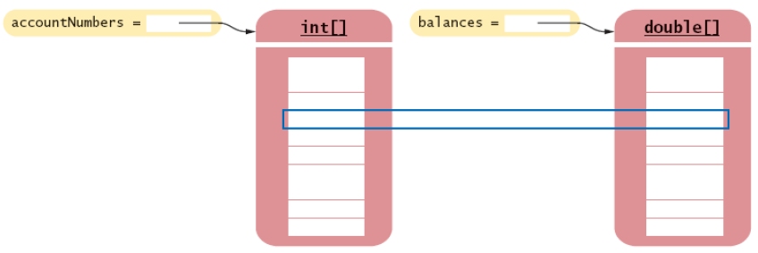
Parallel arrays
// Don't do this
int[] accountNumbers;
double[] balances;
Avoid parallel arrays by changing them into arrays of objects:

Slide 18
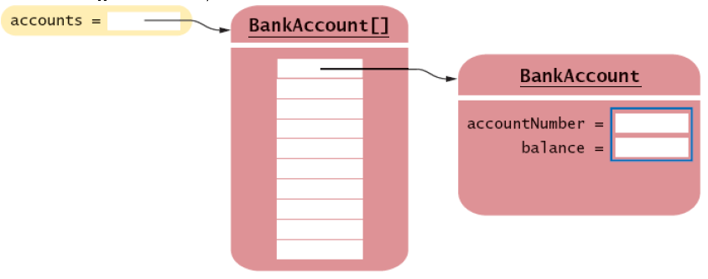
Parallel arrays
BankAccount[] = accounts;
Exercise: do the same for petFrequencies

