Slide 1
Attacking The Internet of Things
(using time)
Paul McMillan
Notes:
Are my presenter notes showing up properly?
References for numbers and code snippets are in the speaker notes in the slide deck, which is on github.

Slide 2
Who am I?
Notes:
Paul McMillan
Security Engineer at Nebula (I build clouds)
Security team for several prominent open source projects (not as exciting as you think it is)
Developer outreach
Mostly Python
Like building distributed systems
Like taking theoretical vulnerabilities and making them practical

Slide 3
There are many ways
to attack the
Internet of Things
Notes:
You generally own the device, so physical attacks all work:
Take it apart, read the flash memory
Disassemble the firmware from the manufacturer
Exploit shitty embedded C
Fuzzing
Logic errors
RF
Most of the standard network security errors are present too:
Random open ports
Old and vulnerable OS/application code
Etc.
We could go on forever. However,
We're here to talk about timing attacks.

Slide 4
Demo
(start)
Notes:
This is a Philips Hue base station. That's a zigbee connected light. I figured they're a pretty good example from the “internet of things that are put on the internet for no good reason”

Slide 5
What is a timing attack?
Notes:
What is a timing attack, anyway?
Well, at the most basic level, asking the computer to do any operation takes time. A measurable amount of time. A timing attack exploits this.
An attacker uses timing measurements to test hypotheses:

Slide 6
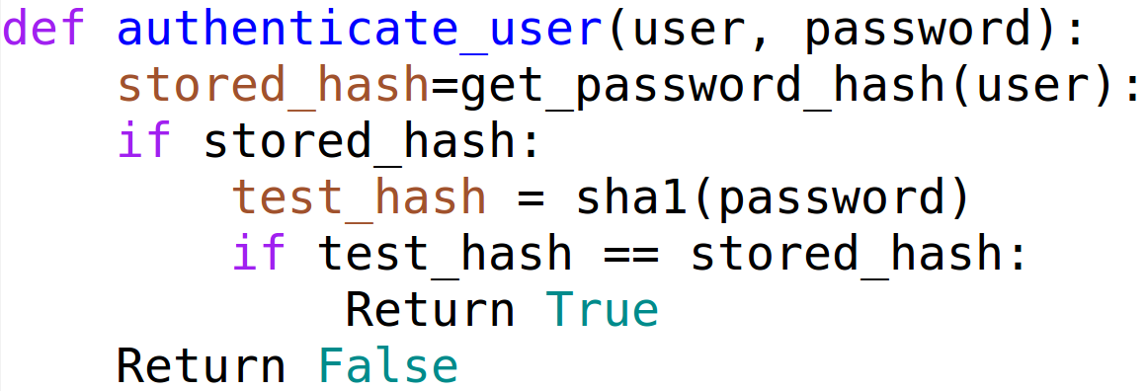
Notes:
This is a pretty typical example of how user authentication works (yes, I know, it has problems, I left stuff out to keep this simple)
<talk through the code>
You'll notice that if it finds a user, it does some extra work. In this case, that work involves calculating the sha1 of the provided password. That's an expensive operation.
An attacker can exploit this code to figure out which users have accounts in the system. Obviously, this isn't a vulnerability in all systems (some publish that data), but it's an unintended behavior.

Slide 7
Many Kinds
User Enumeration
Blind SQL Injection
CPU Cache attacks against crypto
  Local
  Cross-VM
Lucky 13
Many more...
Notes:
The point here is that these all follow a common pattern:
The attacker makes a guess about something
The computer uses that to compute
The attacker observes how long that takes (over many samples) and infers whether their hypothesis was correct

Slide 8
String Comparison
Timing Attacks
Notes:
However, today we're here to talk about string comparison timing attacks.
These are often more difficult to exploit, and usually written off as completely hypothetical vulnerabilities
(Hopefully my demo today will help fix that misconception)

Slide 9
memcmp
while (len != 0)
{
a0 = ((byte *) srcp1)[0];
b0 = ((byte *) srcp2)[0];
srcp1 += 1;
srcp2 += 1;
res = a0 - b0;
if (res != 0)
return res;
len -= 1;
}
Notes:
Snippet from http://www.nongnu.org/avr-libc/
<talk through the snippet>
The key takeaway here is that it stops as soon as it finds 2 non-matching bytes.
Unlike the previous example, we don't have to guess an entire username at once to get our timing difference. Instead, we just have to guess the first character.

Slide 10
ABCD
AXXX
BXXX
CXXX
DXXX

Slide 11
ABCD
AAXX
ABXX
ACXX
ADXX

Slide 12
ABCD
ABAX
ABBX
ABCX
ABDX

Slide 13
ABCD
ABCA
ABCB
ABCC
ABCD

Slide 14
MASSIVE Speedup
c = character set
n = Length of string
Brute Force: c^n
Timing Attack: c * n (* x)
(x is # tries to distinguish)
Notes:
If we're brute forcing an 8 character password with 16 possible characters (I like hex), we have to try a total of 4.2 billion guesses. That's likely to be impractical in the real world.
On the other hand, if we're conducting a timing attack, and let's say it takes us 10000 guesses per character to determine a timing difference, that works out to about 1.2 million.
If you bump the length up to 10, you're looking at a trillion for brute force, and just 1.6 million for the timing attack.
Obviously, this is a worthwhile attack, if you can pull it off.

Slide 15
Why are they interesting?
What are the drawbacks?
Notes:
Why are they interesting?
- They're more "pick the lock on the front door" than "find a backdoor"
- They don't require "bad code" (just non-security mindful code)
- Most people don't list them among "practical" exploits
- Commonly overlooked
What are the drawbacks?
- lots of network traffic
- really time consuming
- work best on a slow devices
- Susceptible to network noise / device contention

Slide 16
Let's talk about time
Notes:
It's hard to get an intuitive grasp on small amounts of time.
Let's look at some examples.

Slide 17
Internet SF-NY 70ms
Spinning Disk 13ms
Ram Latency 83ns
L1 cache 1ns
1 cpu cycle ~0.33ns
Notes:
Numbers more or less from here:
http://duartes.org/gustavo/blog/post/what-your-computer-does-while-you-wait/

Slide 18
Speed of light
in network cable
1 meter in ~5ns
200 meters ~1µs
Notes:
Remember that 1 microsecond is the minimum resolution recorded by the default kernel timestamps.

Slide 19
So... how long does each byte of that string comparison take?
nanoseconds

Slide 20
(on a modern
3Ghz machine)
Notes:
And that's the catch, Ladies and Gentlemen...

Slide 21
What about something a little slower?

Slide 22

Notes:
120 Mhz STM32 processor
Zigbee to the lights
10 base T network port
The perfect device to demonstrate string comparison timing attacks.
The comparison is still going to take nanoseconds, but it's going to take quite a lot of them.
Image from the Philips press kit

Slide 23
Network timing precision
Notes:
It turns out, if you want timing measurements good to the millisecond, or so, you're set. The kernel's networking stack works fine. You get numbers that provide microsecond resolution (but generally aren't precise down to that level).
However, since the effects we're looking for are much smaller than that, we need to work harder.

Slide 24
Sources of Imprecision
Graphics drivers
Background networking
USB Devices
Power saving measures
Audio devices
Etc.
Notes:
For a first try, it makes sense to just try the basic, default kernel packet timestamping. It turns out, it's really noisy.

Slide 25
Software Timestamps
are noisy.
Let's use hardware!
Notes:
It turns out this is easier now than when I started working on this a year ago. Linux support for hardware timestamps works out of the box in recent distros.
Most of the results we're going to discuss in the rest of the talk CAN be obtained without hardware timestamp support. You just need many many more samples.
Try and find a NIC with hardware support – they're pretty common now. Hardware with support for PTP (IEEE 1588) usually works.

Slide 26
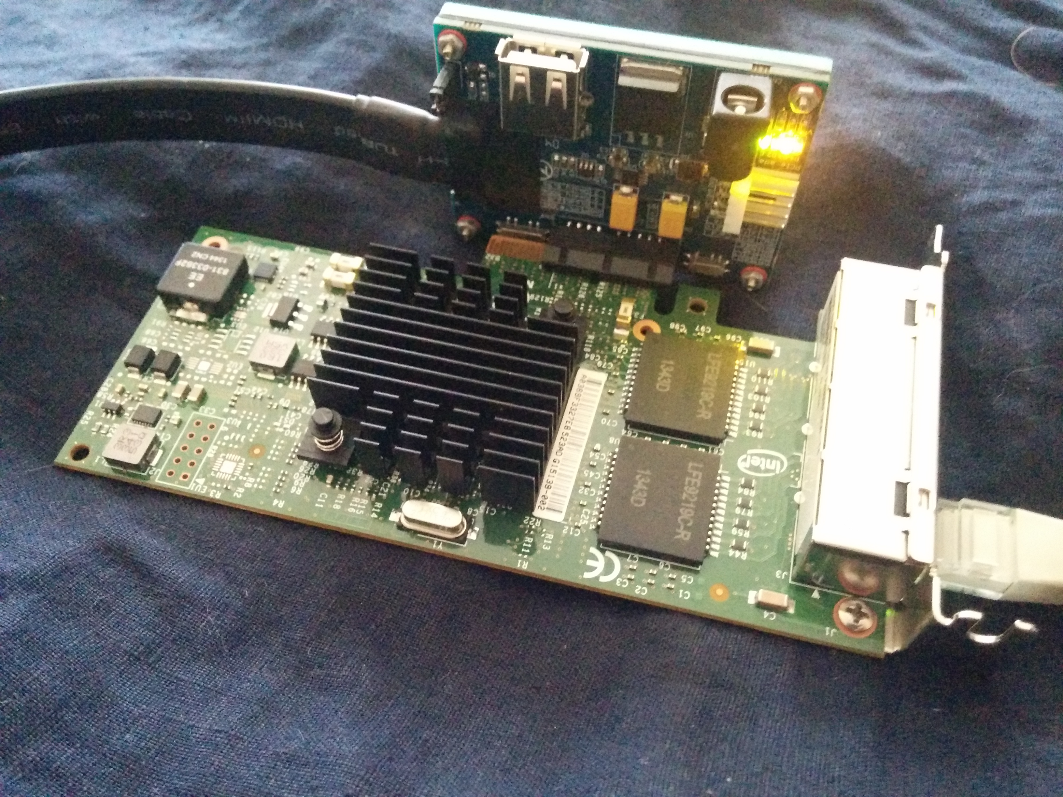
Notes:
Since my laptop hardware doesn't seem to support hardware timestamps, I went looking for a high-quality source. It's always better to start with great hardware and work your way down, than to start with bad hardware and realize you need better.
This is the Intel i350 NIC, which supports hardware timestamping with an 8ns resolution (the datasheet claims). It's connected through an expresscard to PCIe adapter, allowing me to run it from my laptop.
It is directly connected to the Hue Base Station, since we don't want extra hardware introducing unpredictable latency, especially for a live demo.
This is what we're doing the demo with right now.

Slide 27
Data Collection
Generate repeated traffic
TCPdump the packets
Analyze the data
Feed back to traffic gen
Notes:
So we have our target, we have the hardware which will allow us to carefully measure it, and we have our chosen attack technique. What's next?
Three fairly simple scripts. The first just generates login attempts over and over again. It takes an existing guess at the token, and appends a random character, then fires off the network request.
While it's doing this, a second script makes sure that TCPDump is capturing all relevant traffic, using hardware timstamps, at nanosecond level detail.
A third script periodically analyzes all captured data up to this point, and determines whether to advance the generator to a new guess.

Slide 28
Making things work
Libpcap 1.5.0+
TCPDump 4.6.0+ (released July 2, 2014)
Recent-ish Kernel
Compile these from source.
In theory, this might work on OSX?
It works on Ubuntu 14.04 for me.
Notes:
I'm going to take a slight diversion now and explain the practical steps to get nanosecond level hardware timestamps out of tcpdump.
Until very recently, tcpdump only supported microsecond level timestamps. Libpcap added support a while ago, but tcpdump didn't add it until a couple months ago. Hardware timestamp support is also relatively new. The upshot of all this is you need to install tcpdump 4.6.0 and libpcap 1.5.0+.

Slide 29
Nanoseconds. Ugh!
Scapy doesn't read the pcap files
Neither do most other packages
Wireshark does! (so does my fork of dpkt)
Nanosecond timestamps lose precision if you convert them to a float()
So we subtract a large offset, and don't work with raw timestamps.
Use integer Nanoseconds rather than float seconds
Notes:
Nanosecond timestamps turn out to be inconvenient to work with.
For starters, very few things understand the new file format (this will get fixed soon I hope).
Wireshark does understand pcap files with nansecond captures, and so we can use it to analyse our capture file. This isn't very efficient, so I added nanosecond support to dpkt. If you want to replicate this yo have to use the copy of dpkt in my github.
If you float() a nanosecond capture, you lose the last couple digits. To avoid imprecision and mistakes here, we prefer to work only in integers, and subtract a large offset to avoid overflows.

Slide 30
What is the Hue API?
GET /api/<user token>/lights
Basic RESTful API
Not very smart - always returns http status 200 even when returning errors.
User token is the only required auth
(no username, no sessions)
Not very fast (can handle ~30-60req/s)

Slide 31
Hue Base Oddities
Running FreeRTOS/6.0.5
Network stack is dumber than a sack of rocks
SSDP implementation ignores most parameters
Each HTTP response is split into ~8 pieces
HTTP stack ignores most incoming headers
Ethernet Frame Check Sequence sometimes wrong
Noisy: Broadcasts SSDP, ARPs for OpenDNS

Slide 32
Statistics!
Notes:
(Groan) but don't worry, we're only going to cover what you need to know

Slide 33
Basic Review
What is the Null Hypothesis?
What does it mean to reject the null hypothesis?
What are we trying to do here?
  sorting samples into groups, and identifying outlier
Notes:
We have two groups of samples.
We want to see if they come from the same, or different statistical distributions.
Our null hypothesis is that the samples are from the same distribution.
The test doesn't tell us whether they're from the same distribution – it can only help us decide whether we can conclusively say they are NOT from the same distribution.
If the p value from our test is < 0.05, we can REJECT the null hypothesis, and claim (with reasonable certainty) that our two samples are from different groups.

Slide 34
More Stats
Why can't we use the t-test?
What is the K-S test, and why does it help us here?
What other approaches might we use?
Notes:
Why can't we use the t-test? It's the first thing we're taught in stats class, and it works pretty well for a lot of things. However, it DOES NOT WORK for distributions which are not normally distributed.
Our network sample data is very non-normal.
The Komolgrov-Smirnov test is what we'll use instead. It functions by taking two sets of samples, sorting each one, and then comparing the maximum difference between the two samples.

Slide 35
[a series of yet to be completed example data graphs]

Slide 36
Data Prep
Discarding data (Look at your data, pick the cleanest part without clipping if you can)
How to do that wrong!
Why?
Notes:
Don't forget that these stats only work if your data points are approximately aligned in time, and you have the SAME NUMBER OF THEM!
This doesn't work at all with lopsided data sets. It's easy to accidentally get there.

Slide 37
Code
In the repo now, public after the talk:
https://github.com/PaulMcMillan/2014_ekoparty
several separate but related scripts
Don't forget to save your data for re-analysis
Starting points for analysis, not full blown attack tools

Slide 38
[brief browse through the code]

Slide 39
[Demo discussion, dissection of working or failure. Draw some graphs]

Slide 40
Tips and Tricks
Notes:
These are going to come fairly rapid-fire, but most of them represent at least an afternoon of learning associated with failure.

Slide 41
Keep the socket open
(if you can)

Slide 42
Configure your network card parameters properly
use hardware timestamps
turn off queues
use nanosecond timestamps (gah!)
Turn off some offloads

Slide 43
Make everything Quiet
reduce extraneous traffic to the device
Slow loris to exclude other traffic
don't run extra stuff on your attack machine
Profile your victim – discard noisy periods

Slide 44
Do a warmup run before starting to collect data!
Notes:
Yes, physical warmup

Slide 45
Find the simplest possible request

Slide 46
Avoid statistical tests that assume your data is normal

Slide 47
Gather data on all hypothesis concurrently
Notes:
You really can't come back later and mix them up.

Slide 48
Randomize the request order
Notes:
Don't cycle repeatedly. You're more likely to hit cache and cyclical timing weirdness.

Slide 49
Don't overwhelm the device

Slide 50
Don't forget you can stop and brute force a token
Notes:
And it turns out that you can brute force WHILE you're doing the timing attack too.

Slide 51
Some code short circuits if strings aren't the same length.

Slide 52
Try both:
Fast and Noisy
Slow and Quiet
Which one works best will vary.

Slide 53
Don't get fooled by your own data!
When in doubt, take more samples.

Slide 54
If you try hard enough, eventually ‘statistically significant’ findings will emerge from any reasonably complicated data set.
When results are analyzed many ways without a plan, the results simply cannot be interpreted.
At best, you can treat the findings as an hypothesis to be tested in future studies with new data.
Notes:
http://www.graphpad.com/guides/prism/6/statistics/index.htm?stat_approaches_to_dealing_with_mul.htm
This is really important point. Once you think you've found an analysis that works for your data, COLLECT MORE DATA.

Slide 55
Questions?
http://github.com/
PaulMcMillan/
2014_ekoparty
Repo contains slides and many useful references.
Presentation references in speaker notes.

