Slide 1
x[n]
+
+
y[n]
x[n]
+
+
y[n]
D
D
D
D
+
+
+
+
D
D
D
D
+
+
+
+
D
D
D
D

Slide 2
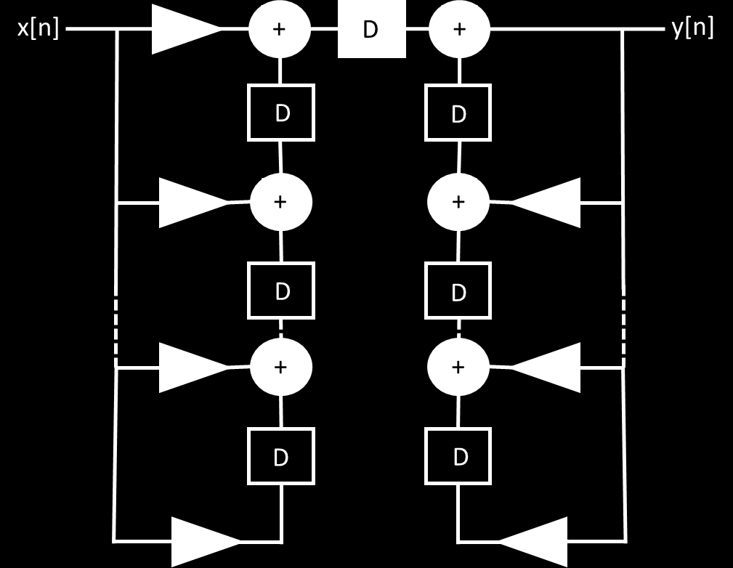
x[n]
+
D
+
y[n]
D
D
+
+
D
D
+
+
D
D

Slide 3
Testbench
IIR_filter_pipelined
filter_index[0:4]
Coeff_selector
SineWave
Counter

Slide 4
x[n]
+
+
y[n]
D
D
+
+
D
D
+
+
D
D

Slide 5
x[n]
+
D
+
y[n]
D
D
+
+
D
D
+
+
D
D

Slide 6
Testbench
IIR_filter_pipelined
filter_index[0:4]
Coeff_selector
SineWave
Counter

