Slide 1
Learning a Loss Function for Text Simplification
Rebekah Cramerus, Paul Opuchlich, Malte Klingenberg
28.06.2018

Slide 2
Learning a Loss Function for Text Simplification
problem
training a neural network using gradient descent requires a differentiable loss function
but: typical text simplicity features defined stepwise, not smooth

Slide 3
Learning a Loss Function for Text Simplification
problem
training a neural network using gradient descent requires a differentiable loss function
but: typical text simplicity features defined stepwise, not smooth
idea: create „helper“ network to calculate difficulty score

Slide 4
Learning a Loss Function for Text Simplification
datasets
British Council „LearnEnglish“, News in levels etc.
but: only small number of difficulty levels
hopefully: Newsela (quasi-continuous difficulty scale)

Slide 5
Learning a Loss Function for Text Simplification
defining difficulty score
lexical features: average word length, ratio of basic english words, type-token ratio...

Slide 6
Learning a Loss Function for Text Simplification
defining difficulty score
lexical features: average word length, ratio of basic english words, type-token ratio...
syntactical features: number of subordinate clauses, prepositional phrases, passive voice...

Slide 7
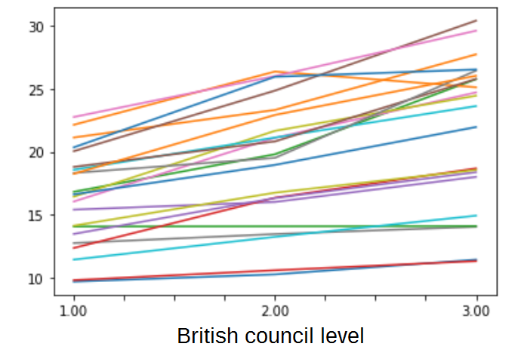
Learning a Loss Function for Text Simplification
type-token ratio

Slide 8
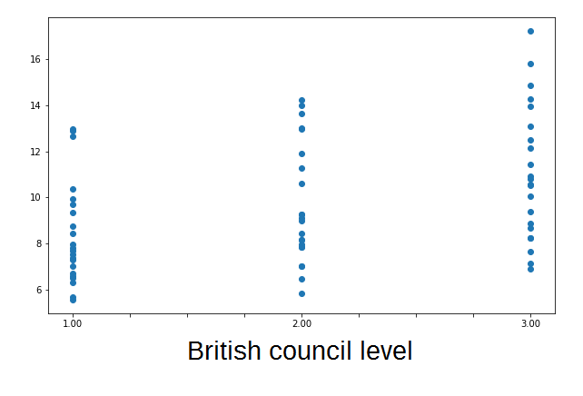
Learning a Loss Function for Text Simplification
all features combined

Slide 9
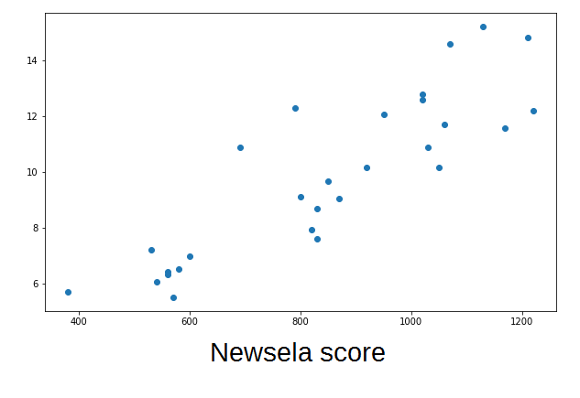
Learning a Loss Function for Text Simplification
all features combined

Slide 10
Learning a Loss Function for Text Simplification
next steps
cross fingers about Newsela corpus
train neural network on the difficulty scores

