Slide 1
An Introduction to Neuroevolution
Paul Pauls,Technical University of Munich (TUM)
Advisor: Michael Adam,Technical University of Munich (TUM)

Slide 2
Evolutionary, Genetic and Neuroevolution Algorithms
Introduction to Neuroevolution

Slide 3
Evolutionary Algorithms
„A generic population-based and meta-heuristically optimized al-
gorithmic solution to an applied problem“
                (Source: [16])
Introduction to Neuroevolution

Slide 4
Evolutionary Algorithms
„A generic population-based and meta-heuristically optimized al-
gorithmic solution to an applied problem“
                (Source: [16])
Introduction to Neuroevolution

Slide 5
Evolutionary Algorithms
„A generic population-based and meta-heuristically optimized al-
gorithmic solution to an applied problem“
                (Source: [16])
Introduction to Neuroevolution

Slide 6
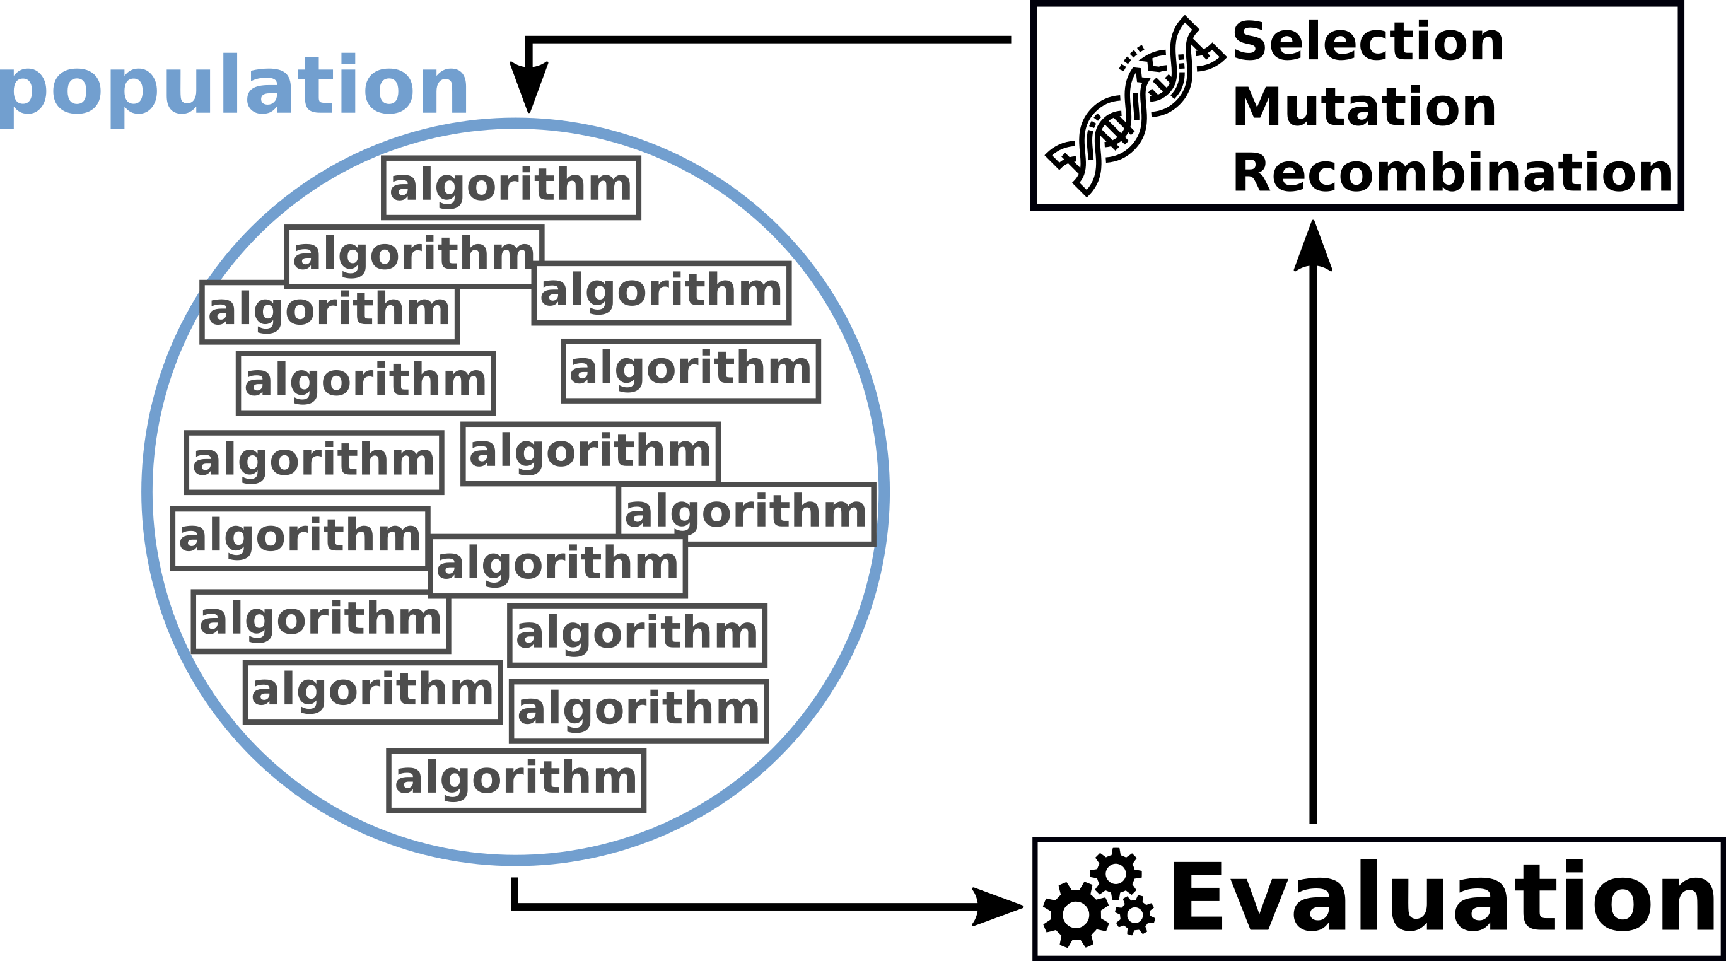
Evolutionary Algorithms
Introduction to Neuroevolution

Slide 7
Evolutionary Algorithms
Introduction to Neuroevolution

Slide 8
Evolutionary Algorithms
Introduction to Neuroevolution

Slide 9
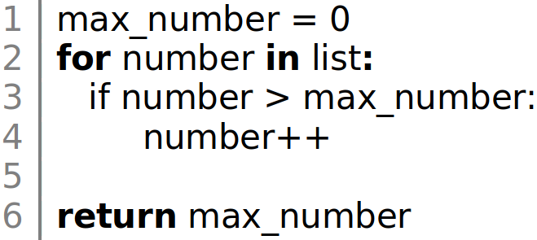
Evolutionary Algorithms – Mutation
Introduction to Neuroevolution

Slide 10
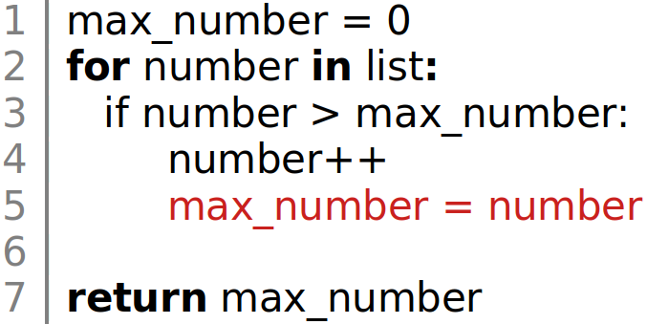
Evolutionary Algorithms – Mutation
Introduction to Neuroevolution

Slide 11
Evolutionary Algorithms
Introduction to Neuroevolution

Slide 12
Evolutionary Algorithms
„A generic population-based and meta-heuristically optimized al-
gorithmic solution to an applied problem“
                (Source: [16])
Introduction to Neuroevolution

Slide 13
Evolutionary Algorithms
Introduction to Neuroevolution

Slide 14
Evolutionary Algorithms
„A generic population-based and meta-heuristically optimized al-
gorithmic solution to an applied problem“
                (Source: [16])
Introduction to Neuroevolution

Slide 15
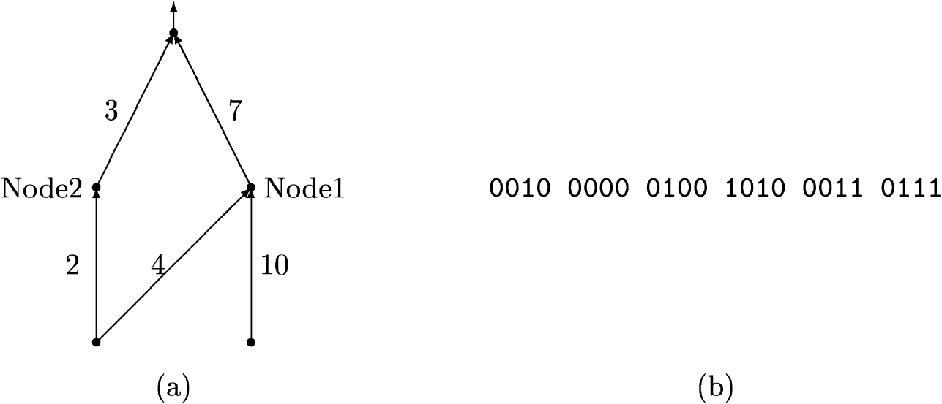
Genetic Algorithms
Introduction to Neuroevolution

Slide 16
Genetic Algorithms
[phenotype] [genotype]
Introduction to Neuroevolution

Slide 17
Genetic Algorithms
[phenotype] [genotype]
Source: [4]
Introduction to Neuroevolution

Slide 18
Neuroevolution
„A neuroevolution algorithm is a genetic algorithm, whose search-
space (genotypes) consists only of artificial neural networks. A
genetic algorithm in turn is an evolutionary algorithm that evolves
genotypes through mutation, recombination and selection.“
Introduction to Neuroevolution

Slide 19
Neuroevolution
Introduction to Neuroevolution

Slide 20
Neuroevolution – Mutation
Introduction to Neuroevolution

Slide 21
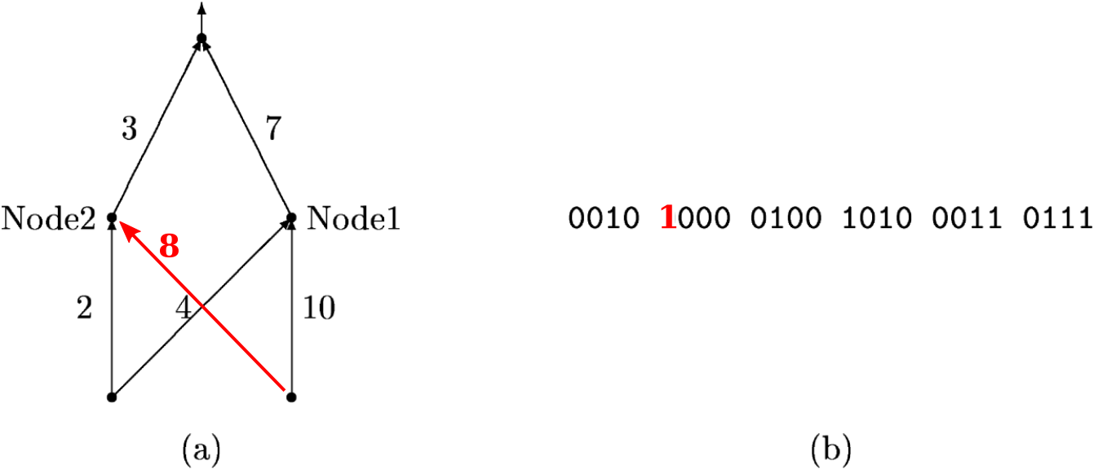
Neuroevolution – Mutation
Introduction to Neuroevolution

Slide 22
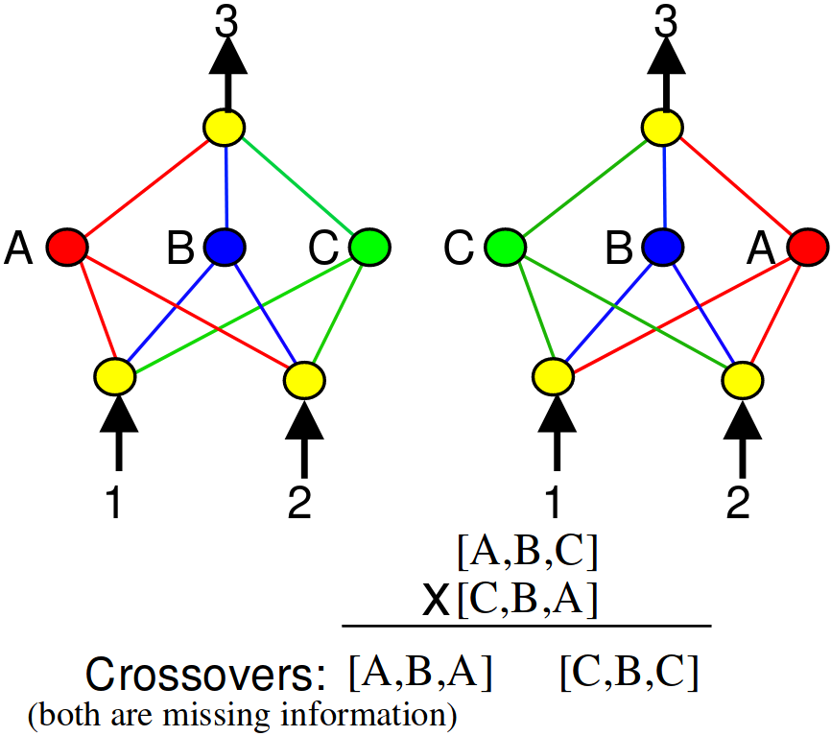
Neuroevolution – Recombination
Introduction to Neuroevolution

Slide 23
Neuroevolution – Selection
Periodical removal of the lowest performing algorithms in the
population
Introduction to Neuroevolution

Slide 24
Neuroevolution
„Neuroevolution is the - possibly boundless - process in which by
the means of a genetic algorithm the population of artificial neural
networks is increasingly optimized in order to maximize the
accuracy or fitness of the best ANN.“
Introduction to Neuroevolution

Slide 25
Neuroevolution of Augmenting Topologies (abbr. NEAT)
Introduction to Neuroevolution

Slide 26
Neuroevolution of Augmenting Topologies
Kenneth O.Stanley and Risto Miikkulainen co-published an approach to neuroevolution in the year 2002, which they called \textit{Neuroevolution of Augmenting Topologies} (abbr. NEAT) \cite{sta02_1}. At the time of envisionment was NEAT considered one of the most promising approaches to ANN evolution and it is still considered a viable approach and a benchmark algorithm in neuroevolution to this day.
Introduction to Neuroevolution

Slide 27
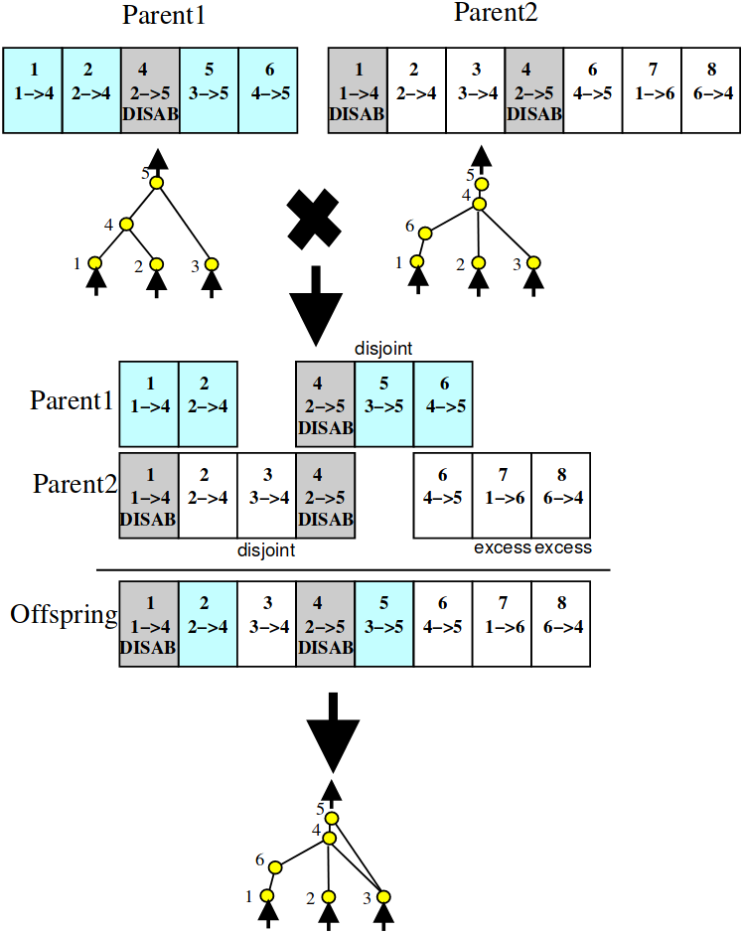
NEAT – Principle of Historical Markings
Explain and vizualize this principle
Introduction to Neuroevolution

Slide 28
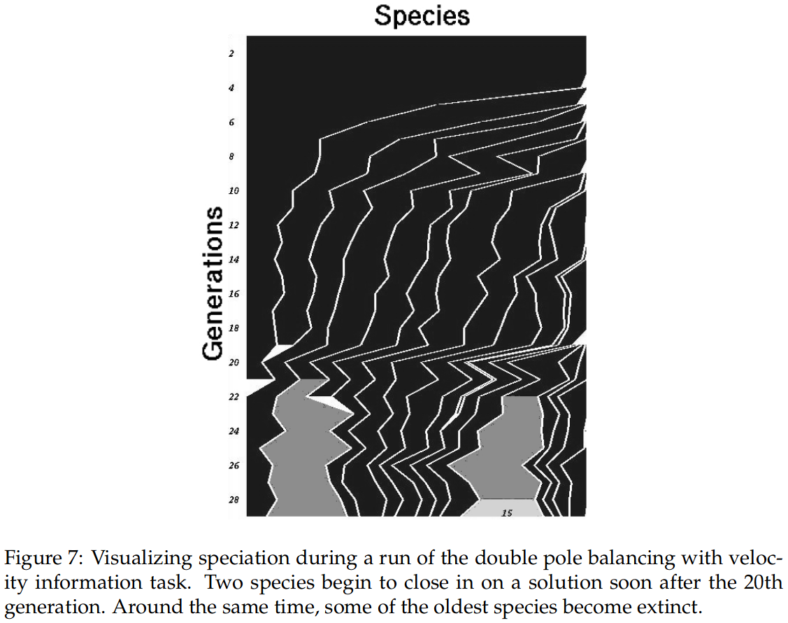
NEAT – Principle of Speciation
Explain and vizualize this principle
Introduction to Neuroevolution

Slide 29
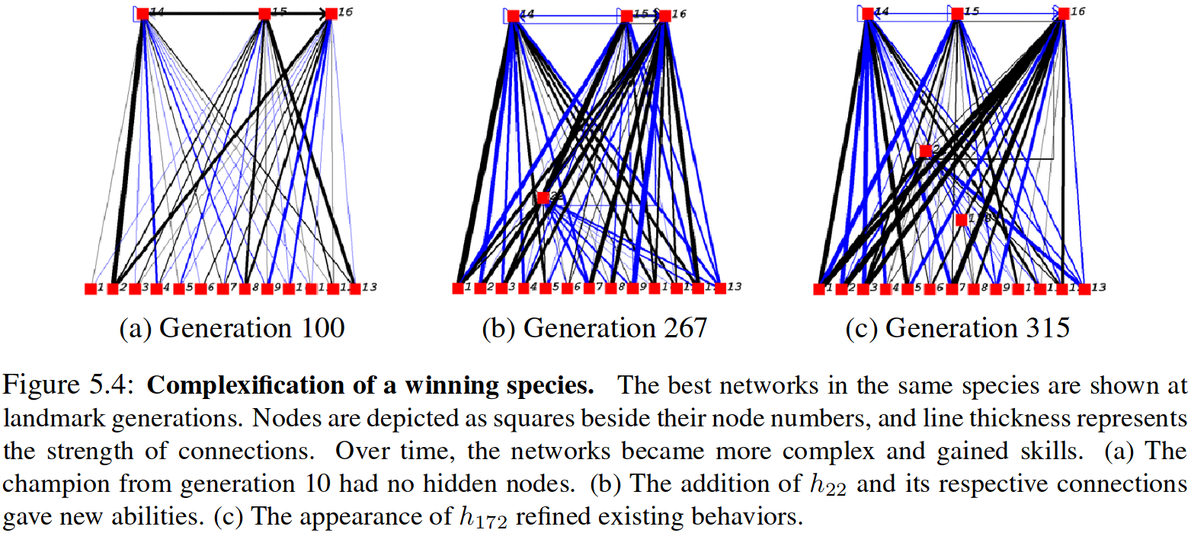
NEAT – Principle of Complexification
Explain and vizualize this principle
Introduction to Neuroevolution

Slide 30
Neuroevolution of Augmenting Topologies
Give Summary and Overview
Introduction to Neuroevolution

Slide 31
Neuroevolution Performance and
Practical Applications
Introduction to Neuroevolution

Slide 32
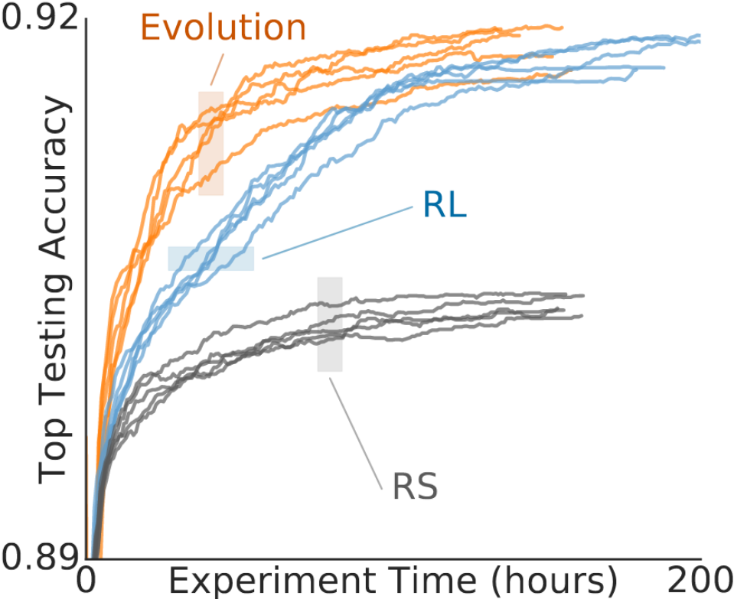
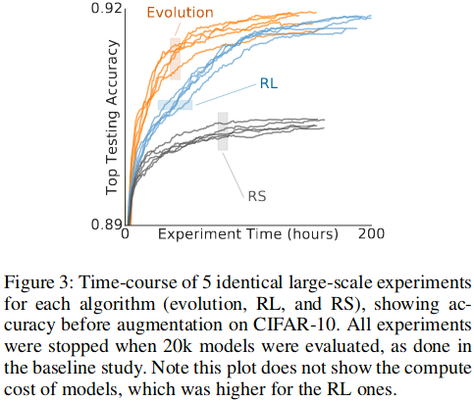
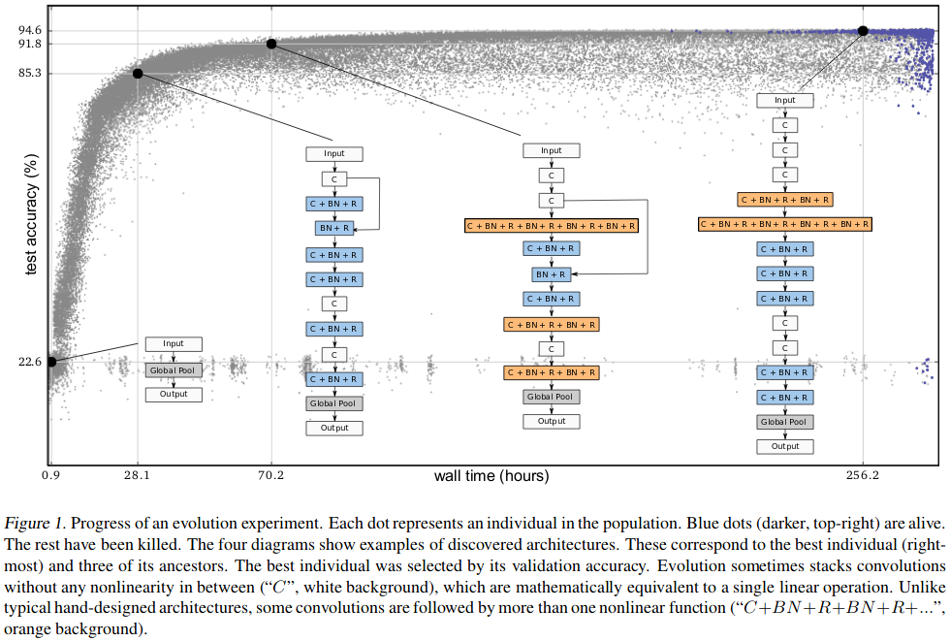
Neuroevolution – Performance
Give Performance Review of NEAT back in 02 and NE in todays real research
Introduction to Neuroevolution

Slide 33
Neuroevolution – Practical Examples
Don‘t go much into detail, but mention that there are no common NE frameworks, though there currently is work on that.
Blend over to live example
Introduction to Neuroevolution

Slide 34
An Introduction to Neuroevolution
Paul Pauls,Technical University of Munich (TUM)
Advisor: Michael Adam,Technical University of Munich (TUM)

Slide 35
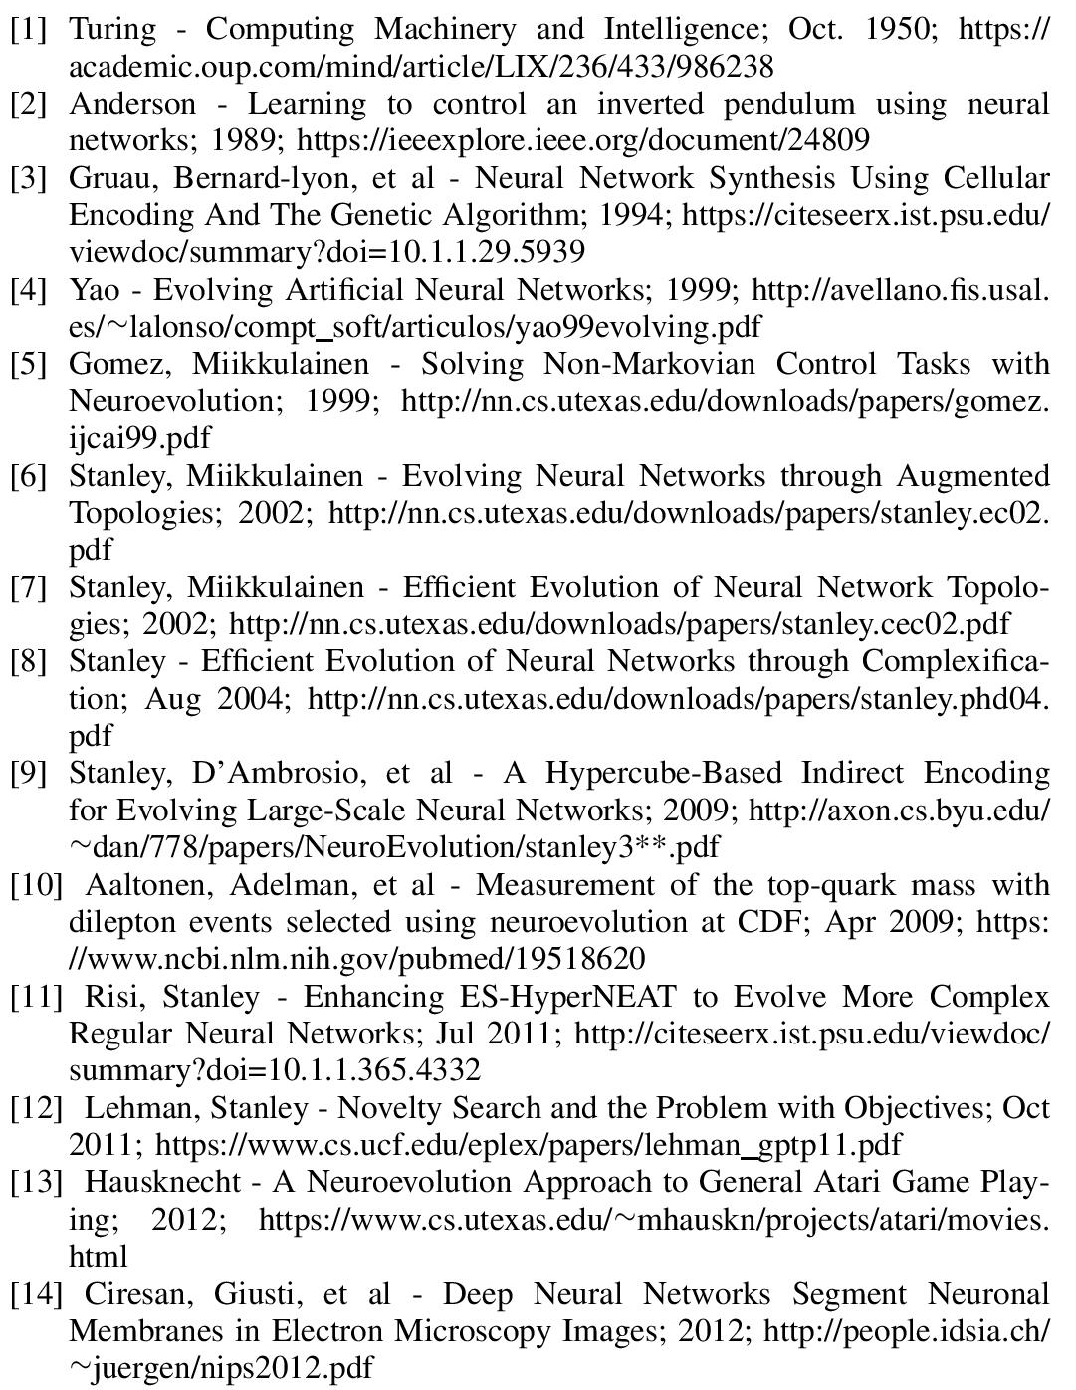
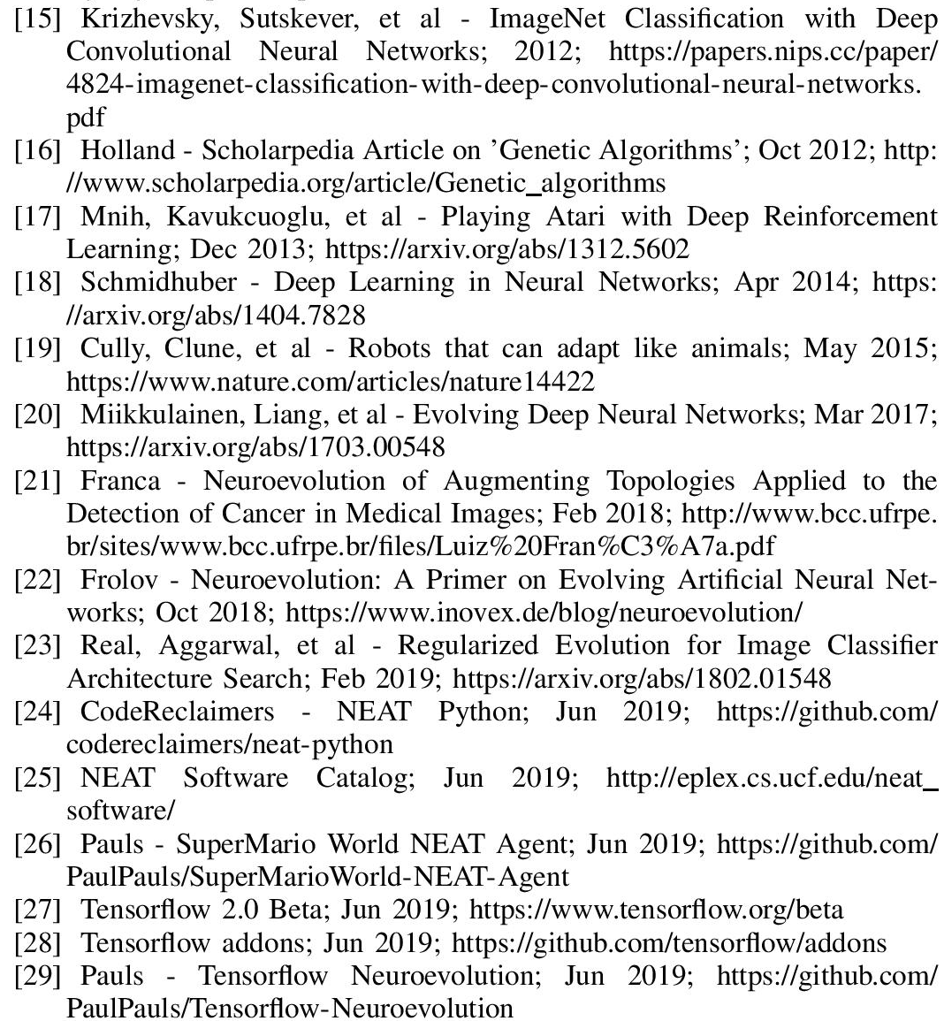
References
Introduction to Neuroevolution

Slide 36
Introduction to Neuroevolution

