Slide 1

AZTEC Protocol
Tom Waite and Paul Berg

Slide 2

Outline
Introduction
What is the AZTEC Protocol
Our experiences of working at a blockchain startup
How to follow AZTEC

Slide 3
Intro

Slide 4
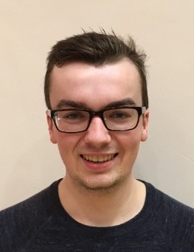
We are engineers from AZTEC
Tom
Imperial Physics MSci (graduated 2018)
Tried out all sorts at uni:
  MBDA Missile Systems
  Robotics research in South Korea
  BCG
  Undergrad research assistant at Imperial’s Crypto Centre
  Machine learning MSci project
Joined AZTEC 6 months ago

Slide 5

We are engineers from AZTEC
Paul
Software engineer for ~5 years
Doing Ethereum for ~2 years
Youngest alumni of Entrepreneur First (19 yo)
Co-Founder of ChronosProtocol
Joined AZTEC 3 months ago

Slide 6
What is AZTEC?

Slide 7
Public blockchains have many benefits, but privacy was a problem
Public blockchains have a raft of benefits:
Single verifiable source of truth
Counterparty risk significantly reduced - transactions settled atomically by smart contracts
Reduced fees
But there’s a problem!
These blockchains are public - confidential activity can not take place on them
…. OR CAN IT?

Slide 8
AZTEC is a privacy protocol for the Ethereum public blockchain
We use a branch of cryptography called zero-knowledge proofs
Allows us to validate the logic of transactions, without revealing the confidential values involved. Checkout a confidential transaction on mainnet here:
The protocol is:
Extremely efficient, 800-900k gas for one private transaction
Interoperable with Ethereum based assets
AZTEC will allow financial services to be provided with privacy on public Ethereum
https://etherscan.io/tx/0xdd879c3181a40c80d738320be2fd2f9d919412537d07d252db8ec974343ff0c1

Slide 9
Our experiences

Slide 10
Tom
Everything is difficult - especially elliptic curve cryptography! 📝
Rate of learning in a startup is fast 😀💭
Physics is pretty good prep for problem solving! ✨🔆

Slide 11
Paul
Feels like consciously walking towards fire 🔥
Constantly learning new things 📚
Must figure a lot of things on your own 🤯
Nevertheless, fun 🥳

Slide 12
How to follow our progress

Slide 13
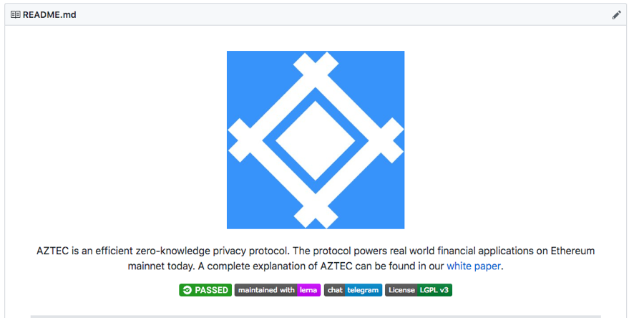
Check out AZTEC!
Website: https://www.aztecprotocol.com/
Github: https://github.com/AztecProtocol
Twitter: https://twitter.com/aztecprotocol

Slide 14

Find us on Twitter
@aztecprotocol
@PaulRBerg
@tom_waite_

Slide 15
Questions?

