Slide 1
GitHub Actions
Paul Riviera
Microsoft AppDev CSA

Slide 2

Recording?

Slide 3
Outline
Intro
Origin
Concepts
Structure
Sharing Values
Security
Runners
Demo

Slide 4
The Origin Story
Forked from Azure DevOps Pipelines
Improved and Simplified YAML Workflow

Slide 5
name: Hello World Workflow
on:
push:
branches: [ main ]
pull_request:
branches: [ main ]
workflow_dispatch:
jobs:
build:
runs-on: ubuntu-latest
steps:
- uses: actions/checkout@v2
- name: Single Command
run: echo Hello, world!
- name: Create File
run: |
touch greeting.txt
cat >> greeting.txt <<EOL
Hello World
EOL
- uses: actions/upload-artifact@v2
with:
name: "Greeting File"
path: greeting.txt
Workflow Name:
Hello World Workflow
Event Triggers:
Push to Main
Pull Request to Main
Dispatch (Manual/REST API)
Jobs
One job named ‘build’ running on
The latest Ubuntu Runner (VM)
Steps
Four Actions
Actions
Checkout the Branch
Single Line Run Action
Multi Line Run Action
Artifact Upload Action

Slide 6
Events
Triggers
Scheduled Events | cron syntax
Manual Events | REST or GitHub Portal
Webhook Events | Any Git Event

Slide 7
Events
Triggers
Scheduled Events | cron syntax
Manual Events | REST or GitHub Portal
Webhook Events | Any Git Event

Slide 8
Runners
Virtual environment | YAML workflow label
Windows Server 2019 | windows-latest or windows-2019
Windows Server 2016 | windows-2016
Ubuntu 20.04 | ubuntu-latest or ubuntu-20.04
Ubuntu 18.04 | ubuntu-18.04
Ubuntu 16.04 | ubuntu-16.04
macOS Big Sur 11.0 | macos-11.0
macOS Catalina 10.15 | macos-latest or macos-10.15

Slide 9
Secrets
Encrypted
Organization Level
Required Alphanumeric names
steps:
- uses: actions/checkout@v2
- name: Write Secret
shell: bash
env:
SUPER_SECRET: ${{ secrets. TEST_SECRET }}
run: |
echo Hello, $SUPER_SECRET

Slide 10
Job Communication
Outputs
Artifacts
Context

Slide 11
Job Communication
Outputs
Artifacts
Context

Slide 12
name: Hello World Workflow
on:
schedule:
- cron: '*/30 5,17 * * *'
jobs:
build:
runs-on: ubuntu-latest
steps:
- uses: actions/checkout@v2
- name: Single Command
run: echo Hello, world!
- name: Create File
run: |
touch greeting.txt
cat >> greeting.txt <<EOL
Hello World
EOL
- uses: actions/upload-artifact@v2
with:
name: "Greeting File"
path: greeting.txt
Event Triggers:
check_run
check_suite
create
delete
deployment
deployment_status
fork
gollum
issue_comment
issues
label
milestone
page_build
project
project_card
project_column
public
etc…

Slide 13
Security
Workflows
Event
Jobs
Steps
Actions

Slide 14
name: Hello World Workflow
on:
schedule:
- cron: '*/30 5,17 * * *'
jobs:
build:
runs-on: ubuntu-latest
steps:
- uses: actions/checkout@v2
- name: Single Command
run: echo Hello, world!
- name: Create File
run: |
touch greeting.txt
cat >> greeting.txt <<EOL
Hello World
EOL
- uses: actions/upload-artifact@v2
with:
name: "Greeting File"
path: greeting.txt
Event Triggers:
check_run
check_suite
create
delete
deployment
deployment_status
fork
gollum
issue_comment
issues
label
milestone
page_build
project
project_card
project_column
public
etc…

Slide 15
Examples

Slide 16
Best Practices
Use your own Runners in private repos when your need to customize things.
Create Chainable Actions (Lots of Small Actions) as opposed to a Mololithic Action

Slide 17
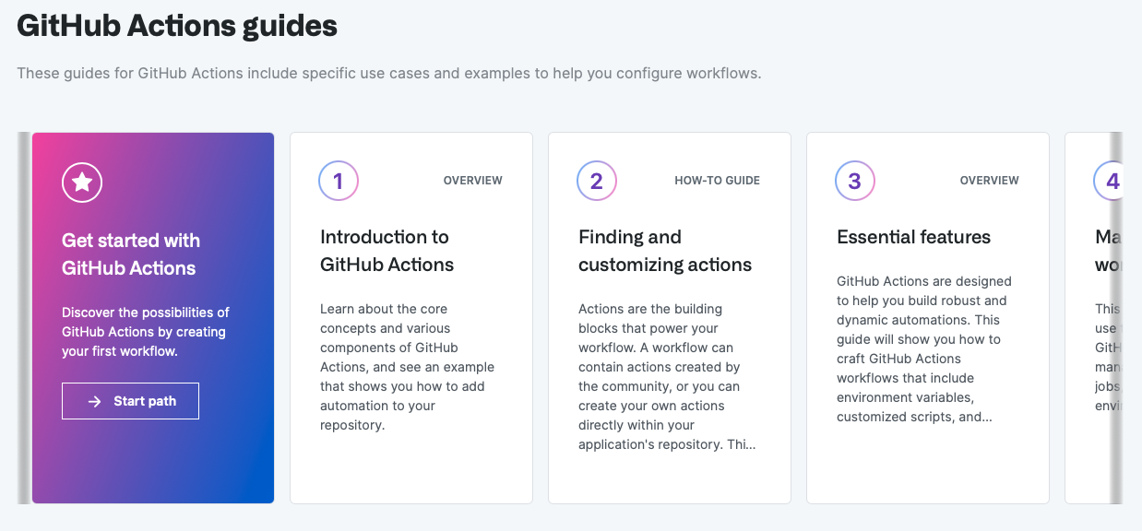
Next Steps

Slide 18

Questions?

