Slide 1
GitOps
Paul Riviera
Microsoft AppDev CSA

Slide 2

Recording?

Slide 3
Outline
Intro
What is GitOps
Flux
Components
Demo

Slide 4
GitOps ≠ DevOps
Notes:
GitOps works by using Git (Source Control) as the single source of truth for the state of your Kubernetes Cluster.

Slide 5
What is GitOps?
Kubernetes Orchestration
&
Application Delivery
Notes:
GitOps works by using Git (Source Control) as the single source of truth for the state of your Kubernetes Cluster.

Slide 6
Principals of GitOps
Cluster Resources Defined Declaratively.
State is Versioned with Git.
Approved changes automatically reflected in the Cluster.
Alert on Divergence
Notes:
GitOps works by using Git (Source Control) as the single source of truth for the state of your Kubernetes Cluster.

Slide 7


Slide 8
Flux v2 Toolkit
Source Controller
Kustomize Controller
Helm Controller
Notification Controller
Image Reflector/Automation Controllers
Notes:
GitOps works by using Git (Source Control) as the single source of truth for the state of your Kubernetes Cluster.

Slide 9
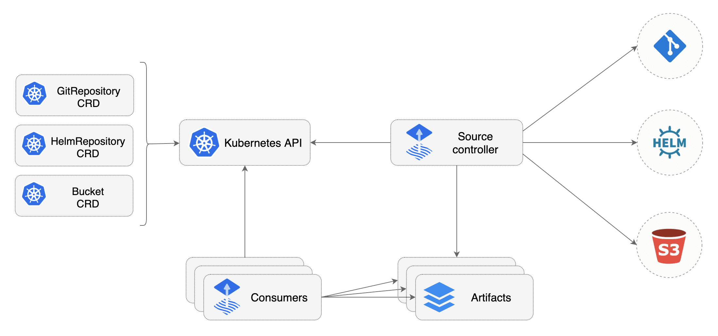
Source Controller
Notes:
Source Controller: Provide a common interface to pull artifacts into the pipeline, this controller will check for changes based on a predefined interval.

Slide 10
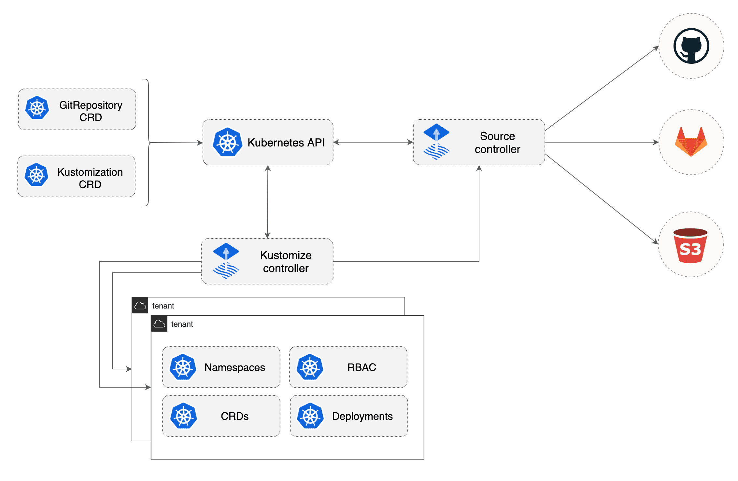
Kustomize Controller

Slide 11
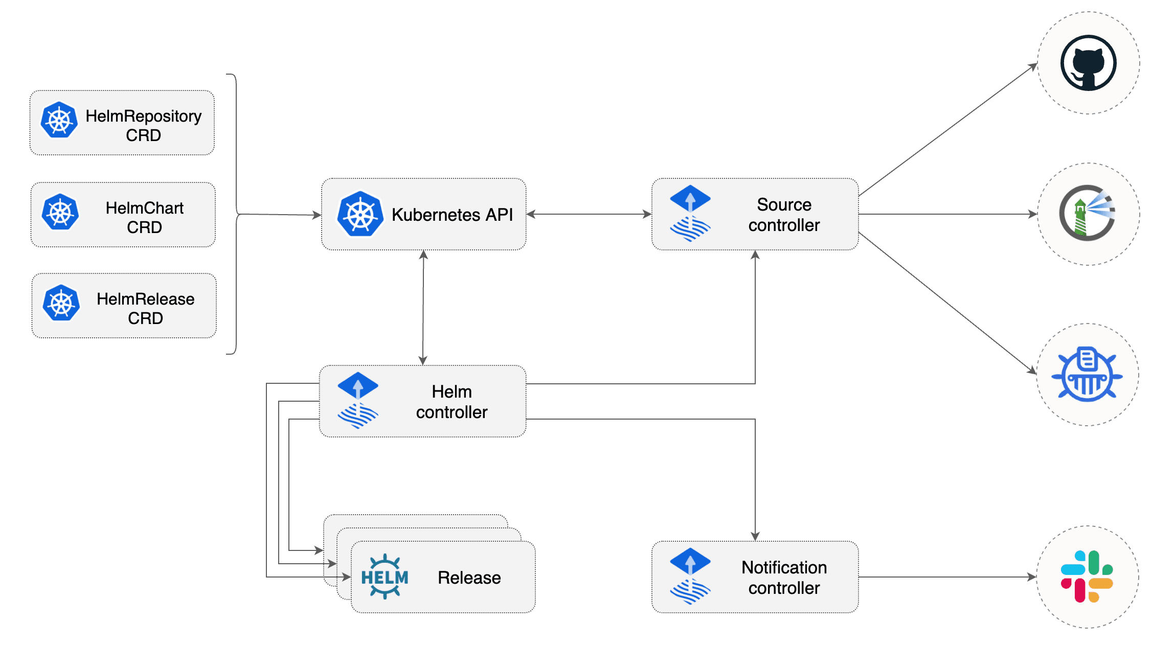
Helm Controller

Slide 12
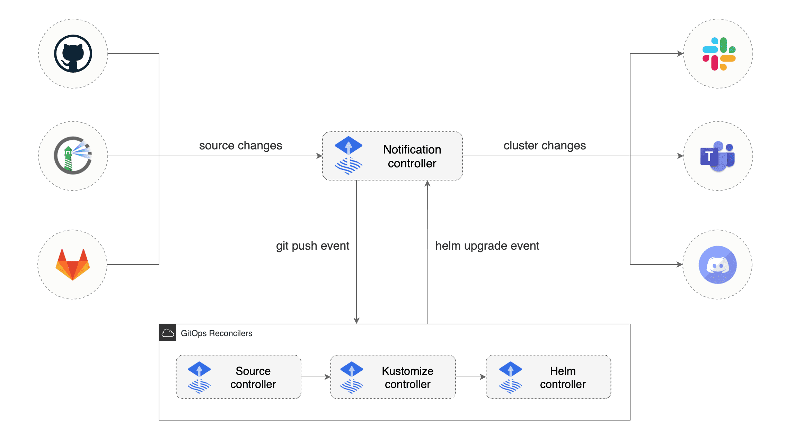
Notification Controller

Slide 13
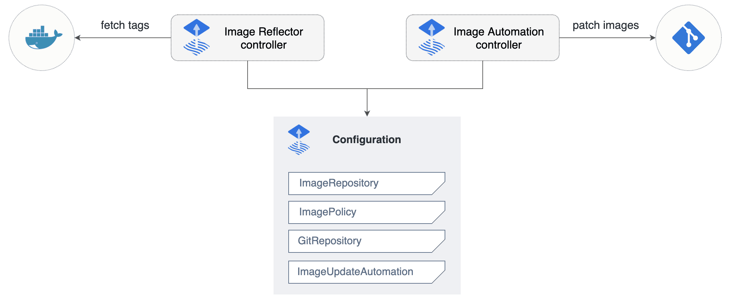
Alpha Feature
Image Reflector/Automation Controllers

Slide 14
Demo
Deploy App through Kubectl
Configure GitOps
Let Flux Configure State
Notes:
GitOps works by using Git (Source Control) as the single source of truth for the state of your Kubernetes Cluster.

Slide 15
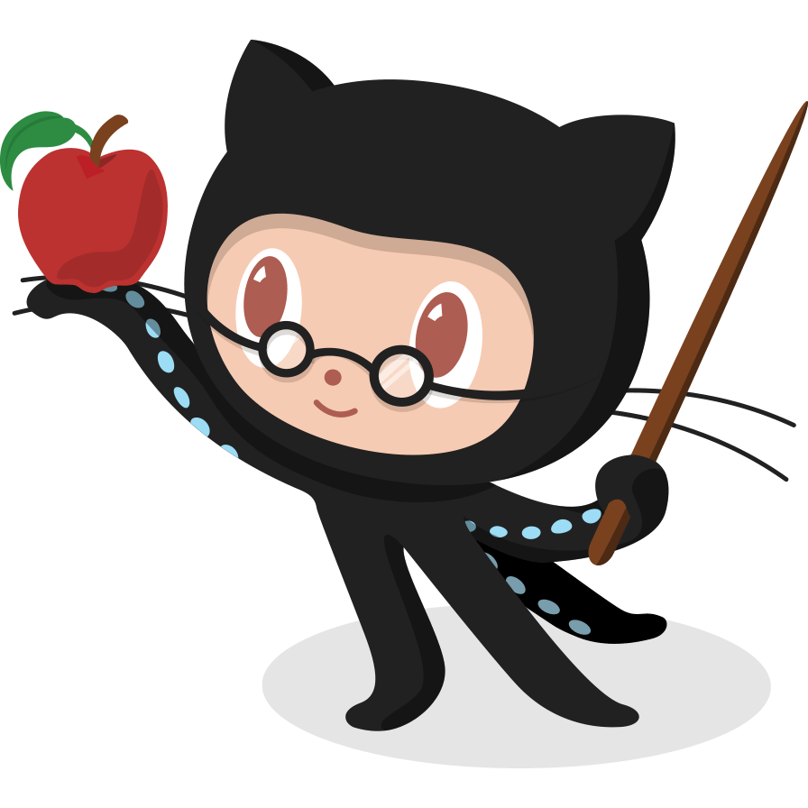
Questions?

