Slide 1
GitHub Actions
Paul Riviera
Microsoft AppDev CSA
Notes:
Welcome to our Spotlight Session on GitHub Actions.
This Session is indented to provide an overview of what GitHub Actions are, the terms and concepts, then we will navigate into the GitHub Portal and look at an example and modify it a bit.
I will be stopping at a few points to check and see if anyone has questions, but if you think of a question as I go along feel free to stop me, It always better when these types of sessions are more conversational vs a lecture.

Slide 2

Recording?
Notes:
We are/Can we record this session, any objections?

Slide 3
Outline
Intro
Excessively Simplified Origin
Concepts
Structure
Runners
Secrets
Job Communication
Examples
Notes:
This is what we will cover today, some areas are far shorter then others and some I hope to have a lot of conversation on.
And GO…

Slide 4
The Origin Story
Forked from Azure DevOps Pipelines
Improved and Simplified YAML Workflow
Notes:
This is wildly over simplified, but I don’t want to stress too much on how Actions began, rather I want to focus on the current cool features that exist now and into the future.
Lets dive right into the concepts of an Action

Slide 5
YAML Structure
“Basically, the most important part…”
- someone… probably

Slide 6
name: Hello World Workflow
on:
push:
branches: [ main ]
pull_request:
branches: [ main ]
workflow_dispatch:
jobs:
build:
runs-on: ubuntu-latest
steps:
- uses: actions/checkout@v2
- name: Single Command
run: echo Hello, world!
- name: Create File
run: |
touch greeting.txt
cat >> greeting.txt <<EOL
Hello World
EOL
- uses: actions/upload-artifact@v2
with:
name: "Greeting File"
path: greeting.txt
Workflow Name:
Hello World Workflow
Event Triggers:
Push to Main
Pull Request to Main
Dispatch (Manual/REST API)
Jobs
One job named ‘build’ running on
The latest Ubuntu Runner (VM)
Steps
Four Actions
Actions
Checkout the Branch
Single Line Run Action
Multi Line Run Action
Artifact Upload Action

Slide 7
Events
Triggers
Scheduled Events | cron syntax
Manual Events | REST or GitHub Portal
Webhook Events | Any Git Event

Slide 8
Runners
Virtual environment | YAML workflow label
Windows Server 2019 | windows-latest or windows-2019
Windows Server 2016 | windows-2016
Ubuntu 20.04 | ubuntu-latest or ubuntu-20.04
Ubuntu 18.04 | ubuntu-18.04
Ubuntu 16.04 | ubuntu-16.04
macOS Big Sur 11.0 | macos-11.0
macOS Catalina 10.15 | macos-latest or macos-10.15

Slide 9
Secrets
Encrypted
Organization Level
Required Alphanumeric names
steps:
- uses: actions/checkout@v2
- name: Write Secret
shell: bash
env:
SUPER_SECRET: ${{ secrets. TEST_SECRET }}
run: |
echo Hello, $SUPER_SECRET

Slide 10
Job Communication
Outputs
Artifacts
Context & Expressions

Slide 11
Outputs
Pass values between Jobs or Steps
jobs:
setup:
runs-on: windows-2019
outputs:
message: ${{ steps.test.outputs.message }}
steps:
- uses: actions/checkout@v2
- name: Write Output
id: test
shell: bash
env:
VALUE: ”some value”
run: |
echo "::set-output name=message::$VALUE"

Slide 12
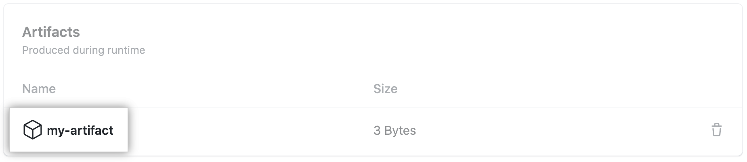
Artifacts

Slide 13
Context Expressions
Access Workflow Context
Evaluate Expressions
Status Checks
Filter on Outputs
More…
jobs:
test:
if: ${{ success() }}
steps:
- uses: actions/checkout@v2
- name: Write Greeting
shell: bash
run: |
echo “Hello, World”

Slide 14
Examples

Slide 15
Examples

Slide 16
Best Practices
Use your own Runners in private repos when your need to customize things.
Create Chainable Actions (Lots of Small Actions) as opposed to a Mololithic Action

Slide 17
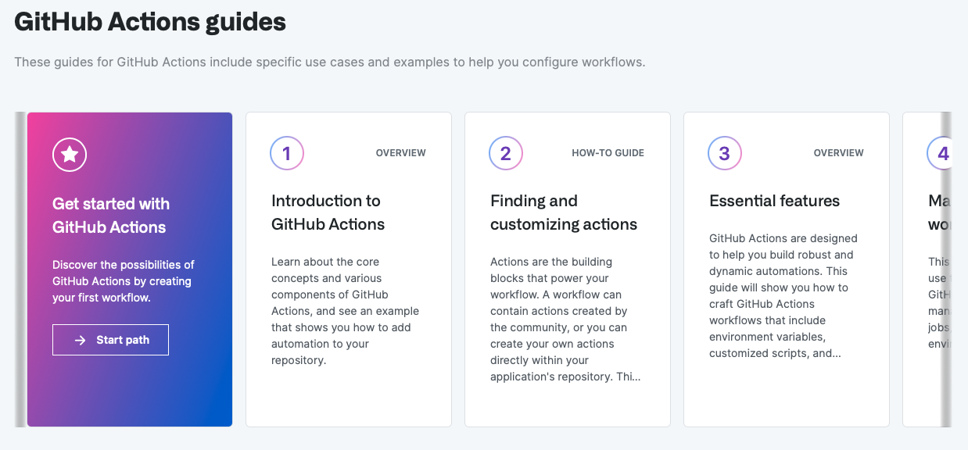
Next Steps

Slide 18

Questions?

