Slide 1

N-cryptoSeismic
Improving the art of seismic attribute detection

Slide 2
Introduction
Seismic surveys are one of the primary mechanisms used in oil and natural gas exploration, both onshore and offshore.
It can be divided in two major steps: Data Acquisition and Seismic Interpretation

Slide 3
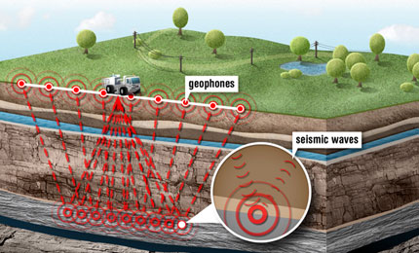
Data Acquisition
An energy source is used to send a wave into the subsurface.
Wave interactions occurs at rock layers, and they can reflect, refract, or diffract in different ways.
Geophones record the travel time of the wave.

Slide 4
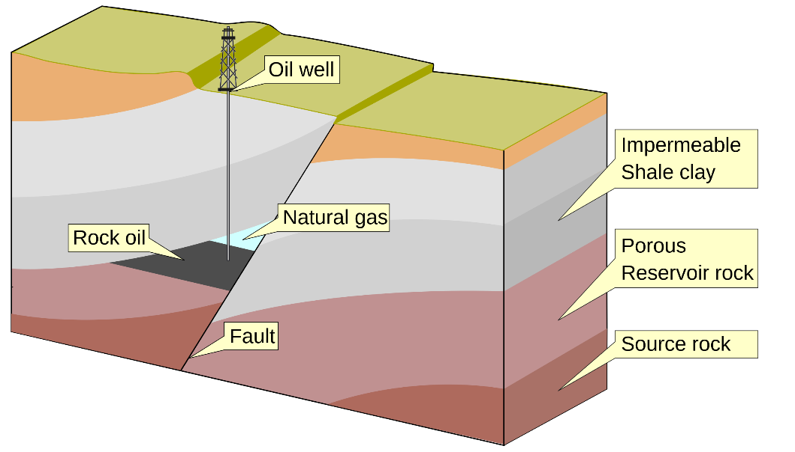
Seismic interpretation
After processing this data, a seismic interpreter will then have the task of mapping geological faults.
Faults are geological structures created by the combination of many processes.
Faults are important for oil and gas exploration because they may act as a natural trap for hydrocarbons and can also help in the migration of these.
The quality of the reservoir characterization process is related to the accuracy of the geological mapping.

Slide 5
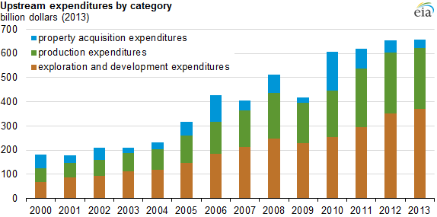
Business Problem
Costs of exploration and drilling make up a large portion of the yearly expenditures of an oil producer, so cost-saving strategies are of high importance.
The possible economic potential benefits of our model are:
Significant reduction of labor and time.
Reduction of dry holes.
Large datasets not needed.
Faster exploration cycles.
Encryption of proved information
Get right information to the managers who make decitions

Slide 6




Conclusion
The proposed method has two obvious advantages,
High-cost effectiveness.
We can use real data as the training set without any concerns
About insufficient data.

Slide 7


