Slide 1
Physics Based Animation
Chapter 6.2: Multiple Points of Collision

Slide 2
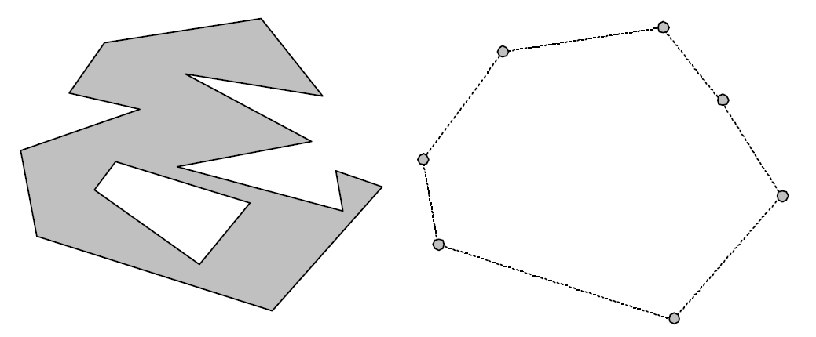
Multiple points of collision
They are more interesting than a single collision point.
To avoid the problem of infinitely many contact points, the region on the left is replaced with a set of finite points lying on the convex hull.

Slide 3
Collision resolving
Collision resolving is the task of computing equivalent contact impulses and applying them to rigid bodies.
There are two methods for collision resolving:
Sequential collisions
Simultaneous collisions

Slide 4
Sequential collisions
IDEA: Treat multiple concurrent single-point collisions as a series of single point collisions. Iterate over them and resolve them using a suitable collision law until none of them is colliding.
Cons
Infinite calculations
Different ordering of points could lead to different simulations.

Slide 5
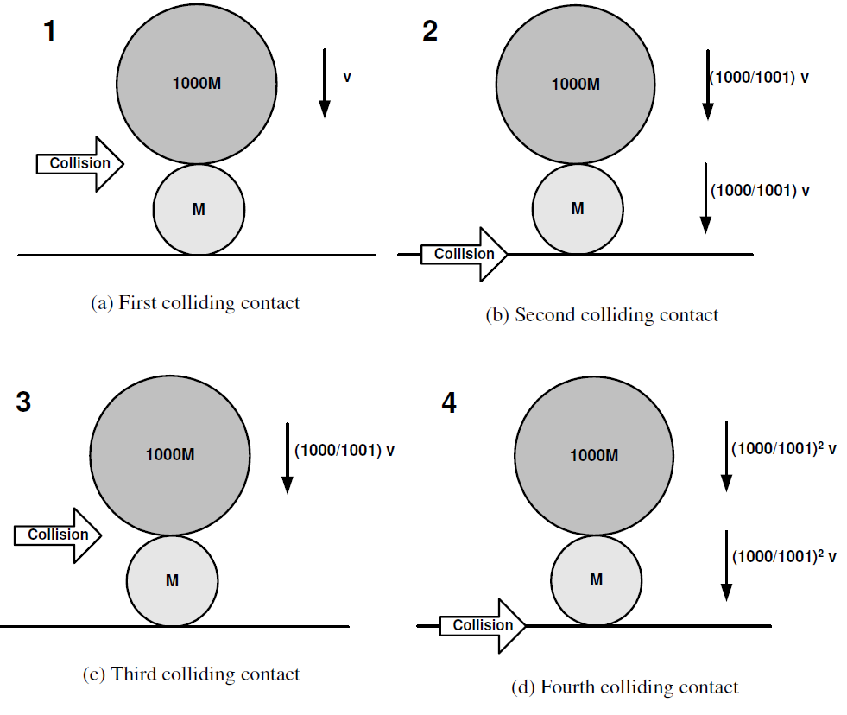
Nontermination of sequential collision resolving
ebp = 0
ebB = 0
No friction
Big ball is given velocity v

Slide 6
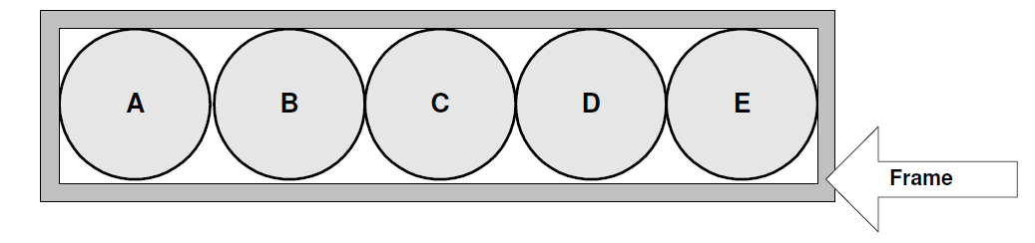
Nontermination of sequential collision resolving
eall pairs = 1
No friction
Frame has the same mass as a ball
Ball E has velocity v to the right.

Slide 7
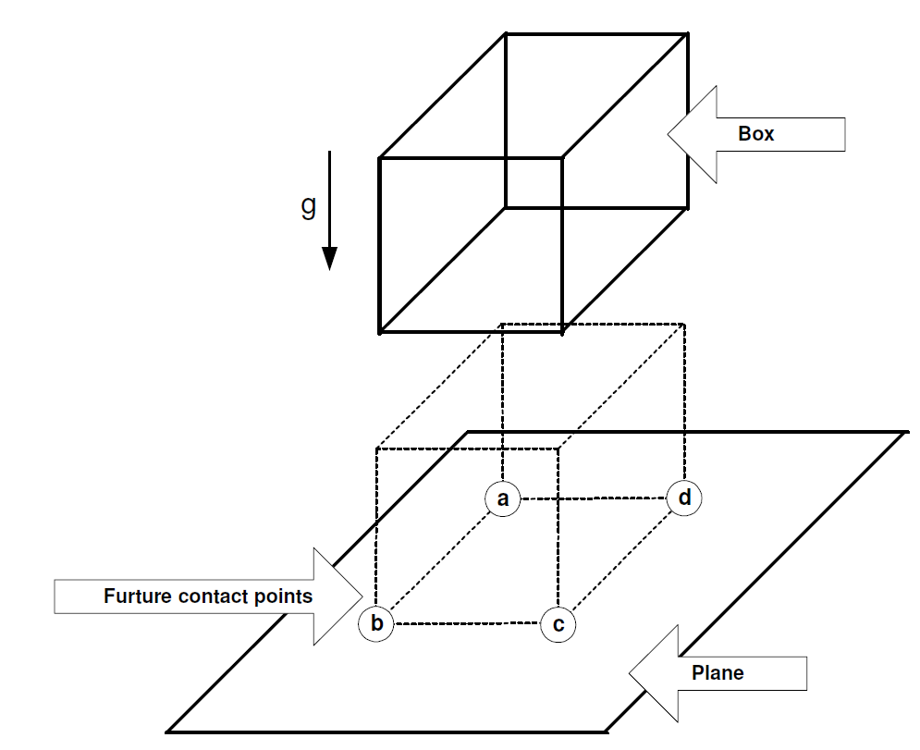
Indeterminacy of sequential collision resolving
ebp = 1
No friction
We expect the box to jump up and down.

Slide 8
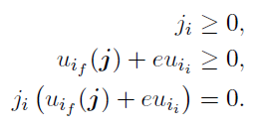
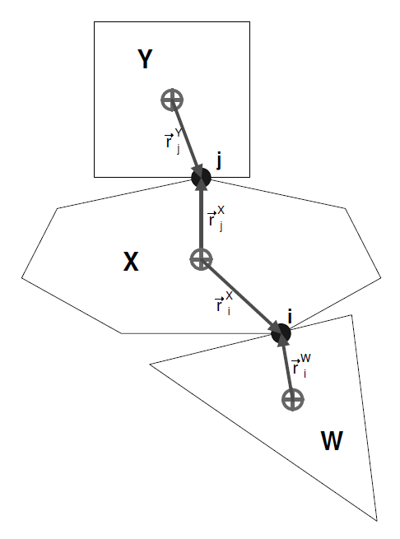

Change of contact velocity j w.r.t. object X due to impulse at i
Simultaneous collision resolving

Slide 9
Robust and stable
simultaneous collision resolving
All single point collisions are inserted into a heap data structure sorted by their normal contact velocity.
The contact point with the smallest relative contact velocity is called minimum contact point.

Slide 10
Robust and stable simultaneous collision resolving
If: minimum contact point is colliding , an impulse is applied to resolve.
Else: Terminate as there cannot be any more colliding contact points.
If a collision is applied, then recompute the relative normal velocity for all the points having at least one object in common with minimum contact point.
Update Heap and minimum contact point.
Repeat

