Slide 1


Slide 2
Bridging a Mongo DB to PostGres
Capstone Project for the Field Research Facility
by Paul Schrum
Image credit: Wikipedia, Wikimedia Commons

Slide 3
Presentation Outline
Client Introduction
Problem Description
Proposed Solution
Implementation of the Solution
Data Analysis
Postgres Database Design
Python code (implements bridge)
Web Map Interface

Slide 4
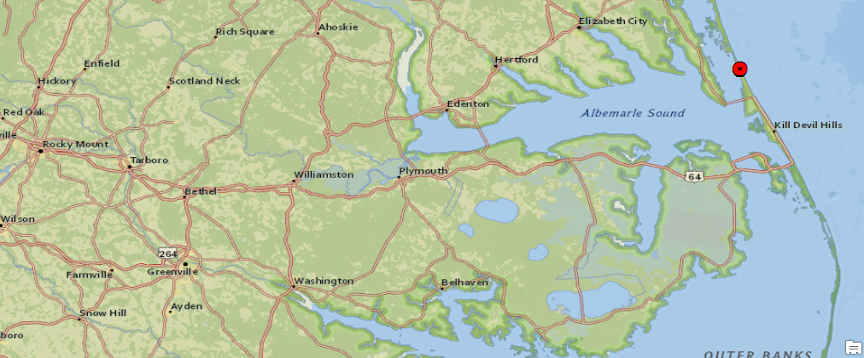
Client Introduction
The Field Research Facility (FRF) in Duck, NC
Part of the US Army Corps of Engineers
A Coastal and Hydraulics Laboratory
Manages multiple sensor gages in the ocean and on land
Duck, NC
Image credit: ESRI and National Geographic

Slide 5
Problem Description
Data on Stations and Gages kept in a MongoDB database
MongoDB is a Document Database, a different database style than RDBMS
Staff is already familiar with how to perform queries using SQL
Staff needs the data in a RDBMS such as PostGres
FRF seeks a way to bridge the data in MongoDB to PostGres

Slide 6
Proposed Solution: Bridge with Python
FRF Personnel Perform Data Dump
Creates a text file where each row is a json object
The Bridge reads the .json text file and creates a collection of
Station Objects
Gage Objects
The Bridge puts the data in the PostGres database.

Slide 7
Proposed Solution: Bridge with Python
Data Dump
MongoDB
Station.json
Bridge
"station" : "FRF – Atlan
"station" : "Wilmington
"station" : "FRF - Pier"
PostGres
fc_stations
OBJECTID
SHAPE@
Description

Slide 8
Implementation of the Solution:
Data Analysis
What's in those .json files?
{ "_id" : "A7QzX4X", "project" : "Test", "projectId" : "iAhodoYG9", "stationName" : "Wilming
{ "_id" : "QJeF8rQ", "project" : "USACE FRF", "projectId" : "xWPyqQ", "stationNa
{ "_id" : "W3i4wTW", "project" : "Baltimore", "projectId" : "S2jpzQWD", "stationName" : "Mar
Key
Value

Slide 9
Implementation of the Solution:
Postgres Database Design
What shall we make from that data?
A .json file maps to a PostGres table.
A key in the .json file maps to a field in the table
fc_stations
OBJECTID
SHAPE@
_id
stationName
status
lat
lon
description
fc_gages
OBJECTID
SHAPE@
_id
stationId
gageNumber
lat
lon
depth
description
Join on these fields

Slide 10
Implementation of the Solution:
Python code
Components:
The Bridge
Station Class
Gage Class
(BridgeMongo2PostGreSQL.py)

Slide 11
Implementation of the Solution:
Python code
Process:
Bridge loads stations.json, converts them into Station Object Instances
Repeats the process for gages.json

Slide 12
Implementation of the Solution:
Python code
Process:
Bridge deletes all existing rows from fc_stations
Bridge writes all Station Instances to fc_stations through arcpy.da.UpdateCursor
Repeats the process for gages.json

Slide 13
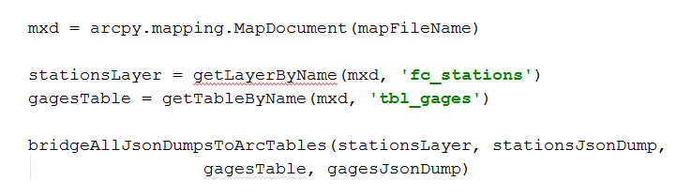
Implementation of the Solution:
Python code: How do you call it?
1. Get the map document
2, 3. Get the
Layers.
4. Run the process
But what's in this?

Slide 14
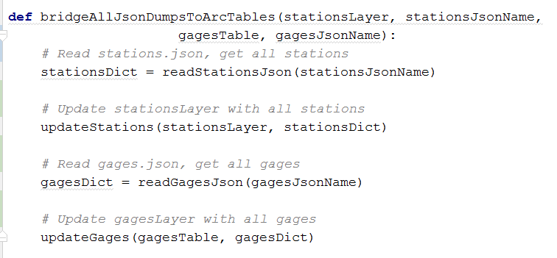
Implementation of the Solution:
Python code
But what's in this?

Slide 15
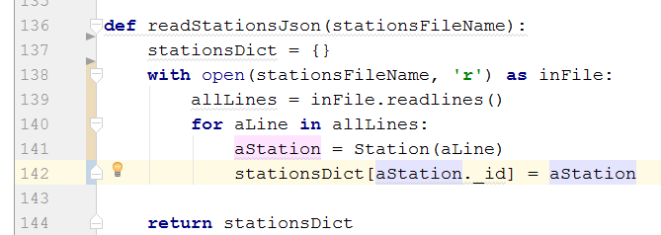
Implementation of the Solution:
Python code
But what's in this?
1. Reads the file
2. Makes a Station for each line
3. Adds the new Station to the collection

Slide 16
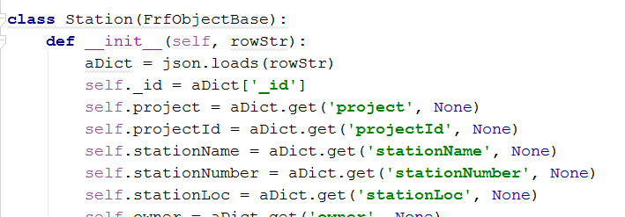
Implementation of the Solution:
Python code
1. json module parses the row string
2. Each attribute of Station class populated from it

Slide 17
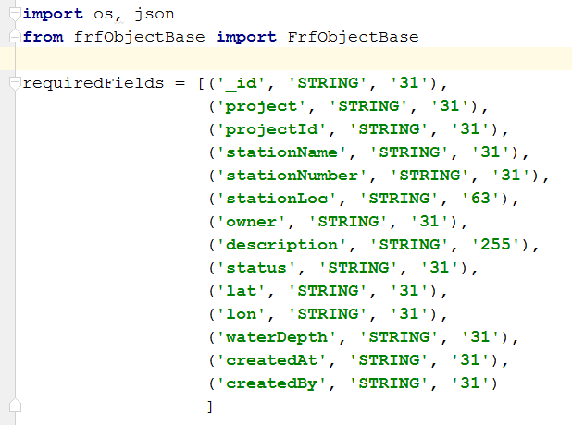
Implementation of the Solution:
Python code
If you ever need to add or remove
a table field, just add it or remove it
here, and it automatically follows
through everywhere.

Slide 18
Implementation of the Solution:
Python code
Let's visit this (quickly)

Slide 19
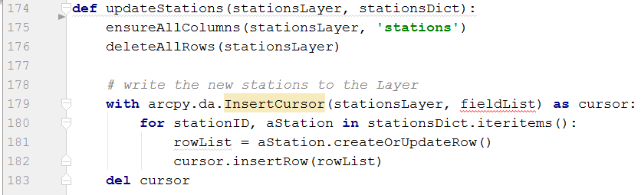
Implementation of the Solution:
Python code
Mxd Layer links to PostGres table
Makes sure all
columns are there
2. Removes all Rows
3. Adds the row to the table.
2. The Station class is responsible for knowing how to make the list.

Slide 20
Presentation Outline
Client Introduction
Problem Description
Proposed Solution
Implementation of the Solution
Data Analysis
Postgres Database Design
Python code (implements bridge)
Web Map Interface

Slide 21
Web Map Interface
?
Over the next 2 ½ weeks:
Implement the Web Interface
Touch Up the Python Code
Update the Digital Poster
Complete All Documentation
Hand the Project to FRF

Slide 22
Bridging a Mongo DB to PostGres
Capstone Project for the Field Research Facility
Question Time

Slide 23
Bridging a Mongo DB to PostGres
Capstone Project for the Field Research Facility
Question Time

